Slide 1
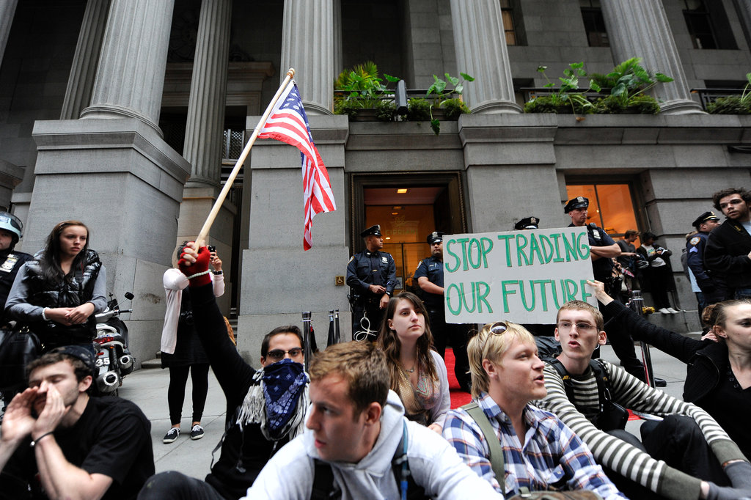
Mobilizing Grievances
Notes:
Add something about same-sex marriage grievances…

Slide 2
Quiz 1 (choose either A or B to answer)
A: Describe, in your own words, what political opportunity is…
Or
B: Give one example of a signal of an open political system

Slide 3
Exercise: Think back to this weekend, today, this month
Write down something that upset, aggravated, or annoyed you (or something that pissed you off) in your own life.

Slide 4
Grievances
Social movements challenge authorities over grievances
Matters about which they are troubled, passionate, or have considerable concern
Notes:
Deeply felt, shared grievances are most important driver for social movements

Slide 5
Mobilizing Grievances are..
Strong feelings…
shared amongst multiple actors (individuals or organizations)…
felt so strongly to warrant collective complaint and collective action

Slide 6
Incorrect Arguments about Grievances
Ubiquitous, inconsequential
Result from objective structural or material conditions
Result from heightened psychological states

Slide 7
1: Grievances as Ubiquitous and Irrelevant
Response to Collective Behavior theories
Grievances omnipresent
“Grievances, much like weeds, flourish naturally and abundantly, irrespective of environmental context or social conditions.”
“There is always enough discontent in any society to supply grassroots support for a movement…"
Notes:
1960s, response to Collective Behavior theories that grievances the most important factor for social movement activity

Slide 8
Problem with “Grievances as Ubiquitous” Argument
Conflates individual grievances and mobilizing grievances
Individual grievances:
Discontent or aggravation that is individually experienced (Not getting a raise, traffic, etc.)
Falling Down (1993)
Individual grievances rarely congeal into collectively shared (mobilizing) grievances that spur collective action
Notes:
Individual grievances are individually experienced: not getting a raise, dissatisfaction with boss, or lines at bank, traffic

Slide 9
2: Grievances a Function of Objective Structural/Material Conditions
Grievances result from two kinds of structural conditions:
Inequality/Group Conflict
Social arrangements that place certain social groups in antagonistic relations with one another
Strain
Changes/trends that alter existing social arrangements and patterns of social life
Disintegration, Absolute Deprivation, Quotidian Disruption

Slide 10
2: Grievances a Function of Objective Structural/Material Conditions - Inequality
Inequality/Group Conflict
Unequal distribution of rewards (money, status, power) and opportunities
Notes:
Grievances rooted in conflicts over claims to rewards and opportunities among groups differentially situated in the social system

Slide 11
Problem with “Inequality” Argument
Groups are hierarchically situated in the social system, yet inequality conflicts don’t always materialize
If conflicts do arise, doesn’t always translate into mobilizing grievances

Slide 12
2: Grievances a Function of Objective Structural/Material Conditions - Disintegration
Strain
Disintegration
Disruptive social changes/breakdown in traditional social arrangements that disconnect people from one another
War, natural disaster, adverse economic trends
Notes:
Weakens social constraints and loosens national fabric

Slide 13
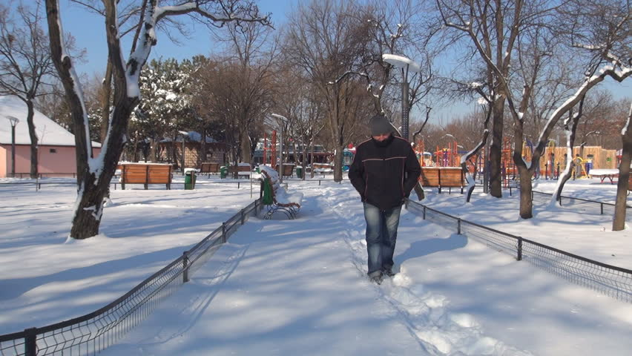
Problem with “Disintegration” Argument
Disorganized or socially isolated people rarely involved in protest

Slide 14
2: Grievances a Function of Objective Structural/Material Conditions – Absolute Deprivation
Strain
Absolute Deprivation
Dire social conditions
Lack of affordable housing, unemployment, inaccessible healthcare, poverty, discrimination
Notes:
Weakens social constraints and loosens national fabric

Slide 15
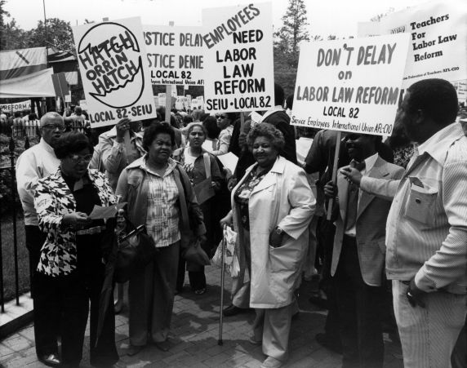
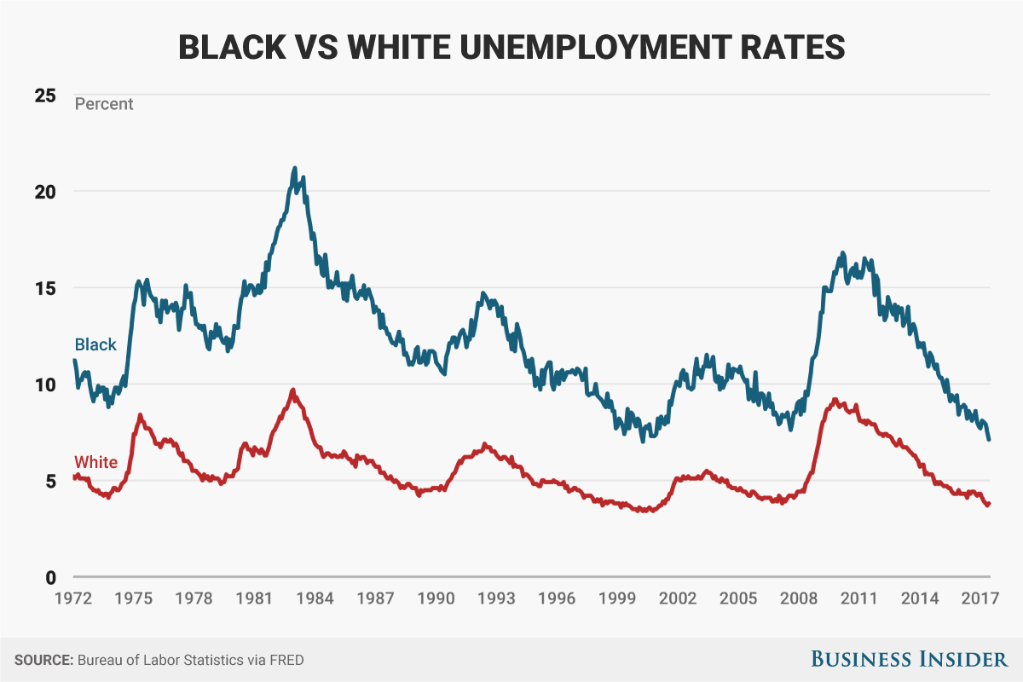
Problem with “Absolute Deprivation” Argument
Grievances don’t automatically result from poor life conditions
Notes:
Research provides mixed findings
Black unemployment is both unrelated to and significantly associated with black riots

Slide 16
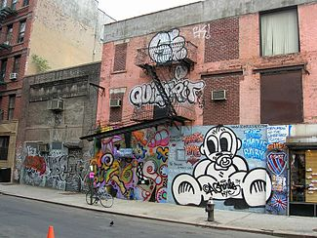
Problem with “Absolute Deprivation” Argument
Grievances don’t automatically result from poor life conditions
Notes:
Research provides mixed findings
Black unemployment is both unrelated to and significantly associated with black riots

Slide 17
A Strain Corrective?

Slide 18
2: Grievances a Function of Objective Structural/Material Conditions – Quotidian Disruption
Strain
Quotidian Disruption
Grievances spring from disruption and uncertainty in the taken-for-granted, habituated ways of living daily life
Human-made disasters that threaten the existence and functioning of a community
Intrusions into/violations of culturally defined spaces of privacy by outsiders
Unanticipated decline in resources/wages
Dramatic changes in systems of control
Notes:
Both actual and threatened loss in the quotidian are enough to spur action. Ppl are motivated to recoup what they have already lost or guard against the prospect of such loss

Slide 19

2: Grievances a Function of Objective Structural/Material Conditions
Quotidian Disruption
Human-made disasters that threaten the existence and functioning of a community

Slide 20
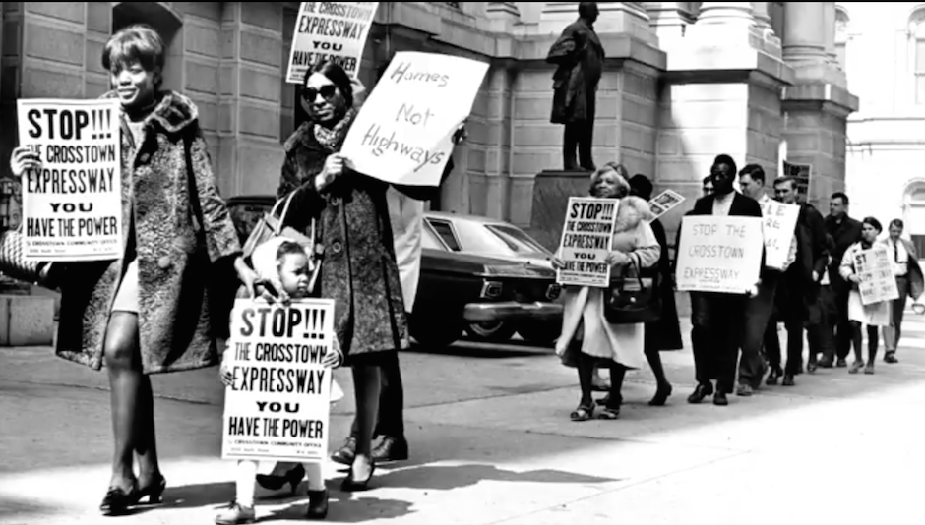
2: Grievances a Function of Objective Structural/Material Conditions – Quotidian Disruption
Quotidian Disruption
Intrusions into/violations of culturally defined spaces of privacy by outsiders

Slide 21
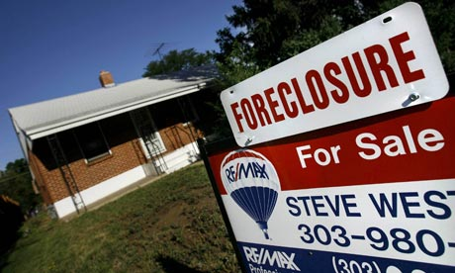
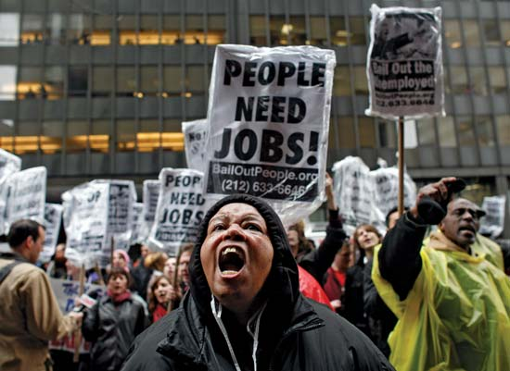
2: Grievances a Function of Objective Structural/Material Conditions – Quotidian Disruption
Quotidian Disruption
Unanticipated decline in resources/wages

Slide 22
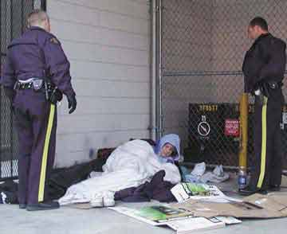
2: Grievances a Function of Objective Structural/Material Conditions – Quotidian Disruption
Quotidian Disruption
Changes in systems of control

Slide 23
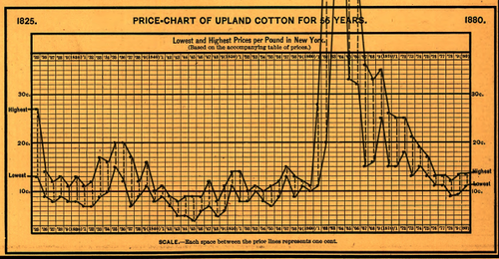
3: Grievances as Function of Heightened Psychological States
Frustration-Aggression
Frustration with a certain condition builds to a threshold and releases in the form of aggression.
Notes:
Post civil war south, declining cotton prices increased poor whites’ frustration, who took out their frustration on local Blacks

Slide 24
Problem with “Frustration-Aggression” Argument
Assumes aggression is the only way to relieve frustrations
Notes:
Group comparisons
Understandings of procedural justice
Actual or threatened loss
Interpretation of grievances

Slide 25
How to Translate Mobilizing Grievances into Mobilization?

Slide 26
Mobilizing People: Framing
Social movements are interpretive/signifying agents
Produce and maintain meaning for constituents, antagonists, and bystanders
Highlight social problems and their solutions

Slide 27

From Erving Goffman’s Frame Analysis
Meanings don’t naturally attach themselves to events, objects, or subjects…
Social actors or signifying agents are required to...
Interpret and attach the meaning to an object (e.g. framing)...
Interpretations must cohere with populations/subpopulations
Notes:
Framing is a way of packaging a belief, view, or argument for consumption and convincing others

Slide 28
SMOs as Signifying Agents
Social movements must engage in framing
Diagnostic
Prognostic
Notes:
Social Movements must engage in framing

Slide 29
SMOs as Signifying Agents
Diagnostic Framing
Identifying a source of the problem
Identify an aspect of social life as a problem
Attribute blame for the problem
Notes:
P54: Austin, TX need to build a new Salvation Army to deal with its homeless problem in the 1980s. Relocation effort faced backlash from NIMBY movements. NIMBY movements portrayed its residents as being victimized by relocation of Salvation Army. Was difficult since SA was a Christian, charitable/outreach organization, so NIMBY movements needed more negative claims against it.
Focused on transients, how they threatened neighborhood women and children. Kept framing the homeless as criminally inclined, drunken, sex-crazed men who would infiltrate their communities and rob their homes and rape their women.

Slide 30
SMOs as Signifying Agents
Prognostic Framing
Proposed solutions to the problem
To inspire or inhibit social change
Notes:
P54: Austin, TX need to build a new Salvation Army to deal with its homeless problem in the 1980s. Relocation effort faced backlash from NIMBY movements. NIMBY movements portrayed its residents as being victimized by relocation of Salvation Army. Was difficult since SA was a Christian, charitable/outreach organization, so NIMBY movements needed more negative claims against it.
Focused on transients, how they threatened neighborhood women and children. Kept framing the homeless as criminally inclined, drunken, sex-crazed men who would infiltrate their communities and rob their homes and rape their women.

Slide 31
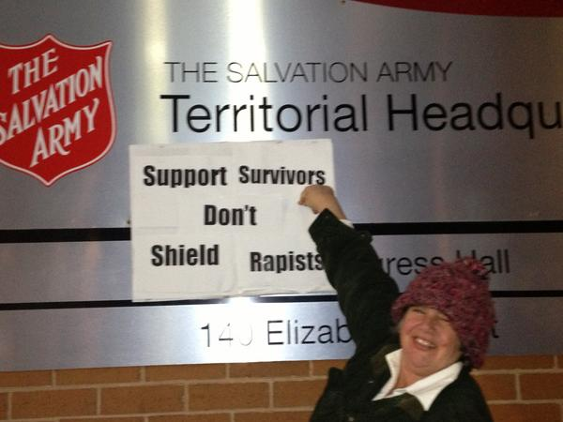
Ex: Salvation Army NIMBY movements
Notes:
P54: Austin, TX need to build a new Salvation Army to deal with its homeless problem in the 1980s. Relocation effort faced backlash from NIMBY movements. NIMBY movements portrayed its residents as being victimized by relocation of Salvation Army. Was difficult since SA was a Christian, charitable/outreach organization, so NIMBY movements needed more negative claims against it.
Focused on transients, how they threatened neighborhood women and children. Kept framing the homeless as criminally inclined, drunken, sex-crazed men who would infiltrate their communities and rob their homes and rape their women.

Slide 32
Exercise: Select a Social Problem or Issue
Come up with
a diagnosis (source of that social problem)
a prognosis (solution to that social problem)
Notes:
Example: income inequality… diagnosis: stagnant wages as a result of politicians not pushing minimum wage policy. Prognosis: elect politicians that would push increases on minimum wage.

Slide 33
Framing (notes)
Frames are constrained
To the material conditions and events being framed
To the cultural environment in which they’re embedded
Frames subject to differential interpretation
People may view the empirical event differently
Notes:
Heavens Gate…religious movement march 1997, thought that if they committed suicide, they would be transported to a UFO trailing the Hale-Bopp comet (the last comet of the century).
needed the empirical event of Hale Bop’s comet in order for it to be framed as a passage to Heaven
Also need to take place in a cultural environment that allowed for the free expression of religion
https://www.youtube.com/watch?v=3hFMhnfesDI#t=07m09s

Slide 34

Ex: Framing Constraints and Empirical Events
Notes:
Heavens Gate…religious movement march 1997, thought that if they committed suicide, they would be transported to a UFO trailing the Hale-Bopp comet (the last comet of the century).
needed the empirical event of Hale Bop’s comet in order for it to be framed as a passage to Heaven
Also need to take place in a cultural environment that allowed for the free expression of religion
https://www.youtube.com/watch?v=3hFMhnfesDI#t=07m09s

