Slide 1
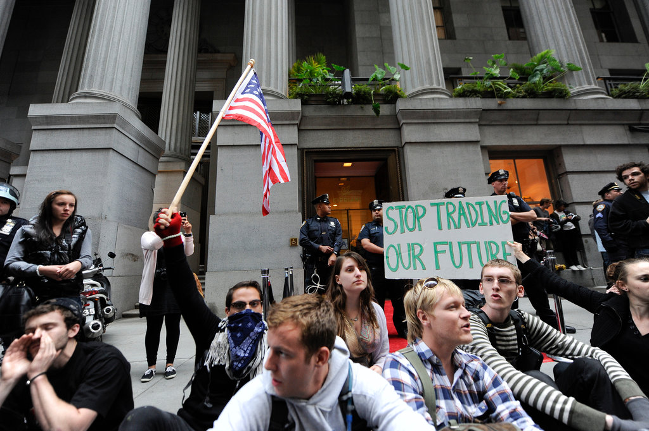
Mobilizing Grievances
Notes:
Add something about same-sex marriage grievances…

Slide 2
Grievances
Social movements challenge authorities over matters about which they are troubled, passionate, and have considerable concern
These matters, and the feelings associated with them, are called grievances
Notes:
Deeply felt, shared grievances are most important driver for social movements

Slide 3
Mobilizing Grievances
Strong feelings…
shared amongst multiple actors (individuals or organizations)…
felt so strongly to warrant collective complaint and corrective, collective action

Slide 4
Older Incorrect Theories about Grievances
Ubiquitous, therefore inconsequential
Result from objective structural or material conditions
Result from heightened psychological states

Slide 5
Grievances as Ubiquitous and Irrelevant
“Grievances, much like weeds, flourish naturally and abundantly, irrespective of environmental context or social conditions.”
Grievances omnipresent. “There is always enough discontent in any society to supply grassroots support for a movement…"
Notes:
1960s, response to Collective Behavior theories that grievances the most important factor for social movement activity

Slide 6
Problem with “Grievances as Ubiquitous” Argument
Conflates individual grievances and mobilizing grievances
Individual grievances:
Discontent or aggravation that is individually experienced
Not getting a raise, traffic, etc.
Falling Down (1993)
Individual grievances rarely congeal into collectively shared (mobilizing) grievances that spur collective action, since movements aren't always active
Notes:
Individual grievances are individually experienced: not getting a raise, dissatisfaction with boss, or lines at bank, traffic

Slide 7
Grievances as Function of Objective Structural or Material Conditions
Grievances result from two kinds of structural or material conditions:
Inequality/Group Conflict
Social arrangements that places certain social groups in antagonistic relations with one another
Strain
Changes/trends that alter existing social arrangements and patterns of social life
Disintegration, Absolute Deprivation, Quotidian Disruption

Slide 8
Grievances as Function of Objective Structural or Material Conditions
Inequality/Group Conflict
Grievances generated by unequal distribution of rewards (money, status, power) and opportunities
Notes:
Grievances rooted in conflicts over claims to rewards and opportunities among groups differentially situated in the social system

Slide 9
Problem with “Inequality” Argument
Groups are hierarchically situated in the social system, yet conflicts (over the distribution of resources, rewards, opportunity) don’t always materialize
If conflicts do arise, doesn’t always translate into mobilizing grievances

Slide 10
Grievances as Function of Objective Structural or Material Conditions
Strain
Disintegration
Disruptive social changes/breakdown in traditional social arrangements make people aggrieved and disconnected from one another, making them more vulnerable to appeals of movements
War, natural disaster, adverse economic trends
Notes:
Weakens social constraints and loosens national fabric

Slide 11
Problem with “Strain” Argument
Disorganized or socially atomized people rarely involved in protest
Participation is conducted by those who are heavily organized

Slide 12
Grievances as Function of Objective Structural or Material Conditions
Strain
Absolute Deprivation
Dire social conditions are a source of grievances and make people more vulnerable to appeals of movements
Lack of affordable housing, unemployment, inaccessible healthcare, poverty, discrimination
Notes:
Weakens social constraints and loosens national fabric

Slide 13
Problem with “Absolute Deprivation” Argument
Grievances don’t automatically result from poor life conditions
Research provides mixed findings
Black unemployment is both unrelated to and significantly associated with black riots

Slide 14
Grievances as Function of Objective Structural or Material Conditions
Strain
Quotidian Disruption
Grievances spring from disruption and uncertainty in the taken-for-granted, habituated ways of living daily life
Human-made disasters that threaten the existence and functioning of a community
Intrusions into/violations of culturally defined spaces of privacy by outsiders
Unanticipated decline in resources/wages
Dramatic changes in systems of control
Notes:
Both actual and threatened loss in the quotidian are enough to spur action. Ppl are motivated to recoup what they have already lost or guard against the prospect of such loss

Slide 15

Grievances as Function of Objective Structural or Material Conditions
Quotidian Disruption
Human-made disasters that threaten the existence and functioning of a community

Slide 16
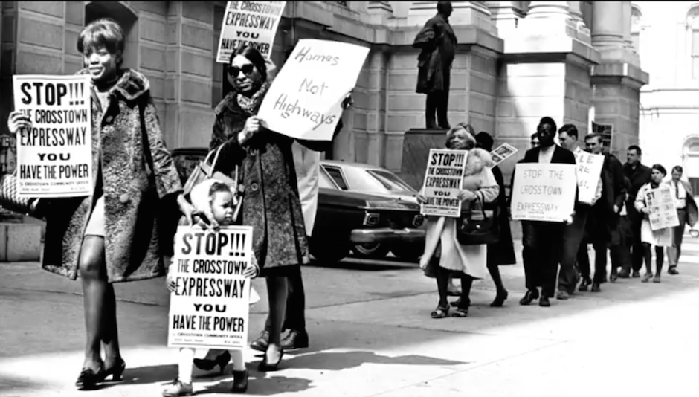
Grievances as Function of Objective Structural or Material Conditions
Quotidian Disruption
Intrusions into/violations of culturally defined spaces of privacy by outsiders

Slide 17
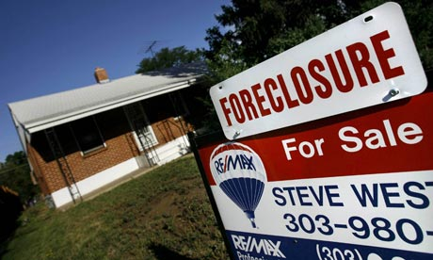
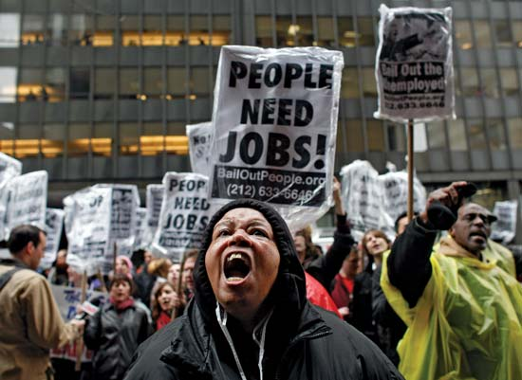
Grievances as Function of Objective Structural or Material Conditions
Quotidian Disruption
Unanticipated decline in resources/wages

Slide 18
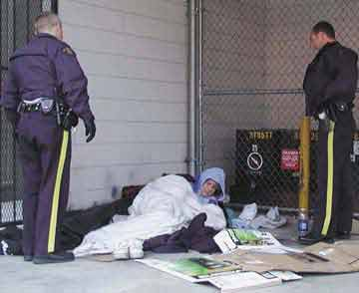
Grievances as Function of Objective Structural or Material Conditions
Quotidian Disruption
Changes in systems of control

Slide 19
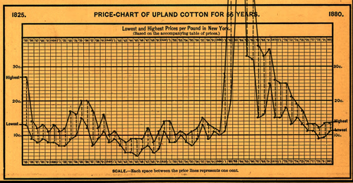
Grievances as Function of Heightened Psychological States
Frustration-Aggression
Frustration with a certain condition builds to a threshold and releases in the form of aggression.
Notes:
Post civil war south, declining cotton prices increased poor whites’ frustration, who took out their frustration on local Blacks

Slide 20
Problem with “Frustration-Aggression” Argument
Glosses over the assessment that aggression is the best means to relieve their frustrations
Group comparisons
Understandings of procedural justice
Actual or threatened loss
Interpretation of grievances

Slide 21
Mobilizing People: Framing
Social movements are interpretive agents
Actively produce and maintain meaning for constituents, antagonists, and bystanders

Slide 22

From Erving Goffman’s Frame Analysis
Meanings don’t naturally attach themselves to events, objects, or subjects…
Social actors or signifying agents are required to...
Interpret and attach the meaning to an object (e.g. framing)...
Interpretations must cohere with populations/subpopulations
Notes:
Framing is a way of packaging a belief, view, or argument for consumption and convincing others

Slide 23
SMOs as Signifying Agents
Social movements must engage in framing
Diagnostic
Prognostic
Notes:
Social Movements must engage in framing

Slide 24
SMOs as Signifying Agents
Diagnostic Framing
Identifying a source of the problem
Identify an aspect of social life as a problem
Attribute blame for the problem
Notes:
P54: Austin, TX need to build a new Salvation Army to deal with its homeless problem in the 1980s. Relocation effort faced backlash from NIMBY movements. NIMBY movements portrayed its residents as being victimized by relocation of Salvation Army. Was difficult since SA was a Christian, charitable/outreach organization, so NIMBY movements needed more negative claims against it.
Focused on transients, how they threatened neighborhood women and children. Kept framing the homeless as criminally inclined, drunken, sex-crazed men who would infiltrate their communities and rob their homes and rape their women.

Slide 25
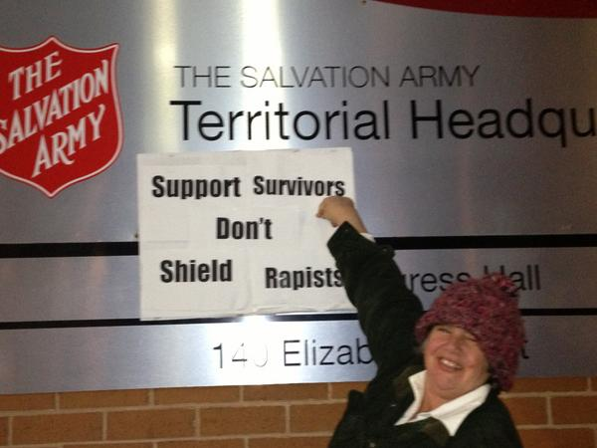
Ex: Salvation Army NIMBY movements
Notes:
P54: Austin, TX need to build a new Salvation Army to deal with its homeless problem in the 1980s. Relocation effort faced backlash from NIMBY movements. NIMBY movements portrayed its residents as being victimized by relocation of Salvation Army. Was difficult since SA was a Christian, charitable/outreach organization, so NIMBY movements needed more negative claims against it.
Focused on transients, how they threatened neighborhood women and children. Kept framing the homeless as criminally inclined, drunken, sex-crazed men who would infiltrate their communities and rob their homes and rape their women.

Slide 26
SMOs as Signifying Agents
Prognostic Framing
Highlighting potential solutions to problems

Slide 27
Notes about Framing
Frames are constrained
To the material conditions and events being framed
To the cultural environment in which they’re embedded
Frames subject to differential interpretation
People may view the empirical event differently
Notes:
Heavens Gate…religious movement march 1997, thought that if they committed suicide, they would be transported to a UFO trailing the Hale-Bopp comet (the last comet of the century).
needed the empirical event of Hale Bop’s comet in order for it to be framed as a passage to Heaven
Also need to take place in a cultural environment that allowed for the free expression of religion

Slide 28

Ex: Heaven’s Gate
Notes:
Heavens Gate…religious movement march 1997, thought that if they committed suicide, they would be transported to a UFO trailing the Hale-Bopp comet (the last comet of the century).
needed the empirical event of Hale Bop’s comet in order for it to be framed as a passage to Heaven
Also need to take place in a cultural environment that allowed for the free expression of religion

