Slide 1
Introducing Vert.x 2.0
Burr Sutter
Red Hat

Slide 2
Burr Bio
Burr Sutter – Product Management Director:
  JBoss Developer Studio/JBoss Tools (Eclipse)
  Aerogear
  Vert.x
  Hibernate Search
  Arquillian
  And: RichFaces, TorqueBox, Errai, Snowdrop, Seam
8 years as President of Atlanta Java Users Group
Founder of DevNexus & Atlanta's IASA chapter
Been part of the JBoss by Red Hat team since 2006

Slide 3
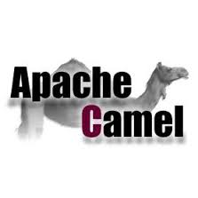


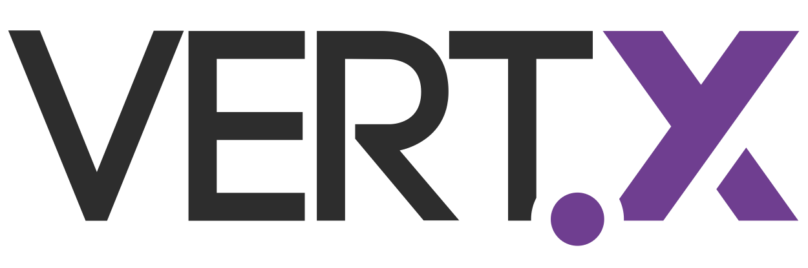

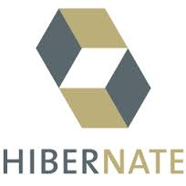
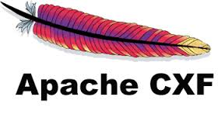




JBoss ++
JBoss AS
JBoss ESB
JBoss Cache

Slide 4






Programmer Evolution
70s
80s
90s
00s
10s
COBOL
JCL
WFL
C/C++
4GLs
RDBMS/SQL
Unix
HTTP/HTML
CGI
GET/POST
Cookies
Java
Servlet
EJB
Windows NT
Solaris/AIX
MVC – Struts
DI- Spring
ORM – Hibernate
XML
WS-*
JSF
RIA/AJAX
Agile
Automated Testing
CI
SVN
Linux
EE6
HTML5
Mobile
iOS/Android
Phonegap/Cordova
Grails/Rails
Scala/Clojure
Maven/Gradle
Git
Node.js
MongoDB/Redis
Hadoop
*-aaS
Batch
Interactive
Distributed
GUI/Event
Request/Response
AJAX Client
Asynchronous
Reactive

Slide 5
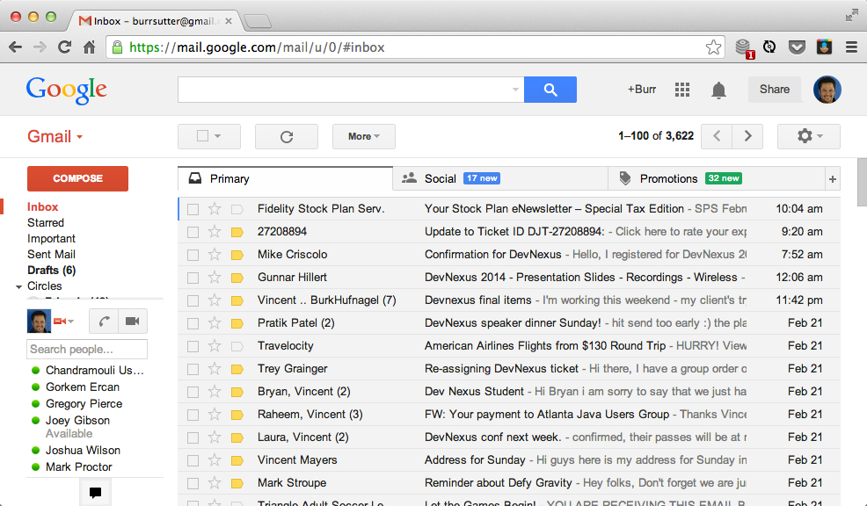
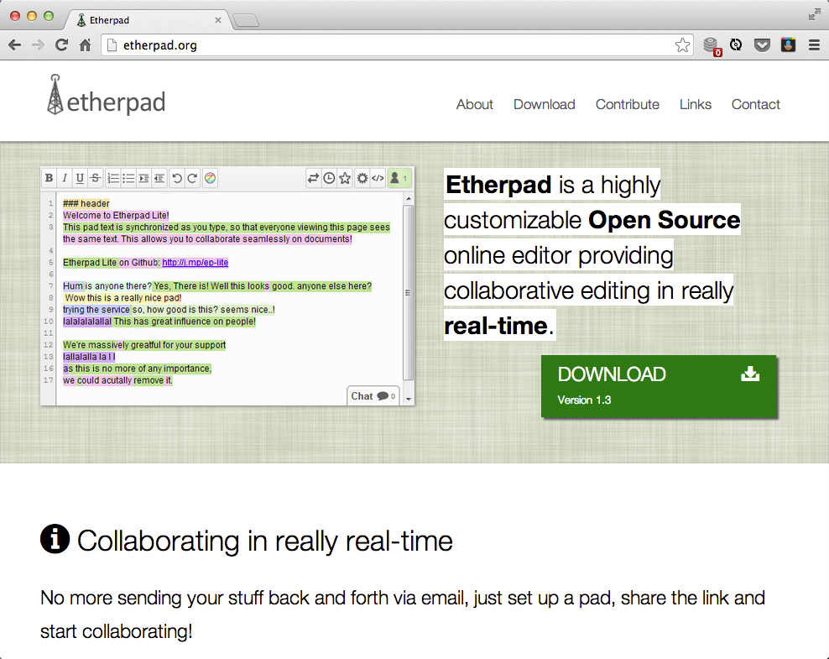
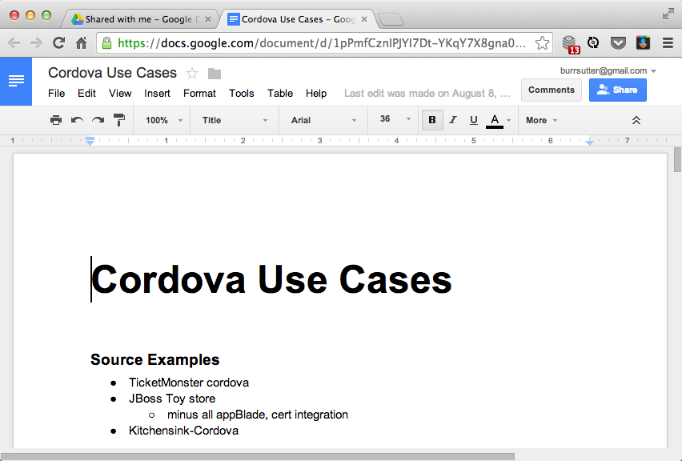
Real-Time/Reactive/Async

Slide 6
Enterprise IT Development
Java EE
.NET
Traditional Ops Focus
Maintaining
“Big Iron”
And
“Big Containers”
Standard
Bearers
Legacy
C++
COBOL
etc
PHP
Drupal
Play
Agile
Focused
Python
ROR
DevOps Focus
Embeddability
Containerless
Automated
Node.js
Asynchronous/Event-Driven/Reactive/Evented IO: Python Twisted & Tornado, Ruby EventMachine, Node.js

Slide 7
Vert.x Overview
Lightweight, reactive, application platform (5MB download)
Superficially similar to Node.js - but not a clone!
Inspired also from Erlang/OTP
Polyglot
High performance (see latest TechEmpower benchmarks!)
Simple but not simplistic
Embeddable
Notes:
* Lightweight, general purpose, reactive, application platform
Less than 5MB download
Provides primarily async APIs for the programming model
* Polyglot – one of the primary selling points vs other reactive platforms, you can program in several different languages, you are not bound to 1 or 2.
* High performance – the top 3 for plaintext from Techempower are Red Hat sponsored (next slide), the benchmarks cover more than JVM-based solutions like Node.js or Rails
Able to handle hundreds of thousands of requests/transactions per second
Based on Netty – you might have heard of Twitter
* Similar to Node.js – one sentence, it is Node.js for the JVM – primarily Async APIs, better performance, not just JavaScript.
* Simple but not simplistic – one of the main goals, was to get away from the preceived complexity of Java EE platforms and application servers, no XML configuration, easier programming model
* Embeddable – you can embedded it in YOUR app

Slide 8
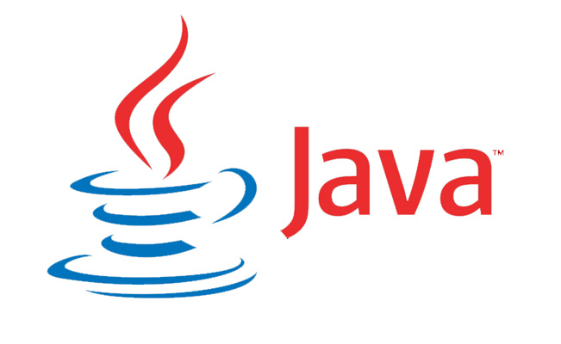

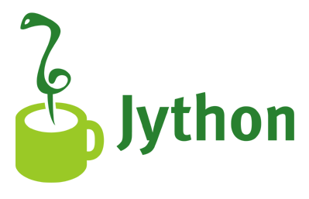
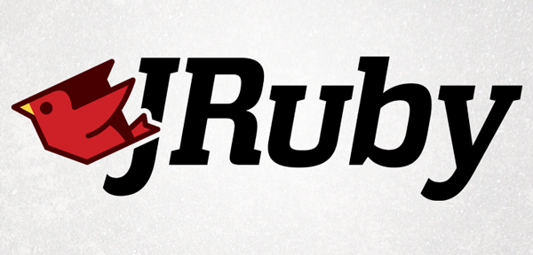





Polyglot
Full implementation:
Almost there:
Notes:
You can mix & match in a single application – focusing the right language for the right job
Java
JavaScript (Rhino, DynJS, Nashorn in Java 8)
JRuby (Ruby)
Groovy
Jython (Python)
Under development:
Clojure
Scala
PHP
Ceylon
Implemented as modules – not part of core, auto-downloaded as needed
You can add your own language

Slide 9
Core Asynchronous APIs
Core is small and static
TCP/SSL clients and servers
HTTP/HTTPS clients and servers
Websockets, SockJS
File system
Event bus
DNS (new)
UDP (new)
etc
Notes:
Cor is static means we do not envision that it will change all that often – additional capabilities are implemented as modules (available via a registry)
SockJS – bit like websockets, an abstraction, it still works even if the network or browser/client does not support WS – it will fall back, degrade gracefully
More on the Event Bus later

Slide 10
Why Asynchronous?
Modern servers need to handle high levels of concurrency – web servers, websockets, IoT etc
OS threads are still a precious resource
Need to service many connections with small number of threads
Blocked OS threads means they can't do other work
Notes:
Why Async? Why the non-blocking approach? When direct style Sync APIs are easier to program?
Async is because of scalability
If you have a blocking thread per connection model, if you have a million “real-time” clients, you would need a million OS threads
And while threads are relatively light-weight, they still take up memory, they still have overheard, stack, context switching
We must have a non-blocking approach to IO
You might have heard of callback hell or the pyramid of doom

Slide 11
Verticle
Execution unit of Vert.x
Can be written in any language
Single threaded – less scope for race conditions
Verticles communicate by message passing
Hmmm.. sounds like the Actor Model?
Notes:
How do you write an application in Vert.x?
Fundamentally all vert apps are composed of verticles
A lump of code that your write and gets executed
A typical app will have more than one verticle
Verticles are singled threaded – the exact same thread, no worries about volatile, no race conditions – no multiple threads running through your code at the same time
One event loop
Threads are assigned to a processor core
Thread safety without compromising cores
Multiple verticles pass messages over the eventbus
Actor model like Erlang or Akka
A very good model for concurrency

Slide 12
Vert.x Verticle
JVM
Vert.x Instance
Verticle 1
Event
Bus
A Verticle is always executed on the same thread
A single thread may execute several verticles – event loop
A Verticle Instance normally starts 1 thread/event-loop per core
Verticle 2
Verticle 3
Verticle 4

Slide 13
Notes:
vertx run helloworld.js
These are “raw verticle”, you can run them directly from the command line, in a real application, you will package your verticles into a module
More on modules later
vertx run HelloWorld.java
The .java version is a bit more verbose, until Java 8 when Lambdas arrive
This one has an anon class, the lambda will make it easier to program against async APIs
And you do not have to compile the .java first, no build script – just run it and it compiles on the fly

Slide 14
Event Bus
The nervous system of Vert.x
Verticles send messages over the event bus
Point to point. Publish/Subscribe. Request/Response
Pass strings, buffers, primitive types or JSON
JSON messages are preferred for structured data
Notes:
The means by which all the verticles talk to each other
A light weight messaging system
Point to point, pub/sub, request/reply
String, bytearrays, primitives
We recommend JSON - a verticle might be written in JS, Ruby, Scala – JSON is well understood by the various languages in Vert.x
The lingua franca is JSON across multiple programming languages

Slide 15
Clustered Event Bus
Lightweight peer-to-peer messaging system
Connects multiple Vert.x JVM instances
Applications are loosely coupled components distributed across your network
No monolithic “application server”
Cluster manager is pluggable, default is Hazelcast
Notes:
Multiple servers/JVMs can “share” the eventbus
Moving away from the application server model where you stand up that process, that already has everything you might possibly need – then throw your applications (e.g. .wars, .ears) at it.
In vert.x, there is no monolithic container/application server, you simply run your verticles where on the network they make sense, using the programming language and team skillset that makes sense.
The clustering is pluggable, by default Hazelcast
But you could implement a few interfaces and plug in something like JGroups or Infinispan

Slide 16
Clustered Event Bus
JVM
JVM
Vert.x Instance
Vert.x Instance
Verticle 1
Event
Bus
Event
Bus
Verticle 5
Verticle 2
Verticle 6
Logical
Bus
Verticle 3
Verticle 7
TCP
Verticle 4
Verticle 8
HOST 1
HOST 2
Hazelcast for cluster member discovery

Slide 17
Notes:
Demo of eventbus_pubsub
registerHandler is a subscription
vertx run receiver.js -cluster
-cluster, If any other vertx's appear on the network, I want you to talk to each other
vertx run Sender.scala -cluster
(still beta as of Feb 2014 – had to manually update lang.properties in the vertx_installation/conf)

Slide 18
Event bus in the Browser
Event bus extends to client side JavaScript too
Uses the same API on the client
Powerful distributed event space spanning both client and server nodes
Ideal for modern “real-time” web applications
Use whatever client side toolkit you prefer (e.g. jQuery, Backbone, AngularJS, etc)
Notes:
We take the eventbus a step further, extending it out the client
Same API in client-side JS
Vert.x is a great choice for real-time applications, responsive, pushing data from the server to client
On the client-side, you can use whatever MVC framework you want like AngularJS or Backbone or straight Jquery
You have one common event space that encompasses your server nodes and all of your browsers
Like you have browsers talking to browsers

Slide 19




Browser Event Bus
Vert.x Instance
Receive
DB
Persist
Publish

Slide 20
Notes:
Demo of browserbus

Slide 21
Modules
Modules encapsulate code and resources
One or more modules per application
Must include a mod.json descriptor file
Modules contain zero or more verticles
Can be runnable or non runnable
Module class-loaders provide isolation
Notes:
A simple app might be 1 module
But a larger app might have several modules
You can configure Vertx to have a flat classpath but by default all mods operate in isolation
No sharing of Java static variables by default
Mods – is where modules are downloaded into
Module naming: com.burrsutter~name~version
+ a mod.json to indicate that the “startup” verticle is

Slide 22
Vert.x Modules
Application
Packaging: encapsulate code & resources
With a specific folder name
com.yourcompany~module-name~1.0-beta1
Add a mod.json descriptor
Module class-loader isolation
Runnable and non-runnable (library)
Publishable to your Maven Repository for reuse
Verticle 3
Module
Verticle 6
Verticle 2
Verticle 5
Verticle 4
Module
Verticle 1

Slide 23
Notes:
Use src/modules/javascript/webapp from vertx examples
vertx runmod io.vertx~example-web-app~1.0
If it can not find the needed module in “mods”, it will download from Maven Central
vertx pulldeps io.vertx~example-web-app~1.0
vertx fatjar io.vertx~example-web-app~1.0
java -jar example-web-app-1.0-fat.jar

Slide 24
An ecosystem of modules
Sharing modules encourages reuse
Modules can be pushed to any Maven or Bintray repository
Vert.x can resolve modules at build time or run time
Encourage an ecosystem of modules
Register your modules in the registry
Modules are the lego bricks to create your application
Notes:
Not just about encapsulation and packaging
But also to encourage an eco-system
The core stays very simple, extra functionality brought in via modules

Slide 25
It's all about the modules
MongoDB
Redis
MySQL/PostgreSQL
SMTP
JDBC
Jersey
Promises
Guice
Spring
Vertigo
Metrics
Facebook
Yoke
Kafka
BSON
work-queue
NoDyn
GCM
SocketIO
Sessions
Via
RxJava
Notes:
Nodyn – drop-in capability with Node.js
Why?
Not just better performance and scalbility
But also more languages
And advanced functionality like the eventbus
RxJava
Netflix – implementation of what Microsoft proposed
Programming against Async APIs is harder – pyramid of doom, callback hell
Rx is a way of mitigating against that

Slide 26
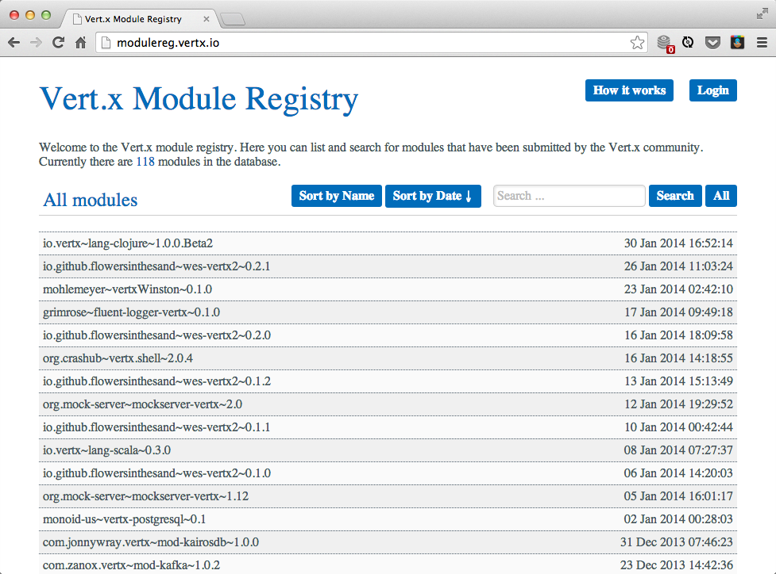

Slide 27
Fat jars
Build module into self contained "fat" executable jar
Convenient for devops
Fairly small overhead ~ 4.7 MB
vertx pulldeps io.vertx~example-web-app~1.0
vertx fatjar io.vertx~example-web-app~1.0
java -jar example-web-app-1.0-fat.jar
Notes:
Particularly using for “devops”, where everything is scripted for easy deployment across hundreds if not thousands of servers

Slide 28
Notes:
mate webapp
cd webapp
vertx runmod io.vertx~example-web-app~1.0
downloads the necessary modules
vertx pulldeps io.vertx~example-web-app~1.0
vertx fatjar io.vertx~example-web-app~1.0
java -jar example-web-app-1.0-fat.jar

Slide 29
High Availability
Automatic failover of deployed modules
Nodes can be logically grouped
Network partition detection (quorum)
Notes:
Resiliency
Your application can carry own in the event that one of the components fail

Slide 30
Notes:
-ha
Like most things in vertx, you just put “ha” on the command line
Run the overall server/bridge:
vertx runmod com.burrsutter~ha~1.0 -ha
http://localhost:8000
Message publishers:
vertx runmod com.burrsutter~senderjava~1.0 -ha
vertx runmod com.burrsutter~senderruby~1.0 -ha
vertx runmod com.burrsutter~senderscala~1.0 -ha
vertx runmod com.burrsutter~senderjavascript~1.0 -ha
vertx runmod com.burrsutter~sendergroovy~1.0 -ha
vertx runmod com.burrsutter~senderpython~1.0 -ha
Another receiver:
vertx runmod com.burrsutter~receiverjavascript~1.0 -ha
ps aux | grep "javascript"
kill -9
Note: Ctrl-C on the process will not cause the fail-over as that is a clean shutdown.
The process that was just running the groovy one before has taken over the JavaScript one as well

Slide 31
Developing with Vert.x
Vert.x is IDE and build system agnostic
Can just use a text editor if you like
Maven archetype
Gradle template
Debug and test in IDE
Module auto-redeploy during development
Notes:
JVM developers tend to use IDEs and Maven or Gradle
Gradle template git clone from github

Slide 32
Notes:
vertx run bridge_server.js -cluster
vertx runmod sender1 -ha
vertx runmod sender2 -ha

Slide 33
Summary
Write apps as set of loosely coupled components that live anywhere where you want
Polyglot – use the language(s) you want
Simple concurrency – wave goodbye to most race conditions
Modules – a library of lego bricks to build apps with
High availability
Ease of development

Slide 34

Project Info
Independent Community Project
The main project is an Eclipse Foundation project
All code is on GitHub
100% open source (ASL 2.0 + Creative Commons)
One of the most popular Java projects on GitHub

Slide 35
Get involved!
Loads more to do
Very active and growing community
Find us on GitHub
https://github.com/vert-x
Google group: vertx
IRC channel: #vertx on freenode.net

Slide 36
Q & A
Notes:
Client-side eventbus – we assume all the server-side is on a trusted network.
On the client,we have something like a firewall you can configure (inbound_permitted,outbound_permitted)
How about scalability/performance measurements? Just the techempower
Does the eventbus do reliable & guaranteed? No, it is a lightweight messaging, founder has worked on enterprise messaging systems – eventbus is not trying to compete with those.
Issues of having vert.x embedded and classloading? You can embed two different ways, just the core or the platform – the platform includes the module system. The core library is just a IO library, no classloading stuff.
Do you require async drivers? This could be a problem in the JVM world – as most things are sync – we have a worker verticle (use a normal thread) – you can use it to interact with more traditional sync APIs like JBDC. There is a MySQL async module.
During fail-over, you will need all modules on all nodes or it can pull it in from a Nexus repo.
What if I had a lot of database intensive operations? Use the worker verticles and use bus.send instead of bus.publish, so that only one worker verticles picks up and responds to the request

