Slide 1
Perl Programming for Biology
G.S. Wise Faculty of Life Science
Tel Aviv University, Israel
October 2010
David (Dudi) Zeevi and David (Dudu) Burstein
http://ibis.tau.ac.il/perluser/2011/

Slide 2


What is Perl ?
  Perl was created by Larry Wall.
  (read his forward to the book “Learning Perl”)
  Perl = Practical Extraction and Report Language

Slide 3
Why Perl ?
Perl is an Open Source project
Perl is a cross-platform programming language
Perl is a very popular programming language,
especially for bioinformatics
Perl is strong in text manipulation
Perl can easily handle files and directories
Perl can easily run other programs‏

Slide 4
Perl & biology
BioPerl: “An international association of developers of open source Perl tools for bioinformatics, genomics and life science research” http://bioperl.org/
Many smaller projects, and millions of little pieces of biological Perl code (which should be used as references – google and find them!)‏

Slide 5
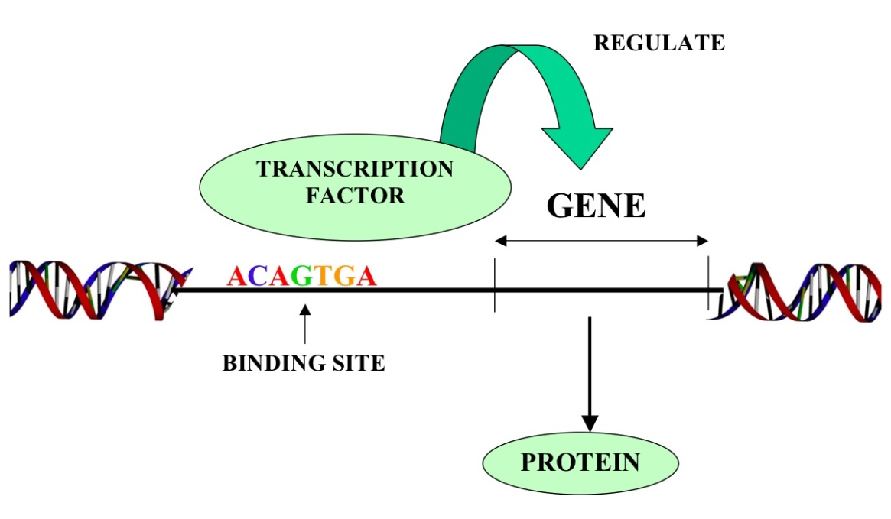
Why biologists need to program?
A real life example:
Finding a regulatory motif in sequences
In DNA sequences:
TATA box / transcription factor binding site in promoter sequences
In protein sequences:
Secretion signal / nuclear localization signal in N-terminal protein sequence
e.g. RXXR – an N-terminus secretion signal in effectors of the pathogenic bacterium Shloomopila apchiella

Slide 6
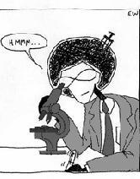
Why biologists need to program?
A real life example:
Finding a regulatory motif in sequences
>gi|307611471|emb|TUX01140.1| vicious T3SS effector [Shloomopila apchiella 130b]
MAAQLDPSSEFAALVKRLQREPDNPGLKQAVVKRLPEMQVLAKTNSLALFRLAQVYSPSSSQHKQMILQS
AAQGCTNAMLSACEILLKSGAANDLITAAHYMRLIQSSKDSYIIGLGKKLLEKYPGFAEELKSKSKEVPY
QSTLRFFGVQSESNKENEEKIINRPTV
>gi|307611373|emb|TUX01034.1| vicious T3SS effector [Shloomopila apchiella 130b]
MVDKIKFKEPERCEYLHIDKDNKVHILLPIVGGDEIGLDNTCETTGELLAFFYGKTHGGTKYSAEHHLNE
YKKNLEDDIKAIGVQRKISPNAYEDLLKEKKERLEQIEKYIDLIKVLKEKFDEQREIDKLRTEGIPQLPS
GVKEVIQSSENAFALRLSPDRPDSFTRFDNPLFSLKRNRSQYEAGGYQRATDGLGARLRSELLPPDKDTP
IVFNKKSLKDKIVDSVLAQLDKDFNTKDGDRNQKFEDIKKLVLEEYKKIDSELQVDEDTYHQPLNLDYLE
NIACTLDDNSTAKDWVYGIIGATTEADYWPKKESESGTEKVSVFYEKQKEIKFESDTNTMSIKVQYLLAE
INFYCKTNKLSDANFGEFFDKEPHATEVAKRVKEGLVQGAEIEPIIYNYINSHYAELGLTSQLSSKQQEE
...
...
...
Shmulik

Slide 7
A Perl script can do it for you
Shmulik writes a simple Perl script to reads protein sequences and find all proteins that contain the N-terminal motif RXXR:
  Use the BioPerl package SeqIO
  Open and read file “Shloomopila_proteins.fasta”
  Iteration – for each sequence:
    Extract the 30 N-terminal amino acids
    Search for the pattern RXXR
    If found – print a message

Slide 8
This course
No prior knowledge expected: intended for students with no experience in programming whatsoever.
Time consuming: compulsory home assignments that will require quite a lot of work.
For you: oriented towards programming tasks for molecular biology.

Slide 9
Some formalities…
Use the course web page: http://ibis.tau.ac.il/perluser/2011/
Presentations will be available on the day of the class.
There will be 5-7 exercises, amounting to 20% of your grade. You get full points if you do the whole exercise, even if some of your answers are wrong, but genuine effort is evident.
Exercises are for individual practice. DO NOT submit exercises in pairs or copy exercises from anyone.

Slide 10
Some formalities…
Submit your exercises by email to your teacher (either Dudu davidbur@tau.ac.il or Dudi davidzee@tau.ac.il) and you will be replied with feedback.
There will be a final exam on computers.
Both learning groups will be taught the same material each week.

Slide 11
Email list for the course
Everybody please send us an email (davidbur@tau.ac.il and davidzee@tau.ac.il) please write that you’re taking the course (even if you are not enrolled yet).
Please let us know:
  To which group you belong
  Whether you are a undergraduate student, graduate (M.Sc. / Ph.D.) student or other

Slide 12
Example exercises
Ex. 1: Write a script that prints "I will submit my assignmnents on time" 100 times
(by the end of this lesson! ☺ )
Ex. 4: Find open reading frames in Fasta format sequences
Ex. 5: Read a GenBank file and print coordinates of ORFs

Slide 13


Slide 14
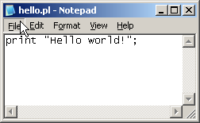

Your very first Perl script
print "Hello world!";
A Perl statement must end with a semicolon “;”
The print function outputs some information to the terminal screen
Now – do it yourself:
Write this script in notepad
Start → Accessories →Notepad
And save (file → save) your script in D:\ex_perl
(my computer → D: → perl_ex)
With the name hello.pl

Slide 15

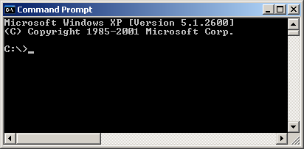
Your very first Perl script
print "Hello world!";
Traditionally, Perl scripts are run from a command line interface
Start it by clicking: Start → Accessories → Command Prompt
or: Start → Run… → cmd

Slide 16
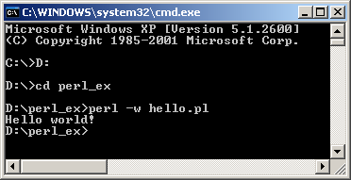
Your very first Perl script
print "Hello world!";
First let’s go to the correct directory:
D: - change drive from C: to D:
cd perl_ex - change directory to perl_ex
dir - list all the files in the directory (you should see your scirpt here)
Running a Perl script
perl –w SCRIPT_NAME

Slide 17

Running Perl at the Command Line
Common DOS commands:
d: change to other drive (d in this case)
md my_dir make a new directory
cd my_dir change directory
cd .. move one directory up
dir list files (dir /p to view it page by page)
help list all dos commands
help dir get help on a dos command
<TAB> (hopefully) auto-complete
<up/down> go to previous/next command
<Ctrl>-c Emergency exit
More tips about the command line are founds here.

Slide 18
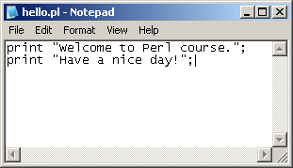
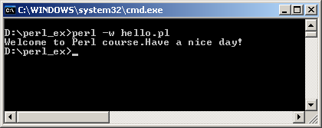
Your very first Perl script
print "Hello world!";
Now – change it to your own name…
print something additional.
And run it again…

Slide 19
Your very first Perl script
print "Hello world!";
Compare this to Java's "Hello world":
public class HelloWorld {
public static void main(String[] args) {
System.out.print("Hello World!");
}
}

Slide 20
Data types
Data Type Description
scalar A single number or string value
9 -17 3.1415 "hello"
array An ordered list of scalar values
(9,-15,3.5)
associative array Also known as a “hash”. Holds an unordered list of key-value couples.
('dudu' => 'davidbur@tau.ac.il'
'dudi' => 'davidzee@tau.ac.il')

Slide 21

1. Scalar Data

Slide 22
Scalar values
A scalar is either a string or a number.
Numerical values
3 -20 3.14152965
1.3e4 (= 1.3 × 10⁴ = 1,300)‏
6.35e-14 ( = 6.35 × 10⁻¹⁴)‏

Slide 23
Scalar values
Strings
Double-quoted strings
print "hello world";
hello world
print "hello\tworld";
hello world
Single-quoted strings
print 'hello world';
hello world
print 'a backslash-t: \t ';
a backslash-t: \t
print "a backslash: \\ ";
a backslash: \
print "a double quote: \" ";
a double quote: "
Backslash is an “escape” character that gives the next character a special meaning:
Construct | Meaning
\n | Newline
\t | Tab
\\ | Backslash
\" | Double quote

Slide 24
Operators
An operator takes some values (operands), operates on them, and produces a new value.
Numerical operators: + - * /
** (exponentiation)
++ -- (autoincrement, will talk about them later)‏
print 1+1;
2
print ((1+1)**3);
8

Slide 25
Operators
An operator takes some values (operands), operates on them, and produces a new value.
String operators: . (concatenate)
x (replicate)‏
e.g.
print ('swiss'.'prot');
swissprot
print (('swiss'.'prot')x3);
swissprotswissprotswissprot

Slide 26
String or number?
Perl decides the type of a value depending on its context:
(9+5).'a'
14.'a'
'14'.'a'
'14a'
Warning: When you use parentheses in print make sure to put one pair of parantheses around the WHOLE expression:
print (9+5).'a'; # wrong
print ((9+5).'a'); # right
You will know that you have such a problem if you see this warning:
print (...) interpreted as function at ex1.pl line 3.
(9x2)+1
('9'x2)+1
'99'+1
99+1
100

Slide 27
Variables
Scalar variables can store scalar values.
Variable declaration my $priority;
Numerical assignment $priority = 1;
String assignment $priority = 'high';
Copy the value of variable $b to $a
$a = $b;
Note: Here we make a copy of $b in $a.

Slide 28
Variables
For example:
$a $b
1
1 1
1 2
1 3
0 3
my $a = 1;
my $b = $a;
$b = $b+1;
$b++;
$a--;

Slide 29
Variables - notes and tips
Tips:
Give meaningful names to variables: e.g. $studentName is better than $n
Always use an explicit declaration of the variables using the my function
Note: Variable names in Perl are case-sensitive. This means that the following variables are different (i.e. they refer to different values):
$varname = 1;
$VarName = 2;
$VARNAME = 3;

Slide 30
Variables - always use strict!
Always include the line:
use strict;
as the first line of every script.
“Strict” mode forces you to declare all variables by my.
This will help you avoid very annoying bugs, such as spelling mistakes in the names of variables.
my $varname = 1;
$varName++;
Warning:
Global symbol "$varName" requires explicit package name at ... line ...

Slide 31
Interpolating variables into strings
use strict;
my $a = 9.5;
print "a is $a!\n";
a is 9.5!
Reminder:
print 'a is $a!\n';
a is $a!\n

Slide 32
Class exercise 1
Write a Perl script that prints the following:
  Use the operator “.” to concatenate the words “apple!”, “orange!!” and “banana!!!”‏
2*. Produce the line: “666:666:666:god help us!”
without any 6 and with only one : in your script!
Like so:
apple!orange!!banana!!!
666:666:666:god help us!

Slide 33
Reading input
<STDIN> allows us to get input from the user:
use strict;
print "What is your name?\n";
my $name = <STDIN>;
print "Hello $name!";
What is your name?
Shmulik
Hello Shmulik
!
$name:
"Shmulik\n"

Slide 34
Reading input
Use the chomp function to remove the “new-line” from the end of the string (if there is any):
use strict;
print "What is your name?\n";
my $name = <STDIN>;
chomp $name; # Remove the new-line print "Hello $name!";
What is your name?
Shmulik
Hello Shmulik!
$name: "Shmulik\n"
$name: "Shmulik"
$name:

Slide 35
The length function
The length function returns the length of a string:
my $str = "hi you";
print length($str);
6
Actually print is also a function so you could write:
print(length($str));
6

Slide 36
The substr function
The substr function extracts a substring out of a string.
It receives 3 arguments: substr(EXPR,OFFSET,LENGTH)
Note: OFFSET count start from 0.
For example:
my $str = "university";
my $sub = substr($str, 3, 5);
$sub is now "versi", and $str remains unchanged.
Also note : You can use variables as the offset and length parameters.
The substr function can do a lot more, Google it and you will see…

Slide 37
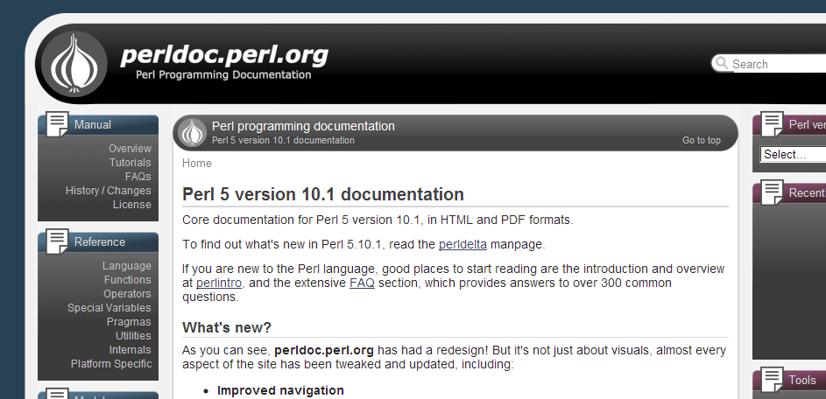
Documentation of perl functions
Anothr good place to start is the list of All basic Perl functions in the Perl documentation site:
http://perldoc.perl.org/
Click the link “Functions” on the left (let's try it…)

Slide 38
Home exercise 1 – submit by email until next class
Install Perl on your computer. Use Notepad to write scripts.
Write a script that prints "I will submit my assignments on time" 100 times.
Write a script that assigns a string containing your e-mail address into the variable called $email and then prints it.
Write a script that reads a line and prints the length of it.
Write a script that reads a line and prints the first 3 characters.
6*. Write a script that reads 4 inputs:
  text line
  number representing "start" position (counting from 0)
  number representing "end" position (counting from 0)
  number representing "copies".
and then prints the letters of the text between the "start" and "end" positions (including the "end"), duplicated "copies" times.
(an example is given in the Ex1.doc on the course web site)
* Kohavit questions are a little tougher, and are not mandatory

