Slide 1

Subroutines

Slide 2

Functions
A function is a portion of code that performs a specific task.
Functions we've met:
$newStr = substr ($str,1,4);
@arr = split (/\t/,$line);
push (@arr, $num);
Takes a string and returns a sub-string
Splits a line into an array
Pushes a scalar to the end of an array

Slide 3
Functions
A function is a portion of code that performs a specific task.
Functions have arguments and return values:
$start = substr ($str,1,4);
Return value:
This function returns a string
Arguments:
(STRING, OFFSET, LENGTH)

Slide 4
Subroutines
A subroutine is a user-defined function.
sub SUB_NAME {
# Do something
...
}
sub printHello {
print "Hello World!\n";
}
sub bark {
print "Woof-woof\n";
}
Subroutines can be placed anywhere, but are usually stacked together at the beginning or the end

Slide 5
Subroutines
To invoke (execute) a subroutine:
SUB_NAME(ARGUMENTS);
For example:
bark();
Woof-woof
print reverseComplement("GCAGTG");
CACTGC

Slide 6
Why use subroutines?
Code in a subroutine is reusable.
For example: a subroutine that reverse-complement a DNA sequence
A subroutine can provide a general solution for different situations.
For example: read a FASTA file
Encapsulation: A well defined task can be done in a subroutine, making the main script simpler and easier to read and understand.
Notes:
Reusable: it can be invoked from several points in the script, no code duplication

Slide 7

Why use subroutines? - Example
my filename = $ARGV[0];
# Read fasta sequence from file
$seq = readFastaFile($fileName);
# Reverse complement the sequence
$revSeq = reverseComplement($seq);
# Print the reverse complement in fasta format
printFasta($revSeq);
# Subroutines definition...
....
A general solution: works with different files
Can be invoked from many points in the code
And the program is beautiful

Slide 8

Why use subroutines? - Example
# Read fasta sequence from file
open (IN, "<$filename") or die "Can't open file";
my @lines = <IN>;
chomp @lines
my ($seq, $line);
foreach my $line (@lines) {
if ($line =~ m/^>/) {next;}
$seq = $seq.$line;
}
close (IN);
# Reverse complement the sequence
$seq =~ tr/ACGTacgt/TGCAtgca/;
$revSeq = reverse ($seq);
# Print the reverse complement in fasta format
my $i = 0;
while (($i+1) * 75 < length ($revSeq)) {
my $fastaLine = substr($revSeq, $i * 75, 75);
print $fastaLine."\n";
$i++;
}
$fastaLine = substr($revSeq, $i*75);
print $fastaLine."\n"
Much better than this

Slide 9
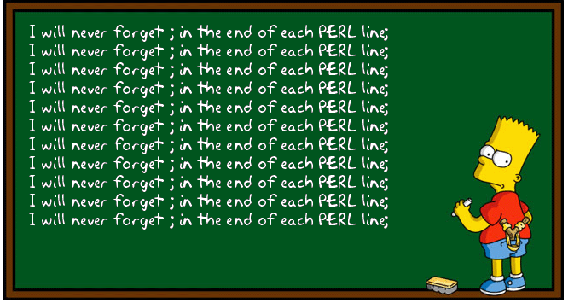
Subroutine arguments
A subroutine may be given arguments through the special array variable @_:
my $bart4today = "I do not have diplomatic immunity";
bartFunc($bart4today ,100);
sub bartFunc {
my ($string, $times) = @_;
print $string x $times;
}
We pass arguments to the subroutine
Inside the subroutine block they are saved in the special array @_
I do not have diplomatic immunity
I do not have diplomatic immunity
I do not have diplomatic immunity
I do not have diplomatic immunity
...

Slide 10
Return value
Definition:
sub reverseComplement {
my ($seq) = @_;
$seq =~ tr/ACGT/TGCA/;
$seq = reverse $seq;
return $seq;
}
Usage:
my $revSeq = reverseComplement("GCAGTG"); CACTGC
The return statement ends the execution of the subroutine and returns a value.

Slide 11
Return value
Definition:
sub reverseComplement {
my ($seq) = @_;
$seq =~ tr/ACGT/TGCA/;
$seq = reverse $seq;
return $seq;
print "I am the walrus!"
}
Usage:
my $revSeq = reverseComplement("GCAGTG"); CACTGC
Everything after the return statement will be ignored

Slide 12
Return value
Definition:
sub reverseComplement {
my ($seq) = @_;
$seq =~ tr/ACGT/TGCA/;
$seq = reverse $seq;
}
Usage:
my $revSeq = reverseComplement("GCAGTG"); CACTGC
If there is no return statement, the value of the last statement in the subroutine is returned.

Slide 13
Return list
Our subroutine returns a list of two elements.
A subroutine may also return an list value:
sub firstLastChar{
my ($string) = @_;
$string =~ m\^(.).*(.)$\;
return ($1,$2);
}
my ($firstChar,$lastChar) = firstLastChar("Yellow");
print "First char: $firstChar, last one: $lastChar.\n";
First char: Y, last one: w.
We pass an argument
And receive a list of two return values

Slide 14
Variable scope
When a variable is defined using my inside a subroutine:
* It does not conflict with a variable by the same name outside the subroutine
* It’s existence is limited to the scope of the subroutine
sub printHello {
my ($name) = @_;
print "Hello $name\n";
}
my $name = "Liko";
printHello("Emma");
print "Bye $name\n";
Hello Emma
Bye Liko

Slide 15
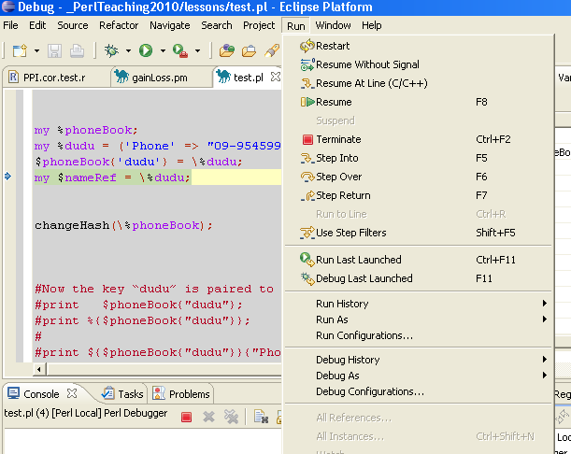
Debugging subroutines
Step into a subroutine (F5)
to debug the internal work of the sub
Step over a subroutine (F6)
to skip the whole operation of the sub
Step out of a subroutine (F7)
when inside a sub – run it all the way to
its end and return to the main script
Resume (F8)
run till end or next break point
Step into
Step over
Step out

Slide 16
Class exercise 11a
Write a subroutine that takes two numbers and prints their sum to the screen (and test it with an appropriate script!).
Write a subroutine that takes two numbers and return a list of their sum, difference, and average.
For example:
@arr = numbersFunc(5,7);
print "@arr"; 12 -2 6
a. Write a subroutine that takes a sentence and returns the last word.
b.* Return the longest word!

Slide 17

Passing variables by reference
If we want to pass arrays or hashes to a subroutine, we should pass a reference:
Passing array references:
subRoutine (\@arr);
Passing hash references:
subRoutine (\%hash);
Arrays and hashes can be very big. That's why we want to pass a direct reference and not create a copy.

Slide 18
Passing variables by reference
If we want to pass arrays or hashes to a subroutine, we should pass a reference:
Passing array references:
subRoutine (\@arr);
Passing hash references:
subRoutine (\%hash);
Dereferencing arrays:
sub subRoutine {
my ($arrRef) = @_;
@arr = @{$arrRef};
...
Dereferencing hashes:
sub subRoutine {
my ($hashRef) = @_;
%hash = %{$hashRef};
...

Slide 19
Passing variables by reference
If we want to pass arrays or hashes to a subroutine, we should pass a reference:
my @pets = ('Liko','Emma','Louis');
printPets (\@pets);
sub printPets {
my ($petRef) = @_;
my @pets = @{$petRef};
foreach my $pet (@pets) {
print "Good $pet\n";
}
}
Reference to @pets
De-reference of $petRef

Slide 20
Passing variables by reference
If we want to pass arrays or hashes to a subroutine, we should pass a reference:
my %newDetails;
$newDetails{"name"} = "Eyal";
$newDetails{"address"} = "Swiss";
@grades = (98,72,86);
$newDetails{"grades"} = [@grades];
printGeneInfo(\%newDetails);
sub printDetails {
my ($detailRef) = @_;
my %details = %{$detailRef};
print "Name: ".$details{"name"}."\n";
print "Adr.: ".$details{"address"}."\n";
my @grades = @{ $details{"grades"} }
print "Grades: @grades\n";
}
Reference to %newDetail
De-reference of $detailRef

Slide 21
Returning variables by reference
Similarly, to return a hash use a reference:
sub getDetails {
my %geneInfo;
$geneInfo{"name"} = <STDIN>;
$geneInfo{"address"} = <STDIN>;
...
return \%geneInfo;
}
$geneRef = getGeneInfo();
In this case the hash continue to exists outside the subroutine! To dereference use:
my %geneHashInfo = %{$geneRef}

Slide 22
Sort revision
We learned the default sort, which is lexicographic:
my @arr = ("Liko","Emma","Louis");
my @sorted = sort(@arr);
print "@sorted";
Emma Liko Louis

Slide 23

Sort revision
We learned the default sort, which is lexicographic:
my @arr = (8,3,45,8.5);
my @sorted = sort(@arr);
print "@sorted";
3 45 8 8.5
To sort by a different order rule we need to give a comparison subroutine – a subroutine that compares two scalars and says which comes first
sort COMPARE_SUB (@array);
no comma here

Slide 24
Sorting numbers
sort COMPARE_SUB (LIST);
COMPARE_SUB is a special subroutine that compares two scalars $a and $b, and says which comes first (by returning 1, 0 or -1). For example:
sub compareNumber {
if ($a > $b) {return 1;}
elsif ($a == $b) {return 0;}
else {return -1;}
}
my @sorted = sort compareNumber (8,3,45,8.5);
print "@sorted\n";
3 8 8.5 45
no comma here

Slide 25
The operator <=>
The <=> operator does exactly that – it returns 1 for “greater than”, 0 for “equal” and -1 for “less than”:
sub compareNumber {
return $a <=> $b;
}
print sort compareNumber (8,3,45,8.5);
For easier use, you can use a temporary subroutine definition in the same line:
print sort {return $a<=>$b;} (8,3,45,8.5);
or just:
print sort {$a<=>$b;} (8,3,45,8.5);

Slide 26

Sorting example
open (IN,"<fight club.txt");
my @lines = <IN>;
my @sorted = sort compareLength @lines;
print @sorted;
sub compareLength{
return (length($a) <=> length($b));
}
Welcome to Fight Club.
Sixth rule: no shirt, no shoes.
Fourth rule: only two guys to a fight.
Fifth rule: one fight at a time, fellas.
. . .
© 1999 - 20th Century Fox - All Rights Reserved

Slide 27
Class exercise 11b
Solve ex11a.2 again, this time use references to pass the arguments and return their values.
Write a script that reads a file with a list of protein names and lengths:
(such as proteinLengths)
AP_000081 181
AP_000174 104
AP_000138 145
Print them sorted according to their length
Modify the solution for class_ex8.1: Make a subroutine that takes the name of an input file, builds the hash of protein lengths and returns a reference to the hash. Test it – see that you get the same results as the original class_ex.8.1. Feel free to use our solution of class_ex8.1…
Now do class_ex. 8.2 by adding another subroutine that takes: (1) a protein accession, (2) a protein length and (3) a reference to such a hash, and returns 0 if the accession is not found, 1 if the length is identical to the one in the hash, and 2 otherwise.

Slide 28
Class exercise 8
Write a script that reads a file with a list of protein names and lengths:
AP_000081 181
AP_000174 104
AP_000138 145
stores the names of the sequences as hash keys, with the length of the sequence as the value. Print the keys of the hash.
Add to Q1: Read another file, and print the names that appeared in both files with the same length. Print a warning if the name is the same but the length is different.
Write a script that reads a GenPept file (you may use the preproinsulin record), finds all JOURNAL lines, and stores in a hash the journal name (as key) and year of publication (as value):
  a. Store only one year value for each journal name
  b*. Store all years for each journal name
Then print the names and years, sorted by the journal name (no need to sort the years for the same journal in b*, unless you really want to do so…)

