Slide 1
Revision: variables & arrays
Array declaration my @array;
Array initialization @array = ('A','B','C','D');
my @array2 = (3..7);
@array2 = ();
Array element: print $array[1]; B
$array[0] = '*'; *BCD
Array size: print scalar(@array); 4
Empty array

Slide 2
Revision(+): Multiple assignment
Multiple declarations
my ($a,$b,@c,@d,@e);
($a,$b) = ('cow' ,'dog');
($a,$b,@c) = (1,2,3,4,5);
@e = (6,7,8,9,10);
($a,$b) = @e;
$a = @e;
($a) = @e;
@d = ($a, $b);
@e = (@c,@d);
$a='cow' $b='dog'
$a=1; $b=2; @c=(3,4,5)
@e=(6,7,8,9,10);
$a=6; $b=7
$a=5;
$a=6;
@d=(6,7)
@e=(3,4,5,6,7);
will be useful for home assignment

Slide 3
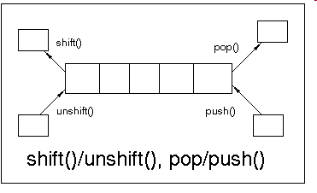
Revision: arrays function
Shift & unshift
@a = @start;
my $x = shift(@a);
print @a;
B 17 hi
print $x;
A
my @a = @start;
unshift(@a,"*");
print "@a";
* A B 17 hi
Pop & push
@a = @start;
my $x = pop(@a);
print @a;
A B 17
print $x;
hi
@a = @start; push(@a,"Z");
print @a;
A B 17 hi Z
@start=("A","B",17,"hi");
@start
"A"
"B"
17
"hi"
0 1 2 3
0
1
2
3
4
Note: These functions change the array (argument)

Slide 4
Revision: arrays function (2)
my $str = "So-long-and-thanks-for-all-the-fish";
my @arr = split(/-/, $str);
$str = join("!! ", @a );
print "$str\n";
So!! Long!! and!! thanks!! for!! all!! the!! Fish
my @letters = ("b","a","c");
my @sorted = sort(@letters);
my @rev = reverse(@letters);
@sorted=("a","b","c');
@rev=("c","a","b");
Note: These functions do NOT change the array (argument),
But return the “manipulated” array

Slide 5
Revision: reading input
Reading a single line:
my $line = <STDIN>;
Reads a single line
End input with Enter
First line
Reading a list of lines:
my @lines = <STDIN>;
Each line is a different element in an array
Hit Ctrl-z to end input
Note: in Mac use Ctrl-d.
First line
Second
Last
Ctrl-z
$line
"First line\n"
@lines
"First line\n"
"Second\n"
"Last\n"
0 1 2

Slide 6



Reading and writing files

Slide 7

Reading files
Open a file for reading, and link it to a filehandle:
open(IN, "<input.txt");
And then read lines from the filehandle, exactly like you would from <STDIN>:
my $line = <IN>; Read a single line from file to scalar (and
move to the next line)
my @inputLines = <IN>; Read all file to array
Every filehandle opened should be closed:
close(IN);
Always check the open didn’t fail (e.g. if a file by that name doesn’t exists):
open(IN, "<$file") or die "can't open file $file";

Slide 8
Writing to files
Open a file for writing, and link it to a filehandle:
open(OUT, ">output.txt") or die...
NOTE: If a file by that name already exists it will be overwriten!
You could append lines to the end of an existing file:
open(OUT, ">>output.txt") or die..
Print to a file (in both cases):
print OUT "This is an output line.\n";
no comma here

Slide 9
File Test Operators
You can ask questions about a file or a directory name (not filehandle):
if (-e $name) { print "The file $name exists!\n"; }
-e $name exists
-r $name is readable
-w $name is writable by you
-z $name has zero size
-s $name has non-zero size (returns size)
-f $name is a file
-d $name is a directory
-l $name is a symbolic link
-T $name is a text file
-B $name is a binary file (opposite of -T).

Slide 10
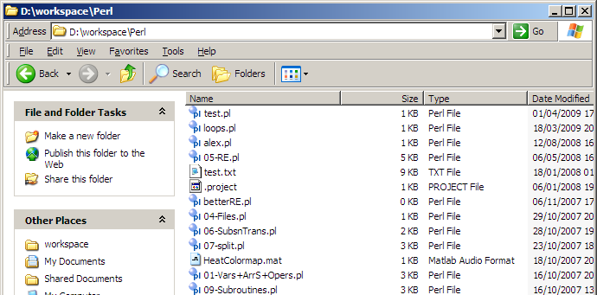
Working with paths
open( IN, '<D:\workspace\Perl\p53.fasta' );
Always use a full path name, it is safer and clearer to read
Remember to use \\ in double quotes
open( IN, "<D:\\workspace\\Perl\\$name.fasta" );
(usually) you can also use /
open( IN, "<D:/workspace/Perl/$name.fasta" );

Slide 11
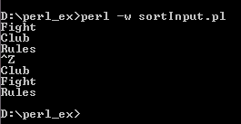

Working with files - example
use strict;
my @lines = <STDIN>;
my @sorted = sort(@lines);
print @sorted;
© 1999 - 20th Century Fox - All Rights Reserved

Slide 12
Working with files - example
use strict;
my $inFile = 'D:\fight club.txt';
open(IN, "<$inFile") or die "cannot open $inFile";
my @lines = <IN>;
my @sorted = sort(@lines);
print @sorted;
close(IN);
© 1999 - 20th Century Fox - All Rights Reserved

Slide 13
Working with files - example
use strict;
my ($inFile,$outFile) = ('D:\fight club.txt','D:\sorted.txt');
open(IN, "<$inFile") or die "cannot open $inFile";
open(OUT, ">$outFile") or die "cannot open $outFile file";
my @lines = <IN>;
my @sorted = sort(@lines);
print OUT @sorted;
close(IN);
close(OUT);
© 1999 - 20th Century Fox - All Rights Reserved

Slide 14
Class exercise 3a
Write scripts that perform as follows:
Read the first and the second line of the "fight club.txt" file, and print them to the screen.
2. Read the entire "fight club.txt" file and print all the file in one line to an output file names "fight.one.txt".
3. The file "numbers.txt" contains numbers, one in each line. Read the first 3 numbers in the files and print their sum to a file called "sum.txt".
4*. Print only the 3rd and the 5th lines of the file "fight club.txt".

Slide 15
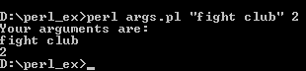
@ARGV - revision
It is possible to pass arguments to Perl from the command line. These Command-line arguments are stored in an array created automatically named @ARGV:
use strict;
my $joinedArr = join("\n",@ARGV);
print "Your arguments are:\n";
print $joinedArr;
@ARGV
"fight club"
2

Slide 16
Command line arguments
It is common to give arguments (separated by spaces) within the command-line for a program or a script:
They will be stored in the array @ARGV:
my $inFile = $ARGV[0];
my $outFile = $ARGV[1];
Or more simply:
my ($inFile,$outFile) = @ARGV;
> perl -w findProtein.pl D:\perl_ex\in.fasta D:\perl_ex\out.txt

Slide 17
Working with files - example
use strict;
my ($inFile,$outFile) = ('D:\fight club.txt','D:\sorted.txt');
open(IN, "<$inFile") or die "cannot open $inFile";
open(OUT, ">$outFile") or die "cannot open $outFile file";
my @lines = <IN>;
my @sorted = sort(@lines);
print OUT @sorted;
close(IN);
close(OUT);
© 1999 - 20th Century Fox - All Rights Reserved

Slide 18
Working with files - example
use strict;
my ($inFile,$outFile) = @ARGV;
open(IN, "<$inFile") or die "cannot open $inFile";
open(OUT, ">$outFile") or die "cannot open $outFile file";
my @lines = <IN>;
my @sorted = sort(@lines);
print OUT @sorted;
close(IN);
close(OUT);
© 1999 - 20th Century Fox - All Rights Reserved

Slide 19
Class exercise 3b
Repeat question 3a.1:
Read the first and the second line of the "fight club.txt" file, and print them to the screen.
This time receive the input file from @ARGV.
Repeat question 3a.2:
Read the entire "fight club.txt" file and print all the file in one line to an output file names "fight.one.txt".
This time receive both the input and output file from @ARGV.

