Slide 1

Revision:
Ifs and Loops

Slide 2
if, elsif, else
It’s convenient to test several conditions in one if structure:
print "Please enter your grades average:\n";
my $number = <STDIN>;
if ($number < 0 or $number > 100) {
print "ERROR: The average must be between 0 and 100.\n";
}
elsif ($number > 90) {
print "wow!\n";
}
elsif ($number > 80) {
print "well done.\n";
}
else {
print "oh well...\n";
}
True if at least one condition is true
Note the indentation:
a single tab in each line of new block
‘}’ that ends the block should be in the same indentation as where it started

Slide 3

if, elsif, else
my $number = <STDIN>;
$number
if ($number < 0 or $number > 100) {
print "ERROR";
}
< 0 or >100
No
Yes
elsif ($number > 90) {
print "wow!\n";
}
> 90
No
Yes
“ERROR”
elsif ($number > 80) {
print "well done.\n";
}
> 80
No
Yes
“wow!”
else {
print "oh well...\n";
}
“oh well…”
“well done”

Slide 4
Comparison operators
Comparison | Numeric | String
Equal | == | eq
Not equal | != | ne
Less than | < | lt
Greater than | > | gt
Less than or equal to | <= | le
Greater than or equal to | >= | ge
if ($age == 18)...
if ($name eq "Yossi")...
if ($name ne "Yossi")...
if ($name lt "n")...
if ($age = 18)...
Found = in conditional, should be == at ...
if ($name == "Yossi")...
Argument "Yossi" isn't numeric in numeric eq (==) at ...

Slide 5
If
Commands inside a loop are executed repeatedly
(iteratively):
my $luckyNum = 42;
print "Guess a number\n";
my $num = <STDIN>;
if ($num != $luckyNum) {
print "Wrong...\n";
}
print "Correct!!\n";
Guess a number
$num
!= 42
No
Yes
Correct!!
Wrong…

Slide 6
Loops: while
Commands inside a loop are executed repeatedly
(iteratively):
my $luckyNum = 42;
print "Guess a number\n";
my $num = <STDIN>;
while ($num != $luckyNum) {
print "Wrong. Guess again.\n";
$num = <STDIN>;
}
print "Correct!!\n";
Guess a number
$num
!= 42
No
Yes
Correct!!
Wrong…
$num

Slide 7
Loops: while (defined …)
Start
read $line
Let's observe the following code :
open (IN, "<numbers.txt");
my $line = <IN>;
while (defined $line) {
chomp $line;
if ($line > 10) {
print $line;
}
$line = <IN>;
}
close (IN);
defined?
No
Yes
>10
No
Yes
print $line
read $line
End

Slide 8
Loops: foreach
The foreach loop passes through all the elements of an array
my @arr = (1,1,2,3,5);
Note:
The array is actually changed
foreach my $num (@arr) {
$num++;
}
$num
@arr
$arr[2]
$arr[1]
$arr[3]
$arr[4]
$arr[0]
undef
1
1
2
3
5
2
2
3
4
6

Slide 9
Loops: while
Start
Guess a number
my @arr = (1,1,2,3,5);
my @arr = (1,1,2,3,5);
my $num;
my $i = 0;
while ($i < @arr) {
$num = $arr[$i];
$num++;
$arr[$i] = $num;
}
foreach my $num (@arr){
$num++;
}
$i = 0
< @arr
No
Yes
$num = $arr[$i]
$num++
Yes
$arr[$i] = $num
End

Slide 10
Breaking out of loops
next – skip to the next iteration last – skip out of the loop
open (IN, "<numbers.txt");
my @lines = <IN>;
chomp @lines;
foreach my $num (@lines) {
if ($num <= 10) {
next;
}
print $num;
}
close (IN);
Notes:
V

Slide 11
Breaking out of loops
next – skip to the next iteration last – skip out of the loop
open (IN, "<numbers.txt");
my @lines = <IN>;
chomp @lines;
foreach my $num (@lines) {
if ($num <= 10) {
last;
}
print $num;
}
close (IN);
Notes:
V

Slide 12

More loops

Slide 13
Scope of variable declaration
If you declare a variable inside a loop it will only exist in that loop
This is true for every {block}:
my $name="";
while ($name ne "Nimrod") {
$name = <STDIN>
chomp($name);
print "Hello $name, what is your age?\n";
my $age;
$age = <STDIN>;
}
print $name;
print $age;
Global symbol "$age" requires explicit package name

Slide 14
Never declare the same variable name twice
If you declare a variable name twice, outside and inside – you are creating two distinct variables… don’t do it!
my $name = "Ruti";
print "Hello $name!\n";
my $num;
my @arr = (1,2,3);
foreach $num (@arr) {
my $name = "Nimrod";
print "$num. Hello $name!\n";
}
print "Hello $name!\n";
Hello Ruti!
1. Hello Nimrod!
2. Hello Nimrod!
3. Hello Nimrod!
Hello Ruti!

Slide 15
Never declare the same variable name twice
If you declare a variable name twice, outside and inside – you are creating two distinct variables… don’t do it!
my $name = "Ruti";
print "Hello $name!\n";
my $num;
my @arr = (1,2,3);
foreach $num (@arr) {
$name = "Nimrod";
print "$num. Hello $name!\n";
}
print "Hello $name!\n";
Hello Ruti!
1. Hello Nimrod!
2. Hello Nimrod!
3. Hello Nimrod!
Hello Nimrod!

Slide 16
Fasta format
Fasta format sequence begins with a single-line description, that start with '>', followed by lines of sequence data that contains new-lines after a fixed number of characters:
>gi|16127995|ref|NP_414542.1| thr operon leader peptide…
MKRISTTITTTITITTGNGAG
>gi|16127996|ref|NP_414543.1| fused aspartokinase I and homoserine…
MG1655]MRVLKFGGTSVANAERFLRVADILESNARQGQVATVLSAPAKITNHLVAMIEKTISGQDALPN
AKFFAALARANINIVAIAQGSSERSISVVVNNDDATTGVRVTHQMLFNTDQVIEVFVIGVGGVGGALLEQ
NAGDELMKFSGILSGSLSYIFGKLDEGMSFSEATTLAREMGYTEPDPRDDLSGMDVARKLLILARETGRE
LELADIEIEPVLPAEFNAEGDVAAFMANLSQLDDLFAARVAKARDEGKVLRYVGNIDEDGVCRVKIAEVD
GNDPLFKVKNGENALAFYSHYYQPLPLVLRGYGAGNDVTAAGVFADLLRTLSWKLGV
>gi|16127997|ref|NP_414544.1| homoserine kinase [Escherichia coli…
MG1655]MVKVYAPASSANMSVGFDVLGAAVTPVDGALLGDVVTVEAAETFSLNNLGRFADKLPSEPREN
IVYQCWERFCQELGKQIPVAMTLEKNMPIGSGLGSSACSVVAALMAMNEHCGKPLNDTRLLALMGELEGR
ISGSIHYDNVAPCFLGGMQLMIEENDIISQQVPGFDEWLWVLAYPGIKVSTAEARAILPAQYRRQDCIAH
GRHLAGFIHACYSRQPELAAKLMKDVIAEPYRERLLPGFRQARQAVAEIGAVASGISGSGPTLFALCDKP
ETAQRVADWLGKNYLQNQEGFVHICRLDTAGARVLEN

Slide 17

GenBank files…
GenBank and GenPept are two format of NCBI files to represent information of genes and proteins (accordingly).
Here is a sample record

Slide 18
Class exercise 4b
Read a file containing several proteins sequences in FASTA format, and print only their header lines using a while loop (see example FASTA file on the course webpage).
Read a file containing several proteins sequences in FASTA format, and print only their header lines using a foreach loop (see example FASTA file on the course webpage).
(Ex 3.1b) Read a file containing numbers, one in each line and print the sum of these numbers. (use number.txt from the website as an example).
4*. Read the "fight club.txt" file and print the 1st word of the 1st line, the 2nd word of the 2nd line, and so on, until the last line. (If the i-th line does not have i words, print nothing).

Slide 19
Class exercise 5a
1*. Read the "fight club.txt" file and print for each line the number of words in the line.
2*. Read a file containing several proteins sequences in FASTA format, and print only the gi numbers (the number that appear after 'gi|'). Note that the number of digits in the gi number might vary.
3*. Read the "fight club.txt" file and print for each line the number of times the letter 'i' appears in it.

Slide 20
The substr function
The substr function extracts a substring out of a string.
It receives 3 arguments: substr(EXPR,OFFSET,LENGTH)
Note: OFFSET count start from 0.
For example:
my $str = "university";
my $sub = substr($str, 3, 5);
$sub is now "versi", and $str remains unchanged.
Also note : You can use variables as the offset and length parameters.
The substr function can do a lot more, Google it and you will see…

Slide 21
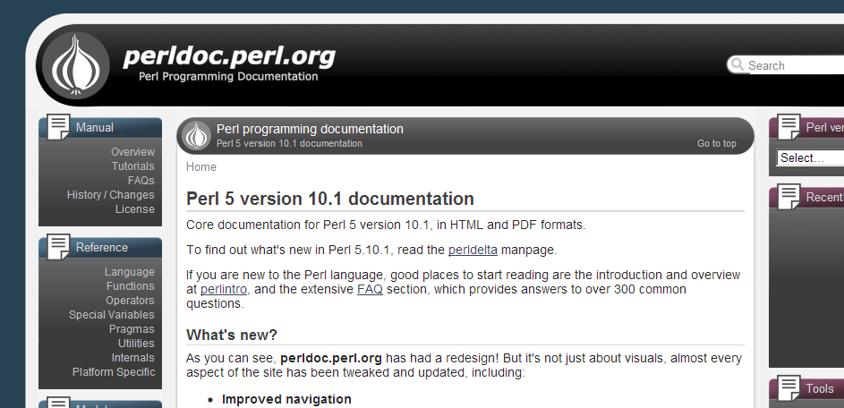
Documentation of perl functions
Anothr good place to start is the list of All basic Perl functions in the Perl documentation site:
http://perldoc.perl.org/
Click the link “Functions” on the left (let's try it…)

Slide 22
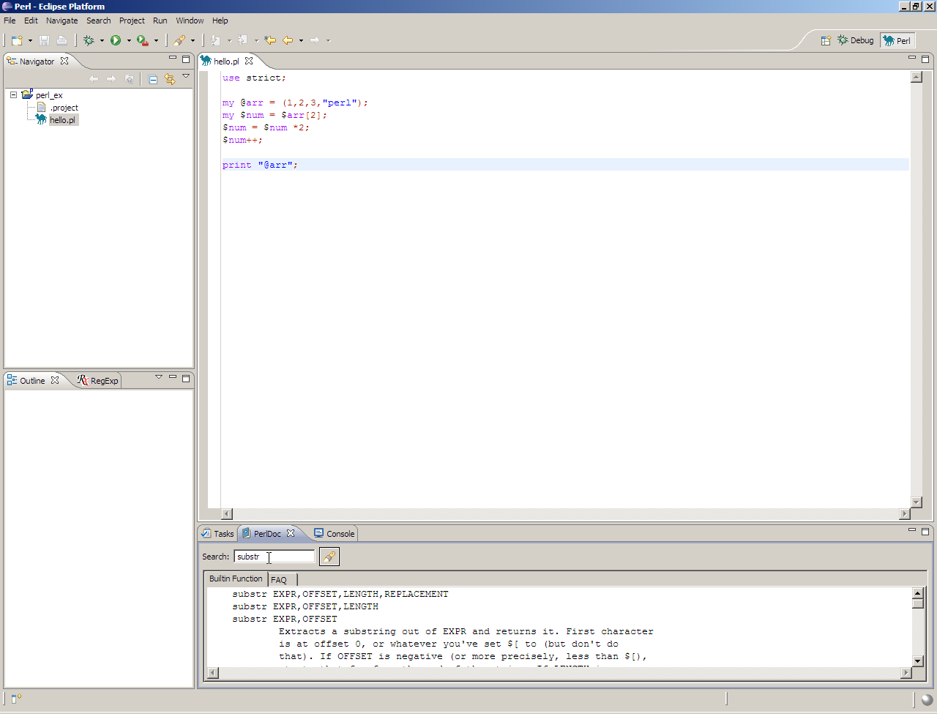
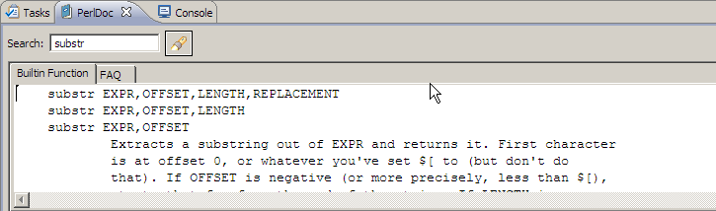
Peldoc in Eclipse
Also note a little pinuk:
At the bottom you have a 'PerlDoc' tab that contains information about all of Perl's functions (and much more)

Slide 23
FASTA: Analyzing complex input
Assignment:
Write a script that reads several protein sequences
in FASTA format, and prints for each sequence print
its header and its 30 C-terminal (last) amino-acids
| Obtain from the assignment:
  Input
  Required Output
  Required processes (functions)

Slide 24
FASTA: Analyzing complex input
Start
Read line
Let's start with something easier:
Print header and last 30 aa of the first protein:
Read the first FASTA sequence:
  1.1. Read FASTA header
  1.2. Read each line until next FASTA header
Do something (print output)
  2.1. Get last 30aa.
  2.2. Print header last 30aa
Let’s see how it’s done…
Save header
Read line
defined and
not header
No
Yes
Concatenate
to sequence
Read line
Do something
End

Slide 25
Start
## 1.1. Read FASTA header and save it
my $fastaLine = <IN>;
chomp $fastaLine;
my $header = substr($fastaLine,1);
## 1.2. Read sequence until next FASTA header
$fastaLine = <IN>;
my $seq = "";
while ((defined $fastaLine) and
(substr($fastaLine,0,1) ne ">" )){
chomp $fastaLine;
$seq = $seq.$fastaLine;
$fastaLine = <IN>;
}
## 2.1 get last 30aa
my $subseq = substr($seq,-30);
## 2.2 print header and last 30aa
print "$header\n$subseq\n";
Read line
Save header
Read line
defined and
not header
No
Yes
Concatenate
to sequence
Read line
Do something
End

Slide 26
FASTA: Analyzing complex input
Start
Read line
Overall design:
Read the FASTA file (several sequences).
For each sequence:
Read the FASTA sequence
  1.1. Read FASTA header
  1.2. Read each line until next FASTA header
For each sequence: Do something
  2.1. Get last 30aa.
  2.2. Print header last 30aa
Let’s see how it’s done…
defined?
No
Yes
Save header
Read line
defined and
not header
No
Yes
Concatenate
to sequence
Read line
Do something
End

Slide 27
Start
## 1.1. Read FASTA header and save it
my $fastaLine = <IN>;
while (defined $fastaLine) {
chomp $fastaLine;
my $header = substr($fastaLine,1);
## 1.2. Read seq until next header
$fastaLine = <IN>;
my $seq = "";
while ((defined $fastaLine) and
(substr($fastaLine,0,1) ne ">" )) {
chomp $fastaLine;
$seq = $seq.$fastaLine;
$fastaLine = <IN>;
}
## 2.1 get last 30aa
my $subseq = substr($seq,-30);
## 2.2 print header and last 30aa
print "$header\n$subseq\n";
}
Read line
defined?
No
Yes
Save header
Read line
defined and
not header
No
Yes
Concatenate
to sequence
Read line
Do something
End

Slide 28
Class exercise 5b
(Ex 3.2) Read a Fasta file (you can use as an example Ecoli.prot.fasta from the course web-site) and print for each sequence the header and the sequence length.
Read a Fasta file (such as Ecoli.prot.fasta from) and print the headers of the proteins that their sequence start with MAD or MAN.
3*. Write a script that reads a file containing names and expenses on separate lines (such as expenses.txt from the course web site).
Sum the numbers while there is a '+' sign before them, and print for each name the total of expenses. For example:
Input: Output:
Nimrod Nimrod 27.60
+6.10 Data 27.00
+16.50
+5.00
Dana
+21.00
+6.00

