Slide 1

Short foreach revision

Slide 2
Loops: foreach
The foreach loop passes through all the elements of an array
my @arr = (2,3,4,5,6);
my $mul = 1;
foreach my $num (@arr) {
$mul = $mul *$num;
}
$num
@arr
$arr[2]
$arr[1]
$arr[3]
$arr[4]
$arr[0]
undef
2
3
4
5
6
$mul
120
720
24
1
6
2

Slide 3
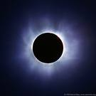
Some Eclipse Tips
Try Ctrl+Shift+L Quick help (keyboard shortcuts)
Try Ctrl+SPACE Auto-complete
Source→Format (Ctrl+Shift+F) Correct indentation
You can maximize a single view of Eclipse.
Debug Debug & Debug!!!
Break points . . .
The (default) location of your files are:
At home: D:\eclipse\perl_ex
Computer class: C:\eclipse\perl_ex

Slide 4
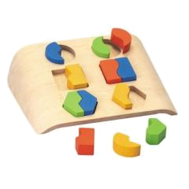
Pattern matching

Slide 5
Pattern matching
We often want to find a certain piece of information within the file, for example:
Exract GI numbers or
accessions from Fasta
Extract the coordinates of all open reading
frames from the annotation of a genome
Extract the accession, description and score of every hit in the output of BLAST
>gi|16127995|ref|NP_414542.1| thr operon …
>gi|145698229|ref|YP_001165309.1| hypothetical …
>gi|90111153|ref|NP_415149.4| citrate …
CDS 1542..2033
CDS complement(3844..5180)
Score E
Sequences producing significant alignments: (bits) Value
ref|NT_039621.4|Mm15_39661_34 Mus musculus chromosome 15 genomic... 186 1e-45
ref|NT_039353.4|Mm6_39393_34 Mus musculus chromosome 6 genomic c... 38 0.71
ref|NT_039477.4|Mm9_39517_34 Mus musculus chromosome 9 genomic c... 36 2.8
All these examples are patterns in the text.
We will see a wide range of the pattern-matching capabilities of Perl, but much more is available – We strongly recommend using documentation/tutorials/google.

Slide 6
Pattern matching
Finding a sub-string (match) somewhere in a string:
if ($line =~ m/he/) ... remember to use slash (/) and not back-slash
Will be true for “hello” and for “the cat” but not for “good bye” or “Hercules”.
You can ignore case of letters by adding an “i” after the pattern:
m/he/i
(matches for “the”, “Hello” , “Hercules” and “hEHD”)
There is a negative form of the match operator:
if ($line !~ m/he/) ...

Slide 7
Single-character patterns
m/./ Matches any character (except “\n”)
You can also ask for one of a group of characters:
m/[atcg]/ Matches “a” or “t” or “c” or “g”
m/[a-d]/ Matches “a” though “d” (a, b, c or d)
m/[a-zA-Z]/ Matches any letter
m/[a-zA-Z0-9]/ Matches any letter or digit
m/[a-zA-Z0-9_]/ Matches any letter or digit or an underscore
m/[^atcg]/ Matches any character except “a” or “t” or “c” or “g” m/[^0-9]/ Matches any character except a digit

Slide 8
Single-character patterns
For example:
if ($line =~ m/TATAA[AT]/)
Will be true for?
✗
✔
✔
TATTAA
TATAATA
CTATATAATAGCTAGGCGCATG
TATTAA
TATAATA
CTATATAATAGCTAGGCGCATG

Slide 9
Repetitive patterns
? means zero or one repetitions:
m/ab?c/ Matches “ac” or “abc”
+ means one or more repetitions:
m/ab+c/ Matches “abc” ; “abbbbc” but not “ac”
A pattern followed by * means zero or more repetitions of that patern:
m/ab*c/ Matches “abc” ; “ac” ; “abbbbc”
Generally – use { } for a certain number of repetitions, or a range:
m/ab{3}c/ Matches “abbbc”
m/ab{3,6}c/ Matches “a”, 3-6 times “b” and then “c”
m/ab{3,}c/ Matches “a”, “b” 3 times or more and then “c”
Use parentheses to mark more than one character for repetition:
m/h(el)*lo/ Matches “hello” ; “hlo” ; “helelello”

Slide 10
Single-character patterns
For example:
if ($line =~ m/TATAA[AT][ATCG]{2,4}ATG/)
Will be true for?
TATAAAGAATG
ACTATAATAAAAATG
TATAATGATGTATAATATCG
TATAAAGAATG
ACTATAATAAAAATG
✔
✔
✗

Slide 11
Single-character patterns
Perl provides predefined character classes:
\d a digit (same as: [0-9])
\w a “word” character (same as: [a-zA-Z0-9_])
\s a space character (same as: [ \t\n\r\f])
For example:
if ($line =~ m/class\.ex\d\.\S/)
And their negatives:
\D anything but a digit
\W anything but a word char
\S anything but a space char
✔
✗
✔
class.ex3.1.pl
class.ex3.
my class.ex8.(old)
class.ex3.1.pl
class.ex3.
my class.ex8.(old)

Slide 12
Example code
Consider the following code:
print "please enter a line...\n";
my $line = <STDIN>;
chomp($line);
if ($line =~ m/-?\d+/) {
print "This line seems to contain a number...\n";
}
else {
print "This is certainly not a number...\n";
}

Slide 13
Example code
Consider the following code:
open(IN, "<numbers.txt") or die "cannot open numbers.txt";
my $line = <IN>;
while (defined $line) {
if ($line =~ m/-?\d+/) {
print "This line seems to contain a number...\n";
}
else {
print "This is certainly not a number...\n";
}
$line = <IN>;
}

Slide 14
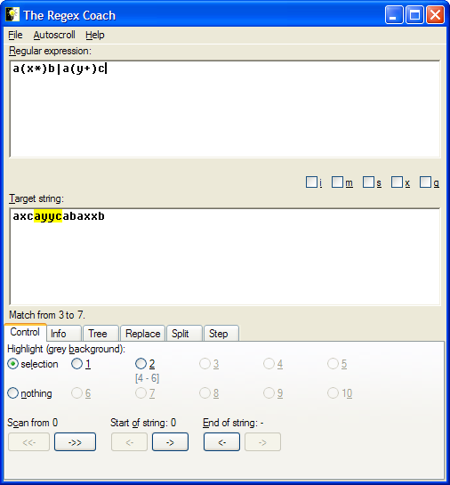
RegEx Coach
An easy to use tool for testing regular expressions:
http://weitz.de/files/regex-coach.exe

Slide 15
Class exercise 6a
Write the following regular expressions. Test them with a script that reads a line from STDIN and prints "yes" if it matches and "no" if not.
Match a name containing a capital letter followed by three lower case letters
Match an NLS (nuclear localization signal) that start with K followed by K or R followed by any character followed by either K or R.
Match an NLS that start with K followed by K or R followed by any character except D or E, followed by either K or R. Match either small or capital letters
4*. Match 3 - 15 characters between quotes (without another quote inside the quotes).

Slide 16
Pattern matching
Replacing a sub string (substitute):
$line = "the cat on the tree";
$line =~ s/he/hat/;
$line will be turned to “that cat on the tree”
To Replace all occurrences of a sub string add a “g” (for “globally”):
$line = "the cat on the tree";
$line =~ s/he/hat/g;
$line will be turned to “that cat on that tree”

Slide 17
Single-character patterns
Perl provides predefined character classes:
\d a digit (same as: [0-9])
\w a “word” character (same as: [a-zA-Z0-9_])
\s a space character (same as: [ \t\n\r\f])
And a substitute example for $line = "class.ex3.1.pl";
$line =~ s/\W/-/;
class-ex3.1.pl
$line =~ s/\W/-/g;
class-ex3-1-pl
And their negatives:
\D anything but a digit
\W anything but a word char
\S anything but a space char

Slide 18
Class exercise 6b
Write the following regular expressions substitutions. For each string print it before the substitution and after it
  Replace every T to U in a DNA sequence.
  Replace every digit in the line with a #, and print the result.
  Replace any number and kind of white space (new-line, tab or space) by a single space.
  d*) Remove all such appearances of "is" from the line (both small and capital letters), and print it.

Slide 19
Enforce line start/end
To force the pattern to be at the beginning of the string add a “^”:
m/^>/ Matches only strings that begin with a “>”
“$” forces the end of string:
m/\.pl$/ Matches only strings that end with a “.pl”
And together:
m/^\s*$/ Matches all lines that do not contain any non-space characters

Slide 20
Some examples
m/\d+(\.\d+)?/ Matches numbers that may contain a decimal point:
“10”; “3.0”; “4.75” …
m/^NM_\d+/ Matches Genbank RefSeq accessions like “NM_079608”
OK… now let's do something more complex…

Slide 21

Some GenBank examples
Let's take a look at the adeno12.gb GenBank record….
Matches annotation of a coding sequence in a Genbank DNA/RNA record:
CDS 87..1109
m/^\s*CDS\s+\d+\.\.\d+/
Allows also a CDS on the minus strand of the DNA:
CDS complement(4815..5888)
m/^\s*CDS\s+(complement\()?\d+\.\.\d+\)?/
Note: We could just use m/^\s*CDS/ - it is a question of the strictness of the format. Sometimes we want to make sure.

Slide 22
Extracting part of a pattern
We can extract parts of the pattern by parentheses:
$line = "1.35";
if ($line =~ m/(\d+)\.(\d+)/ ) {
print "$1\n"; 1
print "$2\n"; 35
}

Slide 23
Extracting part of a pattern
We can extract parts of the string that matched parts of the pattern that are marked by parentheses:
my $line = " CDS 87..1109";
if ($line =~ m/CDS\s+(\d+)\.\.(\d+)/ ) {
print "regexp:$1,$2\n"; regexp:87,1109
my $start = $1;
my $end = $2;
}

Slide 24
Finding a pattern in an input file
Usually, we want to scan all lines of a file, and find lines with a specific pattern. E.g.:
my ($start,$end);
foreach $line (@lines) {
if ($line =~ m/CDS\s+(\d+)\.\.(\d+)/ ) {
$start = $1; $end = $2;
...
...
}
}

Slide 25
Extracting part of a pattern
We can extract parts of the string that matched parts of the pattern that are marked by parentheses. Suppose we want to match
both $line = " CDS complement(4815..5888)";
and $line = " CDS 6087..8109";
if ($line =~ m/CDS\s+(complement\()?((\d+)\.\.(\d+))\)?/ ) {
print "regexp:$1,$2,$3,$4.\n";
$start = $3; $end = $4;
}
Use of uninitialized value in concatenation...
regexp:,6087..8109,6087,8109.

Slide 26
Class exercise 6c
Write a script that extracts and prints the following features from a Genbank record of a genome (Use adeno12.gb)
  Print all the JOURNAL lines
  Print all the JOURNAL lines, without the word JOURNAL, and until the first digit in the line (hint in white: match whatever is not a digit).
  Find the JOURNAL lines and print only the page numbers
  Find lines of protein_id in that file and extract the ids (add to your script from the previous question).
  Find lines of coding sequence annotation (CDS) and extract the separate coordinates (get each number into a separate variable).
  Try to match all CDS lines… (This question is part of home ex. 4).

