Slide 1

Last time on:
Pattern Matching

Slide 2
Pattern matching
Finding a sub string (match) somewhere:
if ($line =~ m/he/) ... remember to use slash(/) and not back-slash
Will be true for “hello” and for “the cat” but not for “good bye” or “Hercules”.
You can ignore case of letters by adding an “i” after the pattern:
m/he/i
(matches for “hello”, “Hello” and “hEHD”)
There is a negative form of the match operator:
if ($line !~ m/he/) ...

Slide 3
Pattern matching
Replacing a sub string (substitute):
$line = "the cat on the tree";
$line =~ s/he/hat/;
$line will be turned to “that cat on the tree”
To Replace all occurrences of a sub string add a “g” (for “globally”):
$line = "the cat on the tree";
$line =~ s/he/hat/g;
$line will be turned to “that cat on that tree”

Slide 4
Single-character patterns
m/./ Matches any character except “\n”
You can also ask for one of a group of characters:
m/[abc]/ Matches “a” or “b” or “c”
m/[a-z]/ Matches any lower case letter
m/[a-zA-Z]/ Matches any letter
m/[a-zA-Z0-9]/ Matches any letter or digit
m/[a-zA-Z0-9_]/ Matches any letter or digit or an underscore
m/[^abc]/ Matches any character except “a” or “b” or “c”
m/[^0-9]/ Matches any character except a digit

Slide 5
Single-character patterns
Perl provides predefined character classes:
\d a digit (same as: [0-9])
\w a “word” character (same as: [a-zA-Z0-9_])
\s a space character (same as: [ \t\n\r\f])
To force the pattern to be at the beginning of the string add a “^”:
m/^>/ Matches only strings that begin with a “>”
“$” forces the end of string:
m/\.pl$/ Matches only strings that end with a “.pl”
And together:
m/^\s*$/ Matches all lines that do not contain any non-space characters
And their negatives:
\D anything but a digit
\W anything but a word char
\S anything but a space char

Slide 6
Repetitive patterns
Generally – use {} for a certain number of repetitions, or a range:
m/ab{3}c/ Matches “abbbc”
m/ab{3,6}c/ Matches “a”, 3-6 times “b” and then “c”
? means zero or one repetitions:
m/ab?c/ Matches “ac” or “abc”
+ means one or more repetitions:
m/ab+c/ Matches “abc” ; “abbbbc” but not “ac”
A pattern followed by * means zero or more repetitions of that patern:
m/ab*c/ Matches “abc” ; “ac” ; “abbbbc”
Use parentheses to mark more than one character for repetition:
m/h(el)*lo/ Matches “hello” ; “hlo” ; “helelello”

Slide 7

Some GenBank examples
Let's take a look at the adeno12.gb GenBank record….
Matches annotation of a coding sequence in a Genbank DNA/RNA record:
CDS 87..1109
m/^\s*CDS\s+\d+\.\.\d+/
Allows also a CDS on the minus strand of the DNA:
CDS complement(4815..5888)
m/^\s*CDS\s+(complement\()?\d+\.\.\d+\)?/
Note: We could just use m/^\s*CDS/ - it is a question of the strictness of the format. Sometimes we want to make sure.

Slide 8
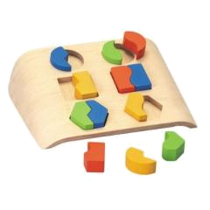
This week on:
More Pattern Matching

Slide 9
Extracting part of a pattern
We can extract parts of the pattern by parentheses:
$line = "1.35";
if ($line =~ m/(\d+)\.(\d+)/ ) {
print "$1\n"; 1
print "$2\n"; 35
}

Slide 10
Extracting part of a pattern
We can extract parts of the string that matched parts of the pattern that are marked by parentheses:
my $line = " CDS 87..1109";
if ($line =~ m/CDS\s+(\d+)\.\.(\d+)/ ) {
print "regexp:$1,$2\n"; regexp:87,1109
my $start = $1;
my $end = $2;
}

Slide 11
Finding a pattern in an input file
Usually, we want to scan all lines of a file, and find lines with a specific pattern. E.g.:
my ($start,$end);
foreach $line (@lines) {
if ($line =~ m/CDS\s+(\d+)\.\.(\d+)/ ) {
$start = $1; $end = $2;
...
...
}
}

Slide 12
Extracting part of a pattern
We can extract parts of the string that matched parts of the pattern that are marked by parentheses. Suppose we want to match
both $line = " CDS complement(4815..5888)";
and $line = " CDS 6087..8109";
if ($line =~ m/CDS\s+(complement\()?((\d+)\.\.(\d+))\)?/ ) {
print "regexp:$1,$2,$3,$4.\n";
$start = $3; $end = $4;
}
Use of uninitialized value in concatenation...
regexp:,6087..8109,6087,8109.

Slide 13
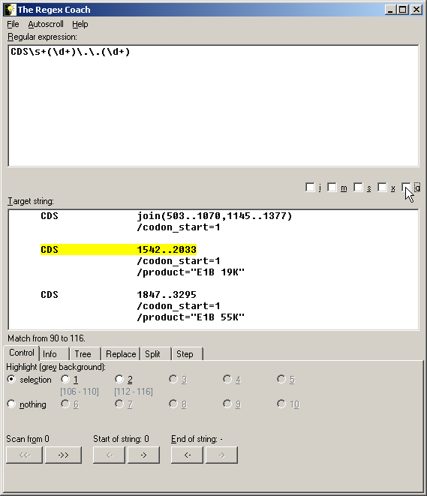
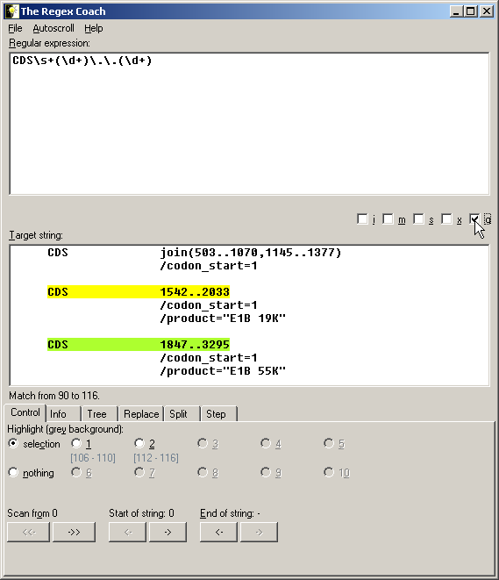
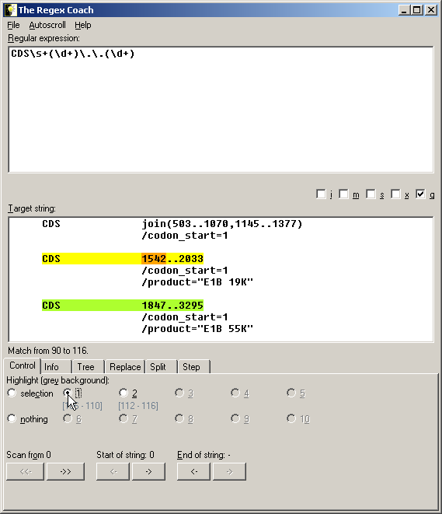
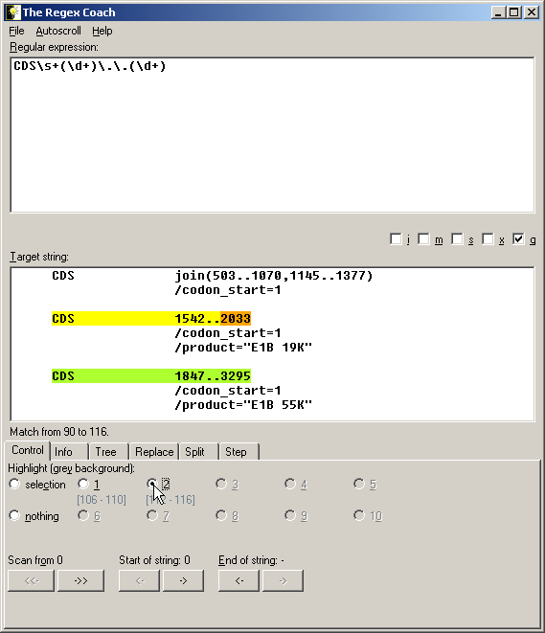

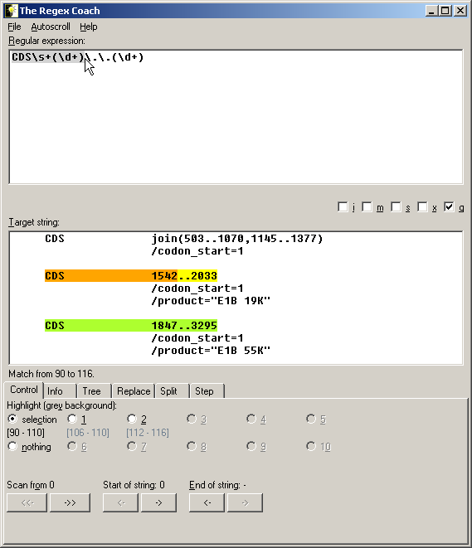
More RegEx Coach
Use the i and g tick box as m//i and m//g
The 1, 2 ..10 buttons, to see what is expected to enter $1, $2 .. $10
In selection mode you can see the match to your selection

Slide 14
Class exercise 7a
Write a script that extracts and prints the following features from a Genbank record of a genome (Use the example of an adenovirus genome which is available from the course site)
Find lines of protein_id in that file and extract the ids (add to previous script)
Example: from the line:
' /product="E1B 19K"'
Extract and print E1B 19K
Find the JOURNAL lines and print only the publication year
Example: from the line:
' JOURNAL J. Gen. Virol. 84 (Pt 11), 2895-2908 (2003)'
Extract and print 2003
3*. Find lines of coding sequence annotation (CDS), extract and print the separate coordinates (get each number into a separate variable) Try to match all CDS lines. (This question is in home ex. 4)

Slide 15
Enforce word start/end
We could enforce a word boundary, similar to enforcing line start/end with ^ and $:
m/\bJovi/ will match “Jovi” and “bon Jovi” but not “bonJovi”
m/fred\b/ will match “fred” and “fred.” but not “fredrick”
\B is the reverse – m/fred\B/ will match “fredrick” and “milfred” but not “fred”

Slide 16
Patterns are greedy
If a pattern can match a string in several ways, it will take the maximal substring:
$line = "fred xxxxxxxxxx john";
$line =~ s/x+/@/;
will become “fred @ john” and not “fred @xxxxx john”
You can make a minimal pattern by adding a ? to any of */+/?/{}:
$line = "fred xxxxxxxxxx john";
$line =~ s/x+?/@/;
Only one x will be replaced: “fred @xxxxxxxxx john”

Slide 17
Patterns are greedy
If a pattern can match a string in several ways, it will take the maximal substring:
$line = " JOURNAL J. Virol. 68 (1), 379-389 (1994)";
$line =~ m/^\s*JOURNAL.*\((\d+)\)/;
$1 is "1994";
Using the minimal pattern by adding a ?:
$line = " JOURNAL J. Virol. 68 (1), 379-389 (1994)";
$line =~ m/^\s*JOURNAL.*?\((\d+)\)/;
$1 is "1";

Slide 18
Multiple choice (or)
If one of several patterns may be acceptable in a pattern, we can write:
m/CDS\s(\d+\.\.\d+|\d+-\d+|\d+,\d+)/
Note: similar to m/CDS\s\d+(\.\.\|-|,)\d+/
will match “CDS 231..345”, “CDS 231-345” and “CDS 231,345”
Note: here $1 will be “231..345”, “231-345” or “231,345”, respectively

Slide 19
Variables in patterns
Variables can be interpolated into regular expressions, as in double-qouted strings:
$name = "Yossi";
$line =~ m/^$name\d+/
This pattern will match:
"Yossi25", "Yossi45"
Special patterns can also be given in a variable: If $name was "Yos+i"
then the pattern could match:
"Yosi5" and "Yossssi5"

Slide 20
Variables in patterns
Say we need to search some blast output:
ref|NT_039621.4|Mm15_39661_34 Mus musculus chromosome 15 genomic... 186 1e-45
ref|NT_039353.4|Mm6_39393_34 Mus musculus chromosome 6 genomic c... 38 0.71
ref|NT_039477.4|Mm9_39517_34 Mus musculus chromosome 9 genomic c... 36 2.8
ref|NT_039462.4|Mm8_39502_34 Mus musculus chromosome 8 genomic c... 36 2.8
for the score of a hit that is named by the user.
We can write:
m/^ref|$hitName.*(\d+)\s+\S+\s*$/
If $hitName was "NT_039353",
we get $1 = 38

Slide 21
split (revisited)
The split function actually treats its first parameter as a regular expression:
$line = "13 5;3 -23 8";
@numbers = split(/\s+/, $line);
print "@numbers";
13 5;3 -23 8

Slide 22
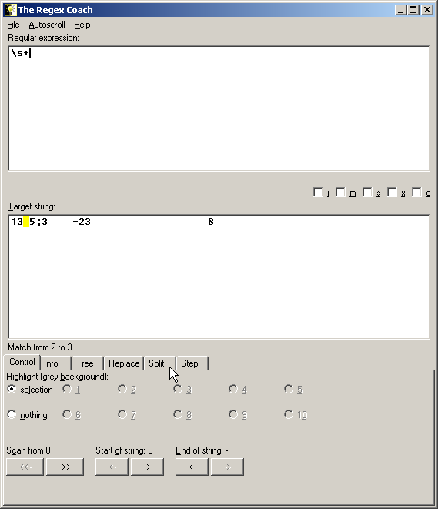
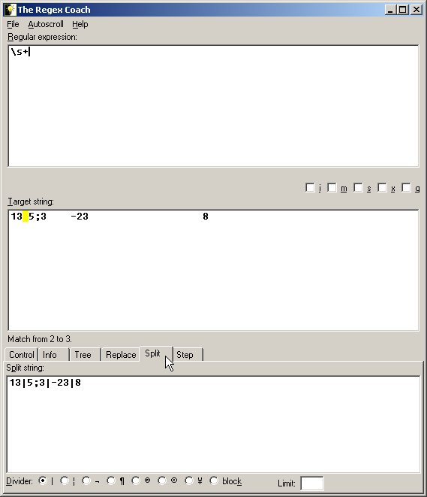

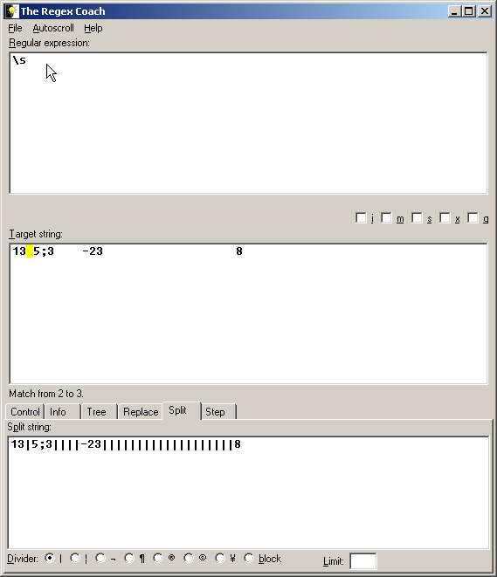
More RegEx Coach
Choose the split window in the Regex Coach to see how the string will be spitted
Split is marked by |

Slide 23
Global matching for repetitive patterns
All the matches from $1, $2, .. can be saved in an array:
$line = 4815-5781,5825-6153;
@arr = m/(\d+-\d+)/;
@arr is “("4815-5781")
@arr = m/(\d+)-(\d+)/;
@arr is “("4815", "5781")

Slide 24
Global matching for repetitive patterns
All the matches from $1, $2, .. can be saved in an array:
$line = 4815-5781,5825-6153;
@arr = m/(\d+-\d+)/g;
@arr is “("4815-5781", "5825-6153")
@arr = m/(\d+)-(\d+)/g;
@arr is “("4815", "5781", "5825", "6153")
This can be very useful for finding repetitive pattern in a sequence.
Global matching: all instances in lines will be matched

Slide 25
Using memories in substitution
The extracted parts of the pattern can be used inside a substitution:
$line = " CDS 4815..5888";
$line =~ s/(\d+)\.\.(\d+)/\1-\2/ );
CDS 4815-5888
$line = "I'm John Lennon";
$line =~ s/([A-Z][a-z]+)\s+([A-Z][a-z]+)/\1_\2/ );
I'm John_Lennon
\1 same as $1

Slide 26
Using memories in substitution
The pattern extracted can be use in substitution
$line = " CDS 4815..5888";
$line =~ s/(\d+)\.\.(\d+)/\2..\1/;
$line is :" CDS 5888..4815"
$line = " CDS join(24763..25078,25257..25558)";
$line =~ s/(\d+)\.\.(\d+)/\2..\1/g;
$line is :" CDS join(25078..24763,25558..25257)"

Slide 27
Using memories in matching
The extracted parts can also be used inside the same match:
m/(\d+)-(\d+),\2-\d+/
will match “4815-5781,5781-6153”
but not “4815-5781,5825-6153”
m/(.)\1+/
will match any character that is repeated at least twice
$line = "kasjfjjjjsja";
if ($line =~ m/((.)\2+)/) {
print "regexp: $1, $2\n";
}
regexp: jjjj, j
only \2 (not $2) will get the current extracted pattern

Slide 28
Position of match
Perl saves the positions of matches in the special arrays @- and @+
The variables $-[0] and $+[0]are the start and end of the entire match
The rest hold the starts and ends of the memories (brackets):
3 10 14 16 20
$line = " CDS 4815..5888";
$line =~ m/CDS\s+(\d+)\.\.(\d+)/;
print " starts: @- \n ends: @+ \n";
starts: 3 10 16
ends: 20 14 20

Slide 29
Transliterate
A special type of substitution allows to “Transliterate” (i.e. replace) a set of characters to different set:
$seq = "AGCATCGA";
$seq =~ tr/ATGC/TACG/;
$seq is now "TCGTAGCT"
(What is the next step in order to get the reverse complement of the sequence?)
NOTE: each single character in “from” is replaced by its corresponding character in “to”
Guess what this will do:
$lines =~ tr/A-Z/a-z/);
(Change all letters to small ones)
from
to

Slide 30
Transliterate
You can get the number of changes as a return value of tr///:
$seq = "AGCATCAG";
$count = ($seq =~ tr/GC/CG/);
$count is 4
$seq is "ACGATGAC";
$count = ($sky =~ tr/*/*/);
Count the stars in $sky

Slide 31
Class exercise 7b
1. Get from the user a DNA sequence and change every A and G to U (pUrines) and every C and T to Y (pYrimidines).
2. Like question 1, but in addition print the number of pyrimidines (Cs and Ts)
Continuing with the GenBank record of the adenovirus genome:
3. Get a journal name and the year of publication from the user (using <STDIN>), find this paper in the adenovirus record and print the JOURNAL line.
For example if the user types "J. Virol." and "1994"
print: "J. Virol. 68 (1), 379-389 (1994)"
but not: "J. Virol. 67 (2), 682-693 (1993)"
4**. Get the first and last names of an author from the user, find the paper in the adenovirus record and print the year of publication. For example if the user types "Kei Fujinaga",
print: "1981"

