Slide 1
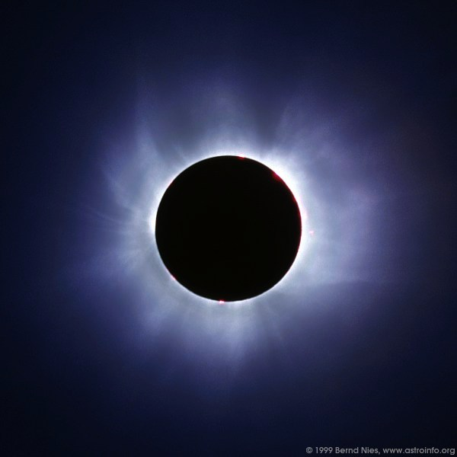
Eclipse

Slide 2
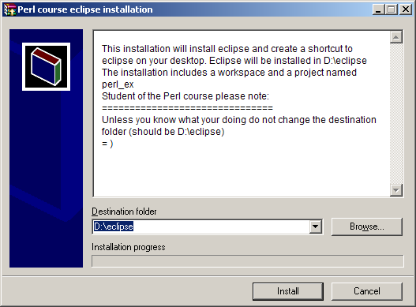
Installing Eclipse
Download the eclipse.installation.exe from the course web site to your computer and execute it.
Keep the destination folder 'D:\eclipse' and install (will take some time…)

Slide 3
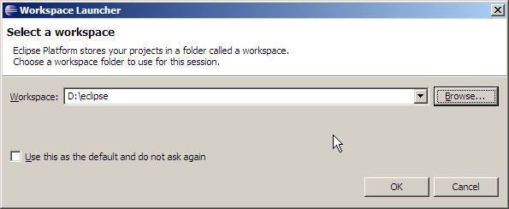
working with Eclipse
Execute D:\eclipse\eclipse.exe
Keep the workspace at 'D:\eclipse' and press 'OK'

Slide 4
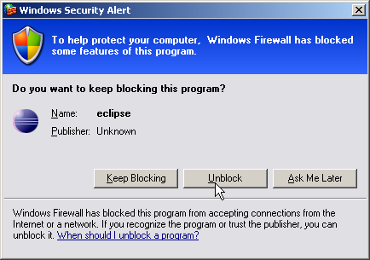
working with Eclipse
If you are asked by your firewall, unblock eclipse (it uses certain ports to connect with certain parts of Perl).

Slide 5
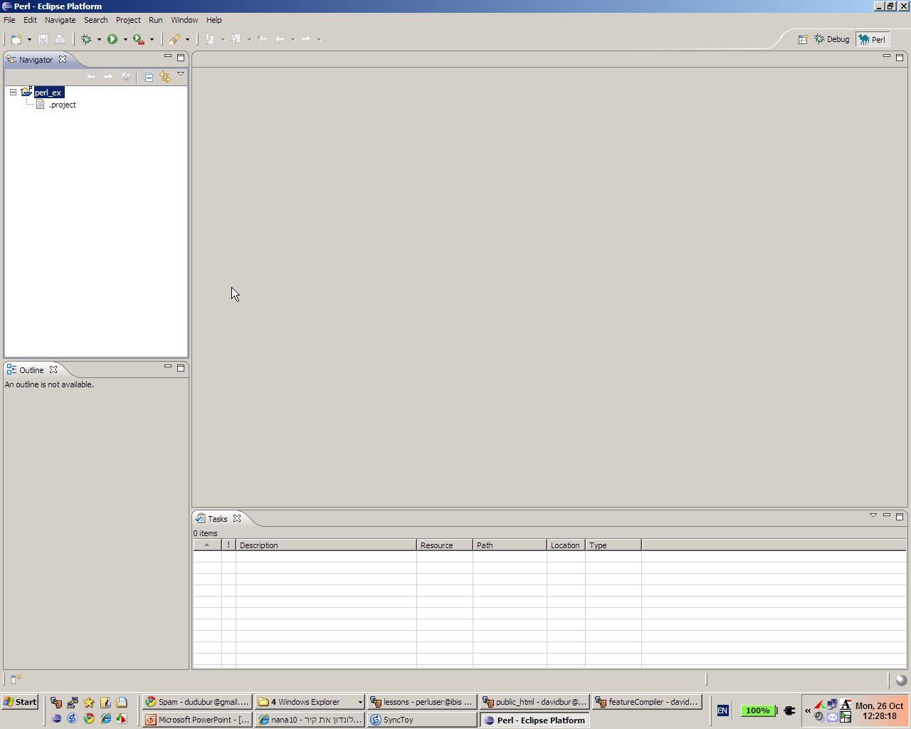
working with Eclipse
Your screen should look something like this

Slide 6
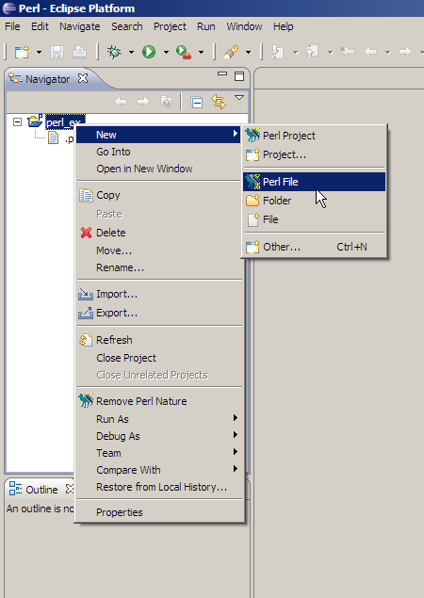
working with Eclipse
Right-click perl_ex on the navigator panel, choose:
new → Perl File

Slide 7
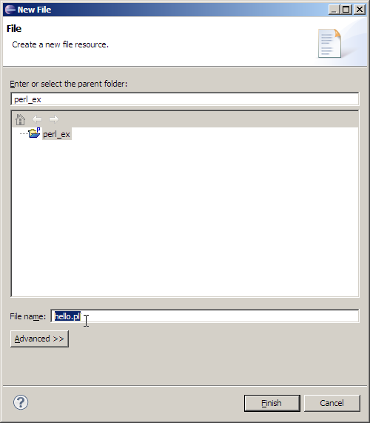
working with Eclipse
Type the name of the file in the "File name" box on the bottom of the window

Slide 8
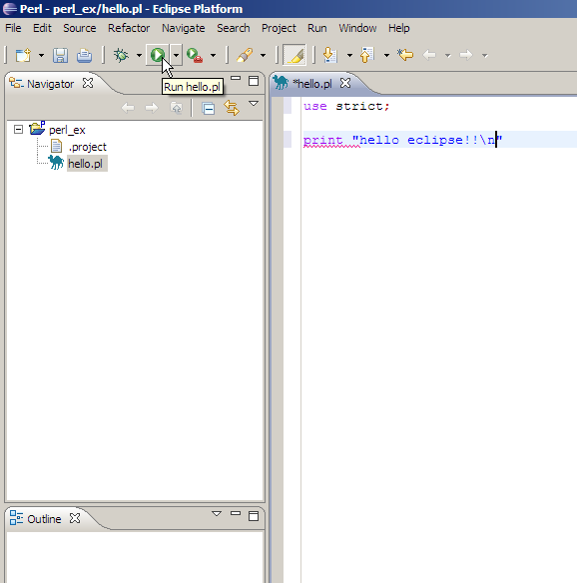
working with Eclipse
In the newly opened window, right your perl script.
When your done hit the
Run button
(or press ctrl-F11)

Slide 9
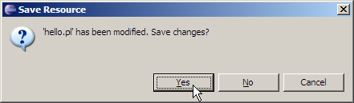
working with Eclipse
Confirm the Save

Slide 10
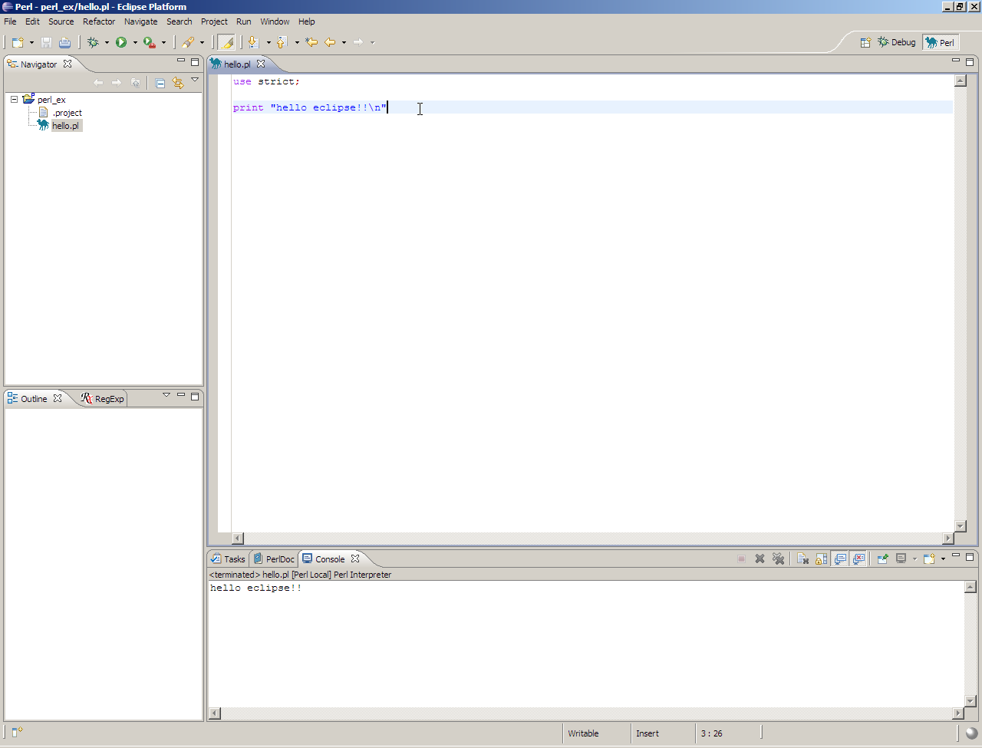
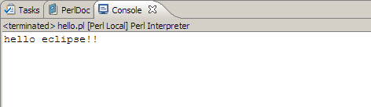
working with Eclipse
The output will appear at the bottom of the screen.
Success!

Slide 11
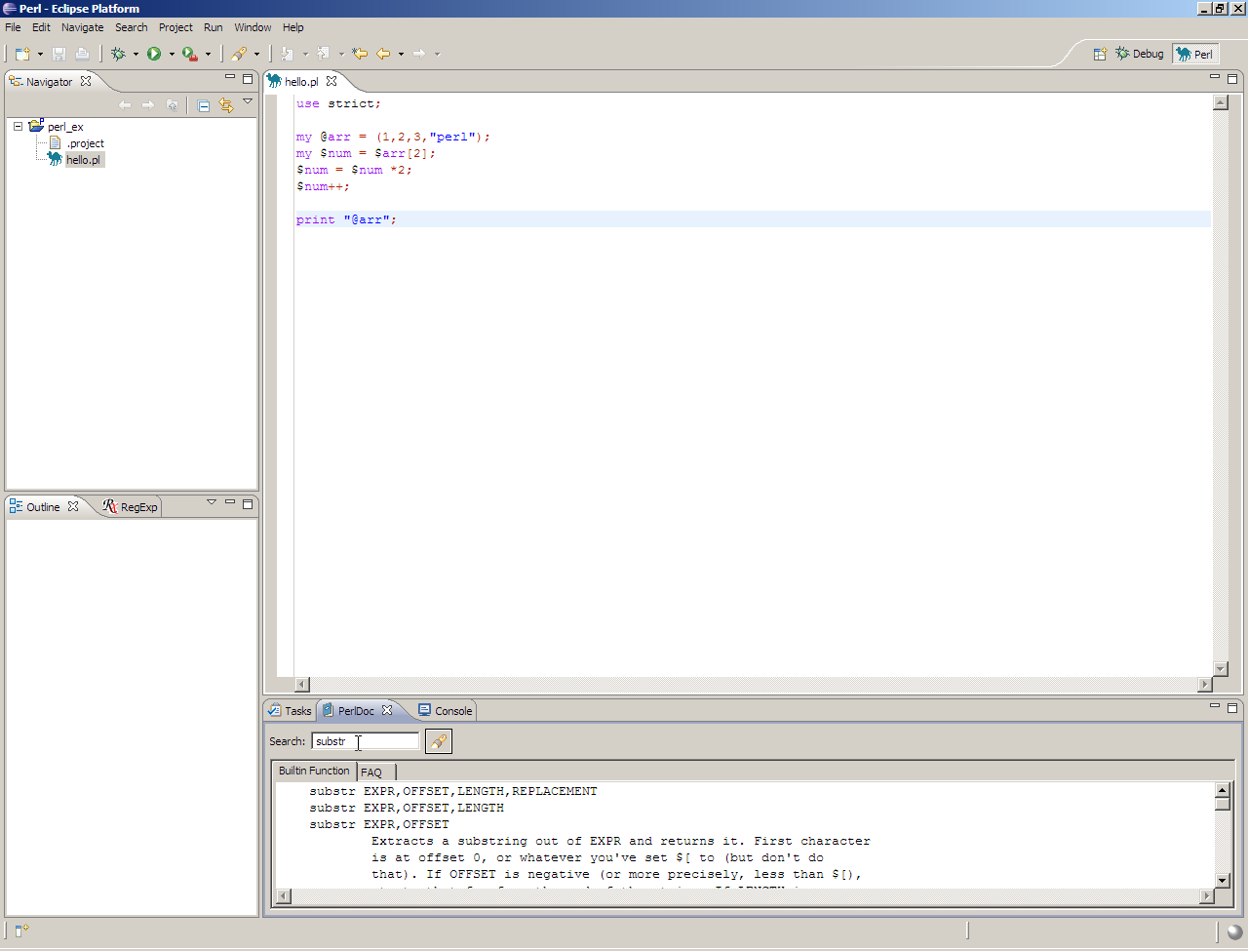
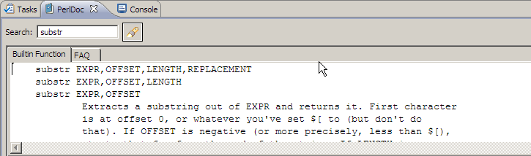
working with Eclipse
Also note a little pinuk:
At the bottom you have a 'PerlDoc' tab that contains information about all of Perl's functions (and much more)

Slide 12
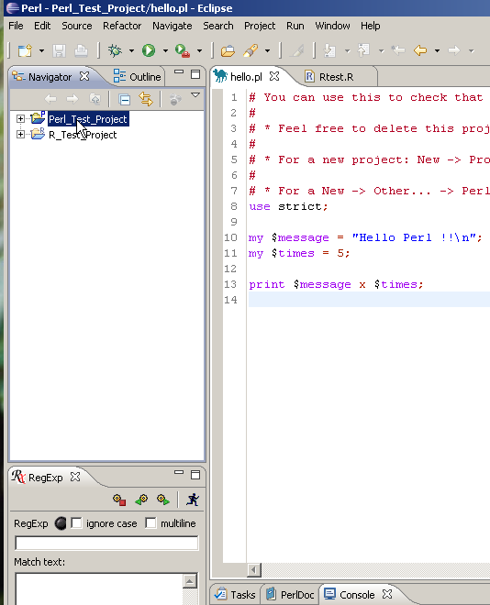
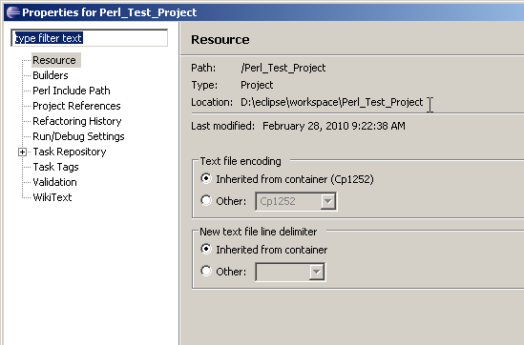
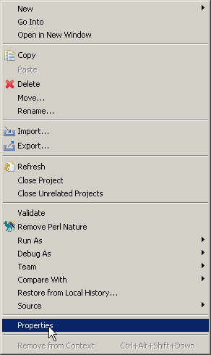
Where are my files ????
Right click on a file/folder/project and click on properties to find its location on your computer.

Slide 13
Eclipse class exercise 1
Create in Eclipse a new Perl script, copy to it your solution to class exercise 3a question 1, and run in from Eclipse.

Slide 14
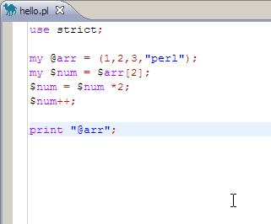
Debugging with Eclipse
Consider the following code…

Slide 15
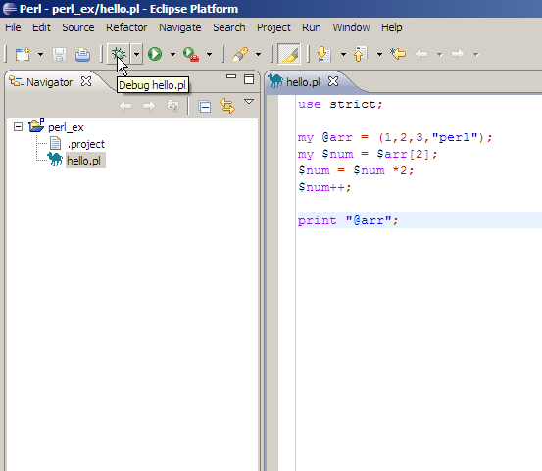
Debugging with Eclipse
Press the Debug button (or hit F11)

Slide 16
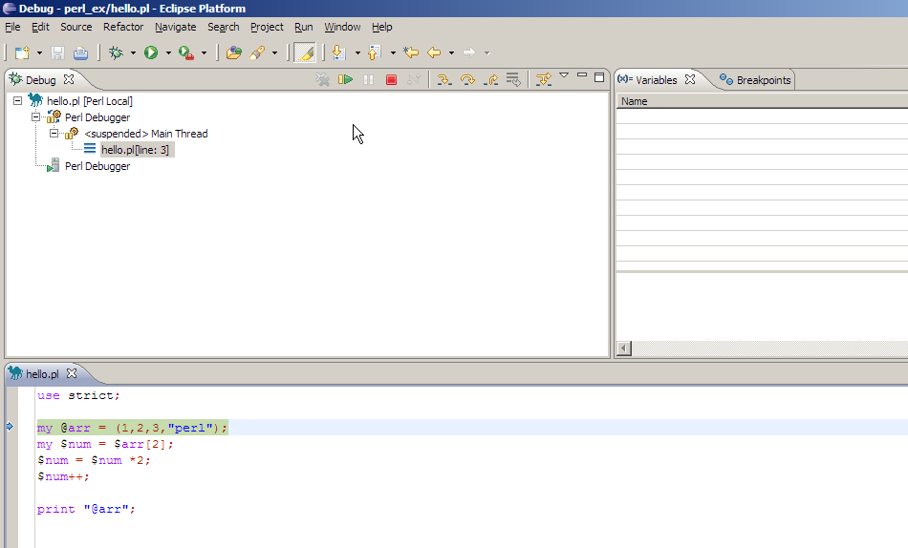
Debugging with Eclipse
You will reach this screen:

Slide 17
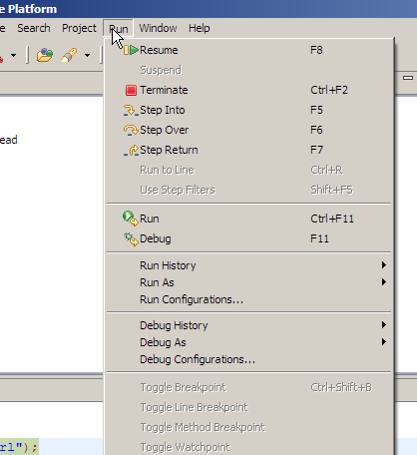
Debugging with Eclipse
Use the Run menu or the panel at the top of the Debug screen (or the keyboard shortcut) to proceed.
At your first try you click F6 or the Stop over button and see the values of the variable change as you proceed…

Slide 18
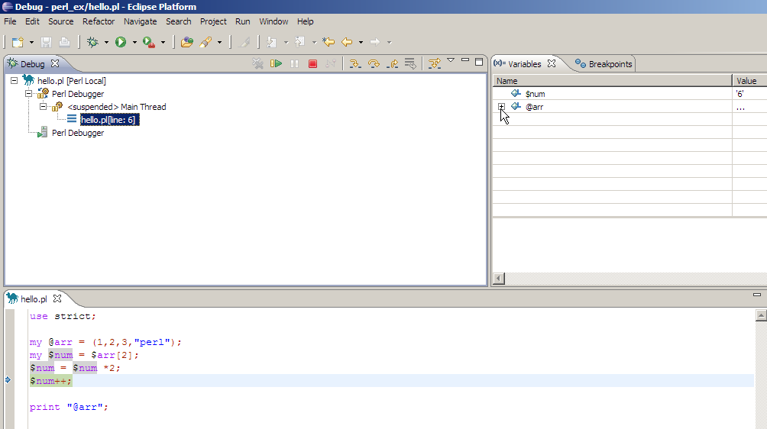
Debugging with Eclipse
The little arrow next to the code specify the line that is being processed
On the top right window you can see the values of the variables.

Slide 19
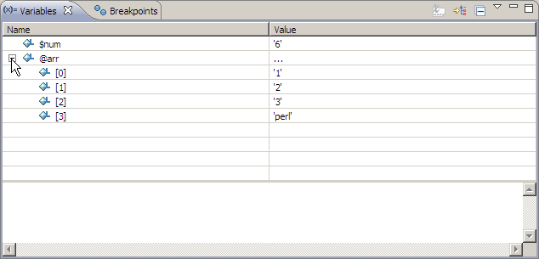
Debugging with Eclipse
Pressing the little '+' sign next to the array name will expand it and display its values.

Slide 20
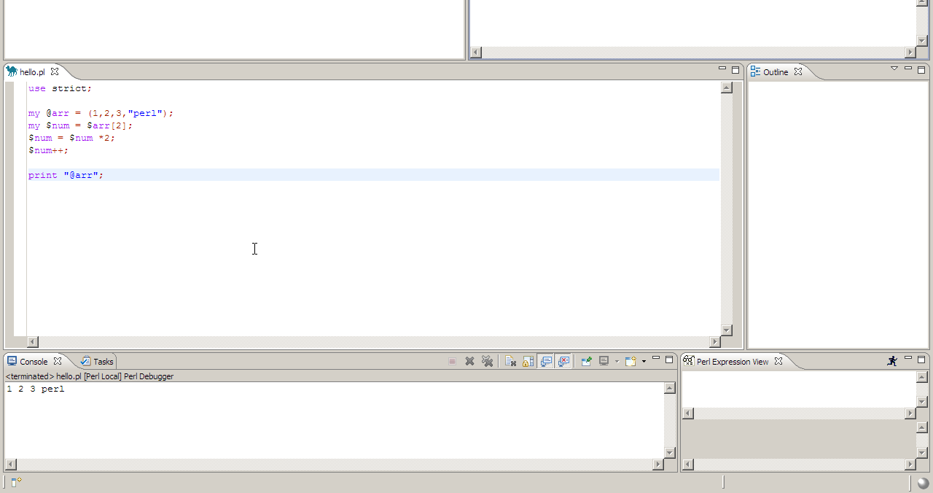
Debugging with Eclipse
As before – the output will be displayed on the bottom of the screen (in the console window).

Slide 21
Debugging with Eclipse
The little arrow next to the code specify the line that is being processed
On the top right window you can see the values of the variables.

Slide 22
Eclipse class exercise 2
Follow the working of the script from class exercise 3a question 1 in Eclipse debugger. Watch the value of each variable.

Slide 23
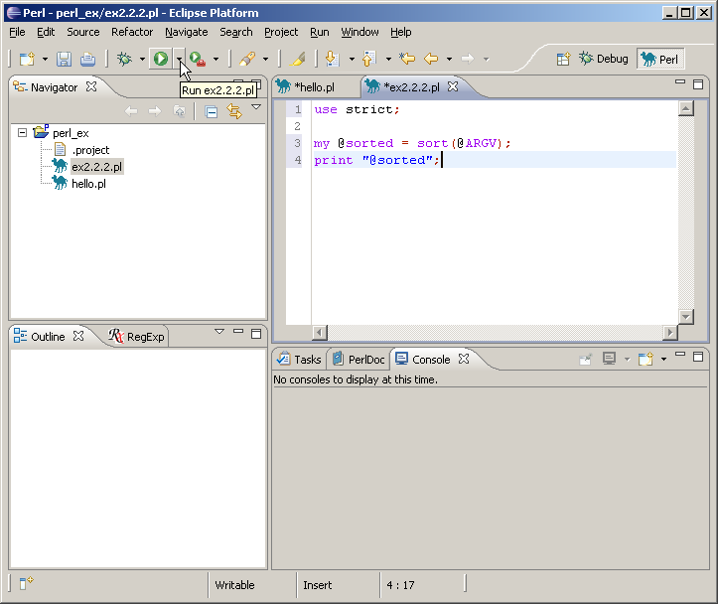
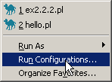
Command line arguments in Eclispe

Slide 24
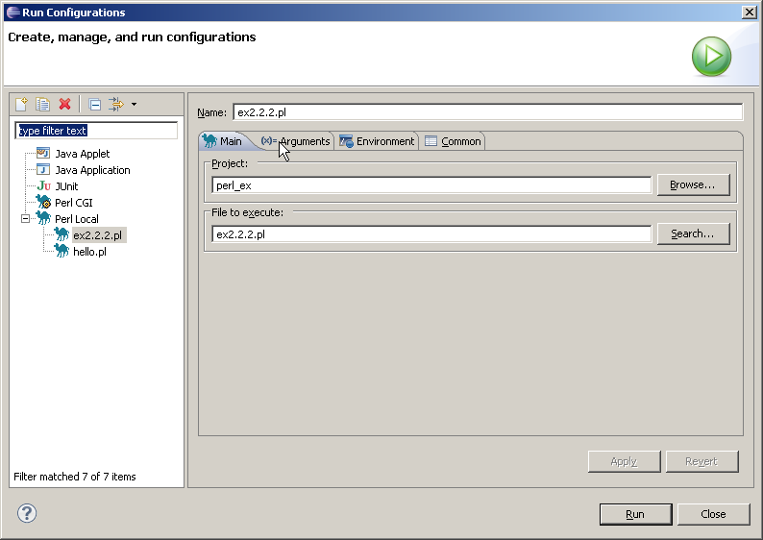
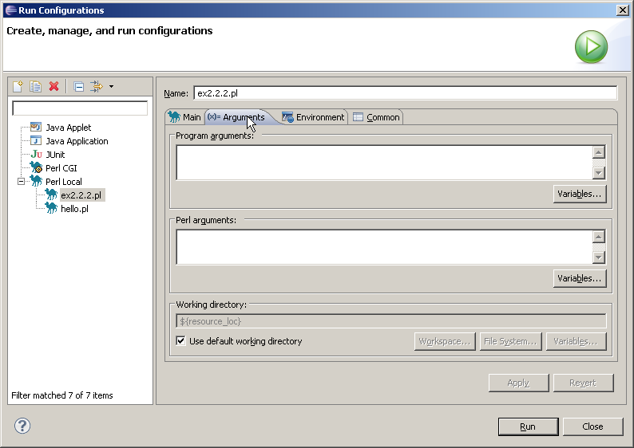
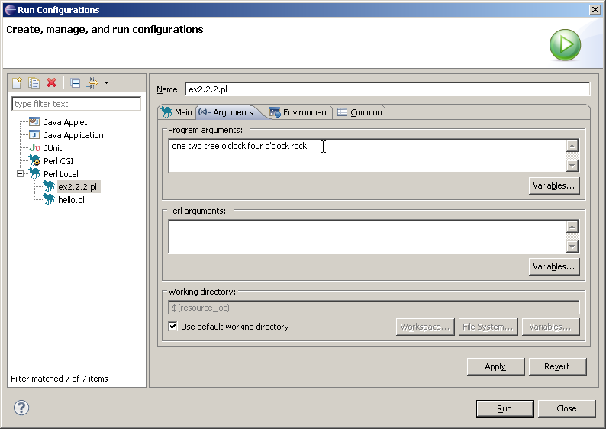

Command line arguments in Eclispe

Slide 25
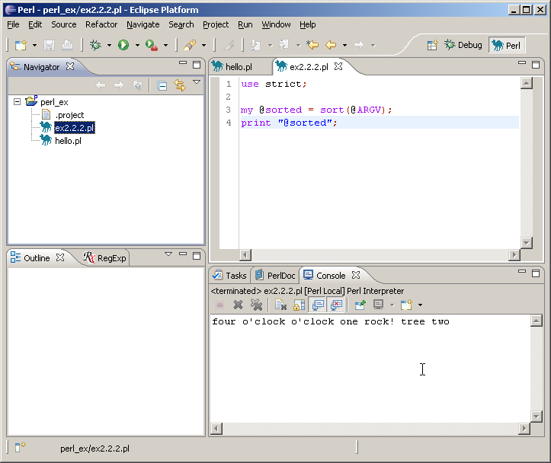
Command line arguments in Eclispe

Slide 26
Eclipse class exercise 3
Follow the working of the script from class exercise 3b question 1 in Eclipse debugger.
Pass the argument using "run configuration…".

