Slide 1
Variable types in PERL
Scalar
Array
Hash
$hash{key}
$number
-3.54
%hash
@array
=>
$string
"hi\n"
=>
$array[0]
=>

Slide 2
Hash – an associative array
An associative array (or simply – a hash) is an unordered set of pairs of keys and values. Each key is associated with a value.
A hash variable name always start with a “%”:
my %hash;
Initialization:
%hash = ("a"=>5, "bob"=>"zzz", 50=>"John");
Accessing:
you can access a value by its key:
print $hash{50}; John
modifying :
$hash{bob} = "aaa"; (modifying an existing value)
adding :
$hash{555} = "z"; (adding a new key-value pair)
%hash
"a"
=>
5
"bob"
=>
"zzz"
50
=>
"John"

Slide 3
Iterating over hash elements
%hash
It is possible to get a list of all the keys in %hash
my @hashKeys = keys(%hash);
Similarly you can get an array of the values in %hash
my @hashVals = values(%hash);
"a"
=>
5
"bob"
=>
"zzz"
50
=>
"John"
@hashKeys
@hashVals
"a"
"bob"
50
5
"zzz"
"John"

Slide 4
Hash within Hash
You can use combinations of hashes (and arrays) together to construct more complex data structures.
If the information is best represented in two levels it is useful to use a hash within a hash:
my %hash;
$hash{Key_level_1}{Key_level_2};

Slide 5
Hash within Hash
For example: for each name in the phone book, we want to store both the phone number and the address:
my %phoneBook;
$phoneBook{'Dudu'}{'Phone'} = "09-9545995";
$phoneBook{'Dudu'}{'Address'} = "115 Menora St., Hulun";
$phoneBook{'Ofir'}{'Phone'} = "054-4898799";
$phoneBook{'Ofir'}{'Address'} = "31 Horkanus St., Eilat";

Slide 6
Class exercise 10a
1. Write a script that reads a file with a list of protein names, lengths and location:
AP_000081 181 Nuc
AP_000174 104 Cyt
AP_000138 145 Cyt
and stores the names of the sequences as hash keys, and use "length" and "location" as keys in an internal hash for each protein.
For example:
$proteins{"AP_000081"}{"length"} should be 181
$proteins{"AP_000081"}{"location"} should be "Nuc"
2. Use the phoneBook.pl example and change it such that for each name in the phone book, the user enters the following data:
» Phone number » Address » ID number
a. In the input section: ask for a name and it's corresponding
phone, address and ID.
b. In the retrieval section: ask for a name and a data type, print the
requested detail associated with the given name (e.g. Dudu's phon
number).

Slide 7
References and complex data structures

Slide 8
References
A reference to a variable is a scalar value that “points” to the variable:
$nameRef = \$name;
@grades = (85,91,67);
$gradesRef = \@grades;
$phoneBookRef = \%phoneBook;
$nameRef
$name
$gradesRef
@grades
$phoneBookRef
%phoneBook
=>
=>
=>

Slide 9
References
A reference to a variable is a scalar value that “points” to the variable:
$nameRef = \$name;
@grades = (85,91,67);
$gradesRef = \@grades;
$phoneBookRef = \%phoneBook;
We can make an anonymous reference without creating a variable with a name:
[ITEMS] creates a new, anonymous array and returns a reference to it;
{ITEMS} creates a hash:
$arrayRef = [85,91,67];
$hashRef = {85=>4,91=>3};
(These are variables with no variable name)
$gradesRef
@grades
$arrayRef

Slide 10
De-referencing
$nameRef = \$name;
$gradesRef = \@grades;
$phoneBookRef = \%phoneBook;
print $gradesRef; ARRAY(0x225d14)
To access the data from a reference we need to dereference it:
print $$nameRef; Yossi
print "@$gradesRef"; 85 91 67
$$gradesRef[3] = 100;
print "@grades"; 85 91 67 100
$phoneNumber = $$phoneBookRef{"Yossi"};
$gradesRef
@grades
100 was added to the original array @grades!

Slide 11
De-referencing
$gradesRef = \@grades;
$phoneBookRef = \%phoneBook;
print "@$gradesRef"; 85 91 67
$$gradesRef[3] = 100;
$phoneNumber = $$phoneBookRef{"Yossi"};
The following notation is equivalent, and sometimes it is more readable:
$gradesRef->[3] = 100;
$phoneNumber = $phoneBookRef->{"Yossi"};
$gradesRef
@grades

Slide 12
References allow complex structures
- hash within hash
Because a reference is a scalar value, we can store a reference to an hash in as an element in another hash:
my %phoneBook;
my %dudu = ('Phone' => "09-9545995",
'Address' => "Hulun");
$phoneBook{'dudu'} = \%dudu;
Or with an anonymous hash:
$students{'Shmuel'} =
{'Phone' => "09-9585833",
'Address' => "Yavne"};
%phoneBook
NAME =>
{Phone => PHONE
Address => ADDRESS}
%phoneBook
=>
=>
=>
=>
=>
=>
=>
=>
=>

Slide 13
References allow complex structures
- hash within hash
Because a reference is a scalar value, we can store a reference to an hash in as an element in another hash:
my %phoneBook;
my %dudu = ('Phone' => "09-9545995",
'Address' => "Hulun");
$phoneBook{'dudu'} = \%dudu;
Now the key “dudu” is paired to a reference value:
print $phoneBook{"dudu"}; HASH(0x22e714)
print "%{$phoneBook{"dudu"}}"; Phone09-9545995AddressHulun
print ${$phoneBook{"dudu"}}{"Phone"}; 09-9545995
print $phoneBook{"Yossi"}->{"Phone"}; 09-9545995
This form is more readable, we strongly recommend it…
%phoneBook
NAME =>
{Phone => PHONE
Address => ADDRESS}
%phoneBook
=>
=>
=>

Slide 14
References allow complex structures
- array within hash within hash…
Now we can do it: “how to keep the phone number, address and list of grades for each student in a course?”
$phoneBook{"dudu"} =
{"Phone"=>3744,
"Address"=>"34 HaShalom St.",
"Grades"=>[93,72,87]};
print $phoneBook{"dudu"}->{"Grades"}->[2];
87
It is more convenient to use a shorthand notation:
print $phoneBook{"dudu"}{"Grades"}[2]
But remember that there are references in there!
%phoneBook
NAME =>
{"Phone" => PHONE
"Address" => ADDRESS
"Grades" => [GRADES]}
%phoneBook
=>
=>
=>
=>
=>
=>
=>
=>
=>
=>
=>
=>
Notes:
לתת דוגמא עם HASH
מוכן שעושים אליו REF

Slide 15
References allow complex structures
The following code is an example of iterating over two levels of the structure –
The top hash (each student)
and the internal arrays (lists of grades):
foreach my $name (keys(%students)) {
foreach my $grade (@{$students{$name}->{"grades"}}) {
print $grade;
}
}
%students
NAME =>
{"phone" => PHONE
"address" => ADDRESS
"grades" => [GRADES]}
%students
=>
=>
=>
=>
=>
=>
=>
=>
=>
=>
=>
=>

Slide 16
The REUSED_ADDRESS problem
When building a complex data structure in some loop (for example) you may come across a problem if you insert a non-anonymous array or hash into the data structure:
my ($line, $id, @grades, %students);
while ($line = <IN>) {
...
@grades = ...
$students{$id} = \@grades;
}
Let’s see what happens when we enter the lines:
a 86 73 89
b 79 90 87
c 100 90 93
This is the address (memory allocation)
This is the re-use
Notes:
Sorry about that…

Slide 17
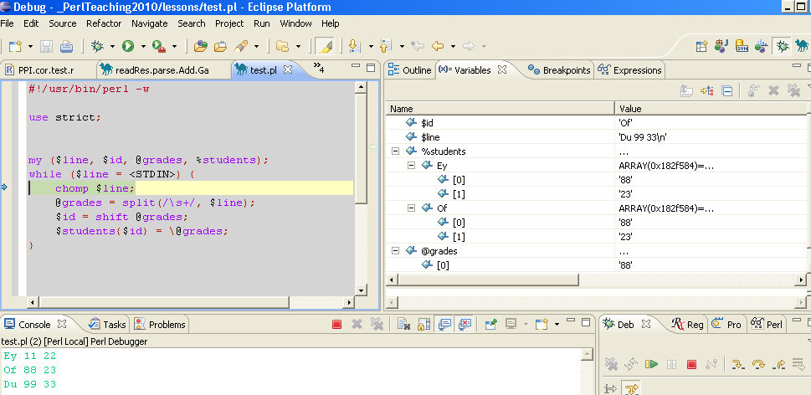
The REUSED_ADDRESS problem
The debugger will show you that there is a problem:

Slide 18
The REUSED_ADDRESS problem
The problem is that for every student we store a reference to the same array.
We have to create new array in every iteration:
1. We could declare (with my) the array inside the loop, so that a new one is created in every iteration:
while ($line = <IN>) {
my @grades = ...
$students{$id} = \@grades;
}
2. Or, use an anonymous array reference:
$students{$id} = [$grade1, $grade2];
or:
$students{$id} = [@grades];
Re-allocate memory
(Note: You may have this problem with the multiple #RP fields in ex5.5)

Slide 19
Class exercise 10b
Read the adenovirus genome file and build a hash of genes, where the key is the "product" name: For each gene store a hash with the protein ID. Print all keys (names) in the hash.
%genes
PRODUCT =>
{"protein_id" => PROTEIN_ID
"strand" => STRAND
"CDS" => [START, END]}
%genes
PRODUCT =>
{"protein_id" => PROTEIN_ID
"strand" => STRAND}
%genes
PRODUCT =>
{"protein_id" => PROTEIN_ID}
Add to the hash the strand of the gene on the genome: “+” for the sense strand and “-” for the antisense strand. Print all antisense genes.
Add to the hash an array of two coordinates – the start and end of the CDS. Print genes shorter than 500bp.
4. Print the product name of all genes on the sense strand whose CDS spans more than 1kbp, and all genes on the antisense strand whose CDS spans less than 500bp.

