Slide 1

Subroutines

Slide 2

Functions
A function is a portion of code that performs a specific task.
Functions we've met:
$newStr = substr ($str,1,4);
@arr = split (/\t/,$line);
push (@arr, $num);
Takes a string and returns a sub-string
Splits a line into an array
Pushes a scalar to the end of an array

Slide 3
Functions
A function is a portion of code that performs a specific task.
Functions have arguments and return values:
$start = substr ($str,1,4);
Return value:
This function returns a string
Arguments:
(EXPR, OFFSET, LENGTH)

Slide 4
Subroutines
A subroutine is a user-defined function.
sub SUB_NAME {
# Do something
...
}
sub printHello {
print "Hello World!\n";
}
sub bark {
print "Woof-woof\n";
}
Subroutines can be placed anywhere, but are usually stacked together at the beginning or the end

Slide 5
Subroutines
To invoke (execute) a subroutine:
SUB_NAME(ARGUMENTS);
For example:
bark();
Woof-woof
print reverseComplement("GCAGTG");
CACTGC

Slide 6
Why use subroutines?
Code in a subroutine is reusable.
For example: a subroutine that reverse-complement a DNA sequence
A subroutine can provide a general solution for different situations.
For example: read a FASTA file
Encapsulation: A well defined task can be done in a subroutine, making the main script simpler and easier to read and understand.
Notes:
Reusable: it can be invoked from several points in the script, no code duplication

Slide 7

Why use subroutines? - Example
my filename = $ARGV[0];
# Read fasta sequence from file
$seq = readFastaFile($fileName);
# Reverse complement the sequence
$revSeq = reverseComplement($seq);
# Print the reverse complement in fasta format
printFasta($revSeq);
# Subroutines definition...
....
A general solution: works with different files
Can be invoked from many points in the code
And the program is beautiful

Slide 8
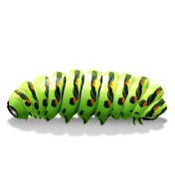
Why use subroutines? - Example
# Read fasta sequence from file
open (IN, "<$filename") or die "Can't open file";
my @lines = <IN>;
chomp @lines
my ($seq, $line);
foreach my $line (@lines) {
if ($line =~ m/^>/) {next;}
$seq = $seq.$line;
}
close (IN);
# Reverse complement the sequence
$seq =~ tr/ACGTacgt/TGCAtgca/;
$revSeq =~ reverse ($seq);
# Print the reverse complement in fasta format
my $i = 0;
while (($i+1) * 75 < length ($revSeq)) {
my $fastaLine = substr($revSeq, $i * 75, 75);
print $fastaLine."\n";
$i++;
}
$fastaLine = substr($revSeq, $i*75);
print $fastaLine."\n"
Much better than this

Slide 9
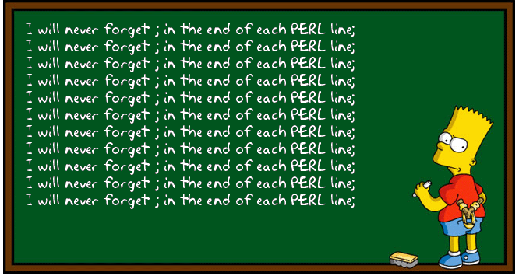
Subroutine arguments
A subroutine may be given arguments through the special array variable @_:
my $bart4today = "I do not have diplomatic immunity";
bartFunc($bart4today ,100);
sub bartFunc {
my ($string, $times) = @_;
print $string x $times;
}
We pass arguments to the subroutine
Inside the subroutine block they are saved in the special array @_
I do not have diplomatic immunity
I do not have diplomatic immunity
I do not have diplomatic immunity
I do not have diplomatic immunity
...

Slide 10
Return value
Definition:
sub reverseComplement {
my ($seq) = @_;
$seq =~ tr/ACGT/TGCA/;
$seq = reverse $seq;
return $seq;
}
Usage:
my $revSeq = reverseComplement("GCAGTG"); CACTGC
The return statement ends the execution of the subroutine and returns a value.

Slide 11
Return value
Definition:
sub reverseComplement {
my ($seq) = @_;
$seq =~ tr/ACGT/TGCA/;
$seq = reverse $seq;
return $seq;
print "I am the walrus!"
}
Usage:
my $revSeq = reverseComplement("GCAGTG"); CACTGC
Everything after the return statement will be ignored

Slide 12
Return value
Definition:
sub reverseComplement {
my ($seq) = @_;
$seq =~ tr/ACGT/TGCA/;
$seq = reverse $seq;
}
Usage:
my $revSeq = reverseComplement("GCAGTG"); CACTGC
If there is no return statement, the value of the last statement in the subroutine is returned.

Slide 13
Return list
A subroutine may also return an list value:
sub integerDivide {
my ($a,$b) = @_;
my $mana = int($a/$b);
my $sheerit = $a % $b;
return ($mana,$sheerit);
}
my ($mana,$sheerit) = integerDivide(7,3);
print "mana= $mana, sheerit= $sheerit";
mana= 2, sheerit= 1
Our subroutine returns a list of two elements.
We pass two arguments
And receive a list of two return values

Slide 14
Variable scope
When a variable is defined using my inside a subroutine:
* It does not conflict with a variable by the same name outside the subroutine
* It’s existence is limited to the scope of the subroutine
sub printHello {
my ($name) = @_;
print "Hello $name\n";
}
my $name = "Liko";
printHello("Emma");
print "Bye $name\n";
Hello Emma
Bye Liko

Slide 15
Class exercise 11a
Write a subroutine that takes two numbers and prints their sum to the screen (and test it with an appropriate script!).
Write a subroutine that takes two numbers and return a list of their sum, difference, and average.
For example:
@arr = numbersFunc(5,7);
print "@arr"; 12 -2 6
a. Write a subroutine that takes a sentence and returns the last word.
b.* Return the longest word!

Slide 16

Passing variables by reference
If we want to pass arrays or hashes to a subroutine, we should pass a reference:
Passing array references:
subRoutine (\@arr);
Passing hash references:
subRoutine (\%hash);
Arrays and hashes can be very big. That's why we want to pass a direct reference and not create a copy.

Slide 17
Passing variables by reference
If we want to pass arrays or hashes to a subroutine, we should pass a reference:
Passing array references:
subRoutine (\@arr);
Passing hash references:
subRoutine (\%hash);
Dereferencing arrays:
sub subRoutine {
my ($arrRef) = @_;
@arr = @{$arrRef};
...
Dereferencing hashes:
sub subRoutine {
my ($hashRef) = @_;
%hash = %{$hashRef};
...

Slide 18
Passing variables by reference
If we want to pass arrays or hashes to a subroutine, we should pass a reference:
my @pets = ('Liko','Emma','Louis');
printPets (\@pets);
sub printPets {
my ($petRef) = @_;
my @pets = @{$petRef};
foreach my $pet (@pets) {
print $pet."\n";
}
}
Reference to @pets
De-reference of $petRef

Slide 19
Passing variables by reference
If we want to pass arrays or hashes to a subroutine, we should pass a reference:
$gene{"protein_id"} = "E4a";
$gene{"strand"} = "-";
@CDS = (126,523);
$gene{"CDS"} = [@CDS];
printGeneInfo(\%gene);
sub printGeneInfo {
my ($geneRef) = @_;
my %gene = %{$geneRef};
print "Protein $gene{'protein_id'}\n";
print "Strand $gene{'strand'}\n";
print "From: $gene{'CDS'}[0] ";
print "to: $gene{'CDS'}[1]\n";
}
Reference to %gene
De-reference of $geneRef

Slide 20
Returning variables by reference
Similarly, to return a hash use a reference:
sub getGeneInfo {
my %geneInfo;
...
... (fill hash with info)
return \%geneInfo;
}
$geneRef = getGeneInfo(..);
In this case the hash will continue to exists outside the scope of the subroutine!
To dereference use:
my %geneHashInfo = %{$geneRef}

Slide 21
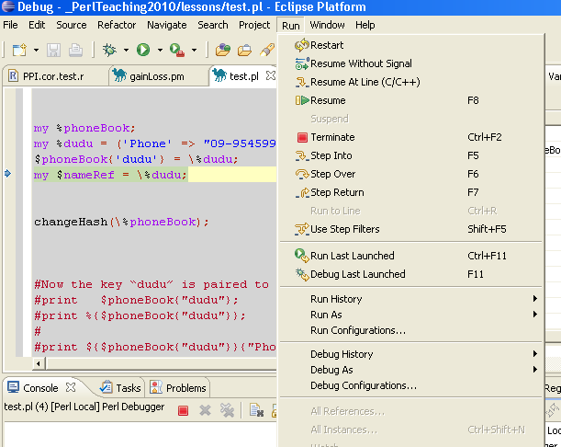
Debugging subroutines
Step into a subroutine (F5)
to debug the internal work of the sub
Step over a subroutine (F6)
to skip the whole operation of the sub
Step out of a subroutine (F7)
when inside a sub – run it all the way to
its end and return to the main script
Resume (F8)
run till end or next break point
Step into
Step over
Step out

Slide 22
Class exercise 11b
Write a subroutine that takes two numbers and return a list of their sum, difference, and average.
For example:
@arr = mubersFunc(5,7);
print "@arr"; 12 -2 6
a. Write a subroutine that takes a sentence and returns the last word.
b.* Return the longest word!
Modify your solution for class exercise 9a.1: Make a subroutine that takes the name of an input file, builds the hash of protein lengths and returns a reference to the hash. Test it – see that you get the same results as the original ex.9a.1
Now do ex. 9a.2 by adding another subroutine that takes: (1) a protein accession, (2) a protein length and (3) a reference to such a hash, and returns 0 if the accession is not found, 1 if the length is identical to the one in the hash, and 2 otherwise.

