Slide 1

סקר הוראה
בשבועות הקרובים יתקיים סקר ההוראה
(באתר מידע אישי לתלמיד)

Slide 2

Modules

Slide 3
Writing a module
A module is usually written in a separate file with a “.pm” suffix.
The name of the module is defined by a “package” line at the beginning of the file:
package Fasta;
sub getHeaders {
...
}
sub getSeqNo {
...
}
The last line of the module must be a true value, so usually we just add:
1;

Slide 4
Using modules
In order to write a script that uses a module add a “use” line at the beginning of the script:
use Fasta;
Note #1: For basic use of modules put the module file is in the same directory as your script, otherwise Perl won’t find it!*
Note #2: You can “use” inside a module another module, and you can have as many “use” as you want.
If you want to “use” a module from a different directory you should “use lib <DIRECTORY_OF_MODULE>”
For example:
use lib 'D:\Perl\myModules\';
use Fasta;

Slide 5
Using modules - namespaces
use Fasta;
Now we can invoke a subroutine from within the namespace of that package:
PACKAGE::SUBROUTINE(...)
e.g. $seq = Fasta::getSeqNo(3);
Note that we cannot access it without specifying the namespace:
$seq = getSeqNo(3);
Undefined subroutine &main::getSeqNo called at...
Perl tells us that no subroutine by that name is defined in the “main” namespace (the global namespace)
There is a way to avoid this by using the “Exporter” module that allows a package to export it’s subroutine names. You can read about it here:
http://www.netalive.org/tinkering/serious-perl/#namespaces_export

Slide 6

References are your friends…

Slide 7
Variable types in PERL
Scalar
Array
Hash
$number
-3.54
%hash
@array
$string
"hi\n"
$reference
0x225d14
%hash
@array1
@array2
@array3

Slide 8
Referencing - Dereferencing
Referencing array :
$gradesRef = \@grades;
$arrayRef = [@grades];
Referencing hash :
$phoneBookRef = \%phoneBook;
$hashRef = {%phoneBook};
Dereferencing array :
@arr = @{$arrRef};
$element1 = $arrRef->[0];
Dereferencing hash :
%hash = %{$hashRef};
$myVal = $hashRef->{"myKey"};
$gradesRef
@grades
$arrRef
$phoneBookRef
%phoneBook
$hashRef

Slide 9


Slide 10
BioPerl
The BioPerl project is an international association of developers of open source Perl tools for bioinformatics, genomics and life science research.
Things you can do with BioPerl:
Read and write sequence files of different format, including: Fasta, GenBank, EMBL, SwissProt and more…
Extract gene annotation from GenBank, EMBL, SwissProt files
Read and analyse BLAST results.
Read and process phylogenetic trees and multiple sequence alignments.
Analysing SNP data.
And more…

Slide 11
BioPerl
BioPerl modules are called Bio::XXX
You can use the BioPerl wiki:
http://bio.perl.org/
with documentation and examples for how to use them – which is the best way to learn this. We recommend beginning with the "How-tos":
http://www.bioperl.org/wiki/HOWTOs
To a more hard-core inspection of BioPerl modules:
BioPerl 1.5.2 Module Documentation

Slide 12
Object-oriented use of packages
Many packages are meant to be used as objects.
In Perl, an object is a data structure that can use subroutines that are associated with it.
$obj
0x225d14
func()
anotherFunc()

Slide 13
Create a new object with new
Many packages are meant to be used as objects. In Perl, an object is a data structure that can use subroutines that are associated with it.
To create an object from a certain package use “new”:
my $obj = new PACKAGE;
e.g. my $in = new FileHandle;
New returns a reference to an object.
New can also receive arguments:
my $obj = new PACKAGE(arg1,arg2,…);
my $in = new FileHandle(">$inFile");
$obj
0x225d14
func()
anotherFunc()

Slide 14
Calling a subroutine with "->"
To invoke a subroutine from the package for a specific object, we use the
“->” notation again:
my $in = new FileHandle(">$inFile");
$line = $in->getLine();
Object
reference
Subroutine
$obj
0x225d14
func()
anotherFunc()

Slide 15
BioPerl: the SeqIO module
The Bio::SeqIO module allows input/output of sequences
from/to files, in many formats:
use Bio::SeqIO;
$in = new Bio::SeqIO( "-file" => "<seq.fasta",
"-format" => "Fasta");
File argument
(file in the same
format as open)
Format argument
A list of all the sequence formats BioPerl can read is in:
http://www.bioperl.org/wiki/HOWTO:SeqIO#Formats

Slide 16
SeqIO: reading and writing sequences
The Bio::SeqIO module allows input/output of sequences
from/to files, in many formats:
use Bio::SeqIO;
$in = new Bio::SeqIO( "-file" => "<seq1.embl",
"-format" => "EMBL");
$out = new Bio::SeqIO( "-file" => ">seq2.fasta",
"-format" => "Fasta");
while ( my $seqObj = $in->next_seq() ) {
$out->write_seq($seqObj);
}
A list of all the sequence formats BioPerl can read is in:
http://www.bioperl.org/wiki/HOWTO:SeqIO#Formats

Slide 17
Bio::Seq - various subroutines
use Bio::SeqIO;
$in = new Bio::SeqIO( "-file" => "<seq.fasta",
"-format" => "Fasta");
while ( my $seqObj = $in->next_seq() ) {
print "ID:".$seqObj->id()."\n"; #1st word in header
print "Desc:".$seqObj->desc()."\n"; #rest of header
print "Length:".$seqObj->length()."\n"; #seq length
print "Sequence: ".$seqObj->seq()."\n"; #seq string
}
The Bio::SeqIO function “next_seq” returns a Bio::Seq object.
You can read more about it in: http://www.bioperl.org/wiki/HOWTO:Beginners#The_Sequence_Object

Slide 18
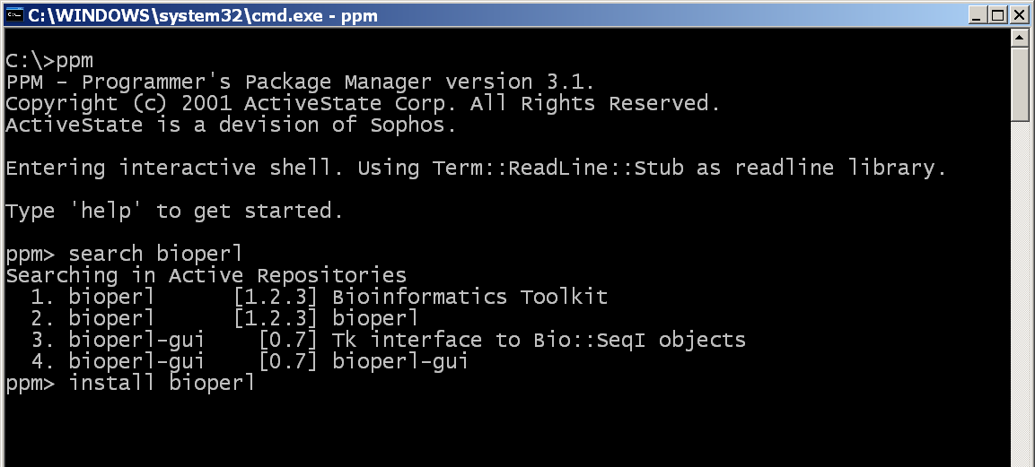
Installing modules from the internet
Alternatively -
Note: ppm installs the packages under the directory “site\lib\” in the ActivePerl directory. You can put packages there manually if you would like to download them yourself from the net, instead of using ppm.

Slide 19
BioPerl installation
In order to add BioPerl packages you need to download and execute the bioperl10.bat file from the course website.
If that that does not work – follow the instruction in the last three slides of the BioPerl presentation.
Reminder:
BioPerl warnings about:
Subroutine ... redefined at ...
Should not trouble you, it is a known issue – it is not your fault and won't effect your script's performances.

Slide 20
Class exercise 13a
Write a script that uses Bio::SeqIO to read a FASTA file (use the EHD nucleotide FASTA from the webpage) and print only sequences shorter than 3,000 bases to an output FASTA file.
Write a script that uses Bio::SeqIO to read a FASTA file, and print all header lines that contain the words "Mus musculus". (you may use the same file).
Write a script that uses Bio::SeqIO to read a GenPept file (use preProInsulin.gp from the webpage), and convert it to FASTA.
4* Same as Q1, but print to the FASTA the reverse complement of each sequence. (Do not use the reverse or tr// functions! BioPerl can do it for you - read the BioPerl documentation).
5** Same as Q4, but only for the first ten bases (again – use BioPerl rather than substr)
Notes:
Show solutions

Slide 21
BioPerl: downloading files from the web
The Bio::DB::Genbank module allows us to download
a specific record from the NCBI website:
use Bio::DB::GenBank;
$gb = new Bio::DB::GenBank;
$seqObj = $gb->get_Seq_by_acc("J00522");
or ... request Fasta sequence
use Bio::DB::GenBank;
$gb = new Bio::DB::GenBank("-format" => "Fasta");
$seqObj = $gb->get_Seq_by_acc("J00522");
see more options in
http://doc.bioperl.org/releases/bioperl-.4/Bio/DB/GenBank.html

Slide 22

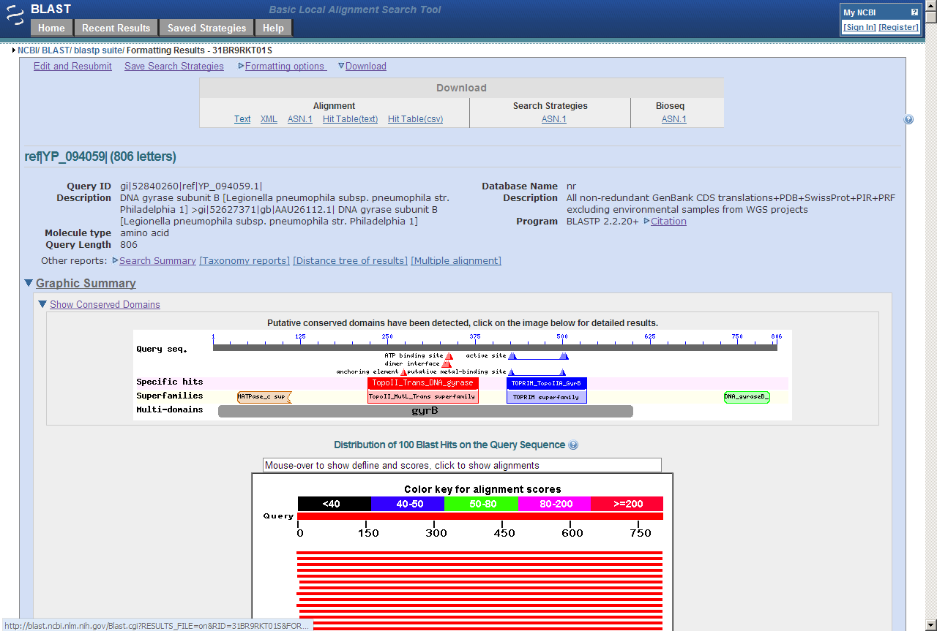
BioPerl: reading BLAST output
First we need to have the BLAST results in a text file BioPerl can read.
Here is one way to achieve this:
Download
Text

Slide 23
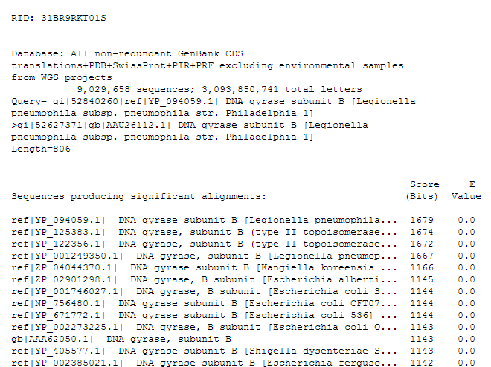
BioPerl: reading BLAST output
Query
Results info

Slide 24
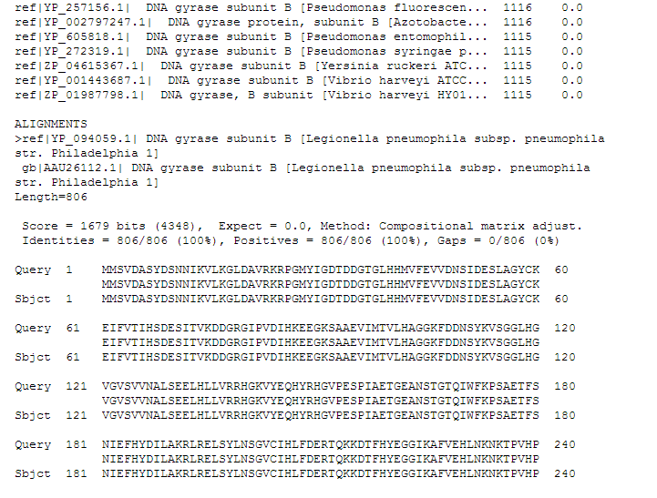
BioPerl: reading BLAST output
Result header
high scoring pair (HSP) data
HSP Alignment

Slide 25
Bio::SearchIO : reading BLAST output
The Bio::SearchIO module can read and parse BLAST output:
use Bio::SearchIO;
my $blast_report =
new Bio::SearchIO ("-format" => "blast",
"-file" => "<mice.blast");
while (my $resultObj = $blast_report->next_result()) {
print "Checking query ", $resultObj->query_name(), "\n";
while (my $hitObj = $resultObj->next_hit()) {
print "Checking hit ", $hitObj->name(), "\n";
my $hspObj = $hitObj->next_hsp();
print $hspObj->hit->start()...
$hspObj->hit->end()...
}
}
(See the BLAST output example in course web-site)

Slide 26
BioPerl: reading BLAST output
You can (obviously) send parameters to the subroutines of the objects:
# Get length of HSP (including gaps)
$hspObj->length("total");
# Get length of hit part of alignment (without gaps)
$hspObj->length("hit");
# Get length of query part of alignment (without gaps)
$hspObj->length("query");
More about what you can do with query, hit and hsp see in:
http://www.bioperl.org/wiki/HOWTO:SearchIO#Parsing_with_Bio::SearchIO

Slide 27
Class exercise 13b?
Write a script that uses Bio::SearchIO to parse the BLAST results (provided in the course web-site) and:
  For each query print out its name and the name of its first hit.
  Print the % identity of each HSP of the first hit of each query.
  Print the e-value of each HSP of the first hit of each query.
  d*) Create a complex data structure that use the query name as a key and the value is a reference to a hash containing the first hit name, the % identity and the e-value of the first HSP of the first hit. Print out the data you've stored.
Notes:
Show solutions

Slide 28
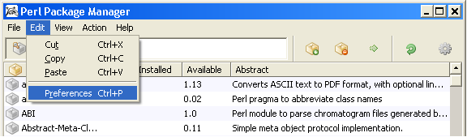
Installing BioPerl – how to add a repository to the PPM
Start → All Programs →Active Perl… → Perl Package manager
You might need to add a repository to the PPM before installing BioPerl:

Slide 29
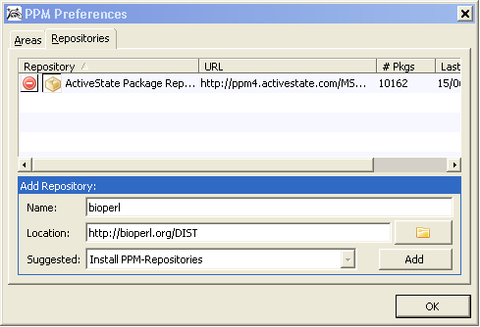
Installing BioPerl – how to add a repository to the PPM
Click the “Repositories” tab, enter “bioperl” in the “Name” field and http://bioperl.org/DIST in the “Location” field, click “Add”, and finally “OK”:

Slide 30
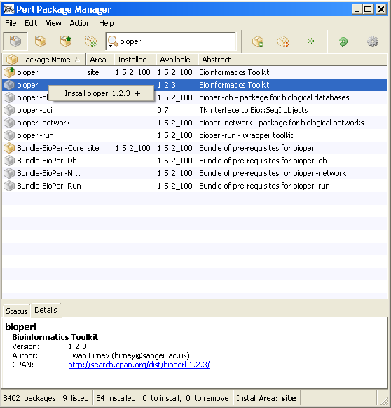
Installing modules from the internet
The best place to search for Perl modules that can make your life easier is:
http://www.cpan.org/
The easiest way to download and install a module is to use the Perl Package Manager (part of the ActivePerl installation)
1.Choose “View all packages”
2. Enter module name
(e.g. bioperl)
3. Choose module
(e.g. bioperl)
4. Add it to the installation list
5. Install!
Note: ppm installs the packages under the directory “site\lib\” in the ActivePerl directory. You can put packages there manually if you would like to download them yourself from the net, instead of using ppm.

