Slide 1
סקר הוראה
בשבועות הקרובים יתקיים סקר ההוראה (באתר מידע אישי לתלמיד)

Slide 2
Subroutines

Slide 3
Subroutines
A subroutine is a user-defined function. Subroutine definition:
sub SUB_NAME {
# Do something
...
}
Note:
Subroutine definitions may be placed anywhere in a script, but they are usually placed together at the beginning or the end.
For example:
sub printHello {
print "Hello world\n";
}

Slide 4
Subroutines
To invoke (execute) a subroutine:
SUB_NAME(PARAMETERS);
For example:
printHello();
Hello world
print reverseComplement("GCAGTG");
CGTCAC

Slide 5
Why use subroutines?
Code in a subroutine is reusable (i.e. it can be invoked from several points in the script, no code duplication)
e.g. a subroutine that reverse-complement a DNA sequence
A subroutine can provide a general solution that may be applied in different situations.
e.g. read a FASTA file

Slide 6
Why use subroutines? - Example
Encapsulation: A well defined task can be done in a subroutine, making the main script simpler and easier to read and understand.
For example:
$seq = readFastaFile($fileName); # reads a FASTA sequence
$revSeq = reverseComplement($seq); # reverse complement the sequnce
printFasta($revSeq); # prints the sequence in FASTA format

Slide 7
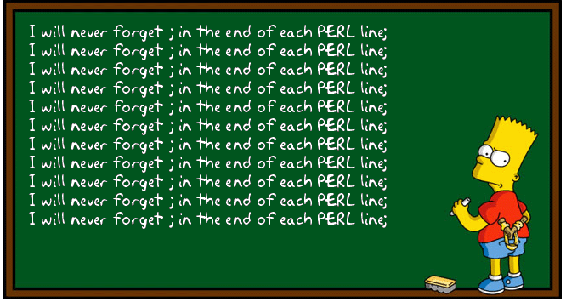
Subroutine arguments
A subroutine may be given arguments through the special array variable @_:
sub printString_N_times {
my ($string, $times) = @_;
print $string x $times;
}
my $bart4today = "I will not eat things for money\n";
printString_N_times($bart4today ,100);
I will not eat things for money
I will not eat things for money
I will not eat things for money
I will not eat things for money
I will not eat things for money
I will not eat things for money
I will not eat things for money

Slide 8
Return value
Definition:
sub reverseComplement {
my ($seq) = @_;
$seq =~ tr/ACGT/TGCA/;
$seq = reverse $seq;
return $seq;
}
Usage:
my $revSeq = reverseComplement("GCAGTG"); CACTGC
Notes:
The return function ends the execution of the subroutine and returns a value.
If there is no (explicit) return statement, the value of the last statement in the subroutine is returned.

Slide 9
Return value a list
A subroutine may also return a list value:
sub integerDivide {
my ($a,$b) = @_;
my $mana = int($a/$b);
my $sheerit = $a % $b;
return ($mana,$sheerit);
}
my ($mana,$sheerit) = integerDivide(7,3);
print "mana= $mana, sheerit= $sheerit";
mana= 2, sheerit= 1

Slide 10
Variable scope
When a variable is defined using my inside a subroutine:
* It does not conflict with a variable by the same name outside the subroutine
* It’s existence is limited to the scope of the subroutine
sub printHello {
my ($name) = @_;
print "Hello $name\n";
}
my $name = "Yossi";
printHello("Moshe");
print "Bye $name\n";
Note:
This effect also holds for my variables in any other “block” of statements in curly brackets – {…} (such as in if-else controls and in loops)
Hello Moshe
Bye Yossi

Slide 11
Class exercise 11b
Write a subroutine that takes two numbers and prints their sum to the
screen (and test it with an appropriate script!)
Write a subroutine that takes two numbers and return a list of their sum, difference, and average.
For example:
@arr = mubersFunc(5,7);
print "@arr"; 12 -2 6
a. Write a subroutine that takes a sentence and returns the last word.
b.* Return the longest word!

Slide 12
Passing variables by reference
If we want to pass arrays or hashes to a subroutine, we must pass a reference:
$gene{"protein_id"} = "E4a";
$gene{"strand"} = "-";
@CDS = (126,523);
$gene{"CDS"} = [@CDS];
printGeneInfo(\%gene);
sub printGeneInfo {
my ($geneRef) = @_;
print "Protein $geneRef->{'protein_id'}\n";
print "Strand $geneRef->{'strand'}\n";
print "From: $geneRef->{'CDS'}[0] ";
print "to: $geneRef->{'CDS'}[1]\n";
}

Slide 13
Returning variables by reference
Similarly, to return a hash use a reference:
sub getGeneInfo {
my %geneInfo;
...
... (fill hash with info)
return \%geneInfo;
}
$geneRef = getGeneInfo(..);
In this case the hash will continue to exists outside the scope of the subroutine!
To dereference use:
my %geneHashInfo = %{$geneRef}

Slide 14
Class exercise 11
Write a subroutine that takes two numbers and prints their sum to the
screen (and test it with an appropriate script!)
a. Write a subroutine that takes a sentence and returns the last word.
b.* Return the longest word!
Modify your solution for class exercise 9.1: Make a subroutine that takes the name of an input file, builds the hash of protein lengths and returns a reference to the hash. Test it – see that you get the same results as the original ex.9.1
Now do ex. 9.2 by adding another subroutine that takes: (1) a protein accession, (2) a protein length and (3) a reference to such a hash, and returns 0 if the accession is not found, 1 if the length is identical to the one in the hash, and 2 otherwise.

Slide 15
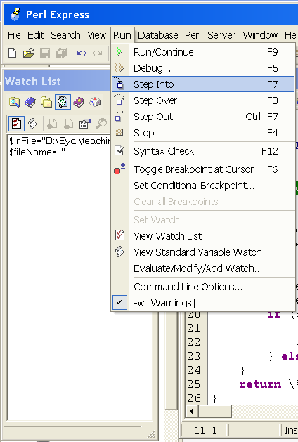
Debugging subroutines
Step into a subroutine (F7)
to debug the internal work of the sub
Step over a subroutine (F8)
to skip the whole operation of the sub
Step out of a subroutine (Ctrl+F7)
when inside a sub – run it all the way to its end and return to the main script

Slide 16

Advanced sorting
We learned the default sort, which is lexicographic:
print sort("Yossi","Bracha","Moshe");
Bracha Moshe Yossi
print sort(8,3,45,8.5);
3 45 8 8.5
To sort by a different order rule we need to give a comparison subroutine – a subroutine that compares two scalars and says which comes first
sort COMPARE_SUB (LIST);
no comma here

Slide 17
Sorting numbers
sort COMPARE_SUB (LIST);
COMPARE_SUB is a special subroutine that compares two scalars $a and $b, and says which comes first (by returning 1, 0 or -1). For example:
sub compareNumber {
if ($a > $b) {return 1;}
elsif ($a == $b) {return 0;}
else {return -1;}
}
print sort compareNumber (8,3,45,8.5);
3 8 8.5 45
no comma here

Slide 18
The operator <=>
The <=> operator does exactly that – it returns 1 for “greater than”, 0 for “equal” and -1 for “less than”:
sub compareNumber {
return $a <=> $b;
}
print sort compareNumber (8,3,45,8.5);
For easier use, you can use a temporary subroutine definition in the same line:
print sort {return $a<=>$b;} (8,3,45,8.5);
or just:
print sort {$a<=>$b;} (8,3,45,8.5);

Slide 19
@genes
{protein_id => PROTEIN_ID
strand => STRAND
CDS => [START, END]}
Now we can also sort complex data:
@sortedGenes = sort compareGene @genes;
sub compareGenes {
return $a->{"CDS"}[0] <=> $b->{"CDS"}[0];
}

Slide 20
@genes
{protein_id => PROTEIN_ID
strand => STRAND
CDS => [START, END]}
Now we can also sort complex data:
@sortedGenes = sort compareGene @genes;
sub compareGenes {
if ($a->{"CDS"}[0] != $b->{"CDS"}[0]) {
return $a->{"CDS"}[0] <=> $b->{"CDS"}[0];
} else {
return $a->{"CDS"}[1] <=> $b->{"CDS"}[1];
}
}

Slide 21
Class exercise 12
Write scripts that read an input file with the following data, sort them and print them in a sorted order to the screen:
Sort a file of grades and names, according to the grades (e.g. grades.txt from the course website).
Sort a file where each line is a date. e.g. 24/7/2003 (e.g. dates.txt).
Sort the proteins in the file from ex. 9.1 by their lengths
(create an array of keys sorted by the protein lengths).
* From the home exercise 4: Sort the CDSs from the adeno genome file:
- First by the number of the exons
- Then by the length of the CDS (without the introns!)
e.g. E1B 55K (1 exon, 1449bp) comes before E1A (2 exons, 801), but after E1B 19K (1 exon, 492bp).
Use an array of gene hashes as in class ex. 10, and an appropriate
comparison subroutine. Print the sorted protein IDs with their
number of exons and lengths of CDS.

Slide 22

Modules

Slide 23
What are modules
A module or a package is a collection of subroutines, usually stored in a separate file with a “.pm” suffix (Perl Module).
The subroutines of a module should deal with a well-defined task.
e.g. Fasta.pm: may contain subroutines that read and write FASTA files:
readFasta, writeFasta, getHeaders, getSeqNo.

Slide 24
Writing a module
A module is usually written in a separate file with a “.pm” suffix.
The name of the module is defined by a “package” line at the beginning of the file:
package Fasta;
sub getHeaders {
...
}
sub getSeqNo {
...
}
The last line of the module must be a true value, so usually we just add:
1;

Slide 25
Using modules
In order to write a script that uses a module add a “use” line at the beginning of the script:
use Fasta;
Note #1: for basic use of modules put the module file is in the same directory as your script, otherwise Perl won’t find it!
Note #2: You can “use” inside a module another module and you can have as many “use” as you want.
* If you want to learn how to “use” a module from a different directory read about “use lib”

Slide 26
Using modules - namespaces
use Fasta;
Now we can invoke a subroutine from within the namespace of that package:
PACKAGE::SUBROUTINE(...)
e.g. $seq = Fasta::getSeqNo(3);
Note that we cannot access it without specifying the namespace:
$seq = getSeqNo(3);
Undefined subroutine &main::getSeqNo called at...
Perl tells us that no subroutine by that name is defined in the “main” namespace (the global namespace)
There is a way to avoid this by using the “Exporter” module that allows a package to export it’s subroutine names. You can read about it here:
http://www.netalive.org/tinkering/serious-perl/#namespaces_export

Slide 27
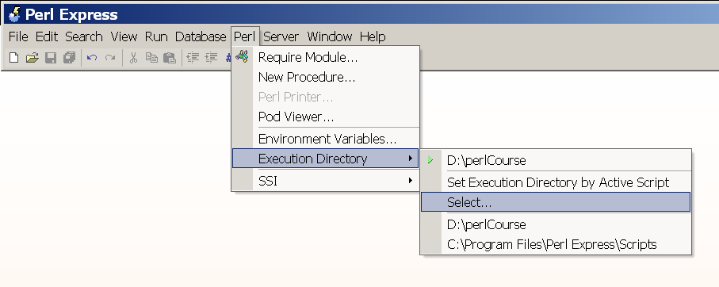
Using subroutines in Perl Express

Slide 28
Class exercise 13
Change the solution for class ex11.4 (the protein-lengths hash) –
move the two subroutines to a module by the name proteinLengths.pm,
and make the necessary changes in the script.
(Home ex. 6.2) Create a module called readSeq.pm with the following functions:
  readFastaSeq: Reads sequences from a FASTA file. Return a hash – the header lines are the keys and the sequences are the values.
  readGenbank: Reads a genome annotations file and extract CDS information, as in class ex. 10, and in home ex. 4 question 5. Return the complex data structure.
Test with an appropriate script!
3.* Use the readSeq.pm module to solve home exercise 4 question 6.
Notes:
Show solutions

Slide 29


Slide 30
BioPerl
The BioPerl project is an international association of developers of open source Perl tools for bioinformatics, genomics and life science research.
Things you can do with BioPerl:
Read and write sequence files of different format, including: Fasta, GenBank, EMBL, SwissProt and more…
Extract gene annotation from GenBank, EMBL, SwissProt files
Read and analyse BLAST results.
Read and process phylogenetic trees and multiple sequence alignments.
Analysing SNP data.
And more…

Slide 31
BioPerl
BioPerl modules are called Bio::XXX
You can use the BioPerl wiki:
http://bio.perl.org/
with documentation and examples for how to use them – which is the best way to learn this. We recommend beginning with the "How-tos":
http://www.bioperl.org/wiki/HOWTOs _x000b_
To a more hard-core inspection of BioPerl modules:
BioPerl 1.5.2 Module Documentation

Slide 32
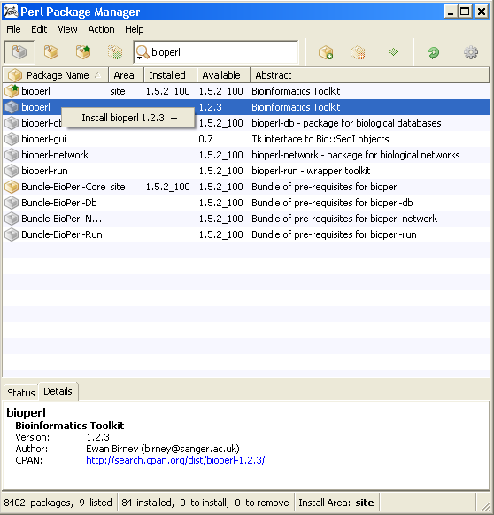
Installing modules from the internet
The best place to search for Perl modules that can make your life easier is:
http://www.cpan.org/
The easiest way to download and install a module is to use the Perl Package Manager (part of the ActivePerl installation)
Choose “View all packages”
Enter module name
Choose module
Add it to the installation list
Install!
Note: ppm installs the packages under the directory “site\lib\” in the ActivePerl directory. You can put packages there manually if you would like to download them yourself from the net, instead of using ppm.

Slide 33
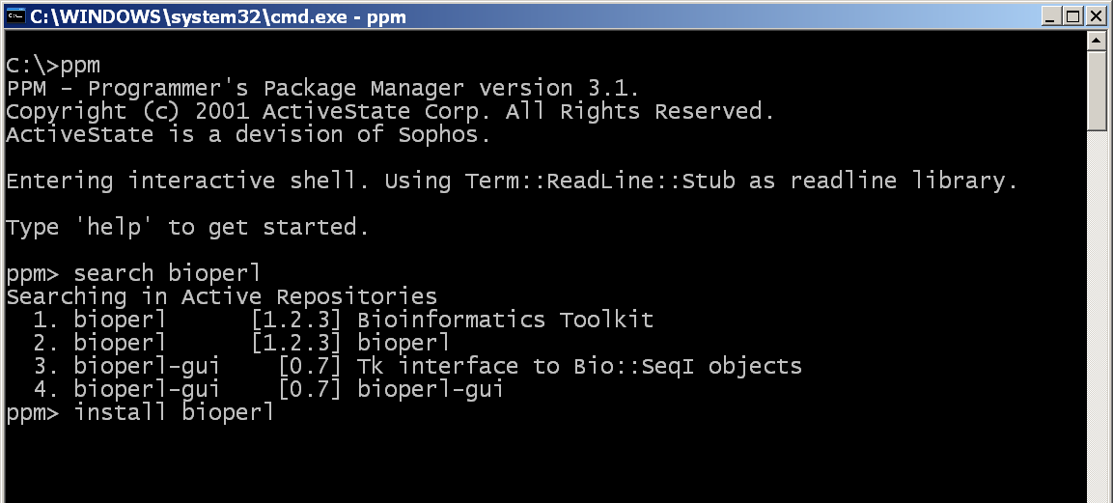
Installing modules from the internet
Alternatively -
Note: ppm installs the packages under the directory “site\lib\” in the ActivePerl directory. You can put packages there manually if you would like to download them yourself from the net, instead of using ppm.

Slide 34
Object-oriented use of packages
Many packages are meant to be used as objects. In Perl, an object is a data structure that can use subroutines that are associated with it.
To create an object from a certain package use “new”:
my $obj = new PACKAGE;
e.g. my $in = new FileHandle;
New returns a reference to a data structure, which acts as a FileHandle object.
New can also receive arguments:
my $obj = new PACKAGE;
my $in = new FileHandle(">$inFile");
=>
=>
$obj
0x225d14
=>
=>
func()
anotherFunc()

Slide 35
Object-oriented use of packages
To invoke a subroutine from the package for a specific object we use the
“->” notation again:
$line = $in->getLine();
Note that this is different from accessing elements of a reference to an array or hash, because we don’t have brackets around “getLine”:
$length = $proteinLengths->{AP_000081};
$grade = $gradesRef->[0];
=>
=>
$obj
0x225d14
=>
=>
func()
anotherFunc()

Slide 36
BioPerl: the SeqIO module
The Bio::SeqIO module allows input/output of sequences from/to files, in many formats:
use Bio::SeqIO;
$in = new Bio::SeqIO( "-file" => "<seq1.embl",
"-format" => "EMBL");
$out = new Bio::SeqIO( "-file" => ">seq2.fasta",
"-format" => "Fasta");
while ( my $seq = $in->next_seq() ) {
$out->write_seq($seq);
}
A list of all the formats BioPerl can Handle can be found in:
http://www.bioperl.org/wiki/HOWTO:SeqIO#Formats

Slide 37
BioPerl: the Seq module
use Bio::SeqIO;
$in = new Bio::SeqIO( "-file" => "<seq.fasta",
"-format" => "Fasta");
while ( my $seqObj = $in->next_seq() ) {
print "ID:".$seqObj->id()."\n"; #1st word in header
print "Desc:".$seqObj->desc()."\n"; #rest of header
print "Length:".$seqObj->length()."\n"; #seq length
print "Sequence: ".$seqObj->seq()."\n"; #seq string
}
The Bio::SeqIO function “next_seq” returns an object of the Bio::Seq module. This module provides functions like id() (returns the first word in the header line before the first space), desc() (the rest of the header line), length() and seq() (return sequence length). You can read more about it in: http://www.bioperl.org/wiki/HOWTO:Beginners#The_Sequence_Object

Slide 38
Class exercise 14
Write a script that uses Bio::SeqIO to read a FASTA file (use the EHD nucleotide FASTA from the webpage) and print only sequences shorter than 3,000 bases to an output FASTA file.
Write a script that uses Bio::SeqIO to read a FASTA file, and print all header lines that contain the words "Mus musculus".
Write a script that uses Bio::SeqIO to read a GenPept file (use preProInsulin.gp from the webpage), and convert it to FASTA.
4* Same as Q1, but print to the FASTA the reverse complement of each sequence. (Do not use the reverse or tr// functions! BioPerl can do it for you - read the BioPerl documentation).
5** Same as Q4, but only for the first ten bases (again – use BioPerl rather than substr)
Notes:
Show solutions

