Slide 1
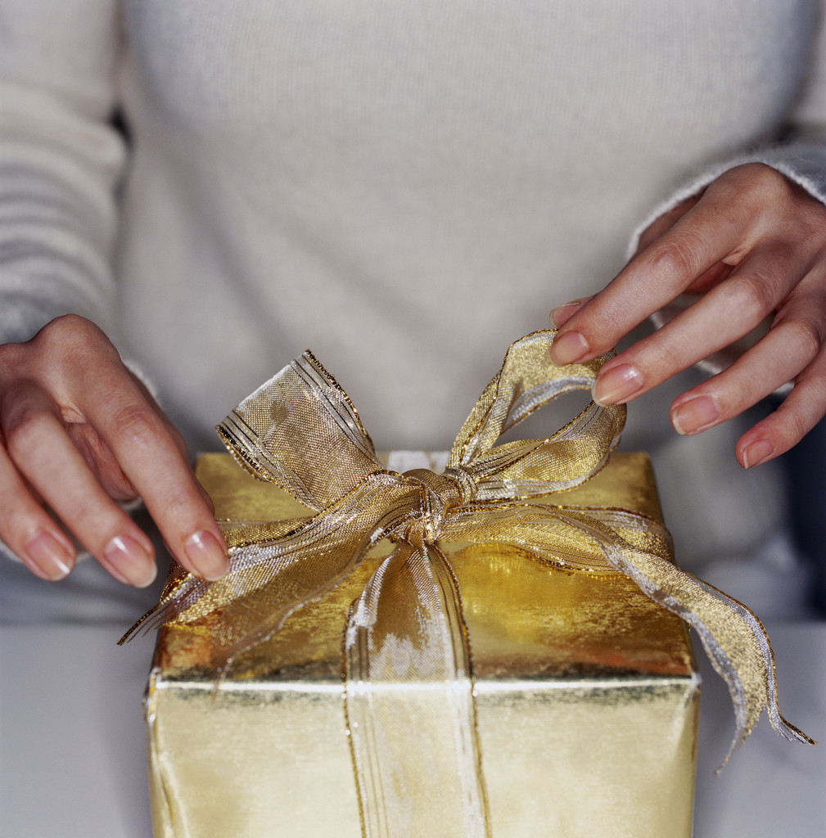
Wrapping up
Notes:
Eclipse (=> Debugger)
The RegEx Coach

Slide 2
Revision

Slide 3

References are your friends…

Slide 4
Variable types in PERL
Scalar
Array
Hash
$number
-3.54
%hash
@array
$string
"hi\n"
$reference
0x225d14
%hash
@array1
@array2
@array3

Slide 5
Referencing – Dereferencing Arrays
Referencing array :
$gradesRef = \@grades;
$arrayRef = [@grades];
Dereferencing array :
@arr = @{$arrRef};
$element1 = $arrRef->[0];
$gradesRef
@grades
A
B
C
@arr
A
B
C
$arrRef
A
B
C
$element1 = $arrRef->[0] = A

Slide 6
Referencing – Dereferencing Hashes
Referencing hash :
$phoneBookRef = \%phoneBook;
$hashRef = {%phoneBook};
Dereferencing hash :
%hash = %{$hashRef};
$myVal = $hashRef->{"A"};
$phoneBookRef
%phoneBook
%hash
A
X
A
X
B
Y
B
Y
C
Z
C
Z
$hashRef
A
X
$myVal = $hashRef->{"A"} = "X"
B
Y
C
Z

Slide 7
Hash within Hash
my %phoneBook;
my $name = "Eyal";
$phoneBook{$name}{"Phone"} = "9016";
$phoneBook{$name}{"Address"} = "Hulun";
$name = "Ofir";
$phoneBook{$name}{"Phone"} = "7693";
$phoneBook{$name}{"Address"} = "Eilat";
"Phone"
"9016"
%phoneBook
"Addrs"
"Hulun"
"Eyal"
"Ofir"
"Phone"
"7693"
"Addrs"
"Eilat"

Slide 8
Hash within Hash
my %phoneBook;
my $name = "Eyal";
$phoneBook{$name}{"Phone"} = "9016";
$phoneBook{$name}{"Address"} = "Hulun";
my $eyalsAddress;
$eyalsAddress = $phoneBook{"Eyal"}{"Address"};
"Phone"
"9016"
%phoneBook
"Addrs"
"Hulun"
"Eyal"
"Ofir"
"Phone"
"7693"
"Addrs"
"Eilat"

Slide 9
Hash within Hash
my %phoneBook;
my $name = "Eyal";
$phoneBook{$name}{"Phone"} = "9016";
$phoneBook{$name}{"Address"} = "Hulun";
my %eyalsHash;
%eyalsHash = %{$phoneBook{"Eyal"}};
"Phone"
"9016"
%phoneBook
"Addrs"
"Hulun"
%eyalHash
"Eyal"
"Phone"
"9016"
"Ofir"
"Addrs"
"Hulun"
"Phone"
"7693"
"Addrs"
"Eilat"

Slide 10
Array within Hash within Hash
my %phoneBook;
my $name = "Eyal";
$phoneBook{$name}{"Phone"} = "9016";
$phoneBook{$name}{"Address"} = "Hulun";
@grades = (93,72,87);
$phoneBook{$name}{"Grades"} = [@grades];
@grades
@grades
"Phone"
"9016"
93
72
87
90
82
100
"Addrs"
"Hulun"
%phoneBook
Grades
93
72
87
"Eyal"
"Ofir"
"Phone"
"7693"
"Addrs"
"Eilat"
Grades
90
82
100

Slide 11
Array within Hash within Hash
my %phoneBook;
$phoneBook{$name}{"Phone"} = "9016";
$phoneBook{$name}{"Address"} = "Hulun";
$phoneBook{$name}{"Grades"} = [@grades];
my $eyalsFirstGrade;
$eyalsFirstGrade = $phoneBook{"Eyal"}{"Grades"}[0];
"Phone"
"9016"
"Addrs"
"Hulun"
%phoneBook
Grades
93
72
87
"Eyal"
"Ofir"
"Phone"
"7693"
"Addrs"
"Eilat"
Grades
90
82
100

Slide 12
Array within Hash within Hash
my %phoneBook;
$phoneBook{$name}{"Phone"} = "9016";
$phoneBook{$name}{"Address"} = "Hulun";
$phoneBook{$name}{"Grades"} = [@grades];
my @eyalsGradeArr;
@eyalsGradeArr; = @{$phoneBook{"Eyal"}{"Grades"}}
@eyalsGradeArr
"Phone"
"9016"
93
72
87
"Addrs"
"Hulun"
%phoneBook
Grades
93
72
87
"Eyal"
"Ofir"
"Phone"
"7693"
"Addrs"
"Eilat"
Grades
90
82
100

Slide 13
Array of arrays
my @grades1 = (93,72,87);
my @grades2 = (95,82,99);
my @grades3 = (96,78,100);
my @gradeMatrix;
$gradeMatrix[0] = [@grades1];
$gradeMatrix[1] = [@grades2];
$gradeMatrix[2] = [@grades3];
my $secondGradeOfFirst;
$secondGradeOfFirst = $gradeMatrix[0][1];
$gradeMatrix[1][2] = 100;
@grades1
@grades2
@grades3
93
72
87
95
82
99
96
78
100
@gradeMatrix
93
72
87
95
82
99
100
96
78
100

Slide 14
Array of arrays
my @grades = (93,72,87);
my @gradeMatrix;
$gradeMatrix[0] = [@grades];
@grades = (95,82,99);
$gradeMatrix[1] = [@grades];
@grades = (96,78,100);
$gradeMatrix[2] = [@grades];
@grades
@grades
@grades
93
95
96
72
82
78
87
99
100
@gradeMatrix
93
72
87
95
82
99
96
78
100

Slide 15


Slide 16
SeqIO: reading and writing sequences
The Bio::SeqIO module allows input/output of sequences
from/to files, in many formats:
use Bio::SeqIO;
$in = new Bio::SeqIO( "-file" => "<seq1.embl",
"-format" => "EMBL");
$out = new Bio::SeqIO( "-file" => ">seq2.fasta",
"-format" => "Fasta");
while ( my $seqObj = $in->next_seq() ) {
$out->write_seq($seqObj);
}
A list of all the sequence formats BioPerl can read is in:
http://www.bioperl.org/wiki/HOWTO:SeqIO#Formats

Slide 17
Bio::Seq - various subroutines
use Bio::SeqIO;
$in = new Bio::SeqIO( "-file" => "<seq.fasta",
"-format" => "Fasta");
while ( my $seqObj = $in->next_seq() ) {
print "ID:".$seqObj->id()."\n"; #1st word in header
print "Desc:".$seqObj->desc()."\n"; #rest of header
print "Length:".$seqObj->length()."\n"; #seq length
print "Sequence: ".$seqObj->seq()."\n"; #seq string
}
The Bio::SeqIO function “next_seq” returns a Bio::Seq object.
You can read more about it in: http://www.bioperl.org/wiki/HOWTO:Beginners#The_Sequence_Object

Slide 18
BioPerl installation
In order to add BioPerl packages you need to download and execute the bioperl10.bat file from the course website.
If that that does not work – follow the instruction in the last three slides of the BioPerl presentation.
Reminder:
BioPerl warnings about:
Subroutine ... redefined at ...
Should not trouble you, it is a known issue – it is not your fault and won't effect your script's performances.

Slide 19
From the supplemental material

Slide 20
Advanced sorting
The sort function sorts array alphabetically:
@arr = (8,3,45,8.5);
@sortedArr = sort(@arr);
print "@sortedArr";
3 45 8 8.5
You can sort numerically using the following syntax:
@sortedArr = sort ({$a<=>$b} @numArr);
print "@sortedArr";
3 8 8.5 45

Slide 21
Running programs from a script
You may run programs using the system function:
$exitValue = system("blastall.exe ...");
if ($exitValue!=0) {die "blast failed!";}

Slide 22
Running a local blast
You could install blastall on your computer from:
ftp.ncbi.nlm.nih.gov
it can perform an all-against-all search (each sequence in one file against every sequence in the other).

Slide 23
Some Final Note

Slide 24
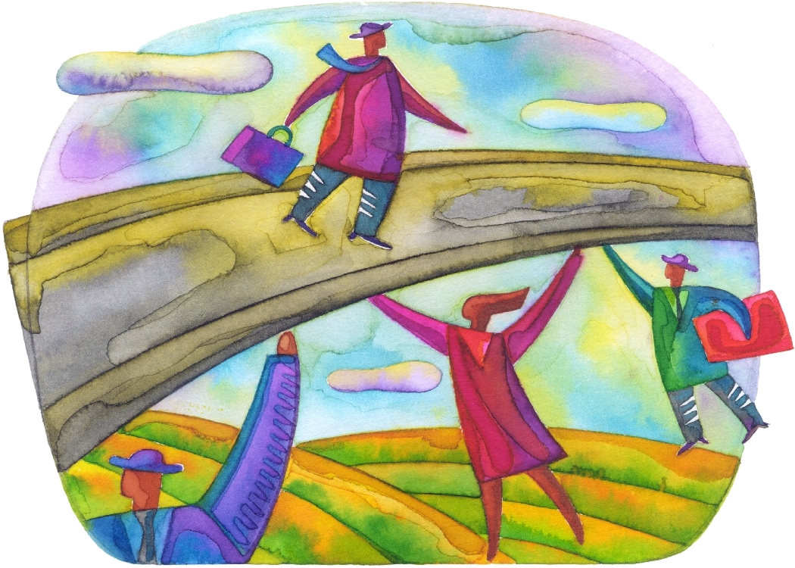
If and when you use PERL in your after-course life, we will be glad to help you along the way.

Slide 25
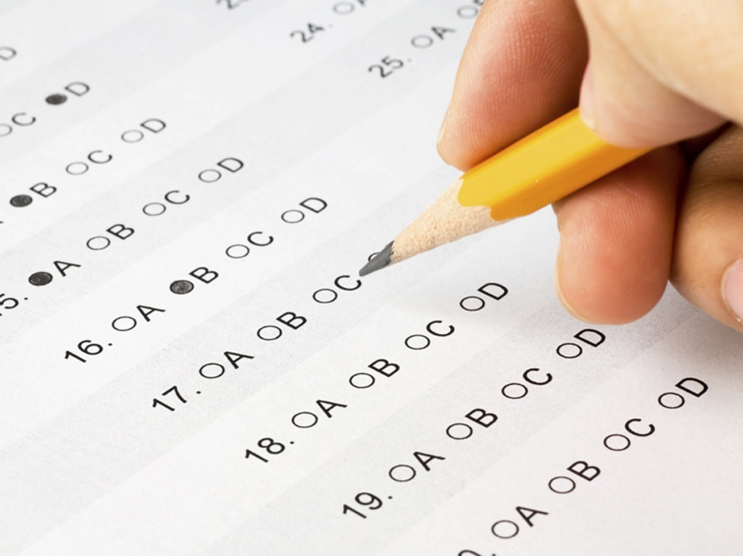
The Exam

Slide 26
Exam – Technical Issues
The exam is 70% of your final grade.
The exam will take place on 31/01/2010 at 09:00 – 12:00
Material of the exam: everything (in particular anything that we practiced either at class or in the home assignments).
Naturally - the supplemental material is NOT part of the material for the exam.
The exam will be on the computers in several computer classrooms all around the campus (arrive early to find your class!). Entry to the class will be on 08:50.
Technical problems with the computes will not come on the expense of your time.
Let's examine the outline of the exam and an exam of previous years…

Slide 27

Differences from previous years
You are allowed to bring 4 double sided pages (instead of 2)
This year there will be 4 question (the 4th will have three parts)
There will be only an Hebrew version
The material in previous years might have been a little different

Slide 28

Exam – Learning Material
Presentations
Home assignments + solutions
Class assignment + solutions
Exams from previous year + solutions

Slide 29
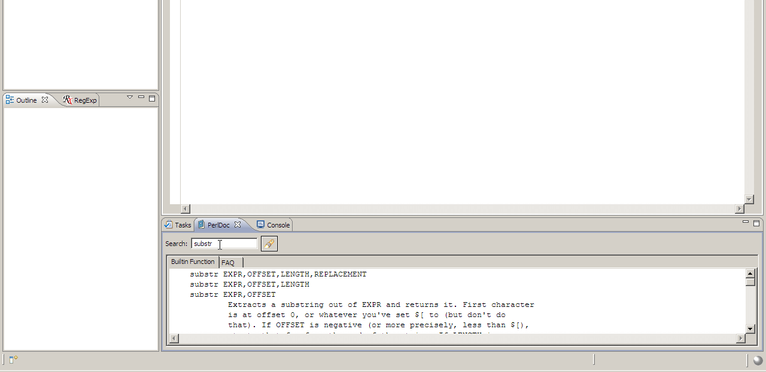
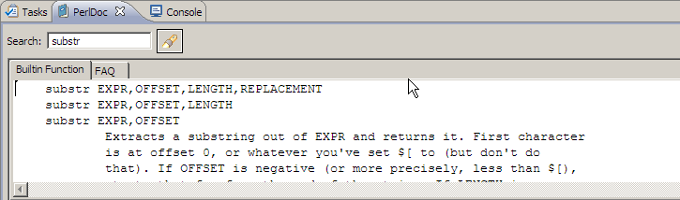

Perl documentation in Eclipse
At the bottom you have a 'PerlDoc' tab that contains information about all of Perl's functions (and much more)

Slide 30
Questions from 2009
1. (15נק') כתבו סקריפט בקובץ "exam1.pl" שמבקש מהמשתמש קלט המורכב מאות ושני מספרים i ו-j. הדפיסו שורה המכילה את האות שניתנה i פעמים, אחריה שורה המכילה את האות i+1 פעמים, וכן הלאה עד שורה שבא תודפס האות j פעמים. לדוגמא:
  קלט:
  a
  3
  5
  פלט:
  aaa
  aaaa
  aaaaa

Slide 31
Questions from 2009
2. (15נק') כתבו סקריפט בקובץ "exam2.pl" שקורא קובץ קלט (הניתן כארגומנט ראשון ב-command line), ומדפיס לקובץ פלט (הניתן כארגומנט שני ב-command line) רק את השורות שבהן המילה השנייה מתחילה ב-“m”. לדוגמא:
  קלט:
  The cat sat on the tree.
  The mouse is fat.
  The Microsoft mouse is not working.
  Help! my cat is on the tree!
  פלט:
  The mouse is fat.
  Help! my cat is on the tree!

