Slide 1
Pattern Matching

Slide 2
Pattern matching
We often want to find a certain piece of information within the file:
Ariel Beltzman
Eyal Privman
Rakefet Shultzman
Find all names that end with “man”
in the phone book
Extract the accession, description and score of every hit in the output of BLAST
Extract the coordinates of all open reading
frames from the annotation of a genome
Score E
Sequences producing significant alignments: (bits) Value
ref|NT_039621.4|Mm15_39661_34 Mus musculus chromosome 15 genomic... 186 1e-45
ref|NT_039353.4|Mm6_39393_34 Mus musculus chromosome 6 genomic c... 38 0.71
ref|NT_039477.4|Mm9_39517_34 Mus musculus chromosome 9 genomic c... 36 2.8
ref|NT_039462.4|Mm8_39502_34 Mus musculus chromosome 8 genomic c... 36 2.8
CDS 1542..2033
CDS complement(3844..5180)
All these examples are patterns in the text.
* We will see a wide range of the pattern-matching capabilities of Perl, but much more is available – I strongly recommend using documentation/tutorials/google to expand your horizons

Slide 3
Pattern matching
Finding a sub string (match) somewhere:
if ($line =~ m/he/) ... remember to use slash and not back-slash (\)
Will be true for “hello” and for “the cat” but not for “good bye” or “Hercules”.
You can ignore case of letters by adding an “i” after the pattern:
m/he/i
(matches for “hello”, “Hello” and “hEHD”)
There is a negative form of the match operator:
if ($line !~ m/he/) ...

Slide 4
Pattern matching
Replacing a sub string (substitute):
$line = "the cat on the tree";
$line =~ s/he/hat/;
$line will be turned to “that cat on the tree”
To Replace all occurrences of a sub string add a “g” (for “globally”):
$line = "the cat on the tree";
$line =~ s/he/hat/g;
$line will be turned to “that cat on that tree”

Slide 5
Single-character patterns
m/./ Matches any character except “\n”
You can also ask for one of a group of characters:
m/[abc]/ Matches “a” or “b” or “c”
m/[a-z]/ Matches any lower case letter
m/[a-zA-Z]/ Matches any letter
m/[a-zA-Z0-9]/ Matches any letter or digit
m/[a-zA-Z0-9_]/ Matches any letter or digit or an underscore
m/[^abc]/ Matches any character except “a” or “b” or “c”
m/[^0-9]/ Matches any character except a digit
For example:
if ($line =~ m/class\.ex[1-9]/)
Will be true for “class.ex3.1.pl” ; “my class.ex8.1c”…

Slide 6
Single-character patterns
m/./ Matches any character except “\n”
You can also ask for one of a group of characters:
m/[abc]/ Matches “a” or “b” or “c”
m/[a-z]/ Matches any lower case letter
m/[a-zA-Z]/ Matches any letter
m/[a-zA-Z0-9]/ Matches any letter or digit
m/[a-zA-Z0-9_]/ Matches any letter or digit or an underscore
m/[^abc]/ Matches any character except “a” or “b” or “c”
m/[^0-9]/ Matches any character except a digit
For example:
if ($line =~ m/class\.ex[1-9]\.[^3]/)
Will be true for “class.ex3.1.pl” ; “my class.ex8.1c”…
but false for “class.ex3.3”

Slide 7
Single-character patterns
Perl provides predefined character classes:
\d a digit (same as: [0-9])
\w a “word” character (same as: [a-zA-Z0-9_])
\s a space character (same as: [ \t\n\r\f])
For example:
if ($line =~ m/class\.ex\d\.\S/)
Will be true for “class.ex3.1” and “class-ex8.(at home)”…
but false for “class.ex3. ” (because of the space)
And their negatives:
\D anything but a digit
\W anything but a word char
\S anything but a space char

Slide 8
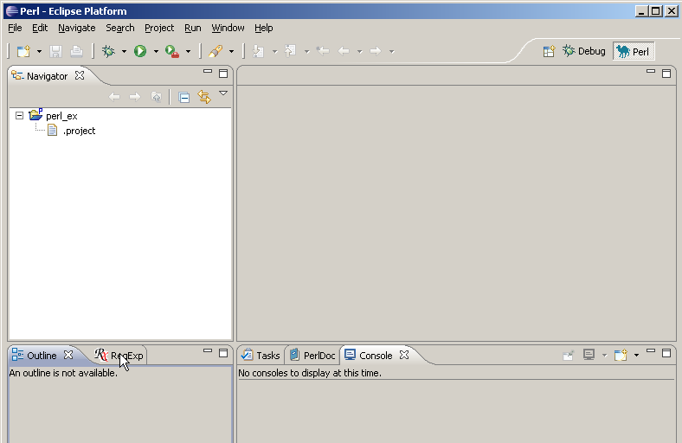
RegExp view

Slide 9
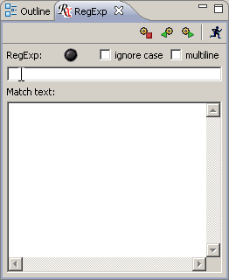
RegEx View

Slide 10
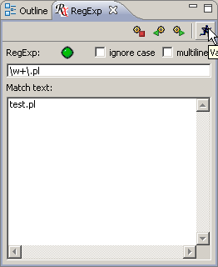
RegEx View

Slide 11
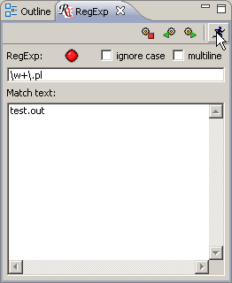
RegEx View

Slide 12
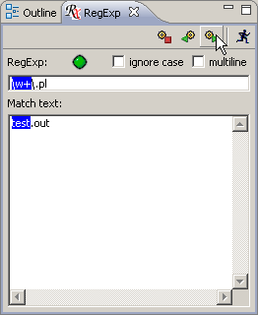
RegEx View

Slide 13
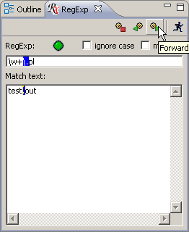
RegEx View

Slide 14
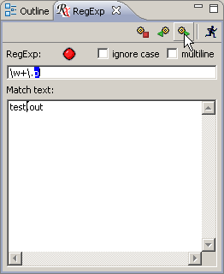
RegEx View

Slide 15
Class exercise 6a
Write the following regular expressions. Test them with a script that reads a line and prints "yes" if it matches and "no" if not.
  Match a name beginning with a capital letter followed by three lower case letters
  Replace every digit in the line with a #, and print the result
  Match "is" in either small or capital letters
  Remove all such appearances of "is" from the line, and print it

Slide 16
Repetitive patterns
A pattern followed by * means zero or more repetitions of that patern:
m/ab*c/ Matches “abc” ; “ac” ; “abbbbc”
+ means one or more repetitions:
m/ab+c/ Matches “abc” ; “abbbbc” but not “ac”
? means zero or one repetitions:
m/ab?c/ Matches “ac” or “abc”
Generally – use {} for a certain number of repetitions, or a range:
m/ab{3}c/ Matches “abbbc”
m/ab{3,6}c/ Matches “a”, 3-6 times “b” and then “c”
Use parentheses to mark more than one character for repetition:
m/h(el)*lo/ Matches “hello” ; “hlo” ; “helelello”

Slide 17
Enforce line start/end
To force the pattern to be at the beginning of the string add a “^”:
m/^>/ Matches only strings that begin with a “>”
“$” forces the end of string:
m/\.pl$/ Matches only strings that end with a “.pl”
And together:
m/^\s*$/ Matches all lines that do not contain any non-space characters

Slide 18
Some examples
m/\d+(\.\d+)?/ Matches numbers that may contain a decimal point:
“10”; “3.0”; “4.75” …
m/^NM_\d+/ Matches Genbank RefSeq accessions like “NM_079608”
m/^\s*CDS\s+\d+\.\.\d+/ Matches annotation of a coding sequence in a Genbank DNA/RNA record:
“ CDS 87..1109”
m/^\s*CDS\s+(complement\()?\d+\.\.\d+\)?/
Allows also a CDS on the minus strand of the DNA:
“ CDS complement(4815..5888)”
Note: We could just use m/^\s*CDS/ - it is a question of the strictness of the format. Sometimes we want to make sure.

Slide 19
Class exercise 6b
Write the following regular expressions. Test them with a script that reads a line and prints "yes" if it matches and "no" if not.
  Match a name beginning with a capital letter followed by any number of lower case letters
  Match a date such as: 12/8/2005 and 3/12/1987

Slide 20
Extracting part of a pattern
We can extract parts of the string that matched parts of the pattern by parentheses:
$line = "1.35";
if ($line =~ m/(\d+)(\.\d+)/ ) {
print "$1\n"; 1
print "$2\n"; .35
}

Slide 21
Extracting part of a pattern
We can extract parts of the string that matched parts of the pattern that are marked by parentheses:
$line = " CDS 4815..5888";
if ($line =~ m/CDS\s+(complement\()?((\d+)\.\.(\d+))\)?/ ) {
print "regexp:$1,$2,$3,$4.\n";
Use of uninitialized value in concatenation...
regexp:,4815..5888,4815,5888.
$start = $3; $end = $4;
}

Slide 22
Finding a pattern in an input file
Usually, we want to scan all lines of a file, and find lines with a specific pattern. E.g.:
foreach $line (@lines) {
if ($line =~ m/CDS\s+(\d+)\.\.(\d+)/ ) {
$start = $1; $end = $2;
...
...
}
}

Slide 23
Class exercise 6c
Write the following regular expressions. Test them with a script that reads a line and prints "yes" if it matches and "no" if not.
  Match a first name followed by a last name, and print the last name
  Match a FASTA header line and print the whole line except for the “>”
  As in Q3b, but print the header only until the first white space

Slide 24
Class exercise 7a
Write a script that extracts and prints the following features from a Genbank record of a genome (Use the example of an adenovirus genome which is available from the course site)
Find the JOURNAL lines and print only the page numbers
Find lines of protein_id in that file and extract the ids (add to previous script)
Find lines of coding sequence annotation (CDS) and extract the separate coordinates (get each number into a separate variable; add to previous script). Try to match all CDS lines!
(This question is in home ex. 4)

Slide 25
Multiple choice
If one of several patterns may be acceptable in a pattern, we can write:
s/CDS (\d+\.\.\d+|\d+-\d+|\d+,\d+)/
will match “CDS 231..345”, “CDS 231-345” and “CDS 231,345”
Note: here $1 will be “231..345”, “231-345” or “231,345”, respectively

Slide 26
Variables in patterns
Variables can be interpolated into regular expressions, as in double-qouted strings:
$name = "Yossi";
$line =~ m/^$name\d+/
This pattern will match: “Yossi25”, “Yossi45”
* Special patterns can also be given in a variable: If $name was “Yos+i”
then the pattern could match “Yosi5” and “Yossssi5”

Slide 27
Variables in patterns
Say we need to search some blast output:
ref|NT_039621.4|Mm15_39661_34 Mus musculus chromosome 15 genomic... 186 1e-45
ref|NT_039353.4|Mm6_39393_34 Mus musculus chromosome 6 genomic c... 38 0.71
ref|NT_039477.4|Mm9_39517_34 Mus musculus chromosome 9 genomic c... 36 2.8
ref|NT_039462.4|Mm8_39502_34 Mus musculus chromosome 8 genomic c... 36 2.8
for the score of a hit that is named by the user.
We can write:
m/^ref|$hitName.*(\d+)\s+\S+\s*$/
If $hitName was NT_039353, we get 38

Slide 28
split
The split function actually treats its first parameter as a regular expression:
$line = "13 5;3 -23 8";
@numbers = split(/\s+/, $line);
print join('#', @numbers);
13#5;3#-23#8

Slide 29
Using memories in substitution
The extracted parts of the pattern can be used inside a substitution:
$line = " CDS 4815..5888";
$line =~ s/(\d+)\.\.(\d+)/$1-$2/ );
CDS 4815-5888
$line = "I'm John Lennon";
$line =~ s/([A-Z][a-z]+)\s+([A-Z][a-z]+)/$1_$2/ );
I'm John_Lennon

Slide 30
Using memories in substitution
$line = " CDS 4815..5888";
$line =~ s/(\d+)\.\.(\d+)/$2..$1/;
$line is now: CDS 5888..4815
$line = " CDS join(24763..25078,25257..25558)";
$line =~ s/(\d+)\.\.(\d+)/$1..$2/g;
$line is now: CDS join(25078..24763,25558..25257)

Slide 31
Using memories in matching
The extracted parts can also be used inside the same match:
m/(\d+)-(\d+),\2-\d+/
will match “4815-5781,5781-6153”
but not “4815-5781,5825-6153”
m/(.)\1+/ will match any character that is repeated at least twice
$line = "kasjfjjjjsja";
if ($line =~ m/((.)\2+)/) {
print "regexp:$1,$2.\n";
}
regexp:jjjj,j.

Slide 32
Position of match
Perl saves the positions of matches in the special arrays @- and @+
The variables $-[0] and $+[0]are the start and end of the entire match
The rest hold the starts and ends of the memories (brackets):
3 10 14 16 20
$line = " CDS 4815..5888";
$line =~ m/CDS\s+(\d+)\.\.(\d+)/;
print " starts: @- \n ends: @+ \n";
starts: 3 10 16
ends: 20 14 20

Slide 33
Patterns are greedy
If a pattern can match a string in several ways, it will take the maximal substring:
$line = "fred xxxxxxxxxx john";
$line =~ s/x+/@/;
will become “fred @ john” and not “fred @xxxxx john”
You can make a minimal pattern by adding a ? to any of */+/?/{}:
$line = "fred xxxxxxxxxx john";
$line =~ s/x+?/@/;
Only one x will be replaced: “fred @xxxxxxxxx john”

Slide 34
Translate
A special type of substitution allows to “translate” (i.e. replace) a set of characters to different set:
$seq = "AGCATCGA";
$seq =~ tr/ATGC/TACG/;
$seq is now "TCGTAGCT"
(What is the next step in order to get the reverse complement of the sequence?)

Slide 35
Enforce word start/end
In ex. 6.1 we wanted to enforce the capital letter to be the beginning of a word. We could enforce a word boundary, similar to enforcing line start/end with ^ and $
m/\bJovi/ will match “Jovi” and “bon Jovi” but not “bonJovi”
m/fred\b/ will match “fred” and “fred.” but not “fredrick”
\B is the reverse – m/fred\B/ will match “fredrick” but not “fred”

Slide 36
Class exercise 7b
Continuing with the record of the adenovirus genome:
4. Get a journal name and the year of publication from the user, find this paper in the adenovirus record and print the pages of this paper in the journal
5*. Get the first and last names of an author from the user, find the paper in the adenovirus record and print the year of publication. Can you find the paper by Kei Fujinaga?

