Slide 1
Pattern Matching

Slide 2
Pattern matching
We often want to find a certain piece of information within the file,
for example:
Ariel Beltzman
Eyal Privman
Rakefet Shultzman
Find all names that end with “man”
in the phone book
Extract the accession, description and score of every hit in the output of BLAST
Extract the coordinates of all open reading
frames from the annotation of a genome
Score E
Sequences producing significant alignments: (bits) Value
ref|NT_039621.4|Mm15_39661_34 Mus musculus chromosome 15 genomic... 186 1e-45
ref|NT_039353.4|Mm6_39393_34 Mus musculus chromosome 6 genomic c... 38 0.71
ref|NT_039477.4|Mm9_39517_34 Mus musculus chromosome 9 genomic c... 36 2.8
ref|NT_039462.4|Mm8_39502_34 Mus musculus chromosome 8 genomic c... 36 2.8
CDS 1542..2033
CDS complement(3844..5180)
All these examples are patterns in the text.
We will see a wide range of the pattern-matching capabilities of Perl, but much more is available – We strongly recommend using documentation/tutorials/google.

Slide 3
Pattern matching
Finding a sub-string (match) somewhere in a string:
if ($line =~ m/he/) ... remember to use slash (/) and not back-slash
Will be true for “hello” and for “the cat” but not for “good bye” or “Hercules”.
You can ignore case of letters by adding an “i” after the pattern:
m/he/i
(matches for “the”, “Hello” and “hEHD”)
There is a negative form of the match operator:
if ($line !~ m/he/) ...

Slide 4
Pattern matching
Replacing a sub string (substitute):
$line = "the cat on the tree";
$line =~ s/he/hat/;
$line will be turned to “that cat on the tree”
To Replace all occurrences of a sub string add a “g” (for “globally”):
$line = "the cat on the tree";
$line =~ s/he/hat/g;
$line will be turned to “that cat on that tree”

Slide 5
Single-character patterns
m/./ Matches any character (except “\n”)
You can also ask for one of a group of characters:
m/[atcg]/ Matches “a” or “t” or “c” or “g”
m/[a-d]/ Matches “a” though “d” (a, b, c or d)
m/[a-zA-Z]/ Matches any letter
m/[a-zA-Z0-9]/ Matches any letter or digit
m/[a-zA-Z0-9_]/ Matches any letter or digit or an underscore
m/[^atcg]/ Matches any character except “a” or “t” or “c” or “g” m/[^0-9]/ Matches any character except a digit

Slide 6
Single-character patterns
‘\’ (back-slash) is used to take the character literally
For example:
if ($line =~ m/class\.ex[1-9]/)
Will be true for?
✔
✔
✔
class.ex3.1.pl
class.ex3.3
my class.ex8.1c
class.ex3.1.pl
class.ex3.3
my class.ex8.1c

Slide 7
Single-character patterns
For example:
if ($line =~ m/class\.ex[1-9]\.[^3]/)
Will be true for?
✔
✗
✔
class.ex3.1.pl
class.ex3.3
my class.ex8.1c
class.ex3.1.pl
class.ex3.3
my class.ex8.1c

Slide 8
Single-character patterns
Perl provides predefined character classes:
\d a digit (same as: [0-9])
\w a “word” character (same as: [a-zA-Z0-9_])
\s a space character (same as: [ \t\n\r\f])
For example:
if ($line =~ m/class\.ex\d\.\S/)
And their negatives:
\D anything but a digit
\W anything but a word char
\S anything but a space char
✔
✗
✔
class.ex3.1.pl
class.ex3.
my class.ex8.(old)
class.ex3.1.pl
class.ex3.
my class.ex8.(old)

Slide 9
Single-character patterns
Perl provides predefined character classes:
\d a digit (same as: [0-9])
\w a “word” character (same as: [a-zA-Z0-9_])
\s a space character (same as: [ \t\n\r\f])
And a substitute example for $line = "class.ex3.1.pl";
$line =~ s/\W/-/;
class-ex3.1.pl
$line =~ s/\W/-/g;
class-ex3-1-pl
And their negatives:
\D anything but a digit
\W anything but a word char
\S anything but a space char

Slide 10
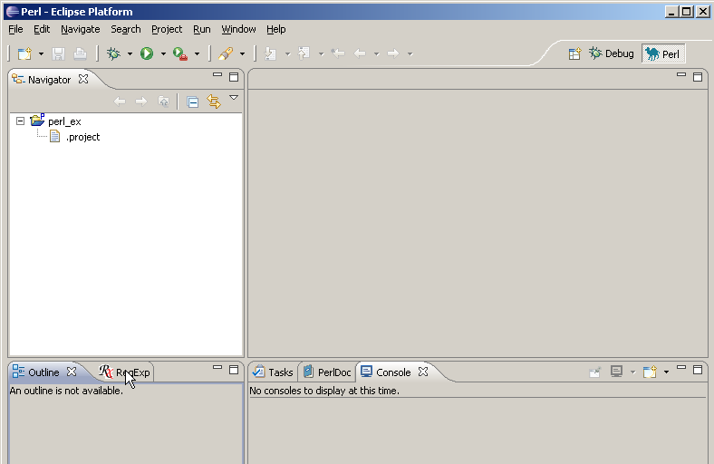
RegExp view

Slide 11
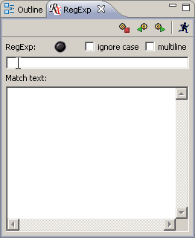
RegEx View

Slide 12
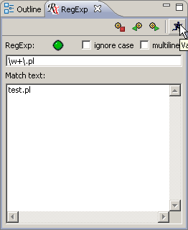
RegEx View

Slide 13
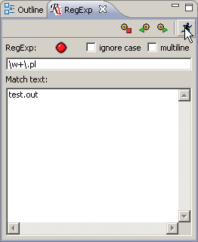
RegEx View

Slide 14
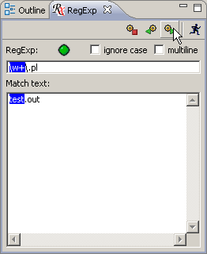
RegEx View

Slide 15
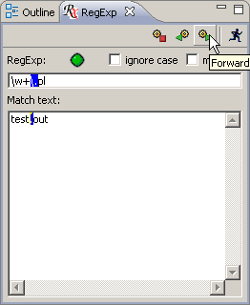
RegEx View

Slide 16
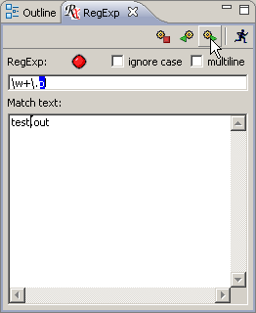
RegEx View

Slide 17
Class exercise 6b
Write the following regular expressions. Test them with a script that reads a line from STDIN and prints "yes" if it matches and "no" if not.
  Match a name containing a capital letter followed by three lower case letters
  Replace every digit in the line with a #, and print the result
  Match "is" in either small or capital letters
  d*) Remove all such appearances of "is" from the line, and print it

