Slide 1

Some Eclipse Tips
Try Ctrl+Shift+L Quick help (keyboard shortcuts)
Try Ctrl+SPACE Auto-complete
Source→Format (Ctrl+Shift+F) Correct indentation
You can maximize a single view of Eclipse.
A note about running scripts over and over again…
Debug Debug & Debug!!!
Break points . . .
The (default) location of your files are:
Home: D:\eclipse\perl_ex
Computer class: C:\eclipse\perl_ex

Slide 2

Last time on:
Pattern Matching

Slide 3
Pattern matching
Finding a sub string (match) somewhere:
if ($line =~ m/he/) ... remember to use slash and not back-slash (\)
Will be true for “hello” and for “the cat” but not for “good bye” or “Hercules”.
You can ignore case of letters by adding an “i” after the pattern:
m/he/i
(matches for “hello”, “Hello” and “hEHD”)
There is a negative form of the match operator:
if ($line !~ m/he/) ...

Slide 4
Pattern matching
Replacing a sub string (substitute):
$line = "the cat on the tree";
$line =~ s/he/hat/;
$line will be turned to “that cat on the tree”
To Replace all occurrences of a sub string add a “g” (for “globally”):
$line = "the cat on the tree";
$line =~ s/he/hat/g;
$line will be turned to “that cat on that tree”

Slide 5
Single-character patterns
m/./ Matches any character except “\n”
You can also ask for one of a group of characters:
m/[abc]/ Matches “a” or “b” or “c”
m/[a-z]/ Matches any lower case letter
m/[a-zA-Z]/ Matches any letter
m/[a-zA-Z0-9]/ Matches any letter or digit
m/[a-zA-Z0-9_]/ Matches any letter or digit or an underscore
m/[^abc]/ Matches any character except “a” or “b” or “c”
m/[^0-9]/ Matches any character except a digit

Slide 6
Single-character patterns
Perl provides predefined character classes:
\d a digit (same as: [0-9])
\w a “word” character (same as: [a-zA-Z0-9_])
\s a space character (same as: [ \t\n\r\f])
And their negatives:
\D anything but a digit
\W anything but a word char
\S anything but a space char

Slide 7
Reminder: last class exercise
Write the following regular expressions. Test them with a script that reads a line from STDIN and prints "yes" if it matches and "no" if not.
  Match a name containing a capital letter followed by three lower case letters
  Replace every digit in the line with a #, and print the result
  Match "is" in either small or capital letters
  d*) Remove all such appearances of "is" from the line, and print it

Slide 8
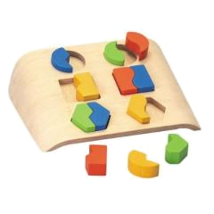
This week:
More Pattern Matching

Slide 9
Repetitive patterns
Generally – use {} for a certain number of repetitions, or a range:
m/ab{3}c/ Matches “abbbc”
m/ab{3,6}c/ Matches “a”, 3-6 times “b” and then “c”
? means zero or one repetitions:
m/ab?c/ Matches “ac” or “abc”
+ means one or more repetitions:
m/ab+c/ Matches “abc” ; “abbbbc” but not “ac”
A pattern followed by * means zero or more repetitions of that patern:
m/ab*c/ Matches “abc” ; “ac” ; “abbbbc”
Use parentheses to mark more than one character for repetition:
m/h(el)*lo/ Matches “hello” ; “hlo” ; “helelello”

Slide 10
Enforce line start/end
To force the pattern to be at the beginning of the string add a “^”:
m/^>/ Matches only strings that begin with a “>”
“$” forces the end of string:
m/\.pl$/ Matches only strings that end with a “.pl”
And together:
m/^\s*$/ Matches all lines that do not contain any non-space characters

Slide 11
Some examples
m/\d+(\.\d+)?/ Matches numbers that may contain a decimal point:
“10”; “3.0”; “4.75” …
m/^NM_\d+/ Matches Genbank RefSeq accessions like “NM_079608”
m/^\s*CDS\s+\d+\.\.\d+/ Matches annotation of a coding sequence in a
Genbank DNA/RNA record:
“ CDS 87..1109”
m/^\s*CDS\s+(complement\()?\d+\.\.\d+\)?/
Allows also a CDS on the minus strand of the DNA:
“ CDS complement(4815..5888)”
Note: We could just use m/^\s*CDS/ - it is a question of the strictness of the format. Sometimes we want to make sure.

Slide 12
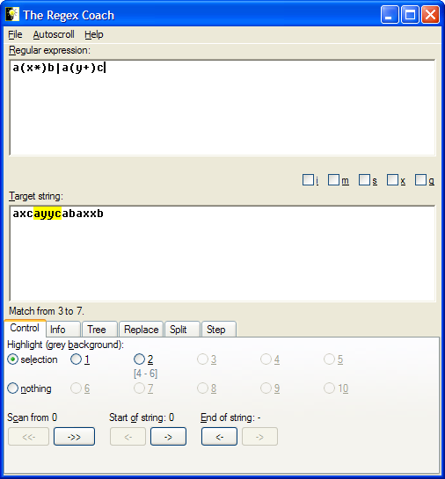
RegEx Coach
An easy to use tool for testing regular expressions:
http://www.weitz.de/regex-coach/

Slide 13
Class exercise 7a
Write the following regular expressions. Test them with a script that reads a line and prints "yes" if it matches and "no" if not.
  Match a name beginning with a capital letter followed by any number of lower case letters.
  Match a string that matches a phone number in Tel-aviv 03- followed by 6 or 7 digits. such as: 03-6409245.
  Match a string that matches a cell phone number in 05 followed by 0 or 2 or 4 and then 7 digits. such as: 054-5224888.
  d*) Match an hour no later than 19:59 in 24h format such as: 09:15 and 19:42.

Slide 14
Extracting part of a pattern
We can extract parts of the pattern by parentheses:
$line = "1.35";
if ($line =~ m/(\d+)\.(\d+)/ ) {
print "$1\n"; 1
print "$2\n"; 35
}

Slide 15
Extracting part of a pattern
We can extract parts of the string that matched parts of the pattern that are marked by parentheses:
$line = " CDS 4815..5888";
if ($line =~ m/CDS\s+(\d+)\.\.(\d+)/ ) {
print "regexp:$1,$2\n"; regexp:4815,5888.
$start = $1;
$end = $2;
}

Slide 16
Finding a pattern in an input file
Usually, we want to scan all lines of a file, and find lines with a specific pattern. E.g.:
foreach $line (@lines) {
if ($line =~ m/CDS\s+(\d+)\.\.(\d+)/ ) {
$start = $1; $end = $2;
...
...
}
}

Slide 17
Extracting part of a pattern
We can extract parts of the string that matched parts of the pattern that are marked by parentheses:
$line = " CDS 4815..5888";
if ($line =~ m/CDS\s+(complement\()?((\d+)\.\.(\d+))\)?/ ) {
print "regexp:$1,$2,$3,$4.\n";
$start = $3; $end = $4;
}
Use of uninitialized value in concatenation...
regexp:,4815..5888,4815,5888.

Slide 18
Class exercise 7b
1. Write the following regular expressions. Test them with a script that reads a line and prints "yes" if it matches and "no" if not.
  Match a first name followed by a last name, and print the last name
  Match a FASTA header line and print the whole line except for the “>”
  As in the previous question, but print the header only until the first white space

Slide 19
Class exercise 7c
Write a script that extracts and prints the following features from a Genbank record of a genome (Use the example of an adenovirus genome which is available from the course site)
Find the JOURNAL lines and print only the page numbers
Find lines of protein_id in that file and extract the ids (add to your script from the previous question)
Find lines of coding sequence annotation (CDS) and extract the separate coordinates (get each number into a separate variable; add to previous script). Try to match all CDS lines!
(This question is in home ex. 4)

