Slide 1
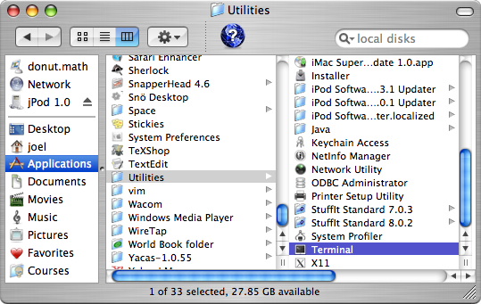
Perl on Mac
Apparently Perl does not need any installation on Mac (it is preinstalled with Mac OS X).
Below you can see how to reach the terminal which is the
equivalent of the "command line interface" in Windows.

Slide 2

Perl on Mac
The commands in Mac terminal are a bit different.
The basic ones are explained here:
http://guides.macrumors.com/Terminal
Here you can find some more tips about Perl on mac:
http://www.mactech.com/articles/mactech/Vol.18/18.09/PerlforMacOSX/index.html
(parts of it are quite advanced, so don't make yourself read the whole thing).
Feel free to email us with any additional question. ☺

