Slide 1
Perl Programming for Biology
The Bioinformatics Unit
G.S. Wise Faculty of Life Science
Tel Aviv University, Israel
October 2010
By Dudu Burstein and Eyal Privman
http://ibis.tau.ac.il/twiki/bin/view/Bioinformatics/PERL2011

Slide 2
This workshop
No experience in programming is assumed
Hands-on practice
Programming tasks for molecular biology
  Read and manipulate sequence files
  Extract and analyze desired information from large files
For your convenience, download this presentation from:
http://ibis.tau.ac.il/perluser/2011/workshop/workshop.ppt
Save it on your computer (choose “Save”, not “Open”)
It will be useful to copy-paste lines from our slides to your scripts…

Slide 3
Further study...
We cannot teach a full Perl course in 3 hours
You could read a book: Beginning Perl for Bioinformatics
Or some of the great Perl tutorials on the internet… (Google!)
Or take the full Perl course (this semester)
Text file handling
Using complex data structure
Using BioPerl tools for common tasks such as:
  Reading/writing sequence files in different formats
  Reverse-complementing and translating DNA sequences
  Analyzing BLAST results, Genbank records, Swiss-Prot
And more…

Slide 4
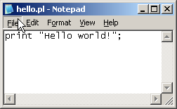

Your very first Perl script
print "Hello world!";
A Perl statement must end with a semicolon “;”
The print function outputs some information to the terminal screen
Now – do it yourself:
Write this script in notepad
Start → Accessories →Notepad
And save (file → save) your script in D:\ex_perl
(my computer → D: → perl_ex)
With the name hello.pl

Slide 5

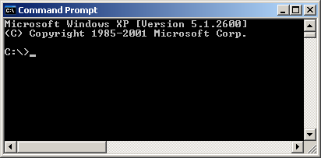
Your very first Perl script
print "Hello world!";
Traditionally, Perl scripts are run from a command line interface
Start it by clicking: Start → Accessories → Command Prompt
or: Start → Run… → cmd

Slide 6
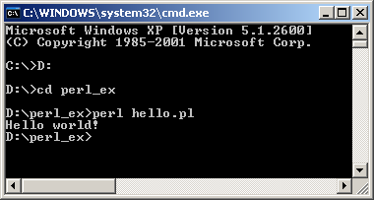
Your very first Perl script
print "Hello world!";
First let’s go to the correct directory:
D: - change drive from C: to D:
cd perl_ex - change directory to perl_ex
dir - list all the files in the directory (you should see your scirpt here)
Running a Perl script
perl YOUR_SCRIPT_NAME

Slide 7
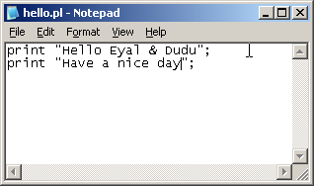
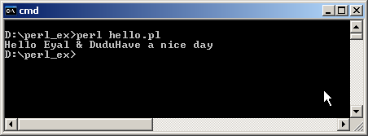
Your very first Perl script
print "Hello world!";
Now – change it to your own name…
print something additional.
And run it again…

Slide 8
Your very first Perl script
print "Hello world!";
Compare this to Java's "Hello world":
public class HelloWorld {
public static void main(String[] args) {
System.out.println("Hello World!");
}
}

Slide 9
Why Perl ?
Perl is a popular programming language,
especially for bioinformatics
Perl allows a rapid development cycle
Perl is strong in text manipulation
Perl can easily handle files and directories
Perl can easily run other programs
Perl is a cross-platform language‏

Slide 10
Perl & biology
BioPerl: “An international association of developers of open source Perl tools for bioinformatics, genomics and other fields in life science research”
http://bioperl.org/
Many smaller projects, and millions of little pieces of biological Perl code (which you should use as references – google and find them!)‏

Slide 11
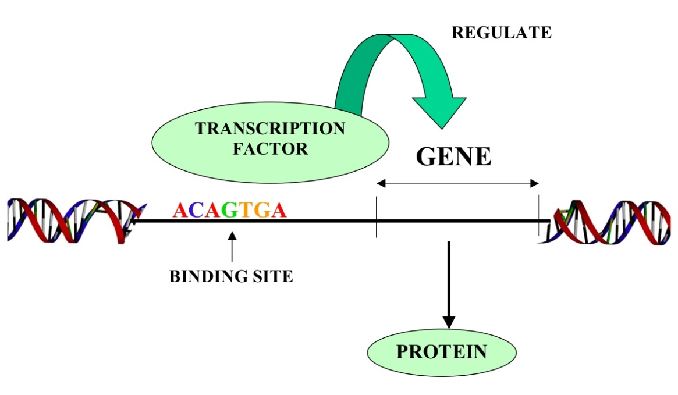
Why biologists need to program?
A real life example:
Finding a regulatory motif in sequences
In DNA sequences:
TATA box / transcription factor binding site in promoter sequences
In protein sequences:
Secretion signal / nuclear localization signal in N-terminal protein sequence
e.g. RXXR – secretion and translocation signal in the pathogenic bacterium Shloomopila apchiella

Slide 12
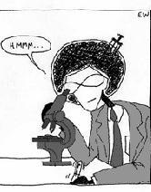
Why biologists need to program?
A real life example:
Finding a regulatory motif in sequences
>gi|307611471|emb|TUX01140.1| vicious T3SS effector [Shloomopila apchiella 130b]
MAAQLDPSSEFAALVKRLQREPDNPGLKQAVVKRLPEMQVLAKTNSLALFRLAQVYSPSSSQHKQMILQS
AAQGCTNAMLSACEILLKSGAANDLITAAHYMRLIQSSKDSYIIGLGKKLLEKYPGFAEELKSKSKEVPY
QSTLRFFGVQSESNKENEEKIINRPTV
>gi|307611373|emb|TUX01034.1| vicious T3SS effector [Shloomopila apchiella 130b]
MVDKIKFKEPERCEYLHIDKDNKVHILLPIVGGDEIGLDNTCETTGELLAFFYGKTHGGTKYSAEHHLNE
YKKNLEDDIKAIGVQRKISPNAYEDLLKEKKERLEQIEKYIDLIKVLKEKFDEQREIDKLRTEGIPQLPS
GVKEVIQSSENAFALRLSPDRPDSFTRFDNPLFSLKRNRSQYEAGGYQRATDGLGARLRSELLPPDKDTP
IVFNKKSLKDKIVDSVLAQLDKDFNTKDGDRNQKFEDIKKLVLEEYKKIDSELQVDEDTYHQPLNLDYLE
NIACTLDDNSTAKDWVYGIIGATTEADYWPKKESESGTEKVSVFYEKQKEIKFESDTNTMSIKVQYLLAE
INFYCKTNKLSDANFGEFFDKEPHATEVAKRVKEGLVQGAEIEPIIYNYINSHYAELGLTSQLSSKQQEE
...
...
...
Shmulik

Slide 13
A Perl script can do it for you
Shmulik writes a simple Perl script to reads protein sequences and find all proteins that contain the motif RXXR:
  Use the BioPerl package SeqIO
  Open and read file “Shloomopila_proteins.fasta”
  Iteration – for each sequence:
    Search for the pattern RXXR
    If found – print a message

Slide 14

1. Scalar Data

Slide 15
Scalar values
A scalar is either a number:
3 -20 3.1415 1.3e-14 (= 1.3 × 10⁻¹⁴)
or a string:
print "hello world";
hello world
print "hello\nworld";
hello
world
Backslash is an “escape” character that gives the next character a special meaning:
Construct | Meaning
\n | Newline
\t | Tab

Slide 16
Variables
Variable declaration: my $priority;
Note: Everything in Perl is case sensitive!
i.e. $priority is different from $Priority
Scalar variables can store scalar values:
Numerical assignment: $priority = 1;
String assignment : $priority = "high";
Copy the value of variable $b into $a:
$a = $b;
Important: To make Perl check the correctness of your variable names
– always include:
use strict;
as the first line of all scripts!

Slide 17
Interpolating variables into strings
use strict;
my $a = 9.5;
print "a is $a!\n";
a is 9.5!

Slide 18
Built-in Perl functions:
The length function
The length function returns the length of a string:
my $str = "TATAAT";
my $a = length($str);
print "$a";
6

Slide 19
The substr function
The substr function extracts a substring out of a string.
It receives 3 arguments: substr(EXPR,OFFSET,LENGTH)
Note: OFFSET count start from 0.
For example:
my $string = "university";
my $sub = substr($str, 3, 5);
$sub is now "versi", and $str remains unchanged.
Also note : You can use variables as the offset and length parameters.
The substr function can do a lot more, Google it and you will see…

Slide 20
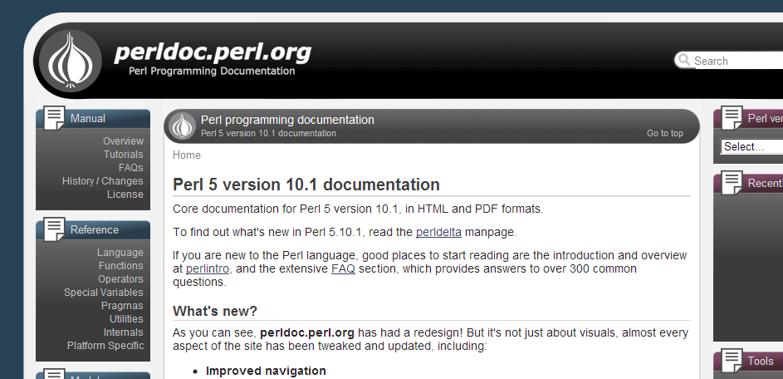
Documentation of perl functions
Anothr good place to start is the list of all basic Perl functions in the Perl documentation site:
http://perldoc.perl.org/
Click the link “Functions” on the left

Slide 21
Reading input
<STDIN> allows us to get input from the user:
print "What is your name?\n";
my $name = <STDIN>;
print "Hello $name!";
Here is a test run:
What is your name?
Shmulik
Hello Shmulik
!
$name: "Shmulik\n"

Slide 22
Reading input
Use the chomp function to remove the “new-line” from the end of the string (if there is any):
print "What is your name?\n";
my $name = <STDIN>;
chomp $name; # Remove the new-line
print "Hello $name!";
Here is a test run:
What is your name?
Shmulik
Hello Shmulik!
$name: "Shmulik\n"
$name: "Shmulik"

Slide 23
Exercise 1
Define a new variable, assign it your name and print this variable.
Read an input line from the user, print its length, and then print its first letter.

Slide 24

2.Controls:
If and loops

Slide 25
Controls: if ?
Controls allow non-sequential execution of commands, and responding to different conditions
print "How old are you?\n";
my $age = <STDIN>; # Read number
if ($age < 18) {
print "How about some orange juice?\n“;
}
else {
print "Here is your beer!\n";
}

Slide 26
Comparison operators
Comparison | Numeric | String
Equal | == | eq
Not equal | != | ne
Less than | < | lt
Greater than | > | gt
Less than or equal to | <= | le
Greater than or equal to | >= | ge
if ($age == 18)...
if ($name eq "Yossi")...
if ($name ne "Yossi")...
if ($name lt "n")...

Slide 27
Controls: While loops
Loops allow iterating over a list of inputs, and performing some actions for each input line. We can repeat a loop until something happens:
my $name = <STDIN>;
chomp $name;
while (length($name) > 1) {
$name = <STDIN>;
chomp $name;
print "Hello $name!\n";
}

Slide 28
Class exercise 2
Read several protein sequences in FASTA format (see for example the file “EHD.fasta” in the zip file from the workshop webpage), and print only their header lines (lines that start with “>”).
Quit the program when you encounter an empty line.
2*. Now print the last 20 amino acid of each sequence.
open IN, "EHD.fasta" or die "Can't open EHD.fasta";
my $line = <IN>;
chomp($line);
while (length($line) > 0)
{
??????????????????
if (???????????) {
???????????
}
$line = <IN>;
chomp($line);
}

Slide 29
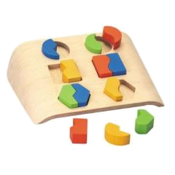
3. Pattern matching

Slide 30
Pattern matching
Finding a sub-string (match) somewhere in a string:
if ($line =~ m/he/) ...
remember to use slash (/) and not back-slash.
Will be true for “hello” and for “the cat” but not for “good bye” or “Hercules”.

Slide 31
Single-character patterns
m/./ Matches any character (except “\n”)
You can also ask for one of a group of characters:
m/[atcg]/ Matches “a” or “t” or “c” or “g”
m/[a-d]/ Matches “a” though “d” (a, b, c or d)
m/[a-zA-Z]/ Matches any letter
m/[^atcg]/ Matches any character except “a” or “t” or “c” or “g” m/[^0-9]/ Matches any character except a digit

Slide 32
Single-character patterns
For example:
if ($line =~ m/TATAA[AT]/)
Will be true for?
✗
✔
✔
TATTAA
TATAATA
CTATATAATAGCTAGGCGCATG
TATTAA
TATAATA
CTATATAATAGCTAGGCGCATG

Slide 33
Repetitive patterns
? means zero or one repetitions:
m/ab?c/ Matches “ac” or “abc”
+ means one or more repetitions:
m/ab+c/ Matches “abc” ; “abbbbc” but not “ac”
A pattern followed by * means zero or more repetitions of that patern:
m/ab*c/ Matches “abc” ; “ac” ; “abbbbc”
Generally – use { } for a certain number of repetitions, or a range:
m/ab{3}c/ Matches “abbbc”
m/ab{3,6}c/ Matches “a”, 3-6 times “b” and then “c”
Use parentheses to mark more than one character for repetition:
m/h(el)*lo/ Matches “hello” ; “hlo” ; “helelello”

Slide 34
Single-character patterns
For example:
if ($line =~ m/TATAA[AT][ATCG]{2,4}ATG/)
Will be true for?
TATAAAGAATG
ACTATAATAAAAATG
TATAATGATGTATAATATCG
TATAAAGAATG
ACTATAATAAAAATG
✔
✔
✗

Slide 35

4.

Slide 36
BioPerl
The BioPerl project is an international association of developers of open source Perl tools for bioinformatics, genomics and life science research.
Things you can do with BioPerl:
Read and write sequence files of different format, including: Fasta, GenBank, EMBL, SwissProt and more…
Extract gene annotation from GenBank, EMBL, SwissProt files
Read and analyze BLAST results.
Read and process phylogenetic trees and multiple sequence alignments.
Analysing SNP data.
And more…

Slide 37
BioPerl: the SeqIO module
The Bio::SeqIO module allows reading/writing sequences from/to files, using many file formats (Fasta, Genbank, EMBL…)
use Bio::SeqIO;
my $in = new Bio::SeqIO("-file" => "inputFile",
"-format" => "genbank");
my $out = new Bio::SeqIO("-file" => ">outputFile",
"-format" => "fasta");
while ( my $seqObj = $in->next_seq() ) {
$out->write_seq($seqObj);
}

Slide 38
Why biologists need to program?
A real life example:
Finding a regulatory motif in sequences
>gi|307611471|emb|TUX01140.1| vicious T3SS effector [Shloomopila apchiella 130b]
MAAQLDPSSEFAALVKRLQREPDNPGLKQAVVKRLPEMQVLAKTNSLALFRLAQVYSPSSSQHKQMILQS
AAQGCTNAMLSACEILLKSGAANDLITAAHYMRLIQSSKDSYIIGLGKKLLEKYPGFAEELKSKSKEVPY
QSTLRFFGVQSESNKENEEKIINRPTV
>gi|307611373|emb|TUX01034.1| vicious T3SS effector [Shloomopila apchiella 130b]
MVDKIKFKEPERCEYLHIDKDNKVHILLPIVGGDEIGLDNTCETTGELLAFFYGKTHGGTKYSAEHHLNE
YKKNLEDDIKAIGVQRKISPNAYEDLLKEKKERLEQIEKYIDLIKVLKEKFDEQREIDKLRTEGIPQLPS
GVKEVIQSSENAFALRLSPDRPDSFTRFDNPLFSLKRNRSQYEAGGYQRATDGLGARLRSELLPPDKDTP
IVFNKKSLKDKIVDSVLAQLDKDFNTKDGDRNQKFEDIKKLVLEEYKKIDSELQVDEDTYHQPLNLDYLE
NIACTLDDNSTAKDWVYGIIGATTEADYWPKKESESGTEKVSVFYEKQKEIKFESDTNTMSIKVQYLLAE
INFYCKTNKLSDANFGEFFDKEPHATEVAKRVKEGLVQGAEIEPIIYNYINSHYAELGLTSQLSSKQQEE
...
...
...
Shmulik

Slide 39
A Perl script can do it for you
Shmulik writes a simple Perl script to reads protein sequences and find all proteins that contain the motif RXXR:
  Use the BioPerl package SeqIO
  Open and read file “Shloomopila_proteins.fasta”
  Iteration – for each sequence:
    Search for the pattern RXXR
    If found – print a message

Slide 40
A Perl script can do it for you
Use the BioPerl package SeqIO
use strict;
use warnings;
use Bio::SeqIO;
my $fastaFile = new Bio::SeqIO (
"-format" => "fasta",
"-file" => "Shloomopila_proteins.fasta");
my $seqObj;
while ($seqObj = $fastaFile->next_seq)
{
print "Checking protein ", $seqObj->id, "...\n";
my $seq = $seqObj->seq;
if ($seq =~ m/R..R/) {
print " Motif found!\n";
}
}
Open file “Shloomopila_proteins.fasta” using SeqIO
Iterate over all protein sequences
Search for the motif
If so – print a message

Slide 41
A Perl script can do it for you
D:\perl>perl ex3.pl
Checking protein gi|307611385|emb|TUX01049.1|...
Checking protein gi|307610288|emb|TUW99852.1|...
Motif found!
Checking protein gi|307609432|emb|TUW98922.1|...
Checking protein gi|307611597|emb|TUX01279.1|...
Checking protein gi|307611471|emb|TUX01140.1|...
Checking protein gi|307611373|emb|TUX01034.1|...
Motif found!
Checking protein gi|307611322|emb|TUX00983.1|...
Motif found!
Checking protein gi|307611314|emb|TUX00973.1|...
Checking protein gi|307611264|emb|TUX00923.1|...
Motif found!
Checking protein gi|307611259|emb|TUX00917.1|...

Slide 42
Class exercise 3
The script “ex3.pl” searches protein sequences for the motif RXXR, which is common in effectors of Shloomopila apchiella. Change it to allow both R and K in both first and last positions.
Allow 2-4 X’s between the R/K residues
The signal should be found in the N-terminal sequence of S. apchiella proteins. Change the script to search only in the first 30 amino acids.
4* Next, you’re going to study the species S. difficile, in which the signal is found in the C-terminal sequence – the last 30 amino acids. Change the script accordingly.

Slide 43
Thanks for your patience and
See you in the full Perl course…

