Slide 1
Kinetic microarray analysis
Data: crawford et al. 2014
01.10.2020

Slide 2
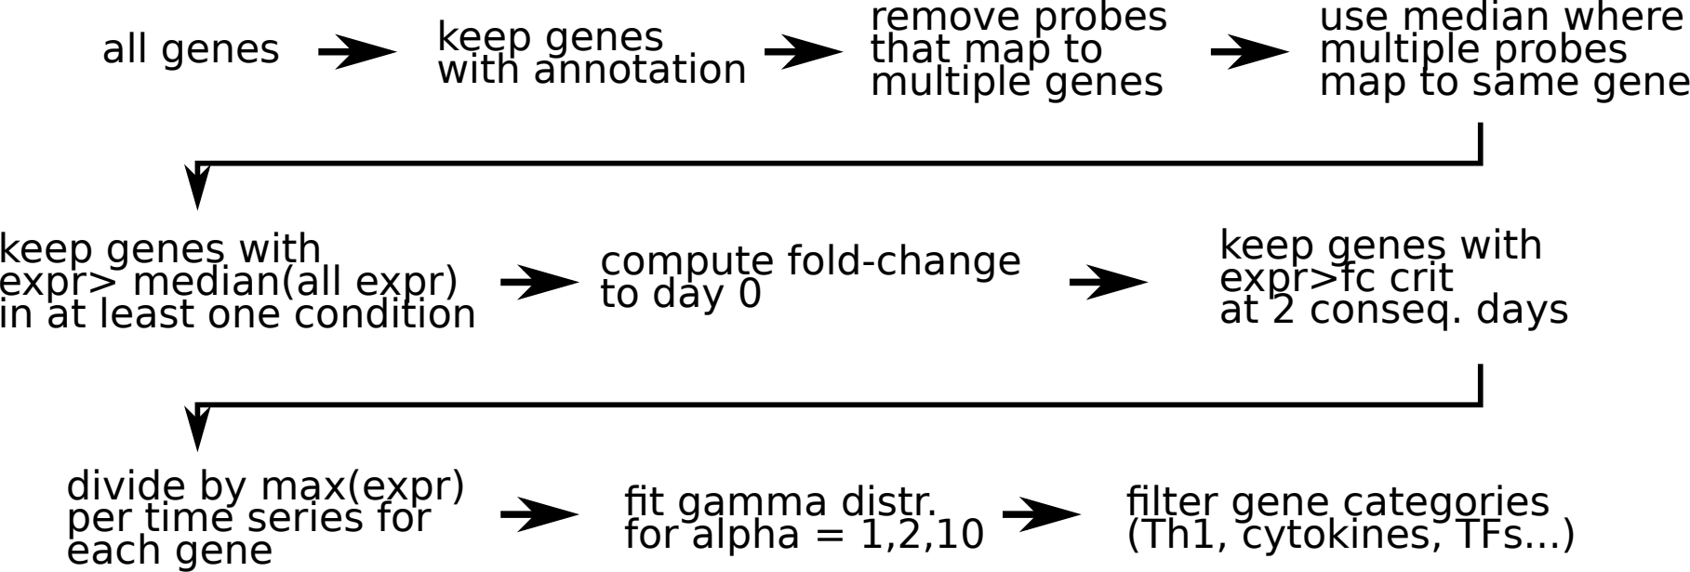
Kinetic genes analysis workflow

Slide 3
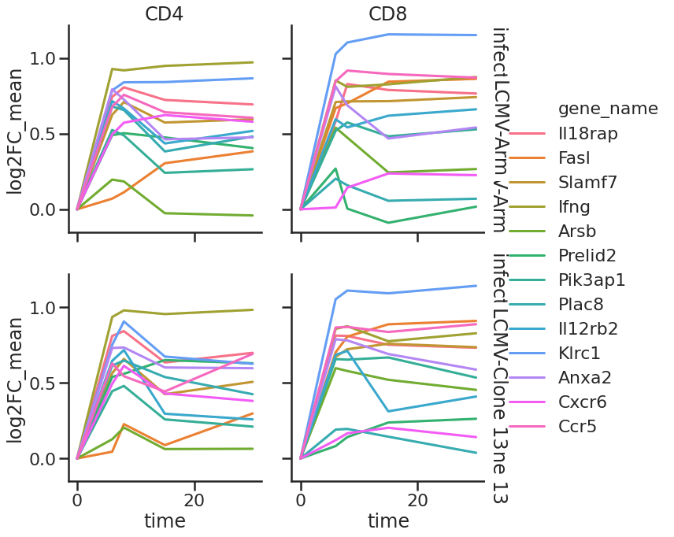
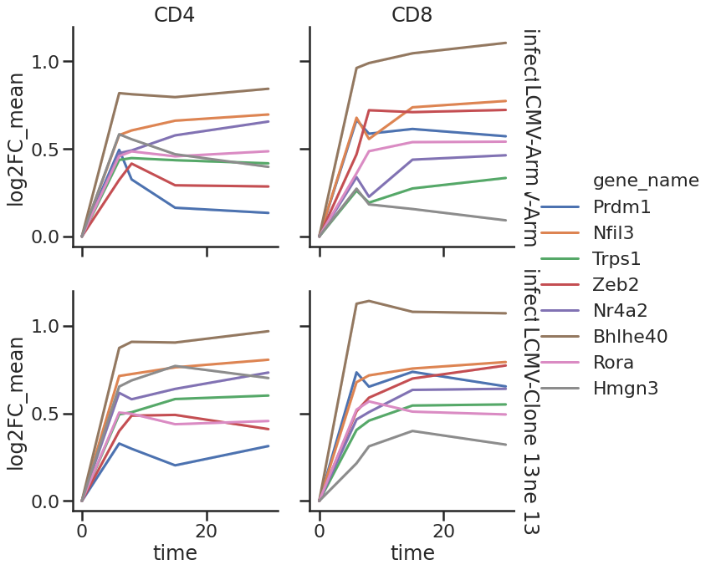
kinetic genes
Th1 genes Transcription factors

Slide 4
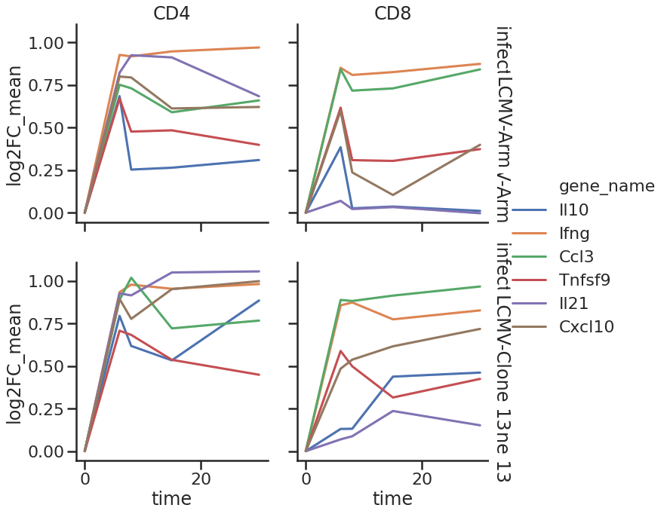
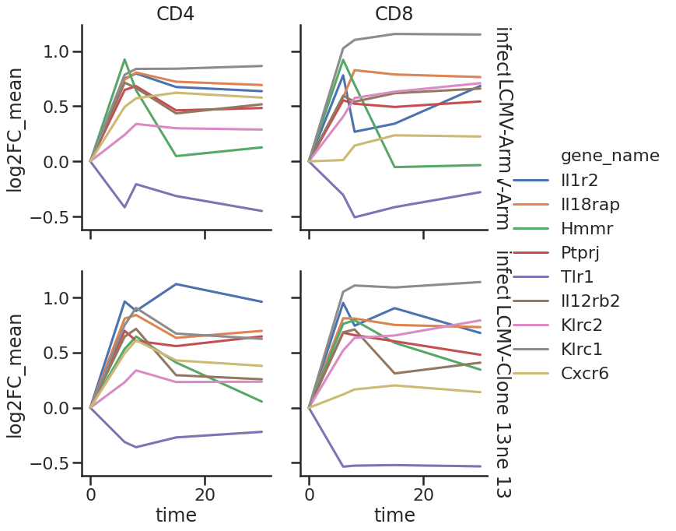
kinetic genes
Cytokines Receptors

Slide 5
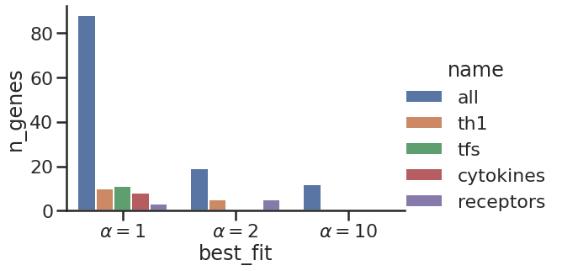
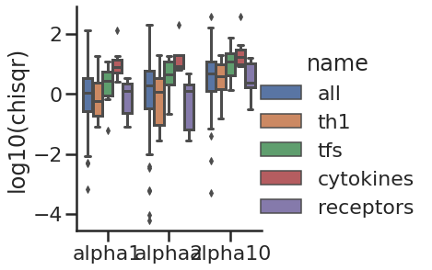
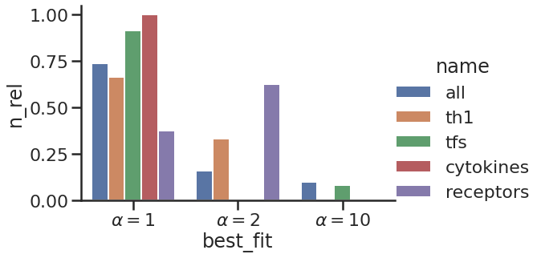
Kinetic fit results
Best fits per gene
Goodness of fit distr

Slide 6
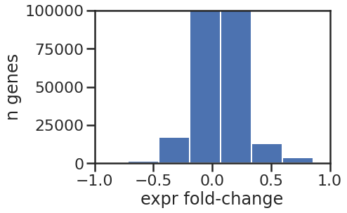
Problem: few genes with strong fold-changes
|log2FC|>0.5 --> 164 kinetic genes

Slide 7
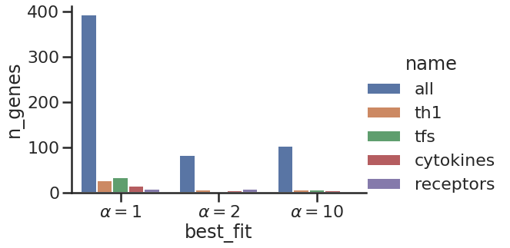
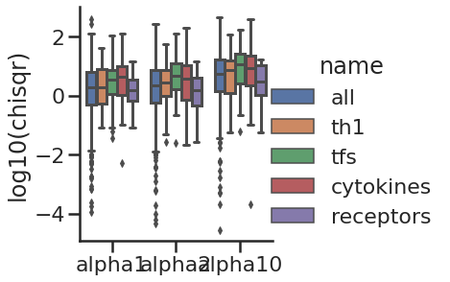
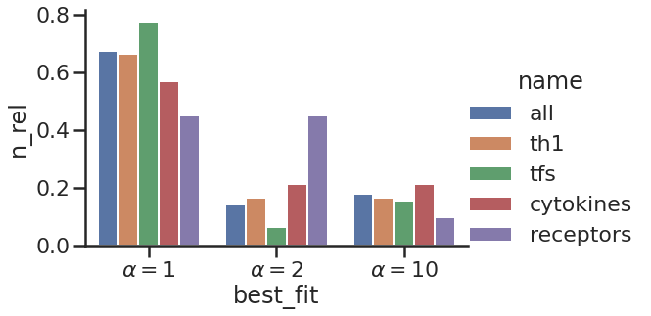
Analysis with |FC|>0.25

Slide 8
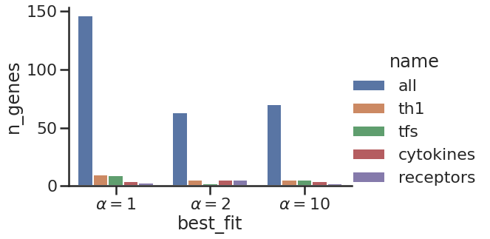
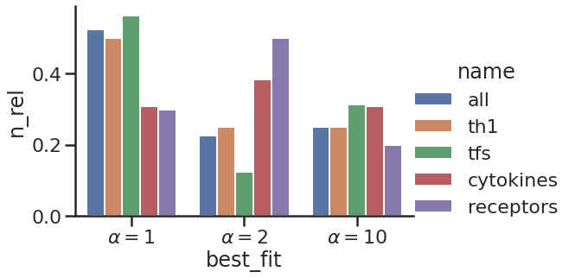
Focusing on fits with small error, the distribution of best fit alpha is more uniform
Only fits with chisqr < 1 + log2FC>0.25

