Slide 1


Characterizing CUDA and OpenMP Synchronization Primitives
Brandon Alexander Burtchell and Martin Burtscher
Department of Computer Science

Slide 2

Motivation
Parallelism is now one of the primary methods of speeding up programs
When writing parallel code, it is often necessary to use synchronization primitives for correctness
Performance depends on many complex factors
Non-trivial for beginners and experts alike
Hence, we need to identify the behavior of sync primitives to guide programmers

Slide 3

Highlights
Create a test framework to measure throughput of single calls of synchronization primitives
Run experiments across several parameters
Analyze behavior and provide recommendations
This talk covers the most notable findings
Code and results are open-source
github.com/burtscher/SyncPerformance

Slide 4

Approach
To time a sync, we define two functions
Baseline and Test
Identical functions, except the test executes the sync at least one more time than the baseline
Subtract the runtimes to yield the runtime of the sync—without testing overhead
Convert to throughput for analysis

Slide 5
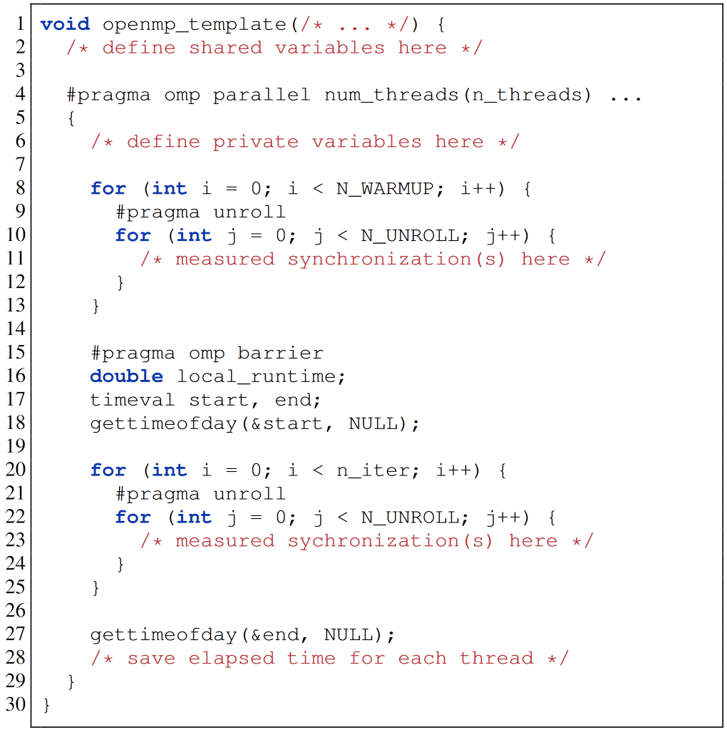
Approach: Test Template
Warmup removes overhead from fetching data from slower memory for the first time
Sync threads before starting per-thread timers
(Not shown) convert to throughput

Slide 6
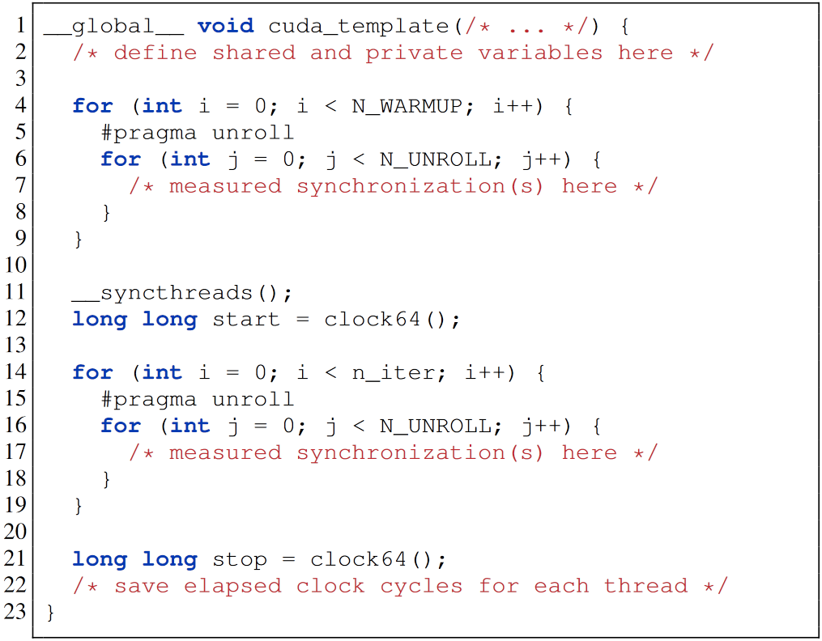
Approach: CUDA Template
Like OpenMP template, except it is a CUDA kernel
clock64() counts elapsed clock cycles

Slide 7
Background: Covered Syncs
OpenMP barrier
All threads must reach barrier before continuing
OpenMP atomic update (add)
Read, update, and write to a memory location in a single uninterruptable atomic transaction (prevents data race)
OpenMP flush
CUDA atomicAdd()
CUDA warp shuffles
Full paper covers more

Slide 8
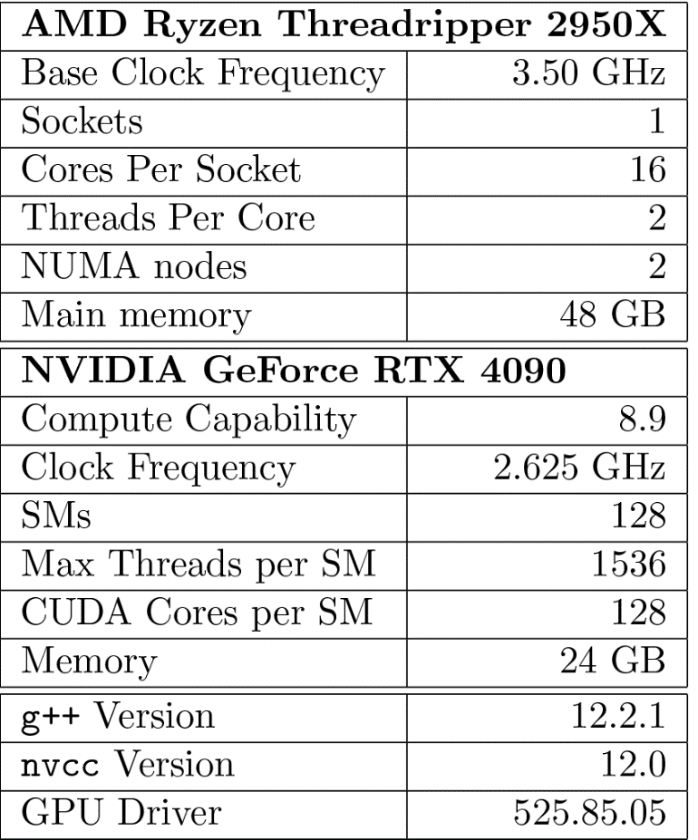
Evaluation Methodology
Tested 3 systems
Results shown from System 3
Parameters
Number of threads
Number of blocks (CUDA)
1, 2, half, full, double capacity
Type (int, ull, float, double)
Stride of array accesses
9 runs per baseline/test

Slide 9
Results

Slide 10
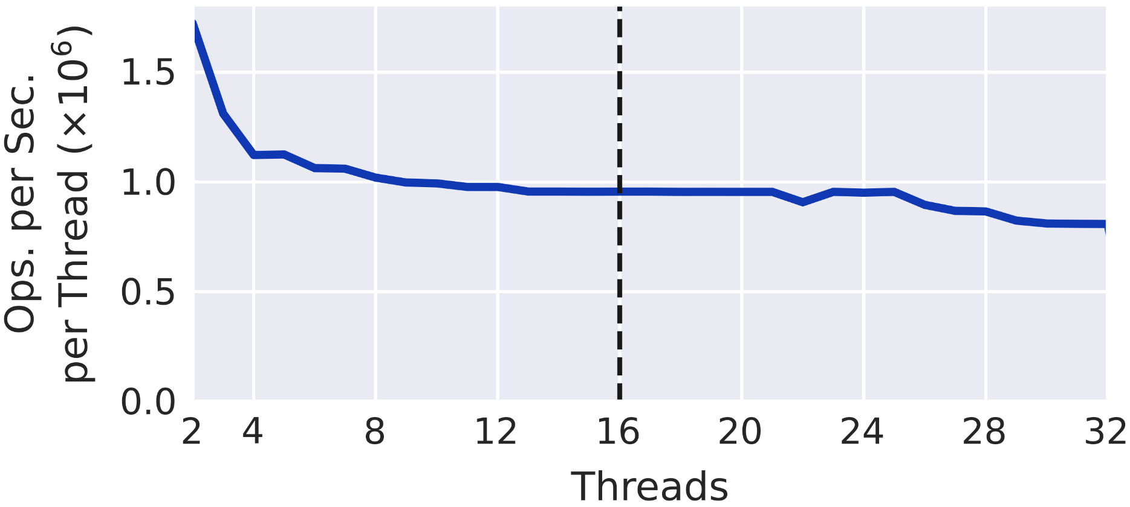
OpenMP Results: Barrier
Dotted line is where hyperthreading starts
Relatively stable beyond 8 threads
Throughput of OpenMP barrier

Slide 11
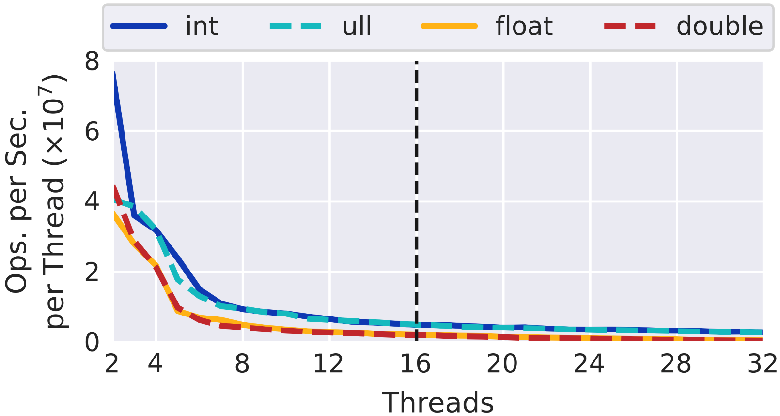
OpenMP Results: Atomic Add (Scalar)
Arithmetic (integer vs. floating-point) is the differentiator
Throughput of OpenMP atomic update on a single shared variable

Slide 12
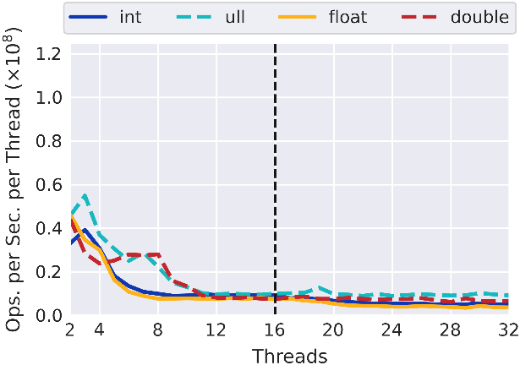
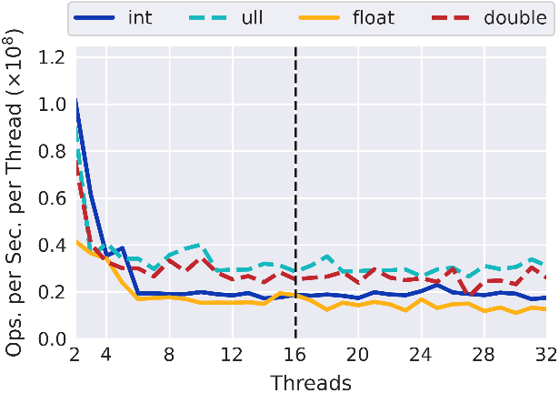
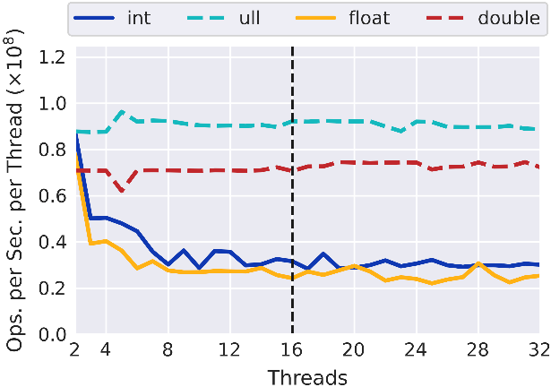
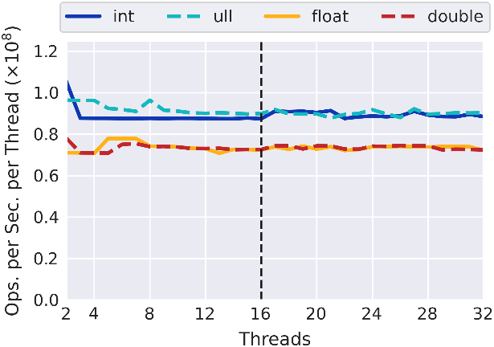
OpenMP Results: Atomic Add (Array)
Stride = 1
Stride = 4
Note: L1 cache line size is 64 bytes
Increasing stride reduces effect of false sharing
Stride = 8
Stride = 16
8-byte types are now padded to separate cache lines
Now no more false sharing
Throughput of OpenMP atomic update on private elements in a shared array for different strides

Slide 13
Background: OpenMP Memory Flush
Memory consistency model specifies allowed reorderings of reads and writes of one variable relative to another
A memory flush prevents reorderings by ensuring all memory operations prior to the flush finish before any start that appear after the flush
Necessary when programmer uses a variable to protect another (e.g., flag in producer-consumer code)

Slide 14
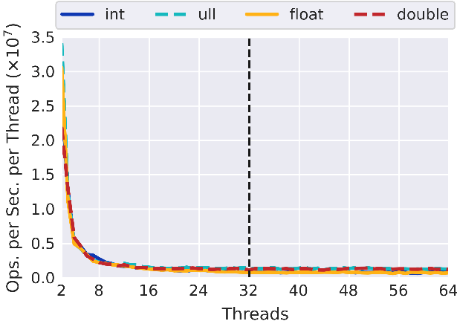
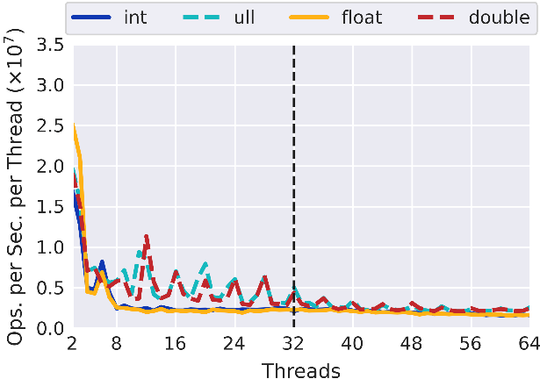
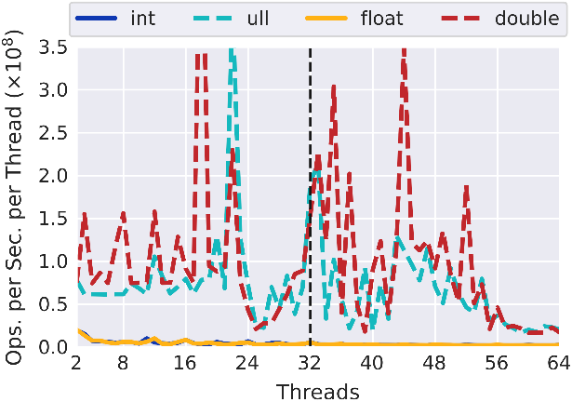
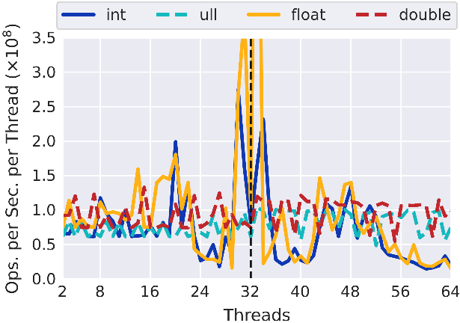
OpenMP Results: Memory Flush
Results from System 2
Stride = 1
Stride = 4
8-byte types oscillate more (false sharing)
Note: L1 cache line size is 64 bytes
Stride = 8
Stride = 16
8-bytes types no longer have false sharing
Throughput of OpenMP flush for different strides

Slide 15
OpenMP Recommendations
Barriers are not a major concern with large thread counts
Using hyperthreads does not significantly impact synchronization performance
Atomic updates/writes to the same memory location should be avoided
Atomic operations to different memory locations are faster if the locations do not reside in the same cache line

Slide 16
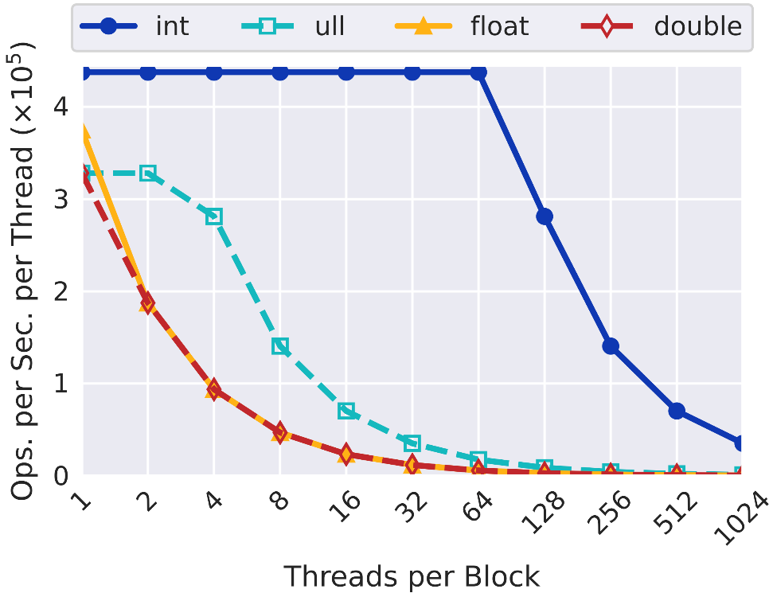
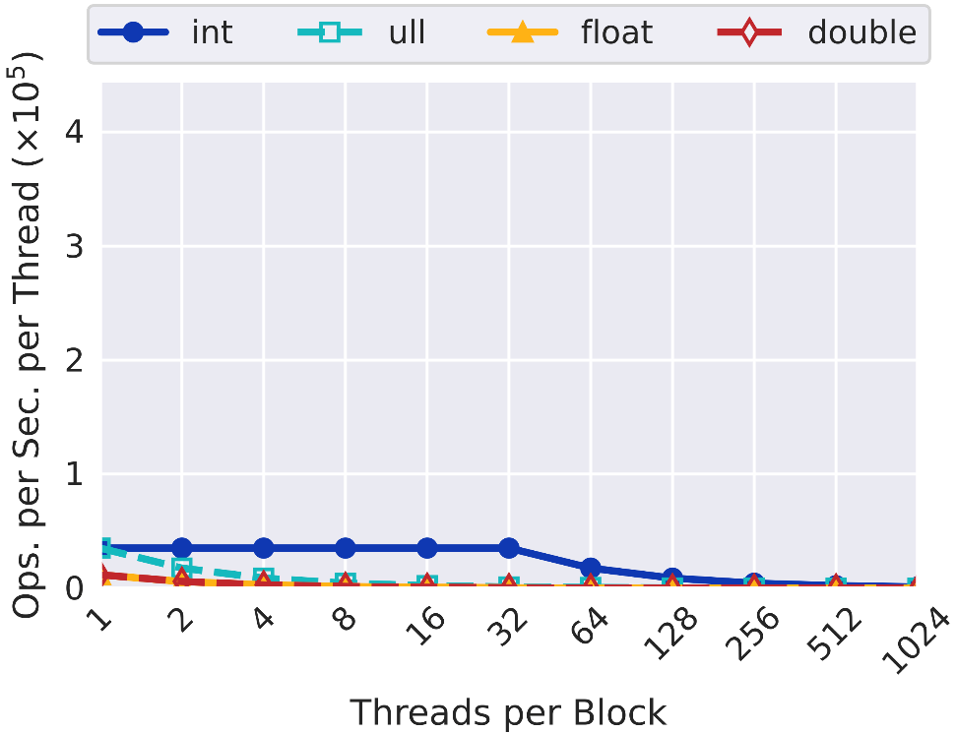
CUDA Results: Atomic Add (Scalar)
Warp-aggregated atomic!
Note: log scale on x-axis
2 Blocks
64 Blocks
half # SMs
GPUs have 32-bit arch
Warp-aggregated atomic!
Slower float: fewer atomic units?
Throughput of atomicAdd() on 1 shared variable

Slide 17
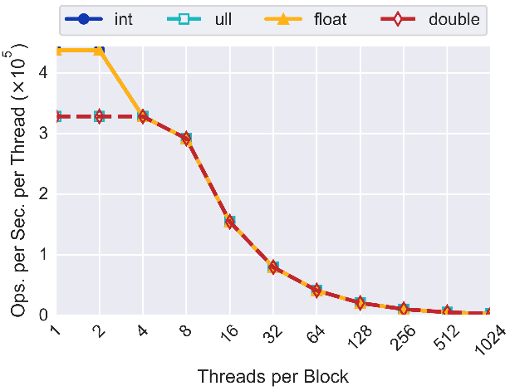
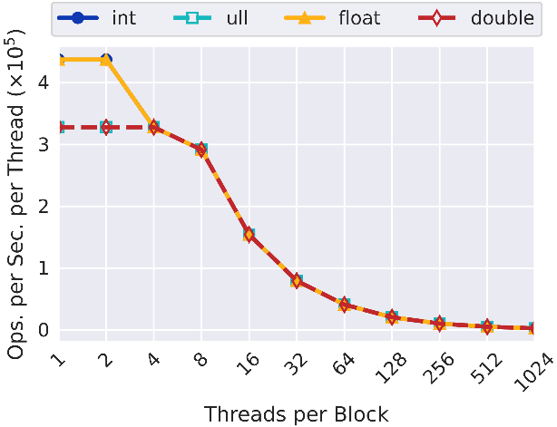
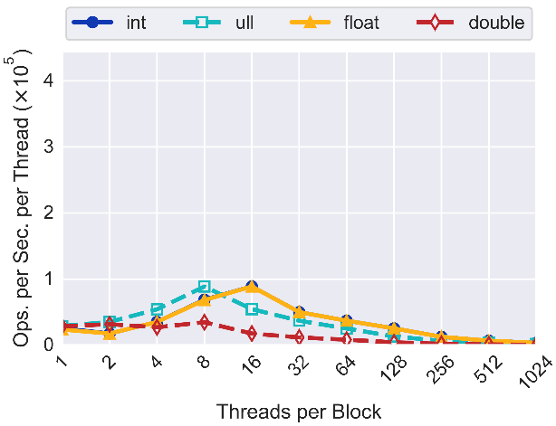
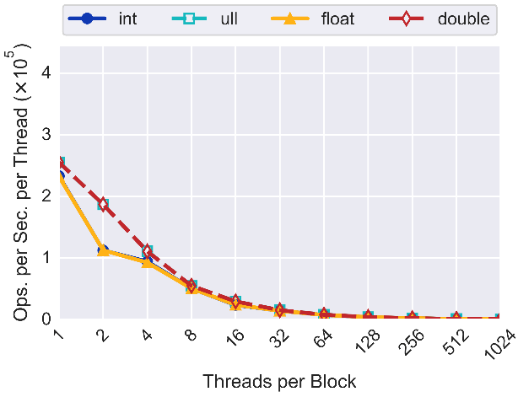
CUDA Results: Atomic Add (Array)
1 Block, Stride = 1
1 Block, Stride = 32
Stride has no effect on 1 block
128 Blocks, Stride = 1
128 Blocks, Stride = 32
More blocks, more traffic to shared L2 cache
Downward trends due to max number of atomics per time unit
Throughput of atomicAdd() on private elements in a shared array for different block counts and strides

Slide 18
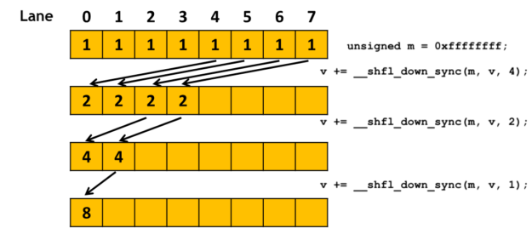
Background: CUDA Warp Shuffles
Warp shuffles synchronize the threads in a warp and have them exchange values
__shfl_sync(), and up, down, xor variants
Example of using warp shuffles to perform a sum reduction
Image source: Lin, Y and Grover, V. “Using CUDA Warp-Level Primitives.”
https://developer.nvidia.com/blog/using-cuda-warp-level-primitives/

Slide 19
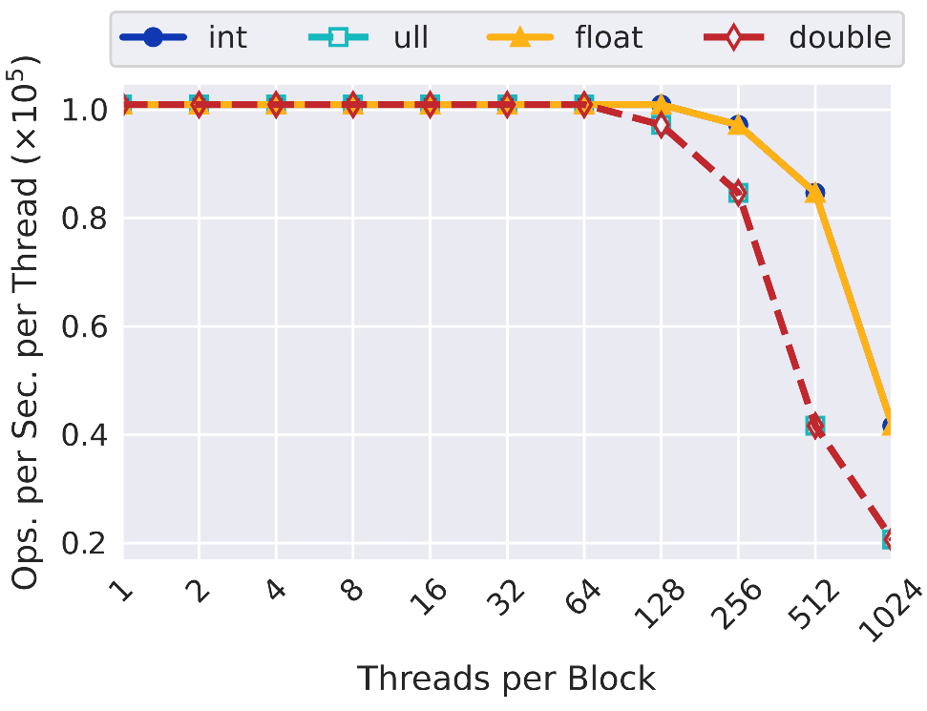
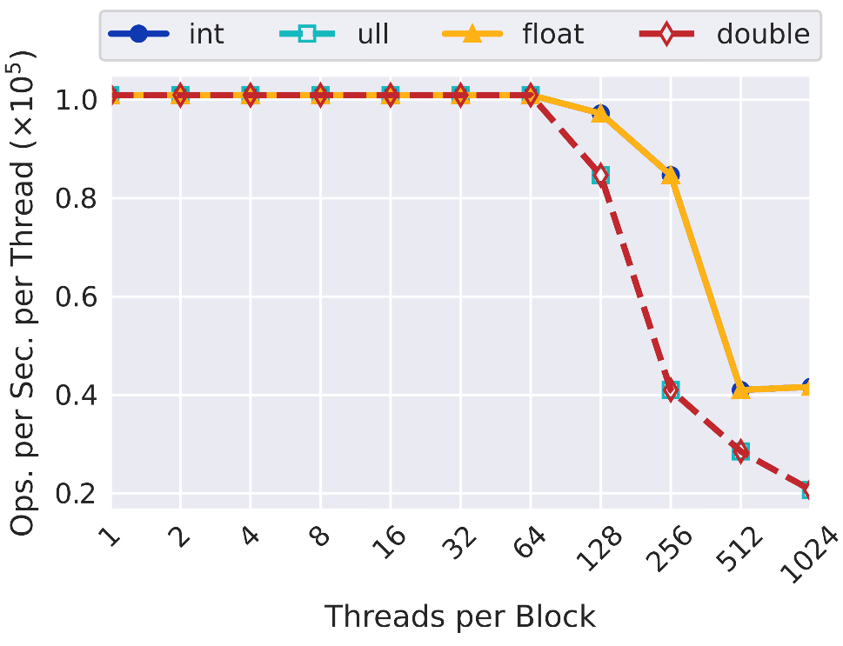
CUDA Results: Shfl Sync
Throughput is constant to a point
64-bit types drop at half number of threads
128 Blocks (“full”)
256 Blocks (“double”)
Throughput of __shfl_sync()

Slide 20
CUDA Recommendations
int atomic operations generally perform better than other data types
Automatic warp-aggregated atomics are powerful
Other atomics (i.e., CAS, Exch) followed similar behavior, implying a hardware limit on the number of concurrent atomic operations
Warp shuffles are fast but decrease throughput when the SM is nearly fully loaded
Still, they should be used to avoid memory traffic

Slide 21




Conclusions
We hope this information aids developers
In the full paper, we cover much more
OpenMP critical section, memory flush
CUDA syncs, thread fences, warp-level functions
Future developers can write new tests
Acknowledgements: DOE, NVIDIA
Code and results are open-source
github.com/burtscher/SyncPerformance
Contact: burtchell@txstate.edu

