Slide 1
Presentation Outline for Topic 74

Slide 2
Student 6
Id BDU 1505500

Slide 3
What is a Parse Table and What is Its Role in Parsing?

Slide 4
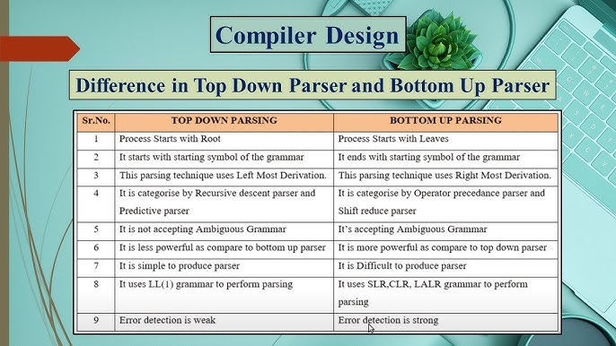

Slide 5
INTRODUCTION

Slide 6
Background and Relevance
Syntax analysis (parsing) checks if tokens follow grammar rules.
Builds parse tree or performs actions.
Main approaches: Top-down (LL) and Bottom-up (LR).
Parse table: Precomputed decision table for efficient parsing.
Importance: Used in tools like YACC/Bison for real compilers.

Slide 7
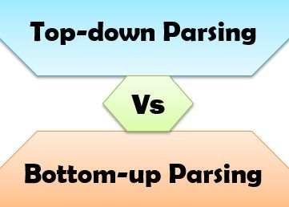

Slide 9
What is a Parse Table?
2D table guiding parser decisions (state + input → action).
Types:
LL(1): Rows = Non-terminals, Columns = Terminals, Entries = Productions.
LR: ACTION (shift/reduce) + GOTO tables.

Slide 10
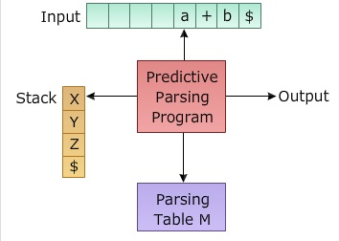
Examples of LL(1) Parse Tables

Slide 11
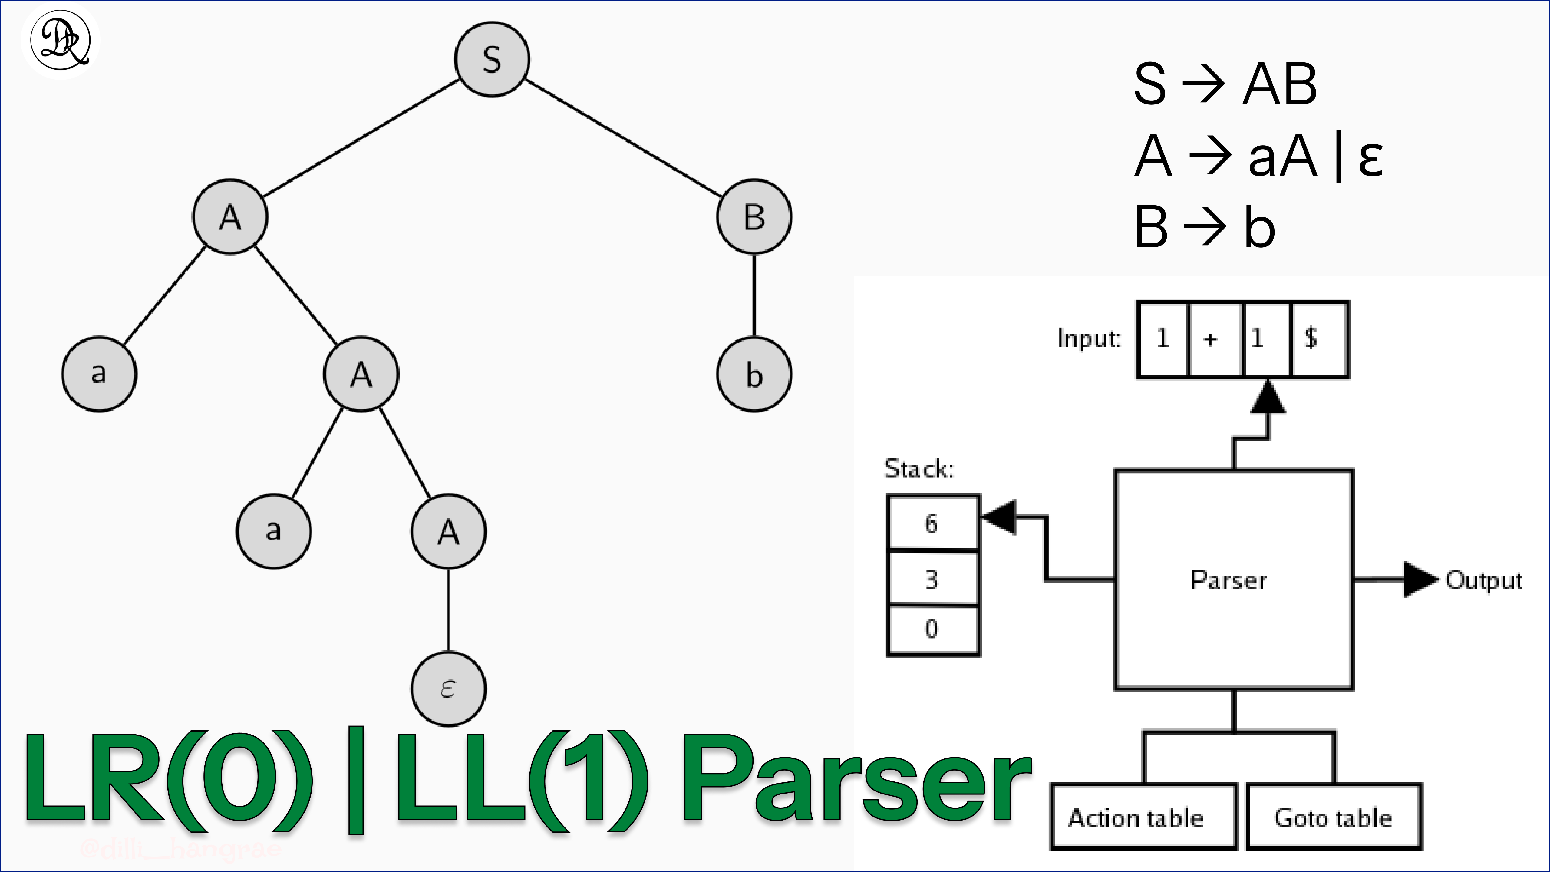

Slide 12
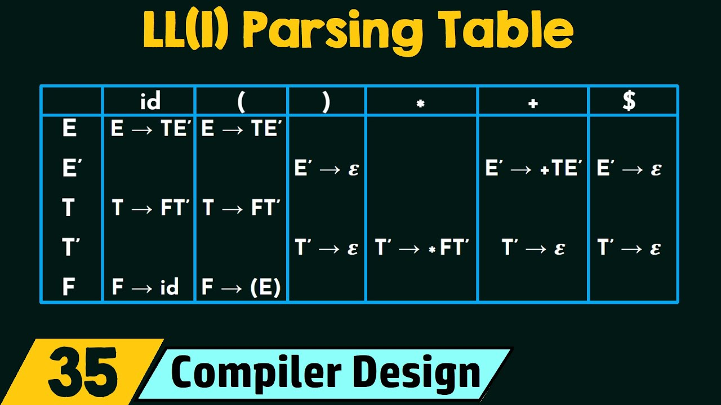

Slide 13
How is a Parse Table Generated?
LL(1): Use FIRST/FOLLOW sets to fill entries.
LR: Build states from LR items, compute closures/gotos.
Tools automate this (e.g., YACC/Bison for LALR).

Slide 14
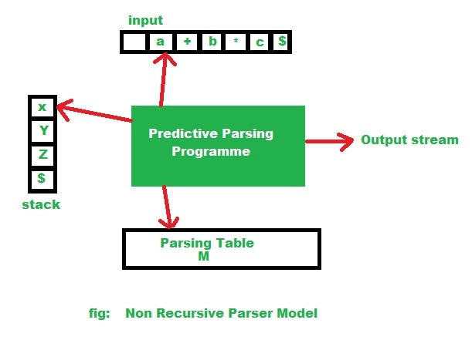
Construction Flowchart/Algorithm

Slide 15
Role of the Parse Table in Parsing
Drives parser loop: Lookup → Shift/Reduce/Predict/Accept/Error.
Enables deterministic, efficient parsing (O(n) time).
Supports error recovery (blank = error).
LL: Predicts productions; LR: Handles complex grammars.

Slide 16
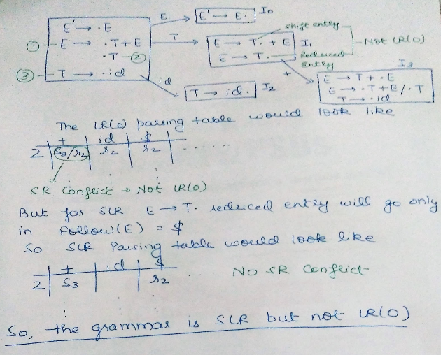
LR Parse Table Examples (SLR/LALR)

Slide 17
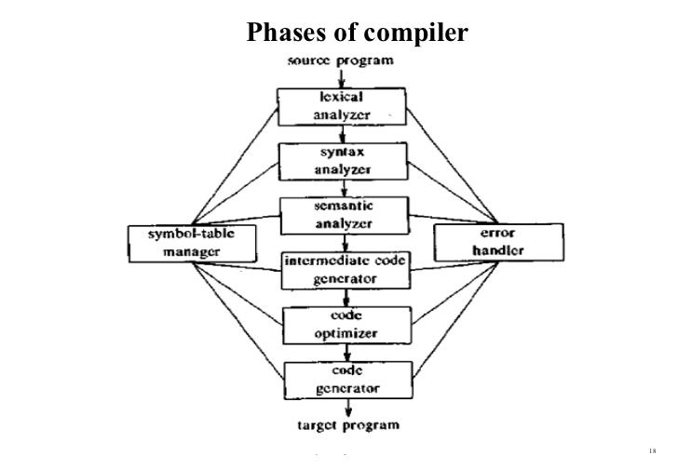

Slide 18
Expression Grammar
Grammar:
E → T E
' E' → + T E
' | ε T → id

Slide 19
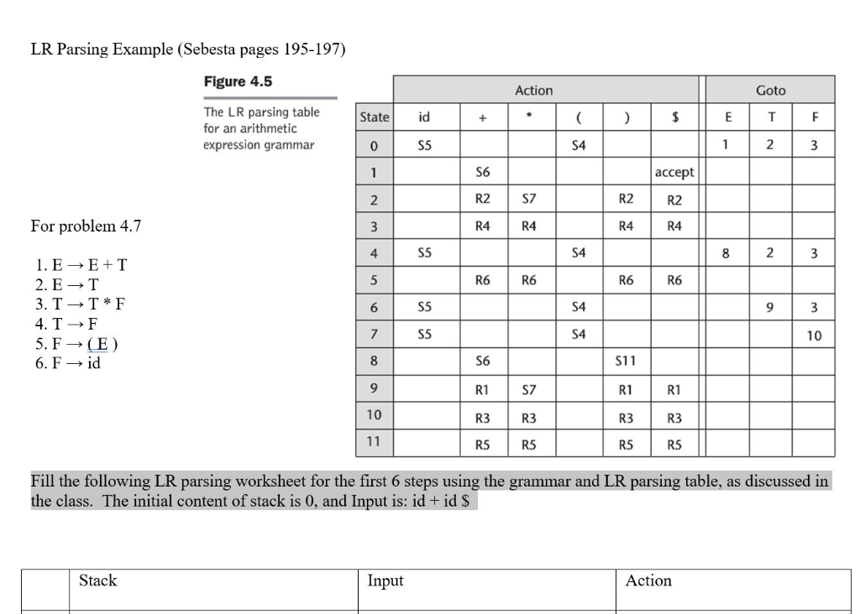

Slide 20
Advantages & Real-World Use
Fast, no backtracking.
Easy error handling.
Used in GCC, Clang, Java parsers.
Automated by parser generators.

Slide 21
Conclusion
parse table = Core of table-driven parsers.
Makes parsing predictable and efficient.
Essential for modern compiler construction

Slide 22
References
Aho, Sethi, Ullman – Compilers: Principles, Techniques, and Tools (Dragon Book).
GeeksforGeeks – Articles on LL/LR Parsing.
YouTube Tutorials on Parsing Tables.
Medium & Stack Overflow explanations.

Slide 23
THANK YOU!

