Slide 1
InSpec Yourself Before you Wreck Yourself
or What to Expect when Your InSpec’ing

Slide 2
Self-Assessment
6 questions

Slide 3
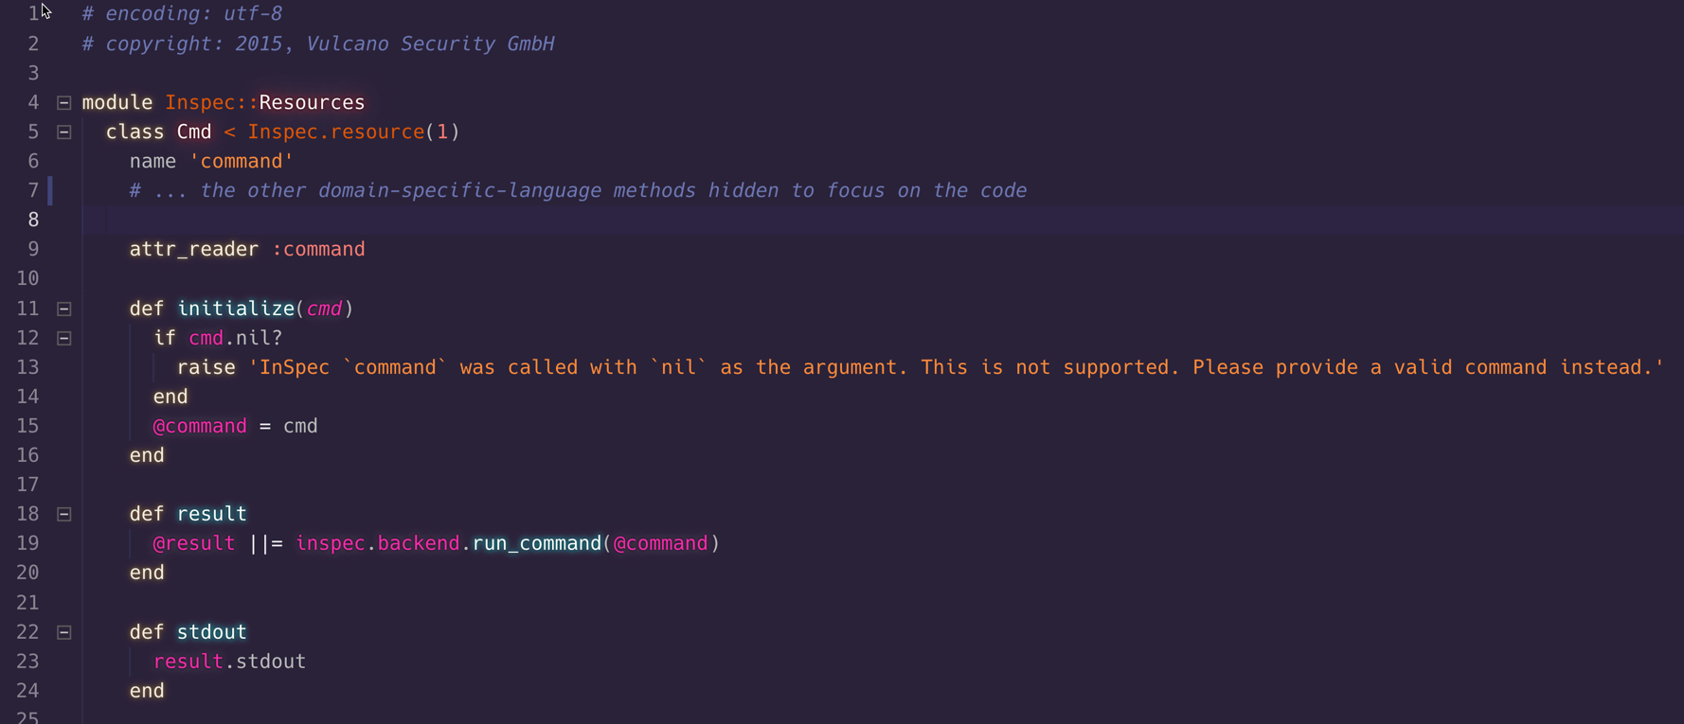
An Examination of the command Resource

Slide 4
Self-Assessment
Do you understand how this works?
Would you feel confident troubleshooting an issue?
Would you feel confident making a change?

Slide 5
Self-Assessment
Could you explain how this works?
Could you explain troubleshooting an issue?
Could you explain how to make a change?

Slide 6
The Agenda
Motivation
Find the InSpec Version
Create a git resource
Create a git_repo resource
Create a git_config resource
Summary

Slide 7
To be a better maintainer
Learning how a resource is constructed will assist you in verifying, troubleshooting, and authoring resources.

Slide 8
To be a better maintainer
Learning how a resource is constructed will assist you in verifying, troubleshooting, and authoring resources.
Bring clarity to your profiles to assist every consumer of the documentation created by InSpec.

Slide 9
To be a better maintainer
Learning how a resource is constructed will assist you in verifying, troubleshooting, and authoring resources.
Bring clarity to your profiles to assist every consumer of the documentation created by InSpec.
By improving your understanding of the underlying constructs that are present in the Ruby programming language

Slide 10
The Agenda
Motivation
Find the InSpec Version
Create a git resource
Create a git_repo resource
Create a git_config resource
Summary

Slide 11
InSpec
Installed from:
a package built by Chef, Inc.
a gem installation via Rubygems
a package built by the community
It provides an executable, inspec, that is added to your workstations PATH. This executable accepts parameters. The 'help' parameter displays
> inspec help
>

Slide 12
InSpec Version
> inspec version
4.3.2

Slide 13
The Agenda
Motivation
Find the InSpec Version
Create a git resource
Create a git_repo resource
Create a git_config resource
Summary

Slide 14
InSpec
Enables you to express your desired expectations about the system resources. A resource is a mapping of a detail about your system. InSpec is packaged with a core set of resources.
InSpec
Test Runner
Expectations
Resources
>

Slide 15
Git Version
> git --version

Slide 16
Creating a Profile
> inspec init profile git
─────────────────────────── InSpec Code Generator ────
Creating new profile at /Users/burtlo/git
• Creating directory libraries
• Creating file libraries/.gitkeep
• Creating file README.md
• Creating directory controls
• Creating file controls/example.rb
• Creating file inspec.yml

Slide 17
Add a command Control
./git/controls/example.rb
describe command('git --version') do
its(:stdout) { should eq 'git version 2.20.1 (Apple
its(:stdout) { should match('2.20.1') }
end

Slide 18
Scanning with the Profile
> inspec exec .
Profile: InSpec Profile (git)
Version: 0.1.0
Target: local://
Command: `git --version`
✔ stdout should match "2.20.1"
Test Summary: 1 successful, 0 failures, 0 skipped

Slide 19
InSpec Language
A resource may also be defined in an InSpec profile and used within that profile* or in any other profile that defines that profile as a dependency.
* The resource pack pattern defines a profile with only resources; no controls.

Slide 20
InSpec Language
A resource has a domain-specific-language (DSL) that helps express:
name
description
examples
supports
Request for Comment (RFC): Resource Introspection (inspec/issues/3165)
>

Slide 21
Add a git Control
./git/controls/example.rb
describe git do
its(:version) { should eq('2.20.1') }
end

Slide 22
Scan for Failure
> inspec exec .
...
...
undefined local variable or method `git' for #<#<Class:0x00007f85106e45f0>:0x00007f85106efd10> (NameError)

Slide 23
Define a git Resource
./git/libraries/git.rb
class Git < Inspec.resource(1)
name :git
def version
raw_result = inspec.command('git --version').stdout
/(\d+\.\d+\.\d+)/.match(raw_result)[1]
end
end

Slide 24
Scan for Success
> inspec exec .
Target: local://
Command: `git --version`
✔ stdout should match "2.20.1"
git
✔ version should eq "2.20.1"
Test Summary: 2 successful, 0 failures, 0 skipped

Slide 25
The git Control with path
./git/controls/example.rb
describe git('/usr/bin/git') do
its(:version) { should eq('2.20.1') }
end

Slide 26
Update the git Resource to Accept a Path
./git/libraries/git.rb
class Git < Inspec.resource(1)
name :git
def initialize(patH)
@path = path
end
attr_reader :path
# ...

Slide 27
Update the git Resource to Accept a Path
./git/libraries/git.rb
class Git < Inspec.resource(1)
# ... attr_reader :path
def version
raw_result = inspec.command("#{path} --version")...
/(\d+\.\d+\.\d+)/.match(raw_result)[1]
end
end

Slide 28
Test Driven Development
1
Define a test that expresses the desired state
2
Implement the solution
3
Verify that the implementation meets the desired state
4
Refactor

Slide 29
Debugging with Pry
Enables you to interrogate the execution flow at breakpoints.
Useful Commands:
ls
help
exit
require 'pry'
binding.pry
Learn more: https://pryrepl.org

Slide 30
Strings - Trimming Space
" output ".strip # "output"
" output ".lstrip # "output "
" output ".rstrip # " output"
Learn more: https://ruby-doc.org/core-2.6.2/String.html

Slide 31
Strings - Substrings
result = "git version 2.20.1 (Apple Git-117)"
result[12..17] # 2.20.1
result[12,6] # 2.20.1
Learn more: https://ruby-doc.org/core-2.6.2/String.html

Slide 32
Strings - Tokenization
result = "git version 2.20.1 (Apple Git-117)"
result.split(' ') # [ 'git', 'version', '2.20.1',
result.split # [ 'git', 'version', '2.20.1',
Learn more: https://ruby-doc.org/core-2.6.2/String.html

Slide 33
Strings - Regular Expressions
result = "git version 2.20.1 (Apple Git-117)"
/(\d+\.\d+\.\d+)/ # MatchData{ version: '2.20.1' }
We used:
\d any digit
\. literal period (as a period means match any charater)
+ suffix to say 1 or more
(<name>REGEX) to create a named group
Learn more: https://rubular.com or talk with @nellshamrell

Slide 34
The Agenda
Motivation
Find the InSpec Version
Create a git resource
Create a git_repo resource
Create a git_config resource
Summary

Slide 35
Live Demonstration
>

Slide 36
The Agenda
Motivation
Find the InSpec Version
Create a git resource
Create a git_repo resource
Create a git_config resource
Summary

Slide 37
Live Demonstration
>

Slide 38
The Agenda
Motivation
Find the InSpec Version
Create a git resource
Create a git_repo resource
Create a git_config resource
Summary

Slide 39
Resources
InSpec documentation – https://docs.inspec.io
Learn Chef Rally tracks/modules - "Compliance Automation"
InSpec source code – https://github.com/inspec/inspec
Chef Community Slack - #inspec

Slide 40

Lynn Frank
GitHub
Slack
Twitter
@burtlo
@burtlo
@lynnvfrank

Slide 42
Ohbye
http://github.com/burtlo/ohbye
Collect ohai details from the comfort of your workstation

Slide 43
chefspec-ohai
http://github.com/burtlo/chefspec-ohai
Unit test your ohai plugins

Slide 44
VSCode
Synthwave '84

