Slide 1
Tandem Ciders Production Database
By
Richard Burton
And
David Burton

Slide 2
Content
We organized our data into 11 different tables:
AppleStorage
Batch
CarbTanks
CiderBottles
CiderCans
CiderKegs
CidertoLBStorage
CidertoRBStorage
CidertoTRBackroom
CidertoTRDraft
Fermentors

Slide 3
AppleStorage
BoxID
Variety
Grower
DateIN
DateOUT
BatchID

Slide 4
Batch
BatchID
CiderType
GallonsFilled
FermentTankID
DateFilled
CarbTankID

Slide 5
CarbTanks
CarbTankID
TankDescription
GallonCap

Slide 6
CiderBottles
BottleRunID
BatchID
DateBottled
#ofBottles

Slide 7
CiderCans
CanRunID
BatchID
DateCanned
#ofCanCases

Slide 8
CiderKegs
KegRunID
BatchID
DateKegged
#of1/6s
#of1/2s

Slide 9
CidertoTRDraft
TRDraftTransferID
DateofTransfer
BatchID
DraftGallons
LilwoodyGallons

Slide 10
CidertoRBStorage
RBTransferID
DateofTransfer
BottleRunID
NumberofBottleCases
KegRunID
Keg1/2s
Keg1/6s
CanRunID
NumberofCanCases

Slide 11
CidertoLBStorage
LBTranferID
DateofTransfer
BottleRunID
NumberofBottleCases
KegRunID
Keg1/2s
Keg1/6s
CanRunID
NumberofCanCases

Slide 12
CidertoTRBackroom
TRBackroomTransferID
DateofTransfer
BottleRunID
NumberofBottleCases
KegRunID
Keg1/2s
Keg1/6s
CanRunID
NumberofCanCases

Slide 13
Fermentors
FermentTankID
TankDescription
GallonCap

Slide 14
Diagram

Slide 15
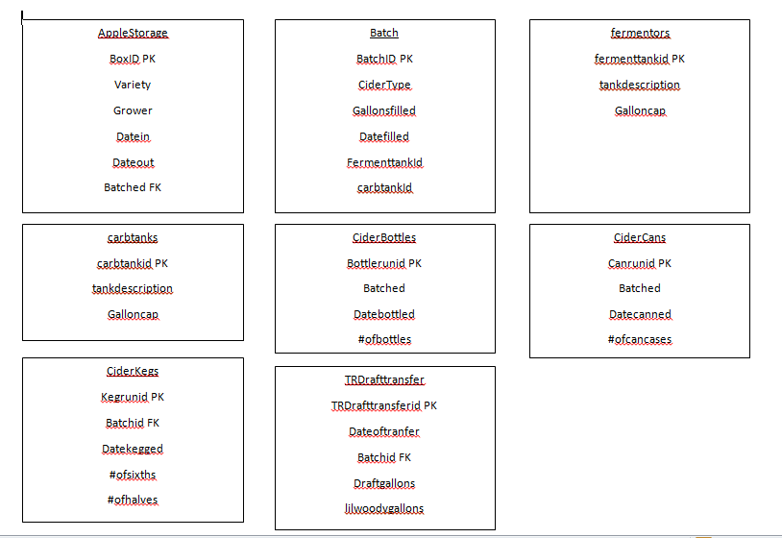
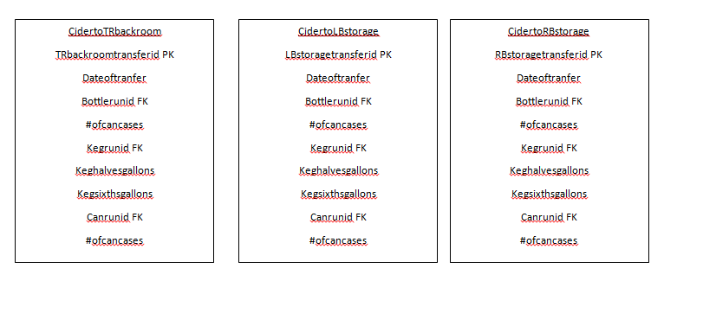
Diagram

Slide 16
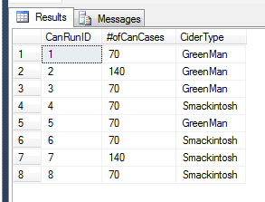
1stView
Canned Varieties

Slide 17
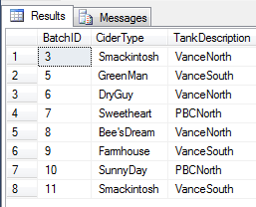
2ndView
Current Fermenting Batches

Slide 18
StoredProcedure
To create:
CREATE PROCEDURE ViewCannedVarieties
AS
SELECT * FROM dbo.CannedVarieties
GO;
To use:
EXEC ViewCannedVarieties;

Slide 19
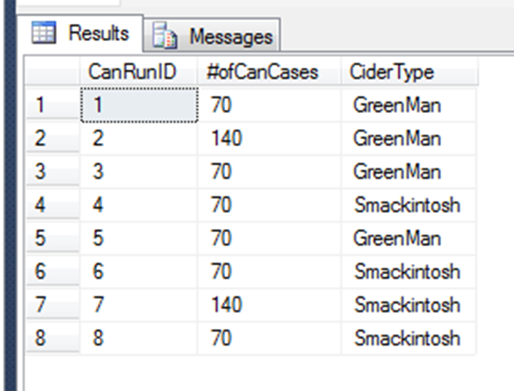
StoredProcedure

Slide 20
Design Decisions

Slide 21
Front End Application
Access

Slide 22
Improvements

Slide 23
What We Learned

Slide 24
Questions?

