Slide 1
Matrix3
AbstractAffinity
Rotation
Translation
RemoteRotation
Affinity

Slide 2
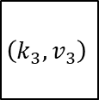
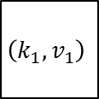
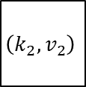
null
null
null
$$\left(k_{1},v_{1}\right)$$
$$\left(k_{2},v_{2}\right)$$
$$\left(k_{3},v_{3}\right)$$
null
null
null
null
null
0
1
2
3
4
5
6
7
8
9
10

Slide 3
null
null
null
$$\left(k_{1},v_{1}\right)$$
null
$$\left(k_{3},v_{3}\right)$$
null
null
null
null
null
0
1
2
3
4
5
6
7
8
9
10

Slide 4
null
null
null
$$\left(k_{1},v_{1}\right)$$
DEL
$$\left(k_{3},v_{3}\right)$$
null
null
null
null
null
0
1
2
3
4
5
6
7
8
9
10

Slide 5
null
null
null
null
null
null
null
null
0
1
2
3
4
5
6
7
8
9
10

