Slide 1

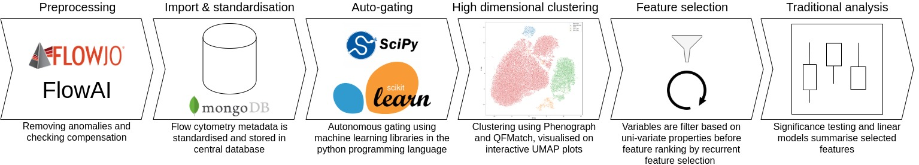
Adventures in computational immunology: a novel approach to analyse high dimensional flow cytometry data​
Ross J Burton¹, Simone Cuff¹, Peter Ghazal², Matthew Morgan^{1,3}, Andreas Artemiou⁴, and Matthias Eberl^{1,2​}
1. Division of Infection and Immunity, School of Medicine, Cardiff University Heath Park, Cardiff, CF14 4XN​
2. Systems Immunity Research Institute, School of Medicine, Cardiff University Heath Park, Cardiff, CF14 4XN
3. Cardiff & Vale University Health Board, Heath Park, Cardiff, CF14, 4XN​
4. School of Mathematics, Cardiff University, Cardiff, CF24 4AG
Introduction
Methods: developing Immunova
Flow cytometry is fundamental for the investigation of immunological states in disease, permitting the generation of vast quantities of single cell data. It is often the case that investigators will compare an array of immunological markers and contrast clinical or experimental endpoints. Statistically significant correlations in this setting point towards biomarkers that might eventually have clinical application. However, the ambition to identify biomarkers can out-weight the analytical cost of doing so, as the number of markers
Conclusions & Future work
Acknowledgements
Contact Information
Corresponding author’s Name
Address | Tel: +1 066 - 666666 Fax: +1 066 - 777777 Email: author@address.org Web: www.yourwebsite.org

