Slide 1

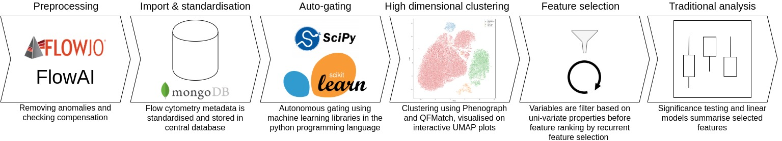
Adventures in computational immunology: a novel approach to analyse high dimensional flow cytometry data​
Ross J Burton¹, Simone Cuff¹, Peter Ghazal², Matthew Morgan^{1,3}, Andreas Artemiou⁴, and Matthias Eberl^{1,2​}
1. Division of Infection and Immunity, School of Medicine, Cardiff University Heath Park, Cardiff, CF14 4XN​
2. Systems Immunity Research Institute, School of Medicine, Cardiff University Heath Park, Cardiff, CF14 4XN
3. Cardiff & Vale University Health Board, Heath Park, Cardiff, CF14, 4XN​
4. School of Mathematics, Cardiff University, Cardiff, CF24 4AG
Introduction
Methods: developing Immunova
Flow cytometry is fundamental for the investigation of immunological states in disease, permitting the generation of vast quantities of single cell data. It is often the case that investigators will compare an array of immunological markers and contrast clinical or experimental endpoints. Statistically significant correlations in this setting point towards biomarkers that might eventually have clinical application. The number of biomarkers we investigate in any single study is limited by the technical capabilities of the cytometry instruments and the analytical abilities of the investigator. The former is rapidly changing to allow larger staining panels with spectral and mass cytometry promising up to 30/40 markers per experiment. If the ambition of high dimensional single cell analysis by cytometry is to be realised then the way in which this data is managed and analysed must change. Traditional manual analysis of flow cytometry output is laborious, subjective, and often not reproducible. Although in the past decade there has been many efforts to address this issue, few have resulted in practical application; many of the methods proposed require extensive programming knowledge, do not provide the rigorous data management needed for large clinical trials, and are not accessible to the wider immunology community. Here we describe a pipeline in development to address the issue of flow cytometry data analysis that address the issues discussed.
Immunova is an analytical pipeline and programming library developed in the Python programming language (version 3.7). Although historically flow cytometry bioinformatics has been largely confined to the R programming ecosystem, we chose to develop our solution in Python to help increase accessibility; Python is designed for ‘readable and beginner friendly code’. Figure 1 shows the analytical steps in Immunova. Prior to analysis a spillover matrix for compensation must be prepared externally. At the heart of Immunova is a document-based database; data is stored in JSON format as opposed to tabular. This design choice provides flexibility in our analysis, as the investigator can include other experimental data (e.g. RNAseq, ELISA, Mass Spec.) and meta-data post-hoc.
Conclusions & Future work
Acknowledgements
Contact Information
Corresponding author’s Name
Address | Tel: +1 066 - 666666 Fax: +1 066 - 777777 Email: author@address.org Web: www.yourwebsite.org

