Slide 1





A High-Performance MST Implementation for GPUs
Alex Fallin, Andres Gonzalez, Jarim Seo, and Martin Burtscher
Texas State University
Department of Computer Science
San Marcos, Texas

Slide 2
Minimum Spanning Trees (MSTs)
A common graph problem
Given a weighted, undirected graph G = (V, E, w)
Find a subset of edges E that connects all vertices V such that the total weight is minimized
When G is not connected, it becomes a minimum spanning forest (MSF)
In this presentation, we use “MST” for both

Slide 3
MST Applications
Network analysis, chip design, eye tracking, route planning, medical diagnostics, etc.
Example: connecting homes with power lines
B
2
C
B
2
C
3
3
2
2
A
D
A
D
1
1

Slide 4
Related Work

Slide 5
Classic MST – Prim’s Algorithm
Given a weighted, undirected graph G = (V, E, w)
Start from an arbitrary vertex
Greedily add the lightest edge that connects to a vertex not already in the growing MST
When all vertices are added, the MST is complete
Tends to perform better on dense graphs

Slide 6
Classic MST – Kruskal’s Algorithm
Given a weighted, undirected graph G = (V, E, w)
Sort E in nondecreasing order
Iterate through sorted E from lightest to heaviest
If the edge does not create a cycle, add it to the growing MST
Once E is processed, the MST is complete
Tends to perform better on sparse graphs

Slide 7
Classic MST – Borůvka’s Algorithm
Given a weighted, undirected graph G = (V, E, w)
Iteratively merge vertices using their lightest connecting edge
Discard all internal edges in the merge that were not the lightest
When all vertices are merged, only the lightest connecting edges remain, which form the MST
Most parallelism friendly of the classics

Slide 8
Related Work: Classic Enhancements

Slide 9

Enhancement: qKruskal
An extension of Kruskal’s algorithm
Instead of sorting the entire edge list, partition it into ‘light’ and ‘heavy’
Only the ‘light’ edge list is sorted initially
An MST can often be built using only the ‘light’ edges
Potentially saves expensive sorting work

Slide 10
Enhancement: Filter-Kruskal
Builds on qKruskal
When the heaviest edge is in the MST, qKruskal provides no benefit over classic Kruskal’s
Edges can be checked for cycles faster than they can be sorted
Before sorting, filter the cyclic edges out
Allows Kruskal’s to perform well on dense graphs

Slide 11
Related Work: Serial and Parallel Implementations

Slide 12
Jucele ‘18
Pure MST on the GPU via modified Borůvka’s
Kernels find and mark lightest edges
Merge based on lightest edges, count connected components
Repeat until a single connected component exists
Vertex-centric, data-driven

Slide 13

Lonestar
CPU-parallel Borůvka’s
Loops over the edges of all disconnected components and identifies light edges in parallel
Merges components using disjoint-set data structure to avoid modifying the graph

Slide 14
PBBS
CPU parallel and serial, based on Kruskal’s
Uses ideas from both qKruskal and Filter-Kruskal
Introduces deterministic reservations, which allows for edges to be added to the MST earlier than basic Kruskal’s
Speculative for loop is used to execute the iterations of the non-parallel algorithm out of order

Slide 15
PBBS contd.
Using deterministic reservations, commits additions to the MST when they are confirmed to not conflict with an earlier iteration
Only sorts k lightest edges to start
k = ~|V|
If the MST is not complete after the first k edges, filter the rest before sorting

Slide 16
RAPIDS cuGraph
GPU-parallel implementation
Based on Borůvka’s algorthim
Uses vertex-centric, topology-driven color propagation with supervertices
Takes advantage of RAFT (Reusable Accelerated Functions and Tools) in its parallelization

Slide 17
UMinho ‘15
GPU and CPU-parallel, based on Borůvka’s algorithm
Vertex-centric, data-driven
Finds the minimum edges of each vertex
Truly merges vertices that ought to be connected into new supervertices
Builds edge list for new, contracted graph

Slide 18
Gunrock
GPU-parallel pure MST
Vertex-centric, topology-driven
Looks through all vertices
Evaluates edges for addition if their source and destination are not in the same connected component

Slide 19
Our ECL-MST Implementation

Slide 20
ECL-MST Approach
qKruskal: Analyze the input graph, only filter edges when average degree is >4
If we are filtering, process edges that are below a weight threshold
This threshold is determined by randomly sampling 20 weights and picking the threshold that corresponds to 4 times the vertex count

Slide 21
ECL-MST Approach
The first worklist (WL) is filled with all weighted edges below threshold
Iterate over first WL
Acyclic edges are kept and added to a second WL
atomicMin is used on edge endpoints, storing the lowest-weight edge in each
WL 1 and 2 are swapped

Slide 22
ECL-MST Approach
Candidate edges, now in WL 1, are iterated over
If an edge ends up being the minimum of either of its endpoints, add edge to the MST
Same concept as deterministic reservations (PBBS)
Merge endpoints in disjoint-set data structure
Clear minimum edge information
Start over processing WL1

Slide 23
ECL-MST Approach
This edge-based computation loop continues until the first worklist is empty
If there are edges left, the worklist is then populated with the remaining edges and the process repeats
The resulting tree is an MST for a connected graph and an MSF for a disconnected graph

Slide 24
ECL-MST Parallelization

Slide 25
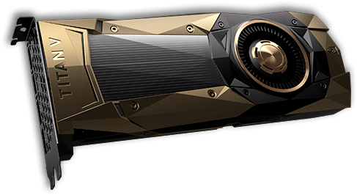
CUDA Parallelization
Initialization is trivially parallel
Initial population of the worklist is done using a thread if a vertex has fewer than 4 neighbors in its adjacency list, a warp is used otherwise
The loops that process the edges in the worklists are parallelized across threads
Besides the aforementioned atomicMin, atomicAdd is used for the worklist updates and atomicCAS for the disjoint-set operations

Slide 26
ECL-MST Performance Optimizations

Slide 27
ECL-MST Performance Optimizations
We stay lock-free by taking advantage of atomics
We concatenate the edge weight and the edge ID when marking the smallest edge
This conveniently gives us a deterministic tiebreaker and allows for easy retrieval of the edge ID
Hybrid parallelization for worklist initialization, lets us use CUDA ballot and shuffle functions to process higher degree vertices more efficiently

Slide 28
More Performance Optimizations
We avoid explicit path compression by storing the results of the find instead of the original vertex IDs in the worklist
We use filtering to hopefully only process the light edges that will end up in the MST
Edge-centric processing for much of the work helps improve load balance

Slide 29
Results

Slide 30
Methodology
System 1
GPU: NVIDIA Titan V, 5120 PEs, 80 SMs, 12 GB memory, nvcc 11.7
CPU: AMD Ryzen Threadripper 2950X (16 cores, 3.5GHz), gcc 11.3
System 2
GPU: NVIDIA RTX 3080 Ti, 10240 PEs, 80 SMs, 12 GB memory, nvcc 12.0
CPU: 2x Intel Xeon Gold 6226R (16 cores each, 2.9GHz), gcc 12.2

Slide 31
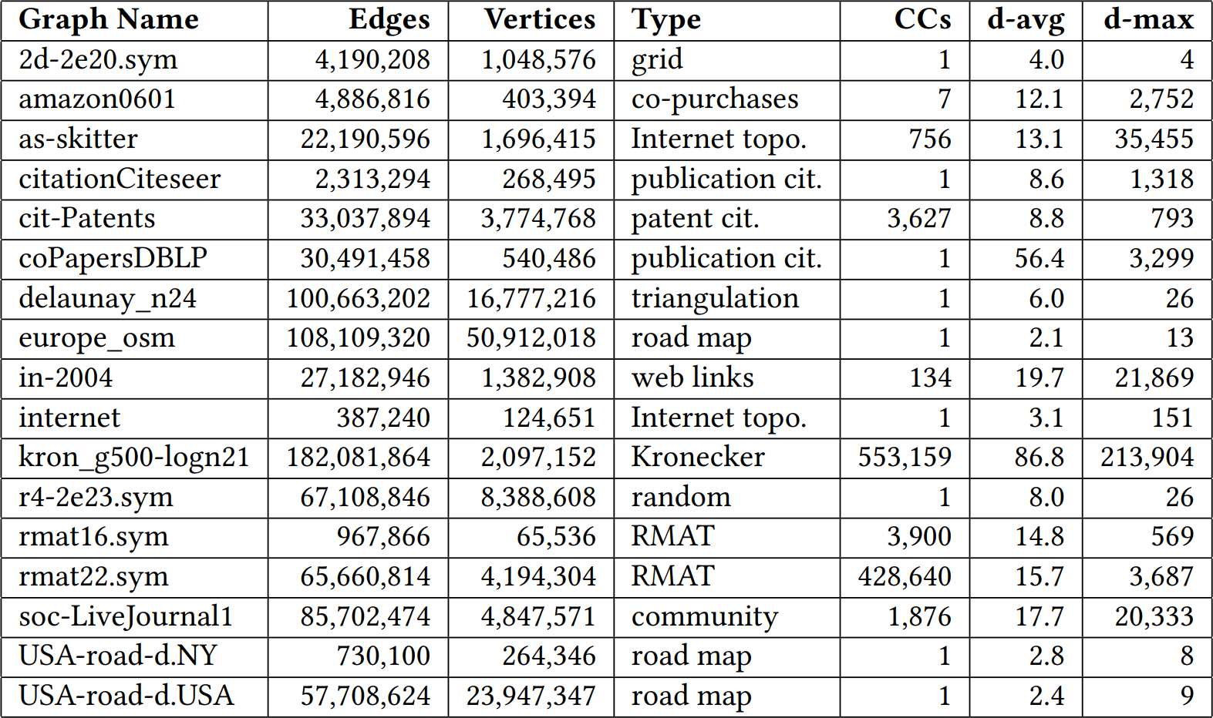
Inputs
Eliminated self-loops, multiple edges, made undirected

Slide 32
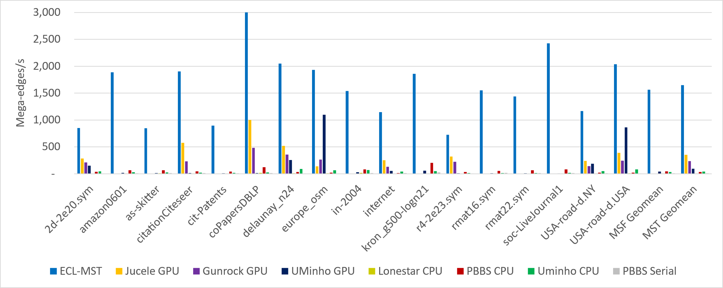
System 1 Throughput
Large, scale-free inputs
High average degree
32.4 times faster than PBBS
4.6 times faster than Jucele

Slide 33
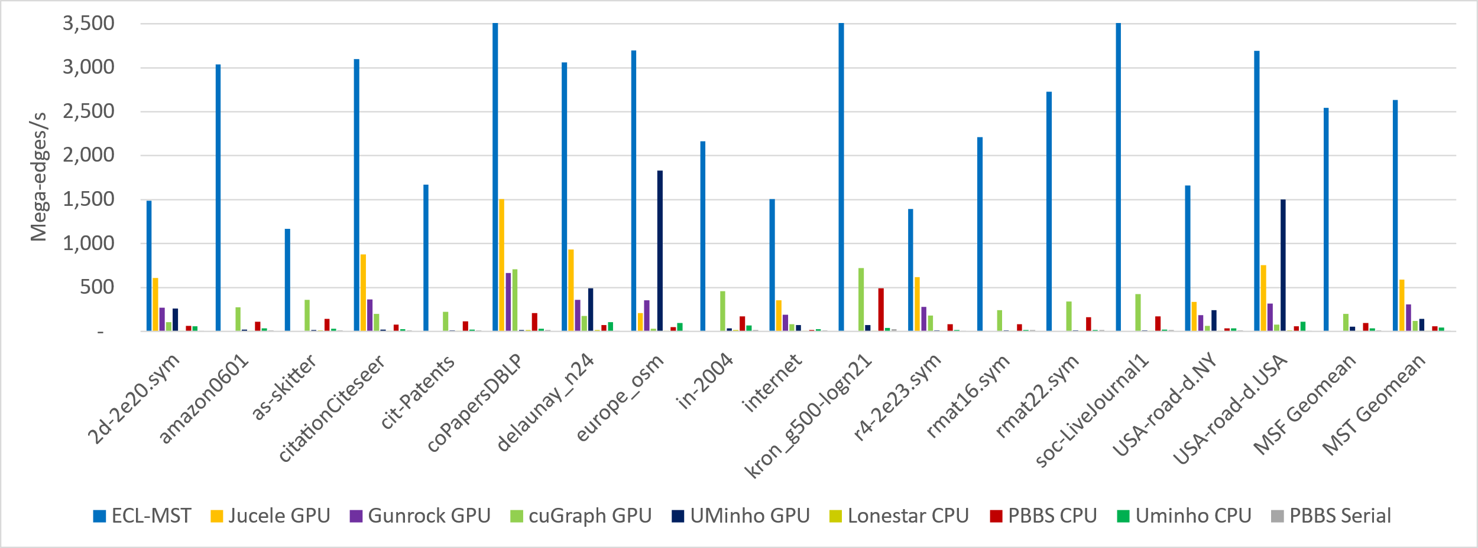
System 2 Throughput
Generally higher throughput system
High average degree
Large, scale-free inputs
12.8 times as fast as cuGraph
4.5 times as fast as Jucele

Slide 34
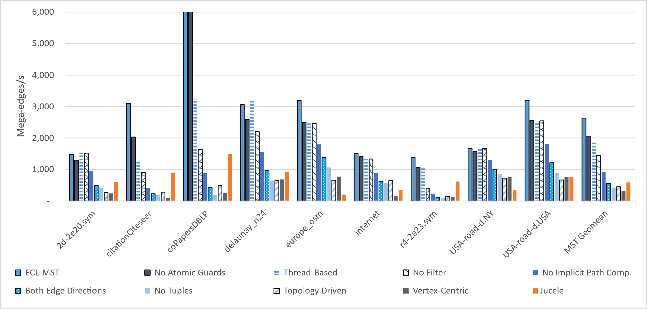
Optimization Evaluation

Slide 35


Summary
We present ECL-MST, an optimized and GPU-specialized MST implementation
4.5× faster on average and faster on every input
Acknowledgements
NSF, NVIDIA, Randy Cornell, Jerry Rosado
Code available on GitHub
https://github.com/burtscher/ECL-MST
Contact: waf13@txstate.edu

