Slide 1
A COUNTY-LEVEL DATA STORY
Health Access in Kenya
Mapping how facilities, workforce, insurance and poverty shape who gets
healthcare — and who is left behind — across Kenya's 47 counties.
Emmilio Burure
47 Counties · 2026

Slide 2
INTRODUCTION
Project Overview
Access to quality healthcare remains uneven across Kenya despite continued investments in the health sector. Significant disparities exist between counties in the availability of healthcare facilities, healthcare workers, infrastructure, and essential health services. Rural populations often travel long distances to access medical care, while poverty, population growth continue to widen healthcare inequalities. These disparities limit the country's progress toward Universal Health Coverage (UHC). Policymakers require integrated and accessible data to identify underserved regions, prioritize investments, and improve health outcomes. This project combines healthcare infrastructure, demographic, and socioeconomic datasets to create an interactive dashboard that highlights healthcare accessibility gaps across Kenya and supports data-driven decision-making.
KENYA COUNTY HEALTH ACCESS · 2026

Slide 3
INTRODUCTION
1. Healthcare Infrastructure
Which counties have the fewest healthcare facilities relative to their population? How evenly are hospitals, health centers, and dispensaries distributed across Kenya? Which counties experience the greatest healthcare infrastructure shortages?
2. Healthcare Workforce
Which counties have the lowest doctor-to-population ratio? Which counties experience shortages of nurses and clinical officers? How does healthcare workforce availability compare across regions?
3. Population Access
Which counties have the largest populations with limited access to healthcare services? How does healthcare facility density vary by county? Which regions require additional healthcare investment?
4. Socioeconomic Factors
Is there a relationship between poverty levels and healthcare access? Do counties with higher poverty rates also experience poorer healthcare infrastructure? Which counties face multiple disadvantages in healthcare accessibility?
5. Overall Development
Which counties perform best and worst in overall healthcare accessibility? What regional patterns emerge when healthcare indicators are combined?
Research Questions
KENYA COUNTY HEALTH ACCESS · 2026

Slide 4
METHODOLOGY
How the Health Access Index Works
How the Health Access Index Works
Every county was ranked against all others on five sets of indicators. A county's Health Access Index is the average of its ranks across every indicator — so it rewards counties that perform consistently well, not just those strong in one area.
READING THE MAP
High access
Facility density
Facilities per 100,000 population
Top-ranked across most indicators
Health workforce
Core health workers per 10,000 population
Above average
Solid, consistent performance
Insurance coverage
Share of population with health insurance
Amenities, equipment, diagnostics and medicine
Below average
Facility readiness
Notable gaps in one or more areas
Poverty rate
Share of county population below the poverty line
Low access
Consistently weak across indicators
The same four-tier color scale (green → amber → orange → red) is used throughout this deck for the Health Access Index.
KENYA COUNTY HEALTH ACCESS · 2026
2

Slide 5
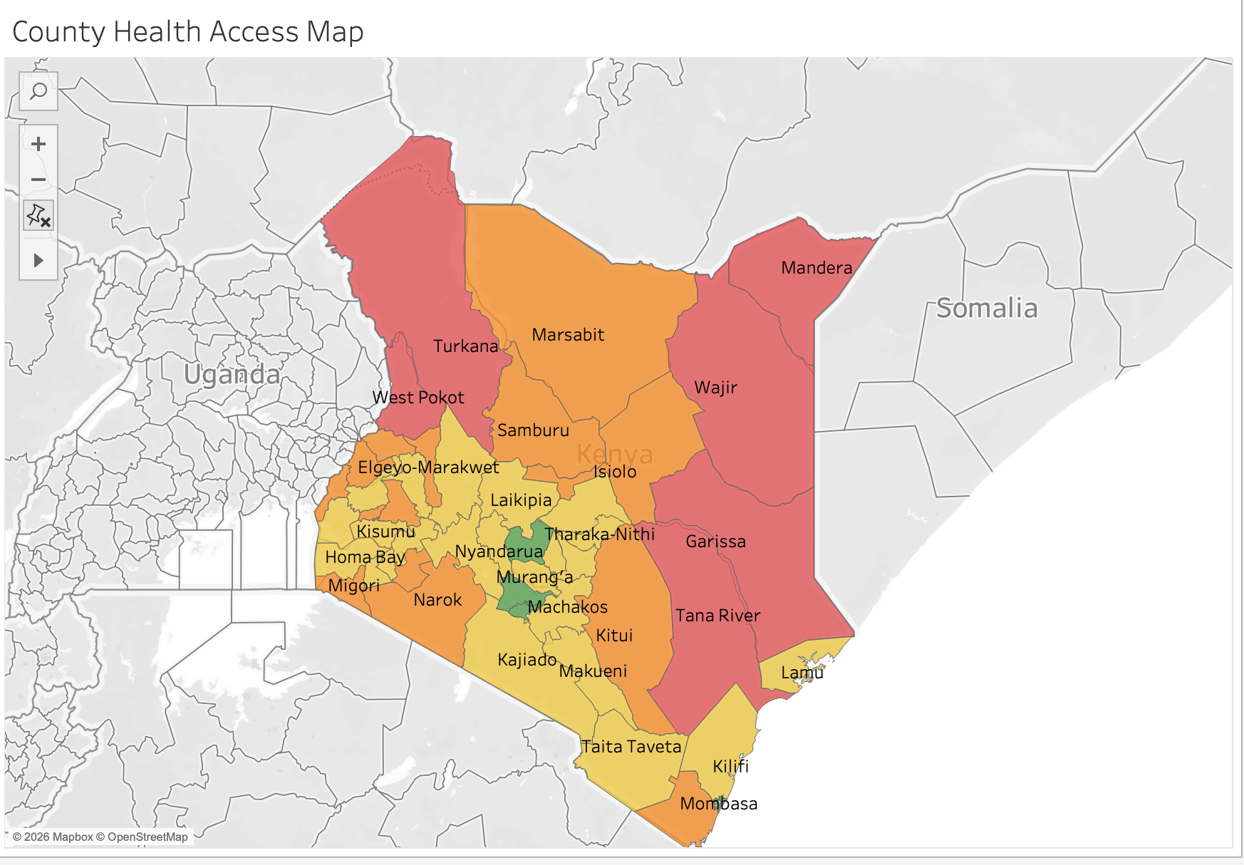
THE OVERVIEW
Access Is Deeply Uneven Across the Country
● What the map shows
A green core of high access runs through Nairobi, the central highlands and coastal cities — Kenya's most developed corridor.
A red belt of low access dominates the north and northeast: Turkana, West Pokot, Marsabit, Mandera, Wajir, Garissa and Tana River.
This is the same arid-and-semi-arid (ASAL) corridor long associated with historical marginalization — the pattern is not random.
KENYA COUNTY HEALTH ACCESS · 2026
3

Slide 6
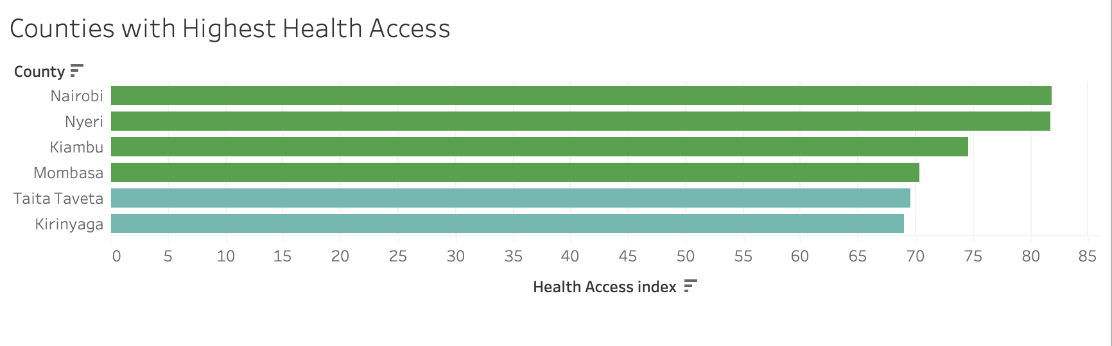
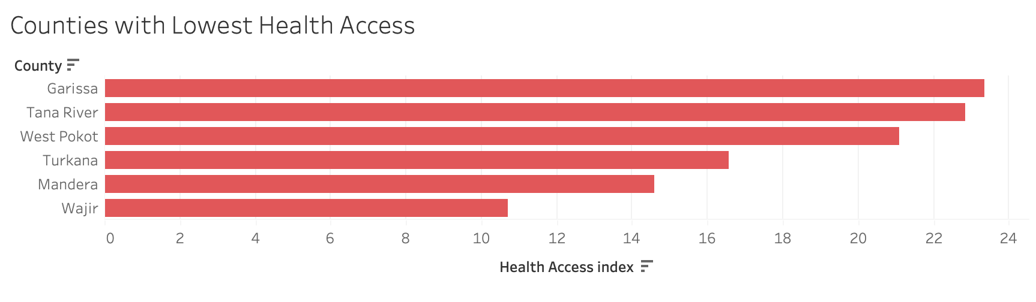
THE GAP
A Tale of Two Kenyas
● The scale of the divide
Nairobi and Nyeri top the index at roughly 82 — nearly matched by Kiambu, Mombasa, Taita Taveta and Kirinyaga, all above 68.
Wajir sits at the opposite end at just 11, with Mandera, Turkana, West Pokot, Tana River and Garissa all below 24.
That is close to a 7x gap between Kenya's best- and worst-served counties on the same 0–100 index.
KENYA COUNTY HEALTH ACCESS · 2026
4

Slide 7
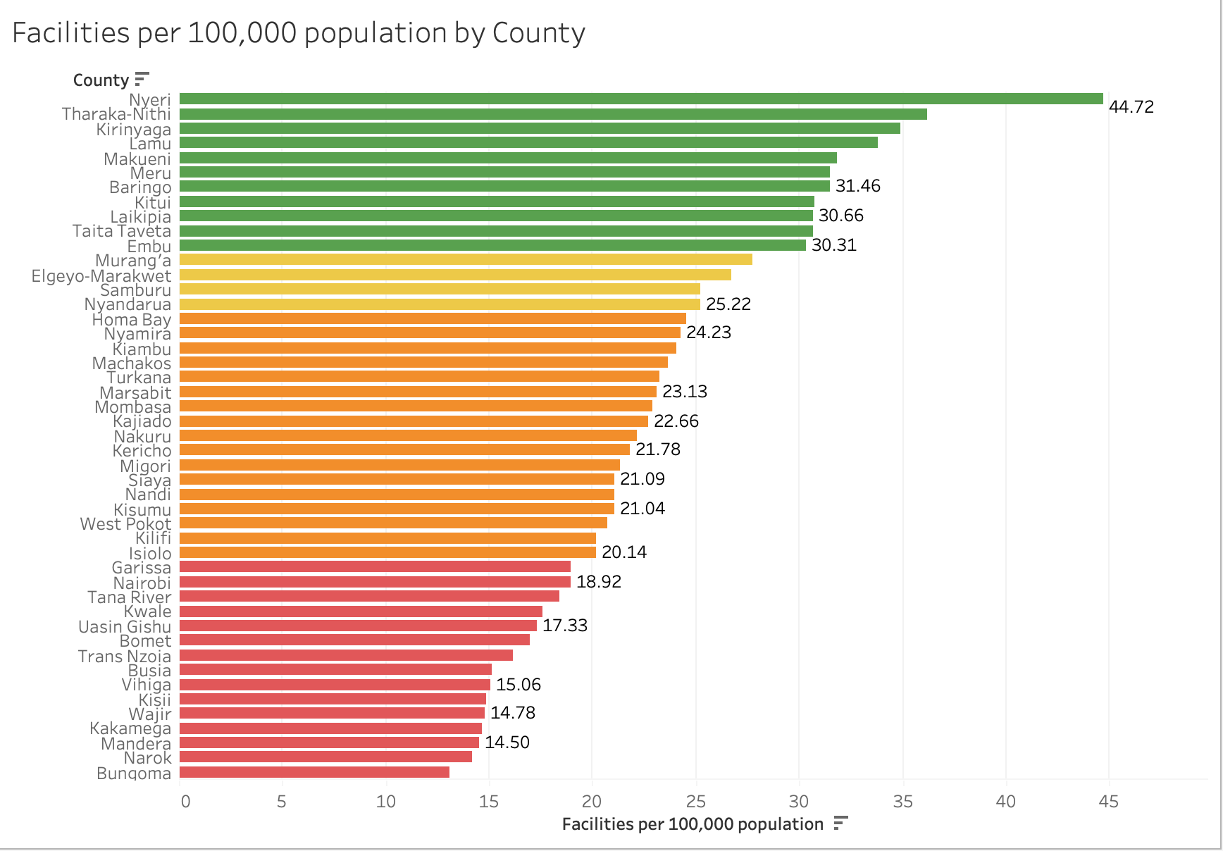
INFRASTRUCTURE
Facility Density: A Wide Regional Spread
● All 47 counties, ranked
Nyeri leads the country with 44.7 facilities per 100,000 people; Bungoma trails at 13.1 — roughly a 3.4x gap top to bottom.
The top ten (all green) are almost entirely central-highland counties — Nyeri, Tharaka-Nithi, Kirinyaga, Meru, Kitui, Laikipia among them.
Nairobi sits surprisingly low at 18.92 facilities per 100,000, in the bottom third of all counties nationally — a first hint that facility count alone won't explain the access rankings.
KENYA COUNTY HEALTH ACCESS · 2026
5

Slide 8
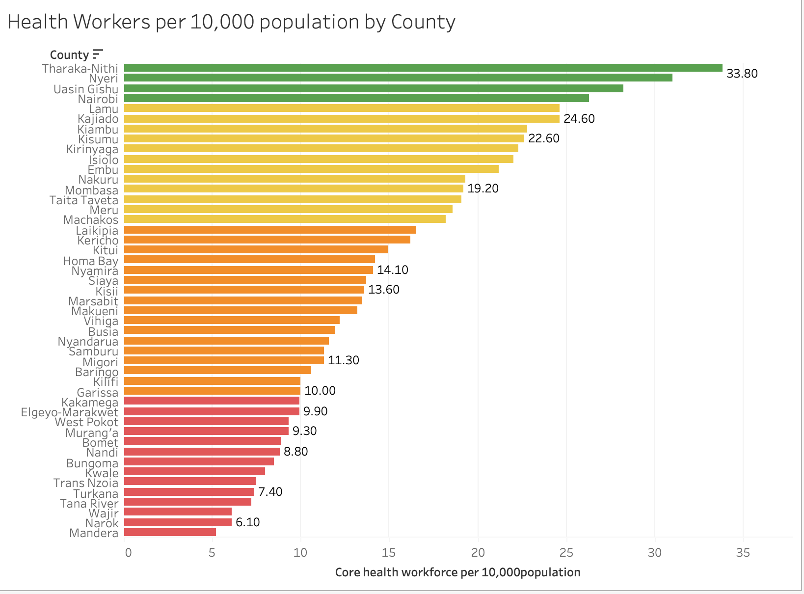
WORKFORCE
Health Workers Follow the Same Divide
● All 47 counties, ranked
Tharaka-Nithi (33.8) and Nyeri (31.0) have the deepest health workforce per 10,000 people; Mandera sits at the very bottom of the list — over a 6x gap top to bottom.
Nairobi (26.3) and Uasin Gishu (28.2) round out the green tier, showing workforce strength isn't confined to the central highlands alone.
Nearly the entire ASAL corridor — West Pokot, Turkana, Tana River, Wajir, Mandera — sits in the bottom (red) quartile, the same counties that anchor the bottom of the Health Access Index.
KENYA COUNTY HEALTH ACCESS · 2026
6

Slide 9
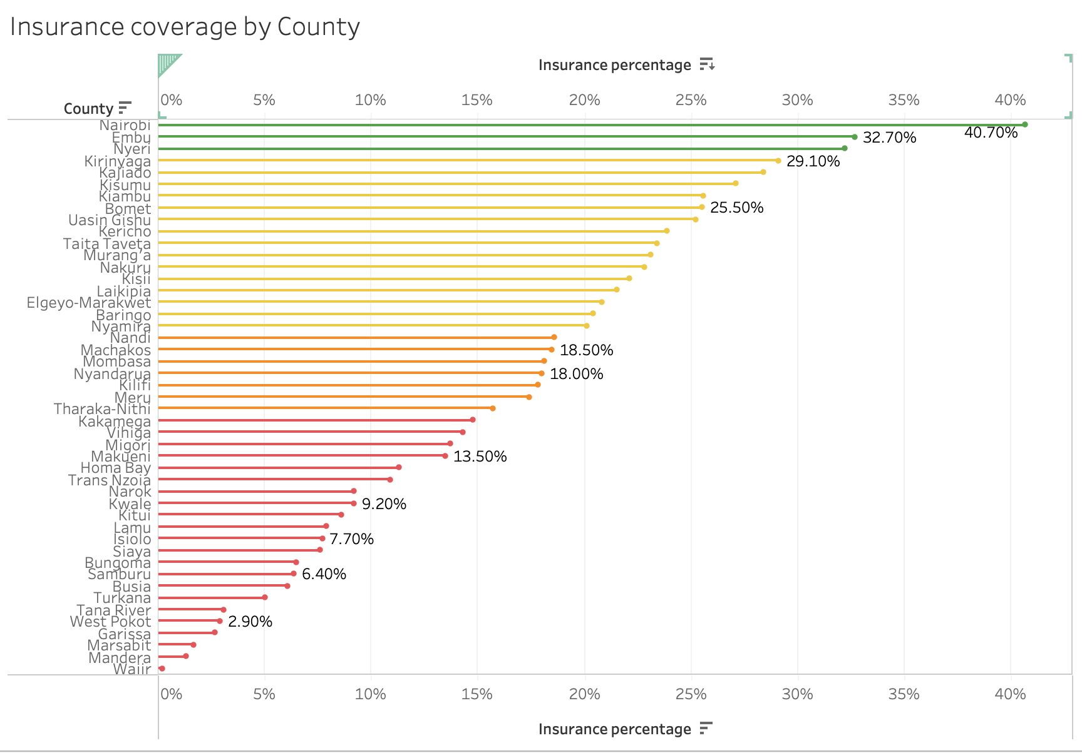
FINANCIAL PROTECTION
Insurance Coverage Mirrors the Divide
● All 47 counties, ranked
Nairobi leads at 40.7% coverage, followed by Embu (32.7%) and Nyeri — all comfortably above the rest of the country.
Wajir has the lowest insurance coverage of any county in Kenya — below Mandera, Marsabit, Garissa and West Pokot (2.9%), which round out the bottom five.
This is the widest relative gap of any indicator in the study: Nairobi's coverage is well over 10x that of the bottom-five counties combined.
KENYA COUNTY HEALTH ACCESS · 2026
7

Slide 10
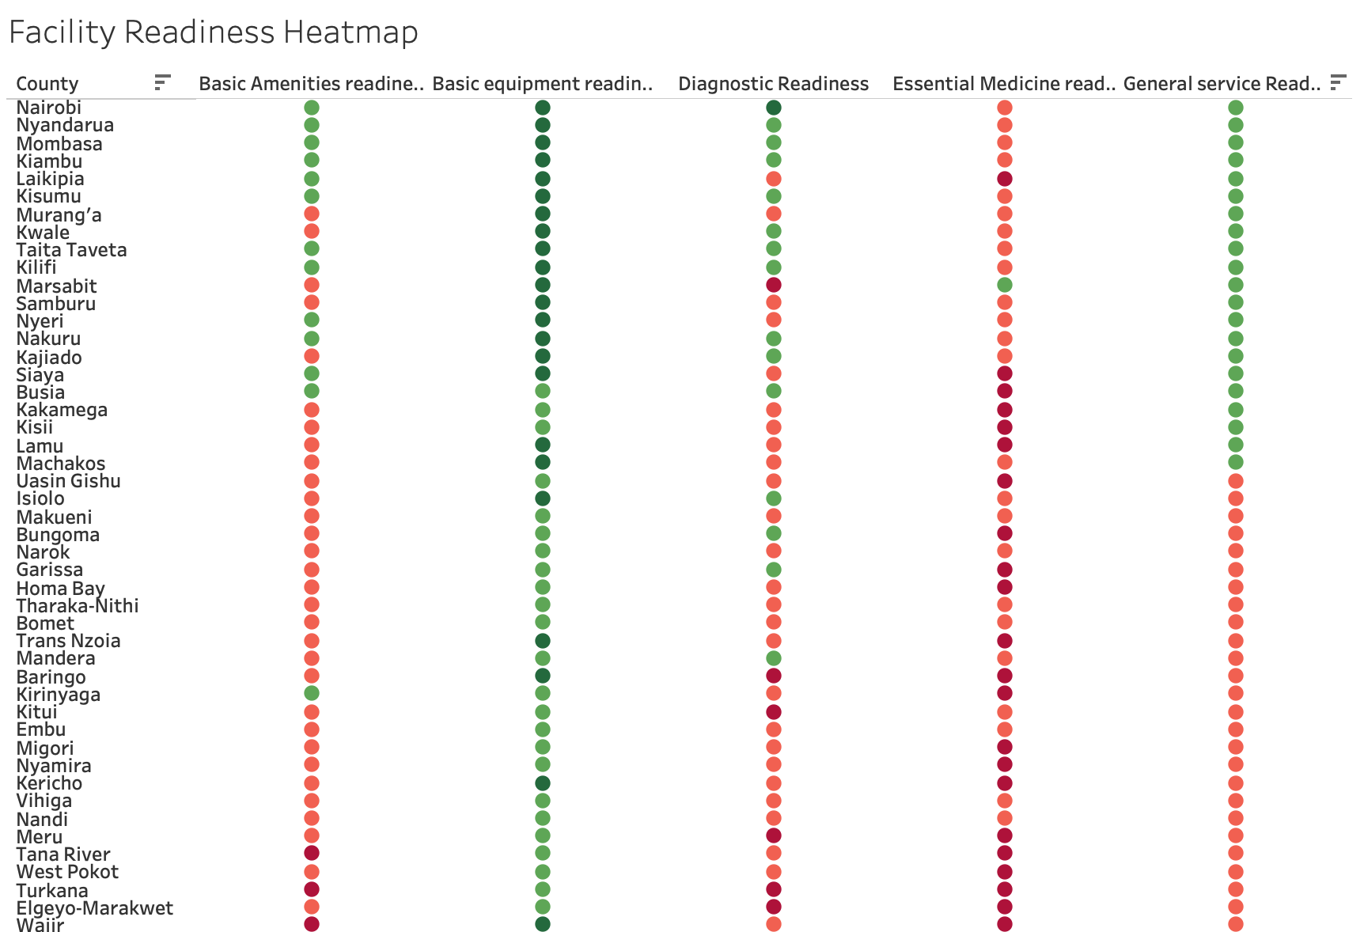
SERVICE QUALITY
Even High-Access Counties Have Readiness Gaps
● Reading the heatmap
Basic equipment readiness is strong (green) for almost all 47 counties — this is the one dimension where Kenya performs consistently well nationwide.
Essential medicine readiness is red or deep red for the large majority of counties — including Nairobi, Kiambu and Mombasa — a nationwide supply-chain gap the overall access ranking doesn't reveal.
Diagnostic readiness is the most volatile dimension: Nairobi scores among the best, while Marsabit, Baringo, Kitui, West Pokot, Turkana and Elgeyo-Marakwet fall to the deepest red tier — compounding their already low access.
General service readiness is the average.
KENYA COUNTY HEALTH ACCESS · 2026
8

Slide 11
PART TWO
What Actually Drives
Health Access?
Four scatterplots test each factor against the Health Access Index to see which relationships are strongest — and which one breaks the pattern.

Slide 12
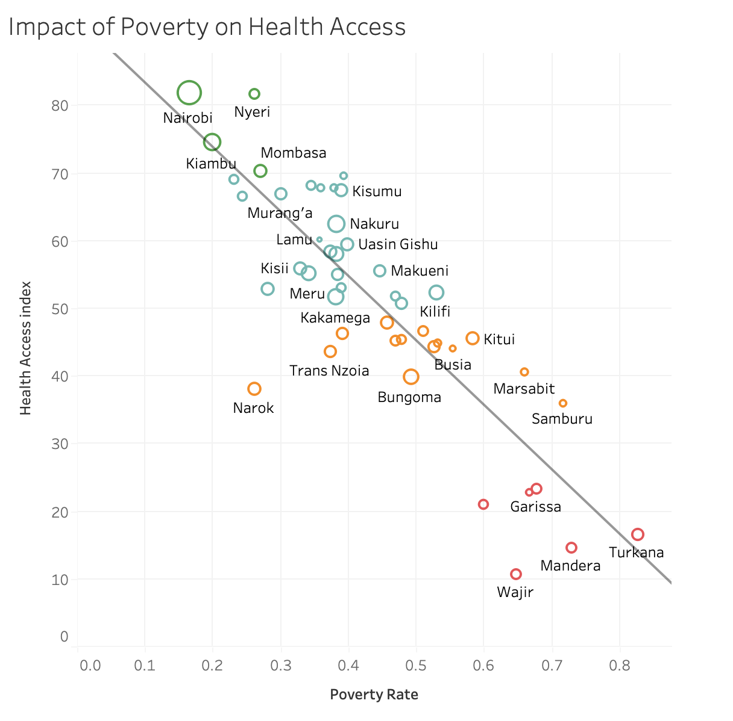
DRIVER 1 · POVERTY
Poverty Is the Strongest Negative Predictor
● What the trend shows
A clear downward slope: as poverty rises, the Health Access Index falls, almost without exception.
Nairobi, Nyeri and Kiambu anchor the top-left corner — low poverty, high access. Wajir, Mandera and Turkana anchor the bottom-right — high poverty, low access.
Counties above ~50% poverty (red dots) cluster below an index of 25; counties under 30% poverty (green dots) sit almost entirely above 65.
KENYA COUNTY HEALTH ACCESS · 2026
10

Slide 13
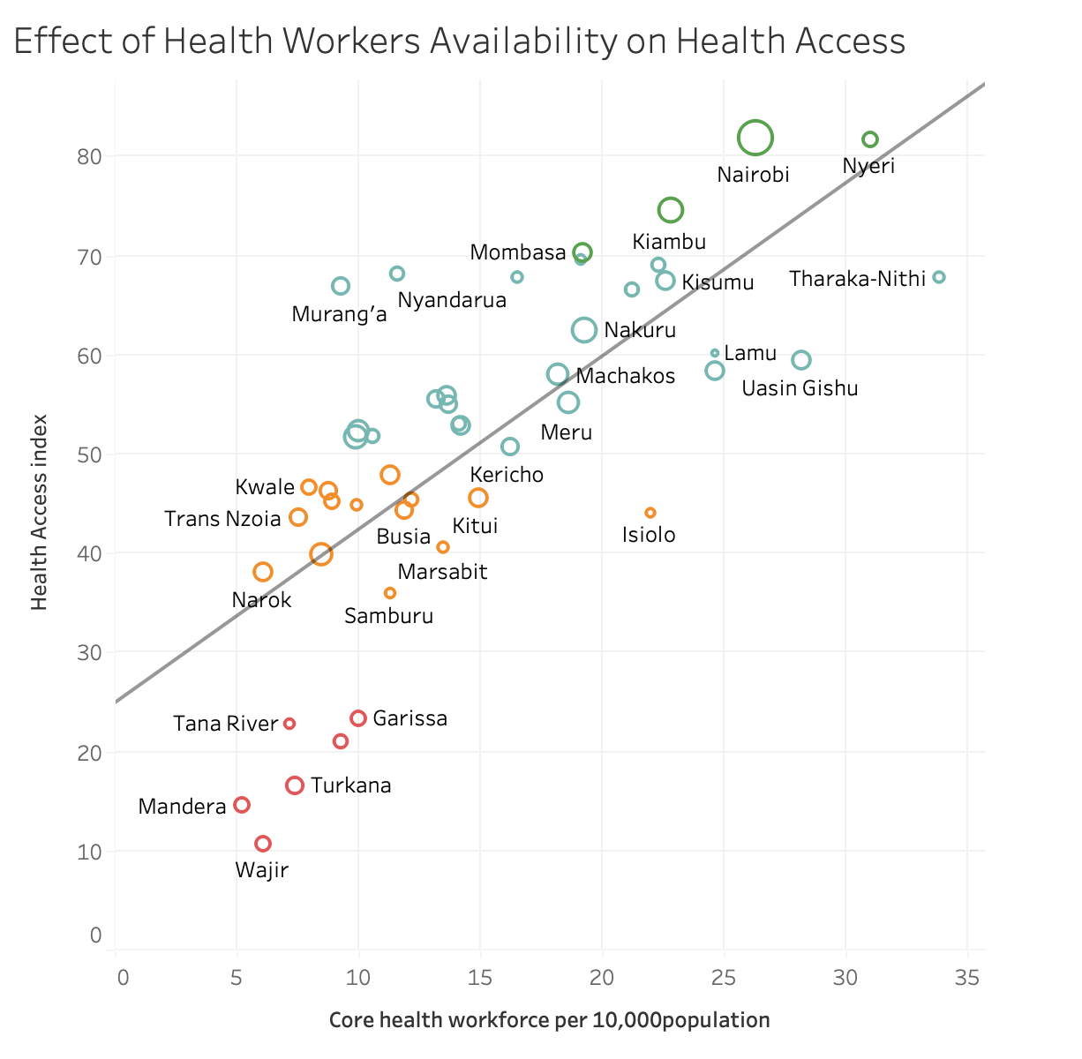
DRIVER 2 · WORKFORCE
More Health Workers, Better Access
● What the trend shows
One of the tight relationships in the dataset — points sit close to the trend line across its full length.
Every county with 20+ workers per 10,000 people scores above 55 on the Health Access Index.
Every county below 10 workers per 10,000 people scores below 45 — workforce looks like a true structural lever.
KENYA COUNTY HEALTH ACCESS · 2026
11

Slide 14
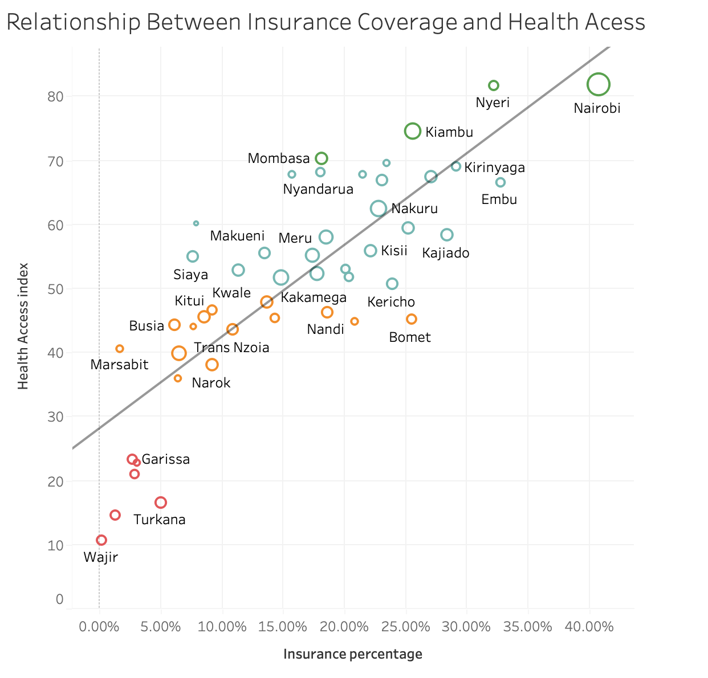
DRIVER 3 · INSURANCE
Insurance Coverage Tracks Closely With Access
● What the trend shows
A strong, steady positive relationship: higher insurance coverage almost always means a higher Health Access Index.
Nairobi, at over 40% coverage, anchors the top-right corner of the chart — the highest access AND highest coverage in Kenya.
Wajir anchors the opposite corner — the lowest coverage in the country paired with the lowest Health Access Index, alongside Turkana and Garissa just above it.
KENYA COUNTY HEALTH ACCESS · 2026
12

Slide 15
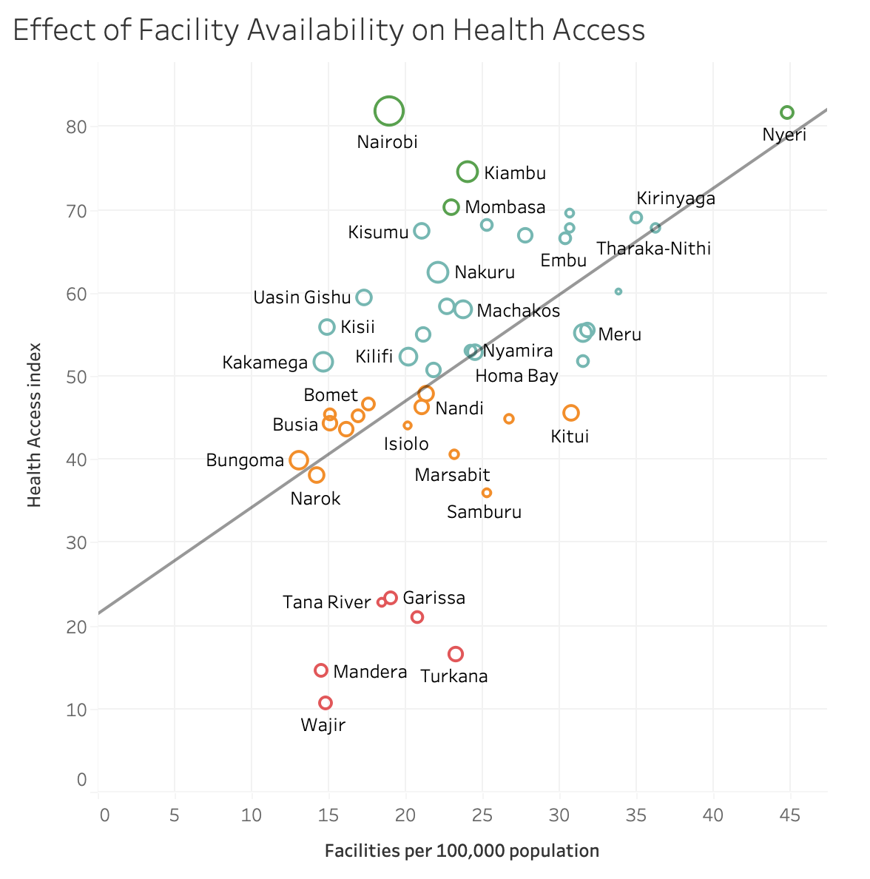
DRIVER 4 · FACILITIES — THE EXCEPTION
Facility Count Alone Doesn't Guarantee Access
● The pattern breaks here
This is the weakest, noisiest relationship of the four — points scatter widely around the trend line.
Nairobi posts the highest Health Access Index (~82) with just 18.9 facilities per 100,000 — well under half of Nyeri's 44.7, which also tops the access index. Both routes lead to the top.
Tana River has more facilities (18.4) than Wajir, Mandera or Narok and almost the same as Nairobi yet still lands among the lowest-access counties in Kenya — facilities without workforce or readiness behind them.
Conclusion: it's the work force, funding and readiness behind a facility — not the facility count — that move the needle.
KENYA COUNTY HEALTH ACCESS · 2026
13

Slide 16
SYNTHESIS
What the Data Tells Us
Geography of inequity
The ASAL corridor — Turkana, West Pokot, Marsabit, Mandera, Wajir, Garissa, Tana River — faces compounding disadvantage across every single indicator, not just one.
Workforce & insurance are the strongest levers
Both show tight, near-linear positive relationships with the Health Access Index — the two most reliable predictors in the study.
Poverty compounds everything
Poverty is the single strongest negative predictor, and it overlaps almost perfectly with low workforce and low insurance coverage.
Facilities ≠ access
Nairobi proves it positively (high access, modest facility count); Tana River proves it negatively (more facilities, still low access).
Quality gaps hide inside “good” counties
Even top-ranked counties show poor essential-medicine readiness — a gap the overall index doesn't fully expose.
KENYA COUNTY HEALTH ACCESS · 2026
14

Slide 17
RECOMMENDATIONS
Priorities for Closing the Gap
1
Deploy health workforce to ASAL counties
Mandera, Wajir, Narok and Turkana first — workforce is the strongest access lever in the data.
2
Expand insurance enrollment where coverage is lowest
Pair subsidies with the poorest counties, where low coverage and high poverty overlap almost exactly.
3
Fix essential-medicine supply chains nationwide
This gap appears even in high-access counties — it needs a national fix, not a targeted one.
4
Invest in facility quality over facility count
Where density is already adequate, upgrading readiness will do more than building new facilities.
5
Target multi-sector poverty reduction in the north
The Turkana–Mandera–Wajir–Garissa corridor needs interventions beyond health alone.
KENYA COUNTY HEALTH ACCESS · 2026
15

Slide 18
Thank You
Kenya County Health Access Project · 2026

