Slide 1
Explainable ML for SMS Scam Detection
Capstone project
• Kenyan mobile-money context
• Naive Bayes · Logistic Regression · Linear SVM · TF-IDF · Streamlit
• Rigorous, leakage-aware evaluation and interpretable predictions

Slide 2
Problem and scope
• Goal: predict whether an SMS is labelled scam or legit (binary classification)
• Dataset: Kenyan SMS CSV - 736 rows; 643 unique after cleaning (376 scam / 267 legit)
• Claim limited to predicting the dataset's labels - labels are annotations, not verified truth
• Contribution: how much do the results survive a rigorous evaluation?

Slide 3
Data audit decisions
• 91 repeated texts = 89 identical rows + 2 texts with conflicting labels
• Dropped the 4 conflicting rows; kept one copy of other repeats
• Grouped near-duplicate templates (cosine ≥ 0.8) so they never straddle train/test
• prelabel perfectly determines label → never a feature (leakage)
• Neutralised a "\n" export artefact that separated classes (42% vs 14%)
• Test set (20%) frozen before any exploration

Slide 4
What the data looks like
• Scams: links, money amounts, capitals, urgency and reward wording
• Legit: emojis, opt-out wording, Skiza / devotional promos, personal chat
• Kiswahili/Sheng is equally common in both classes - language is not the signal
• Moderate-risk scams look structurally like legit messages

Slide 5
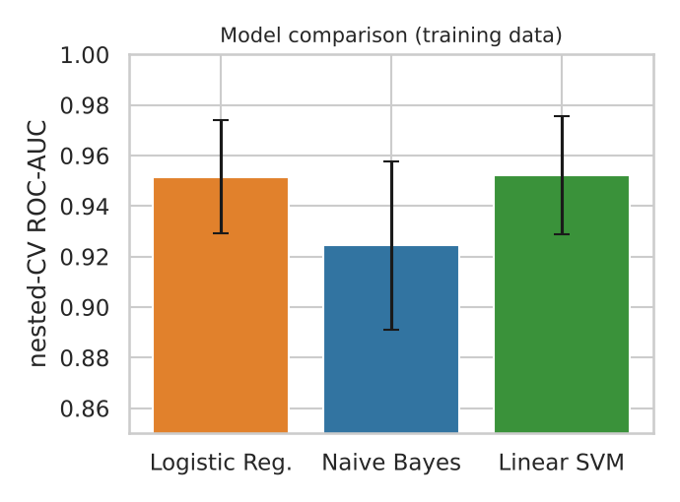
Modelling strategy
• Features: TF-IDF unigrams (bigrams tested) + 17 rule-based features, all inside Pipelines
• Stratified + grouped repeated CV; nested CV for honest tuning
• Pre-declared selection rule: best AUC; ties → most interpretable
• All three models chose unigrams + handcrafted features; bigrams did not help

Slide 6
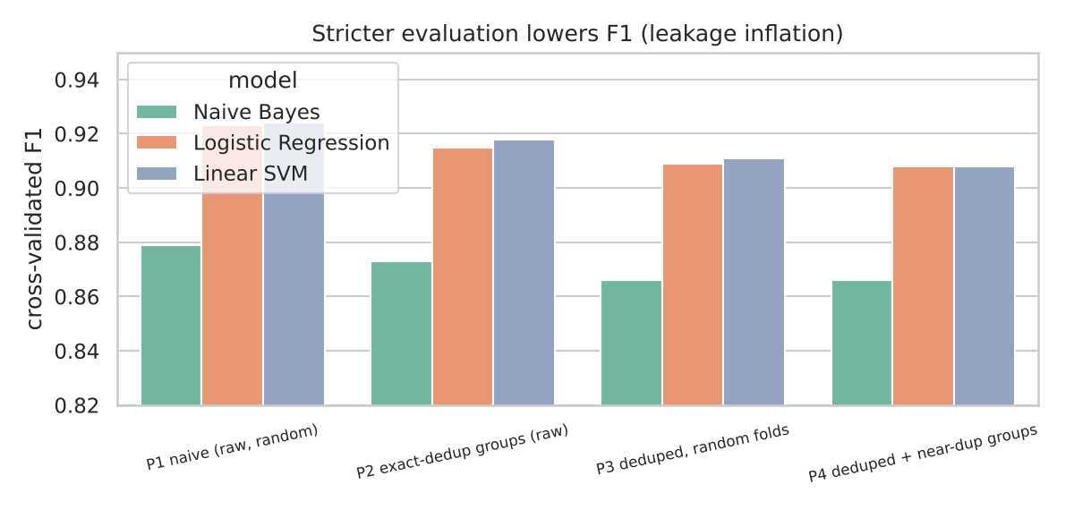
Leakage-aware evaluation
• Naive evaluation (duplicates) inflates F1 by ~1.5 points
• Most of the inflation comes from exact copies; template leakage adds little
• Conclusions unchanged across near-duplicate thresholds 0.6-0.95
• Model ranking identical under every protocol

Slide 7
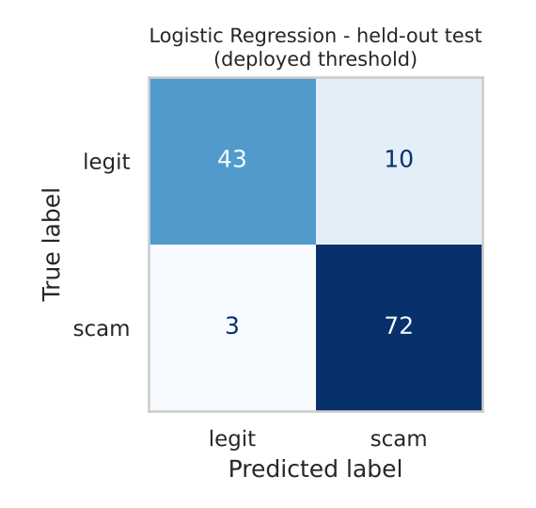
Held-out test results (128 messages, used once)
• Logistic Regression: recall 0.96 · precision 0.88 · F1 0.92 · AUC 0.93
• 3 missed scams, 10 false alarms
• LR ≈ SVM; both better than Naive Bayes in F1 (+0.044, CI excludes 0)
• Wide intervals: F1 95% CI 0.87-0.96

Slide 8
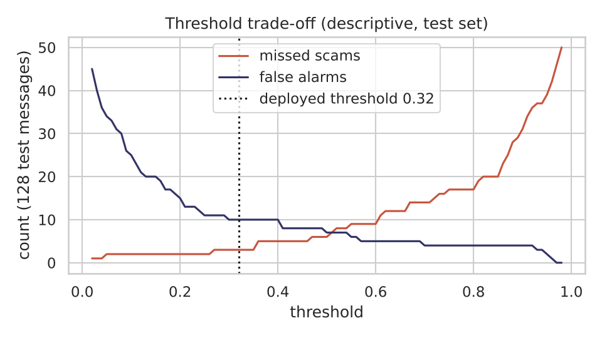
Threshold: missed scams vs false alarms
• Rule: highest threshold keeping ≥95% validation recall → 0.32
• Test: 3 missed / 10 false alarms (default 0.5: 6 / 7)
• Warn-only app: a missed scam costs more than a false alarm
• Real-world precision will be lower (scams are rarer in real inboxes)

Slide 9
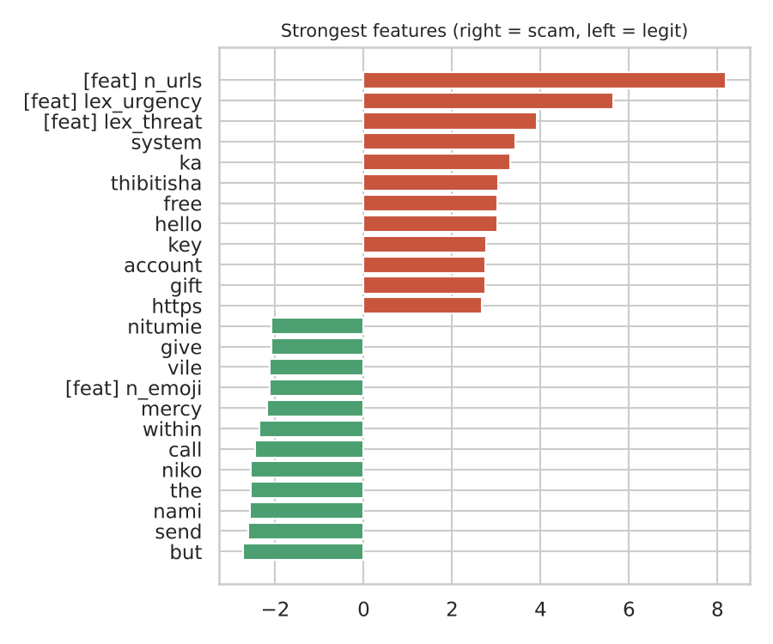
What drives predictions
• Scam: link count, urgency, threat wording, "free", "account", "https"
• Legit: informal personal-chat words and emojis
• Context matters: "send", "job" point to legit
• Headline explanations stable under bootstrap (90% sign-stable)

Slide 10
Error analysis
• Missed scams: short, no link/money; 60% are moderate-risk
• Many "false alarms" look like scams labelled legit → likely label noise
• Genuine M-Pesa receipts may be flagged; link-free social engineering may be missed
• Optional 3-class model: macro-F1 0.84, moderate class weakest (not deployed)

Slide 11
Limitations and ethics
• Small data, annotated labels, collection-driven class ratio
• Static text only; scam wording drifts
• Privacy: app stores nothing; dataset contains personal details
• Never auto-block; say "possibly a scam"; do not treat Swahili as suspicious

Slide 12
Future work
• Verified multi-annotator labels; more genuine M-Pesa / bank messages
• Sender and context features; time-ordered evaluation
• XGBoost and SHAP comparison; multilingual models
• User study of warnings

