Slide 1
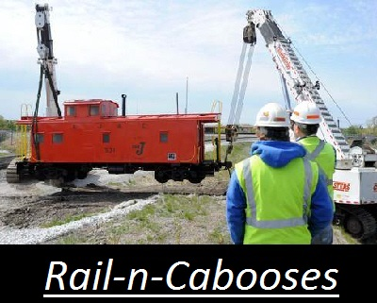

Slide 2
Work Done
Hours
Estimated: 30 hrs per person
Actual: 75 hrs per person

Slide 3
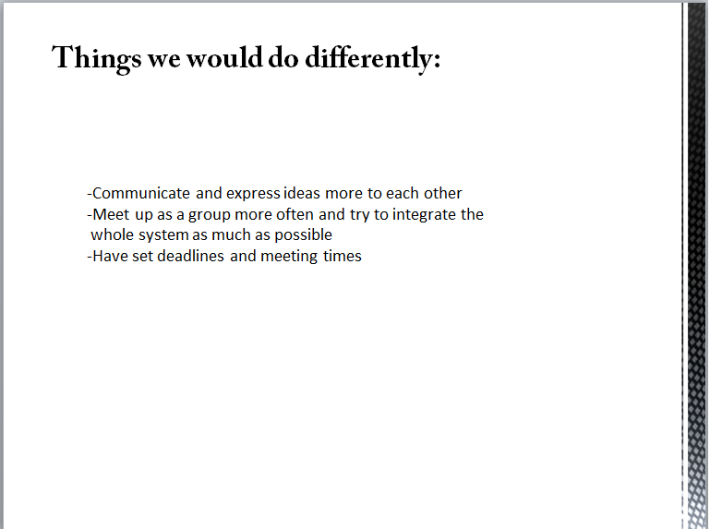
Last Semester my group said they would’ve done the above things
differently
This semester
Constant communication between members
Weekly meetings with almost daily meetings during the three weeks of development
Designed the system to be integrated from the start

Slide 4
What we would do differently
Spend more time on the design of the system
Start development earlier
Started development 4 days before the prototype demo

Slide 5
Biggest Lesson
Test often, test early

Slide 6
Questions

