Slide 1

Week 1 – OSI model
Composed a basic writeup for OSI layered model, with a rudimentary understanding of the theory behind ${\text{networking}}^{1}$
Provided real world examples of OSI model in practical applications (or what would fit within this model’s model of networking)
Notes:
1: https://nbviewer.jupyter.org/github/burwinliu/my-jupyter-nb/blob/master/Notes/Networks/OSILayer.ipynb

Slide 2
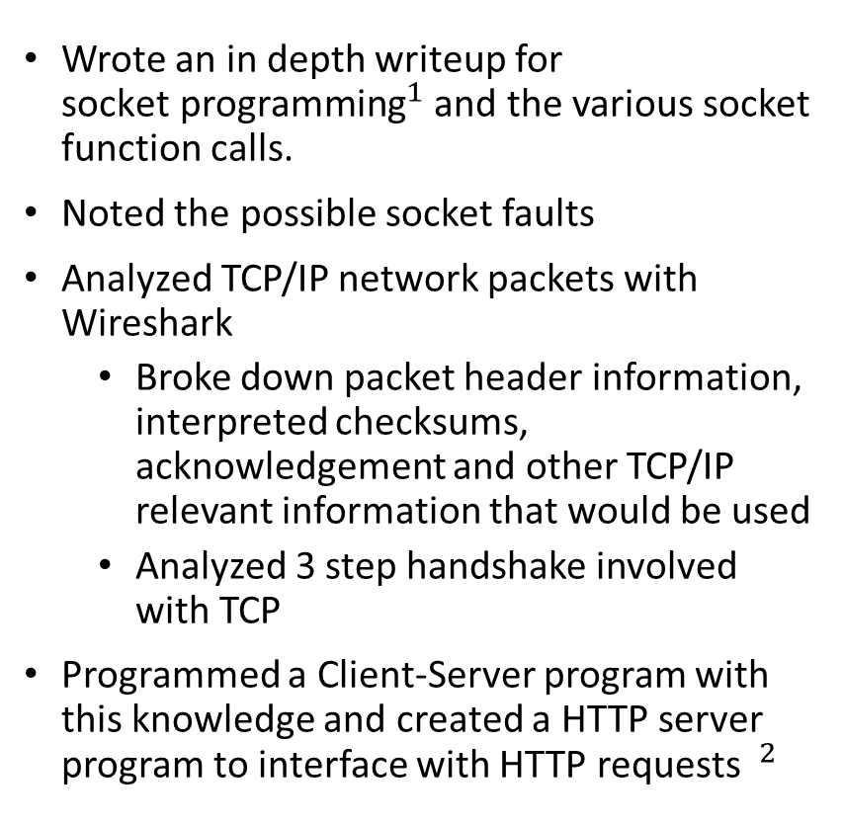
Week 1 – Socket Programming
Wrote an in depth writeup for ${\text{socket} \text{programming}}^{1}$ and the various socket function calls.
Noted the possible socket faults
Analyzed TCP/IP network packets with Wireshark
Broke down packet header information, interpreted checksums, acknowledgement and other TCP/IP relevant information that would be used
Analyzed 3 step handshake involved with TCP
Programmed a Client-Server program with this knowledge and created a HTTP server program to interface with HTTP requests $^{2}$
Notes:
1: https://nbviewer.jupyter.org/github/burwinliu/my-jupyter-nb/blob/master/Notes/Networks/Sockets.ipynb
2:

Slide 3
Week 2 – GIT presentation
Summarized the basic functionality and background behind git
Read the documentation and parsed the information into a relevant summary

Slide 4
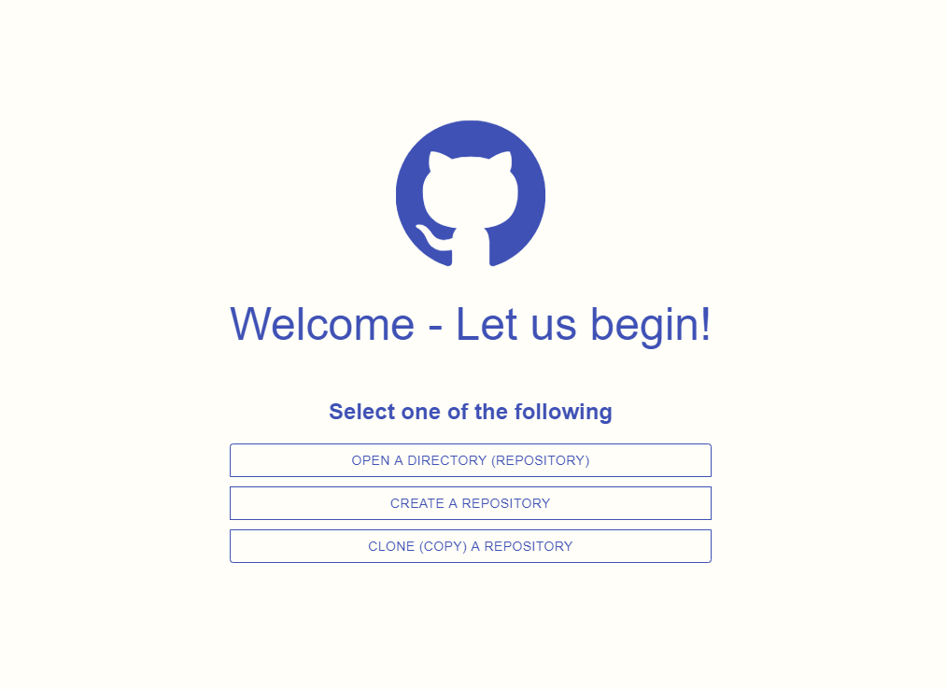
Week 2 – GIT GUI research
Programmed a GIT GUI
Made several key decisions within the GUI
Technologies used include Electron, npm, Materialize and VanillaJS/HTML/CSS
Used node-git to interface with git
Features
Implemented git init, git add, git commit
Interfaced between git’s system and front-end application
Show the diff between current version and changed version of the repository in a GUI interface
Implemented forms to allow users to choose directories

Slide 5
Week 3 – REACT added
Design Decisions
Over the course of this week, I realized that a multi-page application implementation would not be suffice for my uses.
To remedy this situation (as the render of a new page would cause a disconnect in the experience
To augment REACT, I added REDUX (state management) to have a core store for all information to go towards.
Implement Build environment for compilation of the new dependencies – used a boilerplate with gulp, customized for my needs
Features
Added on git push from a configured repository/environment

Slide 6
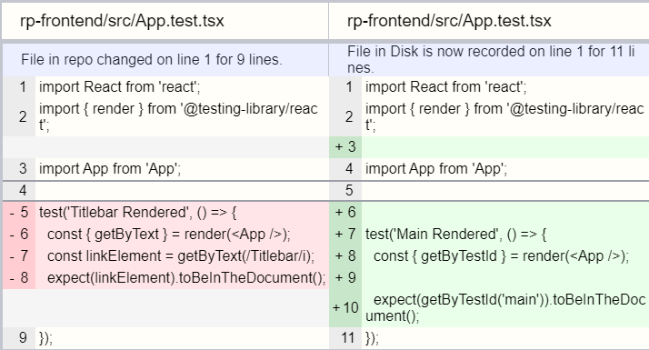
Week 4 – Adding Listening and Routing
Design Decisions
With Redux Routing, allow for one-page applications with multiple views, to solve the previous week’s issue with its full functionality
With node-watch, we view (theoretically) and update whenever a new change has been made
With material UI design a front-end interface with consistent design decisions
Features
Can display git diff and status with information

Slide 7
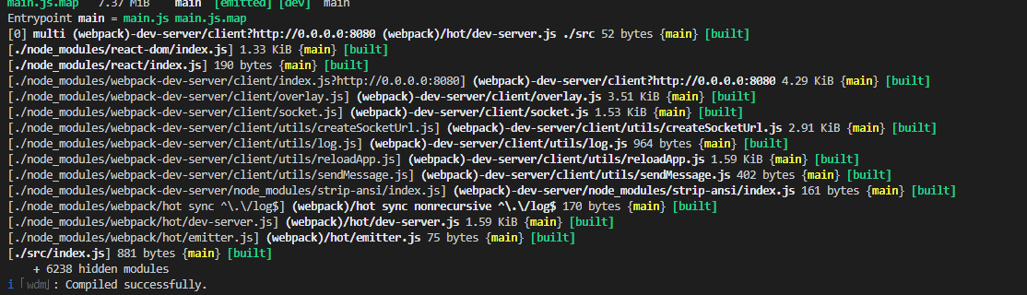
Week 5 –Improvements, Tagging, History
Design Decisions
Improved Build and Compile time – by using WEBPACK instead of GULP, and reconfiguring our repository to use these technologies, we improve build and compile times by over 50% -- it is a LOT better.
Fix some bugs by using a new build technology
Features
Add git log display (to show history), custom file bar, git diff (properly with highlighting), and git tag ( to mark important commits )

Slide 8
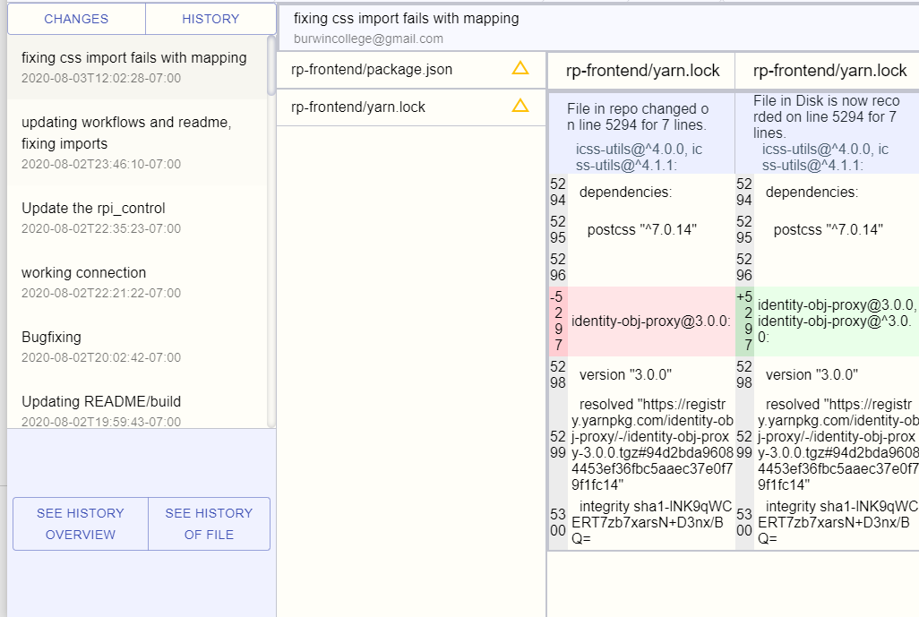
Week 6 – Logging, History Display, Diff Comparison
Features
Fully implement history via git log, and show a full history of the repository
Allow for “focused” rendering of history, focusing on a single file
Diff comparison of the changes made during each commit displayed when specific files are chosen
Implement header to display the commit location and other misc. information
Design Decisions
Added some central state management to remove controls placed within the view

Slide 9
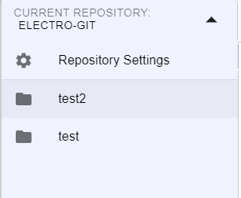
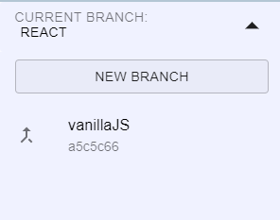
Week 7 – Networks and Updates
Research
Setup a Git server with all basic functionality
Rendered a custom git diff render for Excel
Features
Implemented Git Branching within the application to allow multiple workflows within a single Repository
Updated and modernized the repository selection interface

Slide 10
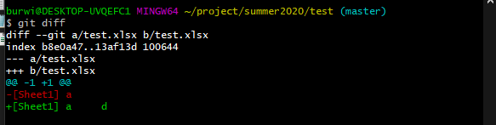
Week 8 – Research
Research
Established how to git diff with Excel (which can be extended to other diff formats. See https://github.com/tokuhirom/git-xlsx-textconv. They use go, but essentially provide a command that can take in input and compare the two diffs.
SSH – How they connect, and security works. SSH has basic TCP handshake, and then there is an asymmetric key exchange to ensure that we are connecting to the correct location. See https://www.digitalocean.com/community/tutorials/understanding-the-ssh-encryption-and-connection-process

Slide 11
Week 8 – Authentication
Research
When you talk with a server, you provide them a public key. This public key is used to encrypt incoming traffic (the security of this based on the two large primes ideal and some other ideas)
To reply to the server, you use some established CA in GitHub case (for company publish a public key to be trusted by all)
Therefore, you can connect to Git with a pub key talk – and you send over a hello with TCP – and negotiate the terms of the communication. Then, check the authenticity of their communication with the public key – they reply with the same information encrypted with the public key you gave it, which may be decrypted with your private key, and then two ephemeral keys may be generated to talk between the two.

Slide 12
Week 9 –Blacklisting, Vulnerabilities and Protected Branching
Research
CVE and CVSS
CVE == Common Vulnerabilities and Exposures – PUBLICLY disclosed cybersecurity vulnerabilities and exposures. These act as record for SW vulnerabilities, maintained by National Cybersecurity FFRDC from Mitre Corp w/ US Homeland Security Support
CVSS == Common Vulnerability Scoring System that dictates how severe the threat is.
CVSS measures based on three points – “Base” which measures intrinsic qualities of the vulnerability; “Temporal” which measures how it evolves over the life of the vulnerability; “Environmental” which measures how it affects the environment around the vulnerability.
These can each be broken down further, and combined to calculate the CVSS score – for more info see https://en.wikipedia.org/wiki/Common_Vulnerability_Scoring_System
Blacklisting
Whitelisting is possible, but requires a lot more effort – blacklisting everything, and whitelisting a select item
Did not find any “Filter” style restrictions, ignoring via size of a file

Slide 13
Week 9 – Continued
Research
Protected Branching
Using Gitlab/Github, you can create user accounts which will allow role assignment and subsequently role assignment with certain abilities to access/push/pull for certain information.

