Slide 1

Week 1 – OSI model
Composed a basic writeup for OSI layered model, with a rudimentary understanding of the theory behind ${\text{networking}}^{1}$
Provided real world examples of OSI model in practical applications (or what would fit within this model’s model of networking)
Notes:
1: https://nbviewer.jupyter.org/github/burwinliu/my-jupyter-nb/blob/master/Notes/Networks/OSILayer.ipynb

Slide 2
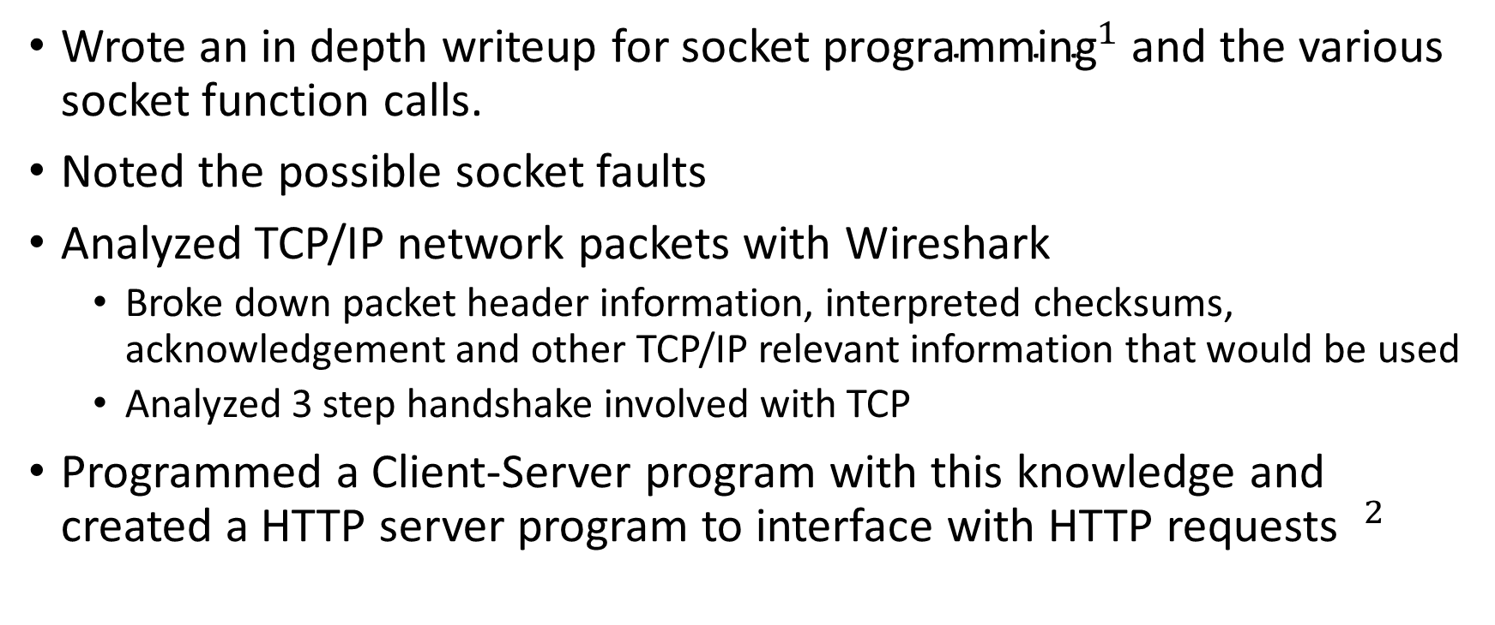
Week 1 – Socket Programming
Wrote an in depth writeup for ${\text{socket} \text{programming}}^{1}$ and the various socket function calls.
Noted the possible socket faults
Analyzed TCP/IP network packets with Wireshark
Broke down packet header information, interpreted checksums, acknowledgement and other TCP/IP relevant information that would be used
Analyzed 3 step handshake involved with TCP
Programmed a Client-Server program with this knowledge and created a HTTP server program to interface with HTTP requests $^{2}$
Notes:
1: https://nbviewer.jupyter.org/github/burwinliu/my-jupyter-nb/blob/master/Notes/Networks/Sockets.ipynb
2:

Slide 3
Week 2 – GIT presentation
Summarized the basic functionality and background behind git
Read the documentation and parsed the information into a relevant summary

Slide 4
Week 2 – GIT GUI research
Programmed a GIT GUI
Made several key decisions within the GUI
Technologies used include Electron, npm, Materialize and VanillaJS/HTML/CSS
Used node-git to interface with git
Implemented basic functionality
Implemented git init, git add, git commit
Interfaced between git’s system and front end application
Show the diff between current version and changed version of the repository in a GUI interface
Implemented forms to allow users to choose directories

