Slide 1

Week 1 – OSI model
Wrote a basic writeup for OSI layered model, with a rudimentary understanding of the theory behind ${\text{networking}}^{1}$
Provided real world examples of OSI model in practical applications (or what would fit within this model’s model of networking)
Notes:
1: https://nbviewer.jupyter.org/github/burwinliu/my-jupyter-nb/blob/master/Notes/Networks/OSILayer.ipynb

Slide 2
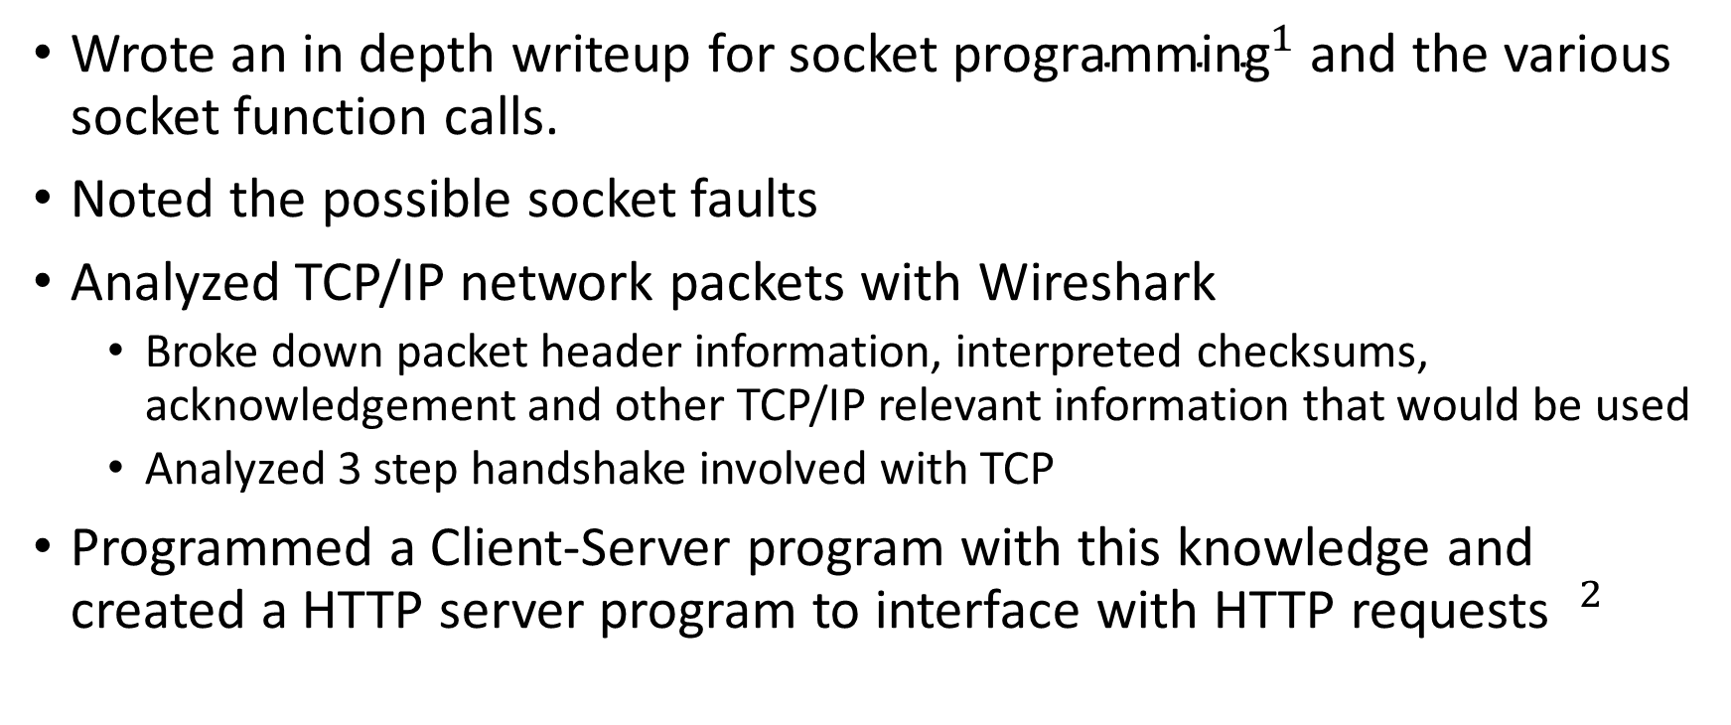
Week 1 – Socket Programming
Wrote an in depth writeup for ${\text{socket} \text{programming}}^{1}$ and the various socket function calls.
Noted the possible socket faults
Analyzed TCP/IP network packets with Wireshark
Broke down packet header information, interpreted checksums, acknowledgement and other TCP/IP relevant information that would be used
Analyzed 3 step handshake involved with TCP
Programmed a Client-Server program with this knowledge and created a HTTP server program to interface with HTTP requests $^{2}$
Notes:
1: https://nbviewer.jupyter.org/github/burwinliu/my-jupyter-nb/blob/master/Notes/Networks/Sockets.ipynb
2:

Slide 3
Week 2 – GIT presentation

Slide 4
Week 2 – GIT GUI research

