Slide 1
EE464 – Hardware Project Feedback Session
PowerLovers
Burak Yalçın – 2167534
Emre Deniz Şenel – 2167237
27.03.2020

Slide 2
General Info on Chosen Topology
Chosen Topology : #FOR1.
Implementation with reset winding.
Specifications :
Input Voltage : 24-48 V
Output Voltage : 15 V
Rated Power : 48 W
Max Output Voltage ripple : 2%
Line and Load Regulations : 2%

Slide 3
Reasoning
A better output current waveform.
A simpler magnetic design.
More challenging overall design.

Slide 4
Design Process
Theoretical foundations.
Basic properties – switching frequency, turns ratio, duty cycle etc.
Magnetic design of the transformer.
Calculations on output filter elements.
Simulations for different scenarios.
Component selection.

Slide 5
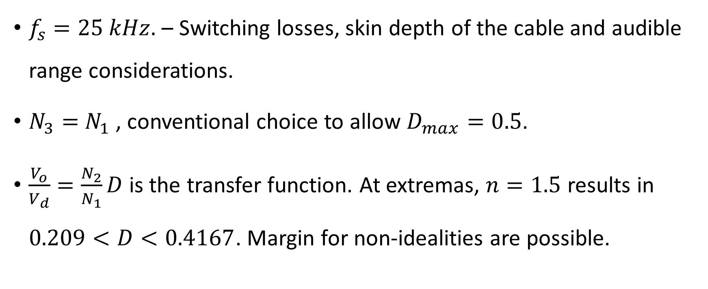
First Steps
$f_{s}=25 kHz.$ – Switching losses, skin depth of the cable and audible range considerations.
$N_{3}=$ $N_{1}$, conventional choice to allow $D_{max}=0.5$.
$\frac{V_{o}}{V_{d}}=\frac{N_{2}}{N_{1}}D$is the transfer function. At extremas, $n=1.5$ results in $0.209<D<0.4167$. Margin for non-idealities are possible.

Slide 6
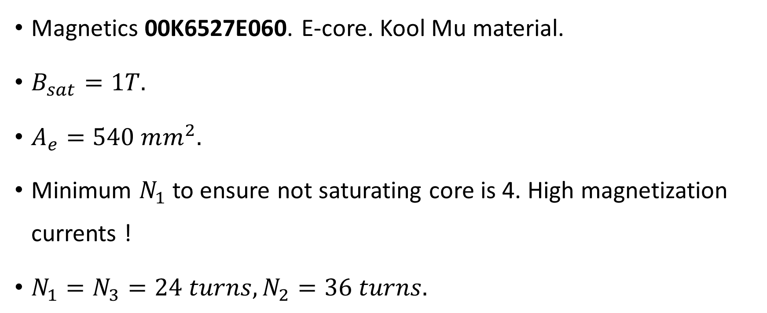
Transformer Design
Magnetics 00K6527E060. E-core. Kool Mu material.
$B_{sat}=1T.$
$A_{e}=540 mm^{2}.$
Minimum $N_{1}$to ensure not saturating core is 4. High magnetization currents !
$N_{1}=N_{3}=24 turns,N_{2}=36 turns.$

Slide 7
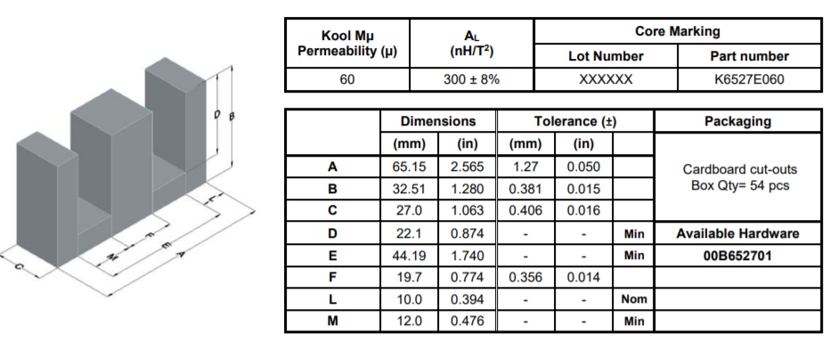
Transformer Design

Slide 8
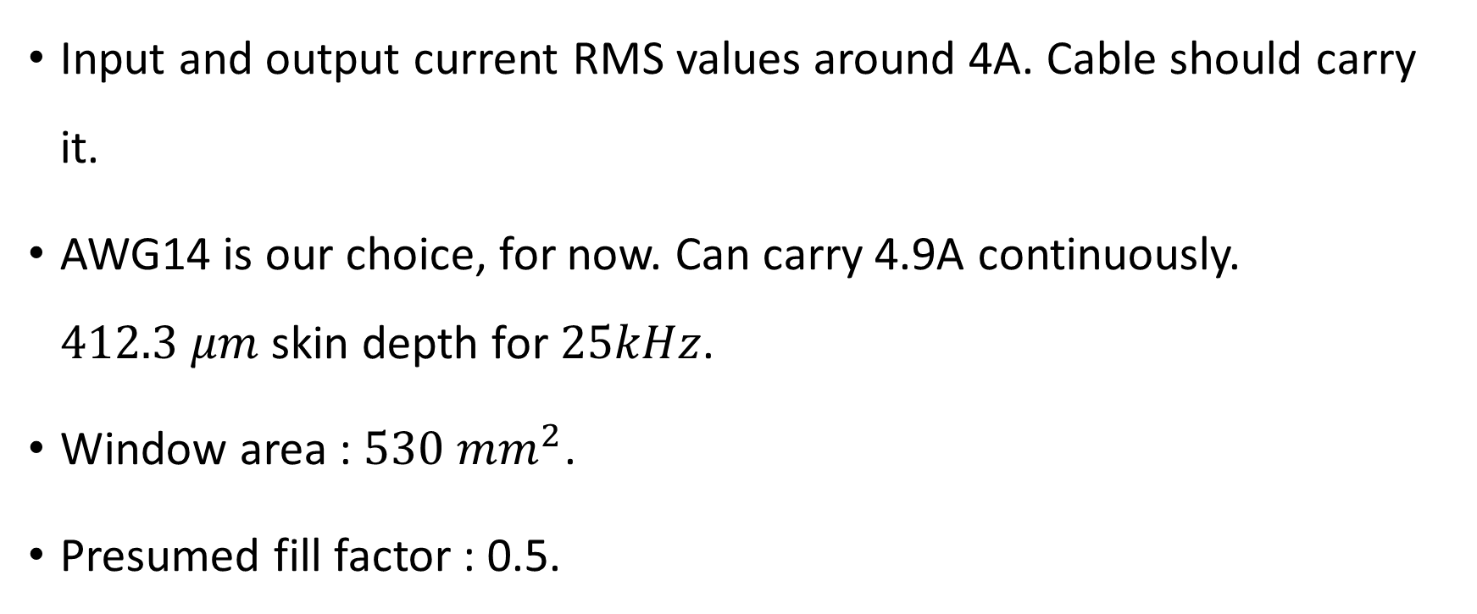
Transformer Design
Input and output current RMS values around 4A. Cable should carry it.
AWG14 is our choice, for now. Can carry 4.9A continuously. $412.3 μm$skin depth for $25kHz$.
Window area : $530 mm^{2}$.
Presumed fill factor : 0.5.

Slide 9
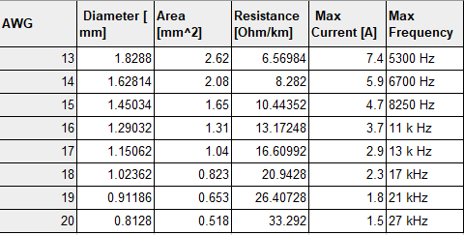
Transformer Design

Slide 10
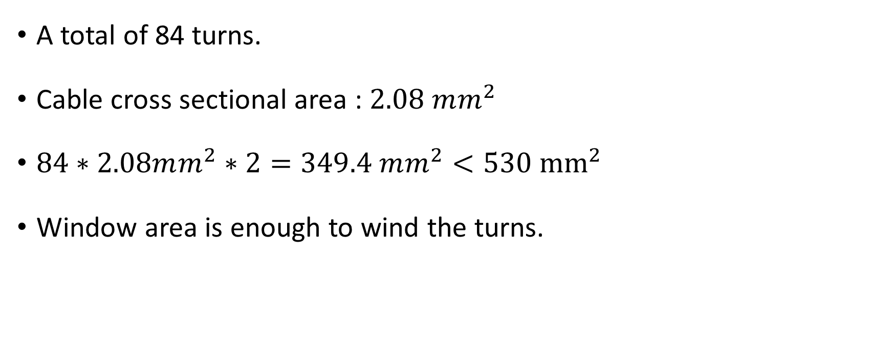
Transformer Design
A total of 84 turns.
Cable cross sectional area : $2.08 mm^{2}$
$84∗2.08mm^{2}∗2=349.4 mm^{2}<530 {mm}^{2}$
Window area is enough to wind the turns.

Slide 11

Filtering Elements
Capacitor : At least 15 V, $328 μF$.
Chosen : 25V, $470 μF.$
Paralleling is another option.

Slide 12
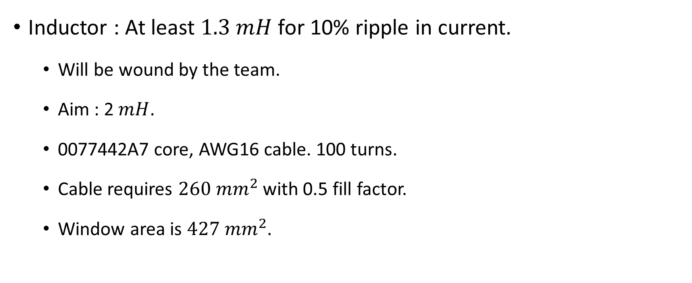
Filtering Elements
Inductor : At least $1.3 mH$ for 10% ripple in current.
Will be wound by the team.
Aim : 2 $mH$.
0077442A7 core, AWG16 cable. 100 turns.
Cable requires $260 mm^{2}$ with 0.5 fill factor.
Window area is $427 mm^{2}$.

