Slide 1
Programming Error Pattern Recognition
Pattern recognition project: prototype, real-data validation, and BIFI comparison
Goal: help instructors identify recurring programming mistakes without replacing human review.

Slide 2
Project goal and PR framing
Input: a Python code submission.
Output: an error-pattern label or a correct-solution label.
Pattern recognition task: represent source code, train classifiers, evaluate generalization.
Practical value: summarize recurring mistakes and support instructor triage.

Slide 3
Research questions
Can source-code representations recognize recurring programming-error patterns?
Does a model trained on generated labels transfer to real submissions?
What does a successful research model require beyond this project setup?

Slide 4
System built in this project
Reusable Python package with data loading, preprocessing, features, training and evaluation modules.
Command-line scripts for dataset preparation, training, evaluation and prediction.
Two model paths: TF-IDF + Linear SVM and CodeBERT sequence classification.
Instructor-facing Streamlit dashboard for pasted code, sample examples and CSV upload.

Slide 5
Datasets and labels
Synthetic prototype: 976 unique balanced Python snippets across eight labels.
Eight-label taxonomy: correct, syntax, variable misuse, loop logic, conditional logic, function definition, data-structure misuse and algorithmic inefficiency.
CodeContests validation: real Python submissions using official problem splits.
Real-data labels are limited to accepted solutions and AST-confirmed syntax errors.

Slide 6
Data integrity controls
Normalize each code sample, hash it and remove duplicates.
Reject any experiment where train and test fingerprints overlap.
Use a deterministic stratified split for the synthetic data.
Use the official CodeContests problem split to reduce problem-level leakage.

Slide 7
Model approaches
SVM baseline: tokenized code, unigram/bigram TF-IDF features and LinearSVC.
CodeBERT: microsoft/codebert-base with a sequence-classification head.
CodeBERT settings: max length 256, batch size 8, gradient accumulation, early stopping and seed 42.
The full real-data CodeBERT target was resource-heavy, so a reduced CodeContests run is reported.

Slide 8
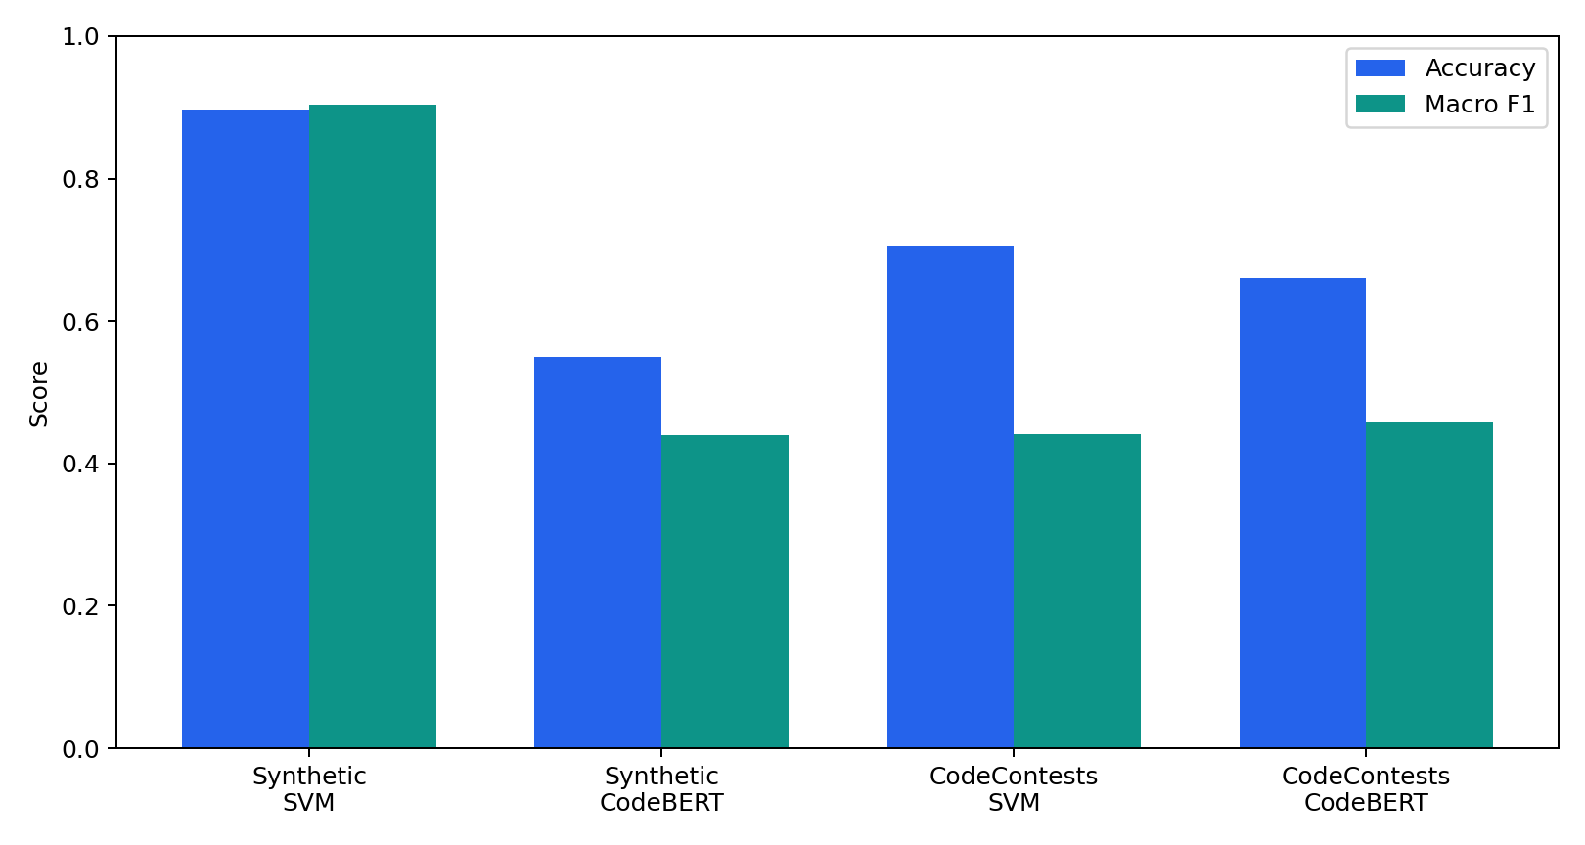
Measured model results
Macro F1 is the main metric because the real test set is imbalanced
Model | Dataset | Train | Test | Accuracy | Macro F1 | Weighted F1
SVM | Synthetic 8-class | 732 | 244 | 0.898 | 0.903 | 0.900
CodeBERT | Synthetic 8-class | 732 | 244 | 0.549 | 0.439 | 0.448
SVM | CodeContests binary | 19,999 | 2,059 | 0.705 | 0.440 | 0.803
CodeBERT reduced | CodeContests binary | 2,000 | 2,059 | 0.661 | 0.458 | 0.770

Slide 9
What the real-data results mean
The CodeContests test set contains 2,000 correct solutions and only 59 syntax errors.
SVM: 18/59 syntax errors found; syntax precision 0.03 and recall 0.31.
Reduced CodeBERT: 51/59 syntax errors found; syntax precision 0.07 and recall 0.86.
CodeBERT improves recall, but many correct programs are incorrectly flagged.
The achievement is an honest validation boundary, not a claim of deployment-ready accuracy.

Slide 10
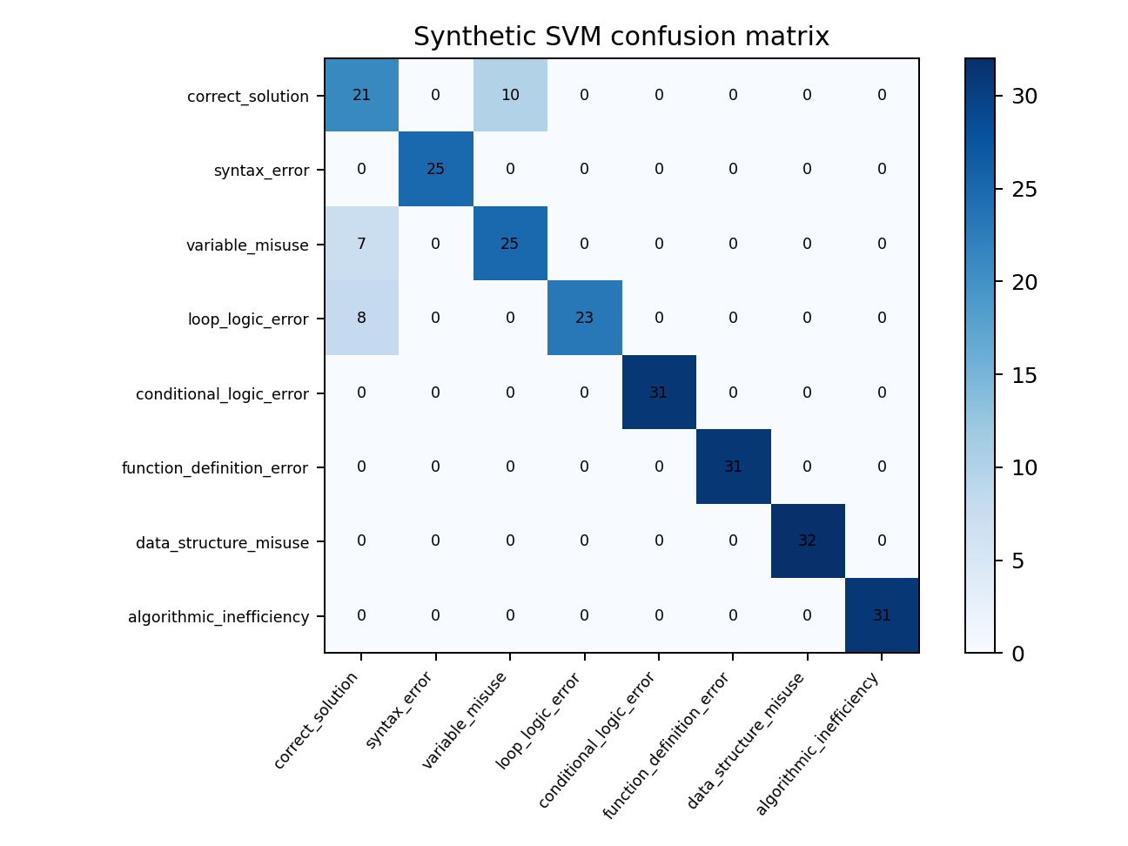
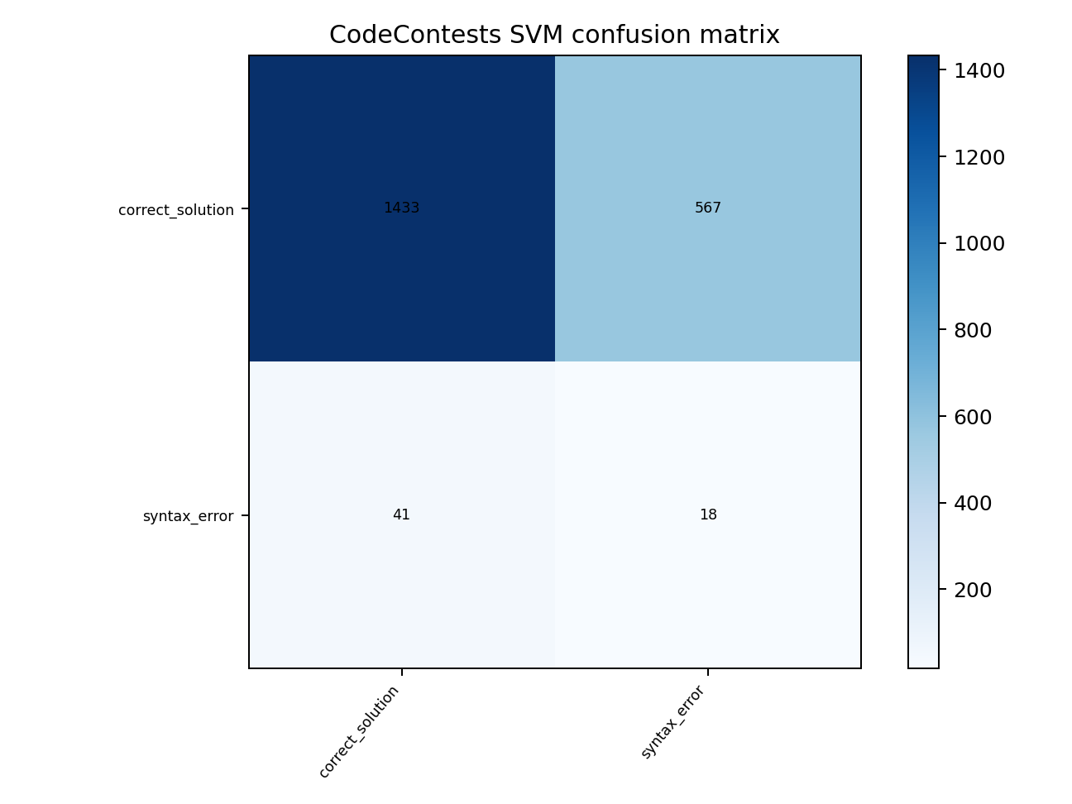
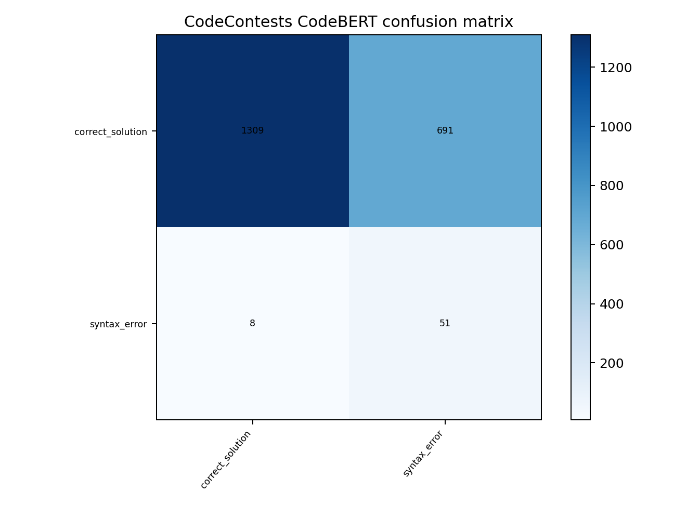
Confusion matrices
Synthetic SVM is strong on template-like labels. Real-data models expose the minority-class problem clearly.

Slide 11
Successful external study: BIFI
Break-It-Fix-It (Yasunaga and Liang, ICML 2021) is a program-repair model, not a classifier.
It uses a parser/compiler-style critic to verify whether generated code is valid.
Reported results: 90.5% repair accuracy on GitHub-Python AST parse errors and 71.7% on DeepFix C.
It directly addresses our key limitation: synthetic errors often do not match real human errors.

Slide 12
Our system compared with BIFI
Aspect | This project | BIFI
Task | Error-pattern classification | Syntax/compile error repair
Training signal | Labels from generated data and AST checks | Parser/compiler critic plus generated pairs
Strength | End-to-end PR pipeline and dashboard | High repair accuracy with real-error adaptation
Requirement | Labeled examples and class balance | Large corpora, critic, more compute
Limitation | Low precision on real syntax errors | Does not solve semantic bugs without stronger feedback
Future direction: use parser and unit-test feedback to move from static labels toward verified behavior.

Slide 13
Project achievements
Built a reproducible package, scripts, tests, experiment artifacts and dashboard.
Measured a strong synthetic baseline: SVM Macro F1 0.903 on eight labels.
Ran real external validation on CodeContests instead of relying only on generated data.
Showed that CodeBERT can improve syntax-error recall, but not precision under imbalance.
Added a research comparison explaining what a successful model needs.

Slide 14
Limitations
Synthetic eight-class labels demonstrate feasibility but not classroom generalization.
CodeContests is competitive-programming data, not a classroom dataset.
Real semantic labels are unavailable; parseable incorrect submissions are excluded.
The current task is single-label, while real code can contain multiple errors.
A reliable production model needs expert annotation or test-based behavioral labels.

Slide 15
Conclusion
The project achieved a complete PR workflow for programming-error pattern recognition.
The synthetic task shows the pipeline can learn the proposed taxonomy.
The real-data task shows why accuracy alone is misleading under severe imbalance.
BIFI shows the next step: combine large data with parser/compiler or test feedback.

Slide 16
References
Yasunaga and Liang, Break-It-Fix-It: Unsupervised Learning for Program Repair, ICML 2021.
Yasunaga and Liang, Graph-based, Self-Supervised Program Repair from Diagnostic Feedback, ICML 2020.
DeepMind CodeContests dataset for real competitive-programming submissions.
Microsoft CodeBERT for transformer-based source-code representation.

