Slide 1
Inside Fdb.Script
A quick overview of a pure functional programming language

Slide 2
Why creating a new language
Narrow domain
Runtime optimisations
Increased readability
Learning aspect

Slide 3
Design Assumptions
Fully functional (no variables or state)
Declarative parallel execution
Pipeline data processign
Portability

Slide 4
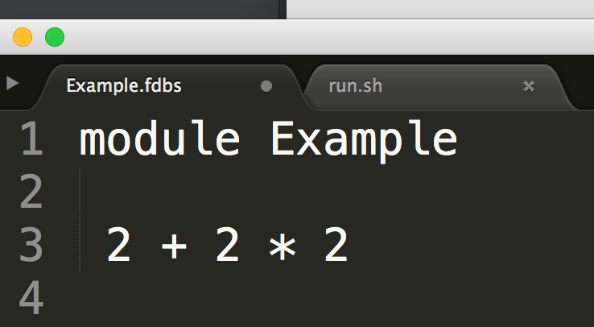
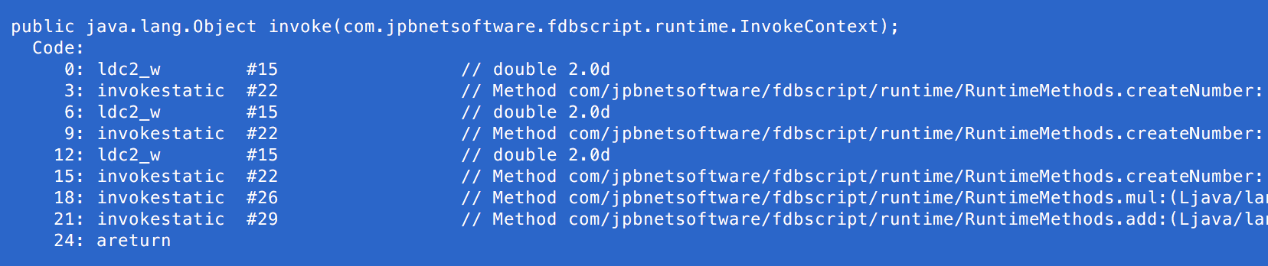
Hello World

Slide 5
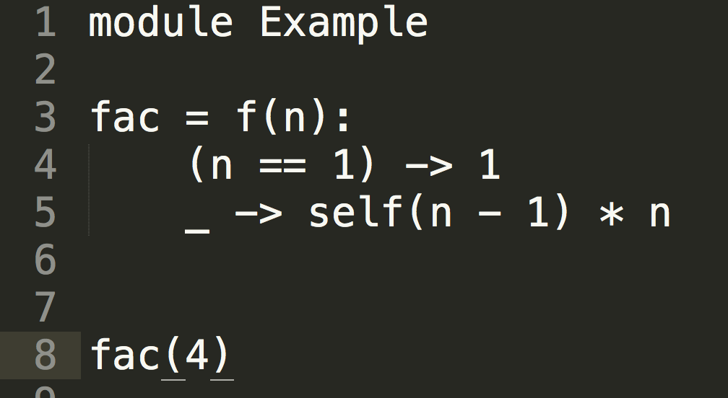
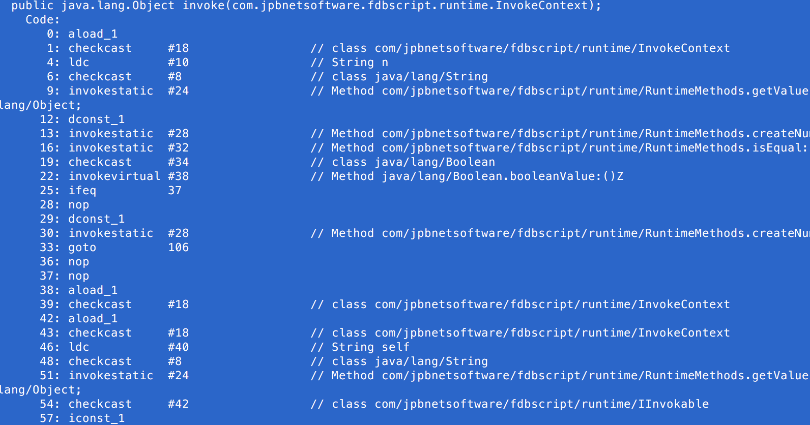
Factorial

Slide 6
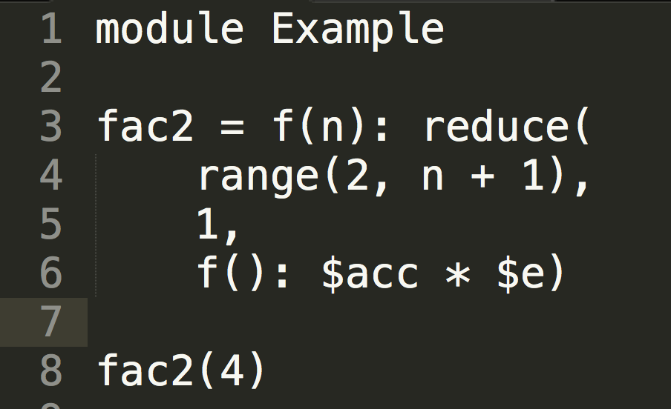
Factorial v2

Slide 7
Features
Lists and objects - [1, 2, 3], { prop: “value” }
List concatenation - [1, 2, 3] @ [4, 5] yields [1, 2, 3, 4, 5]
Function parameter injection - f(): $acc * $e
Infinite lists - range(1, 99999999)

Slide 8
Future
parallel execution - ||f(24) + ||f(88)
object extension - {prop: “v”} @ {prop2: “v”}
Runtime optimisations
bytecode optimisations

Slide 9
Thank you!
https://github.com/burzyk/FdbScript.Compiler

