Slide 1


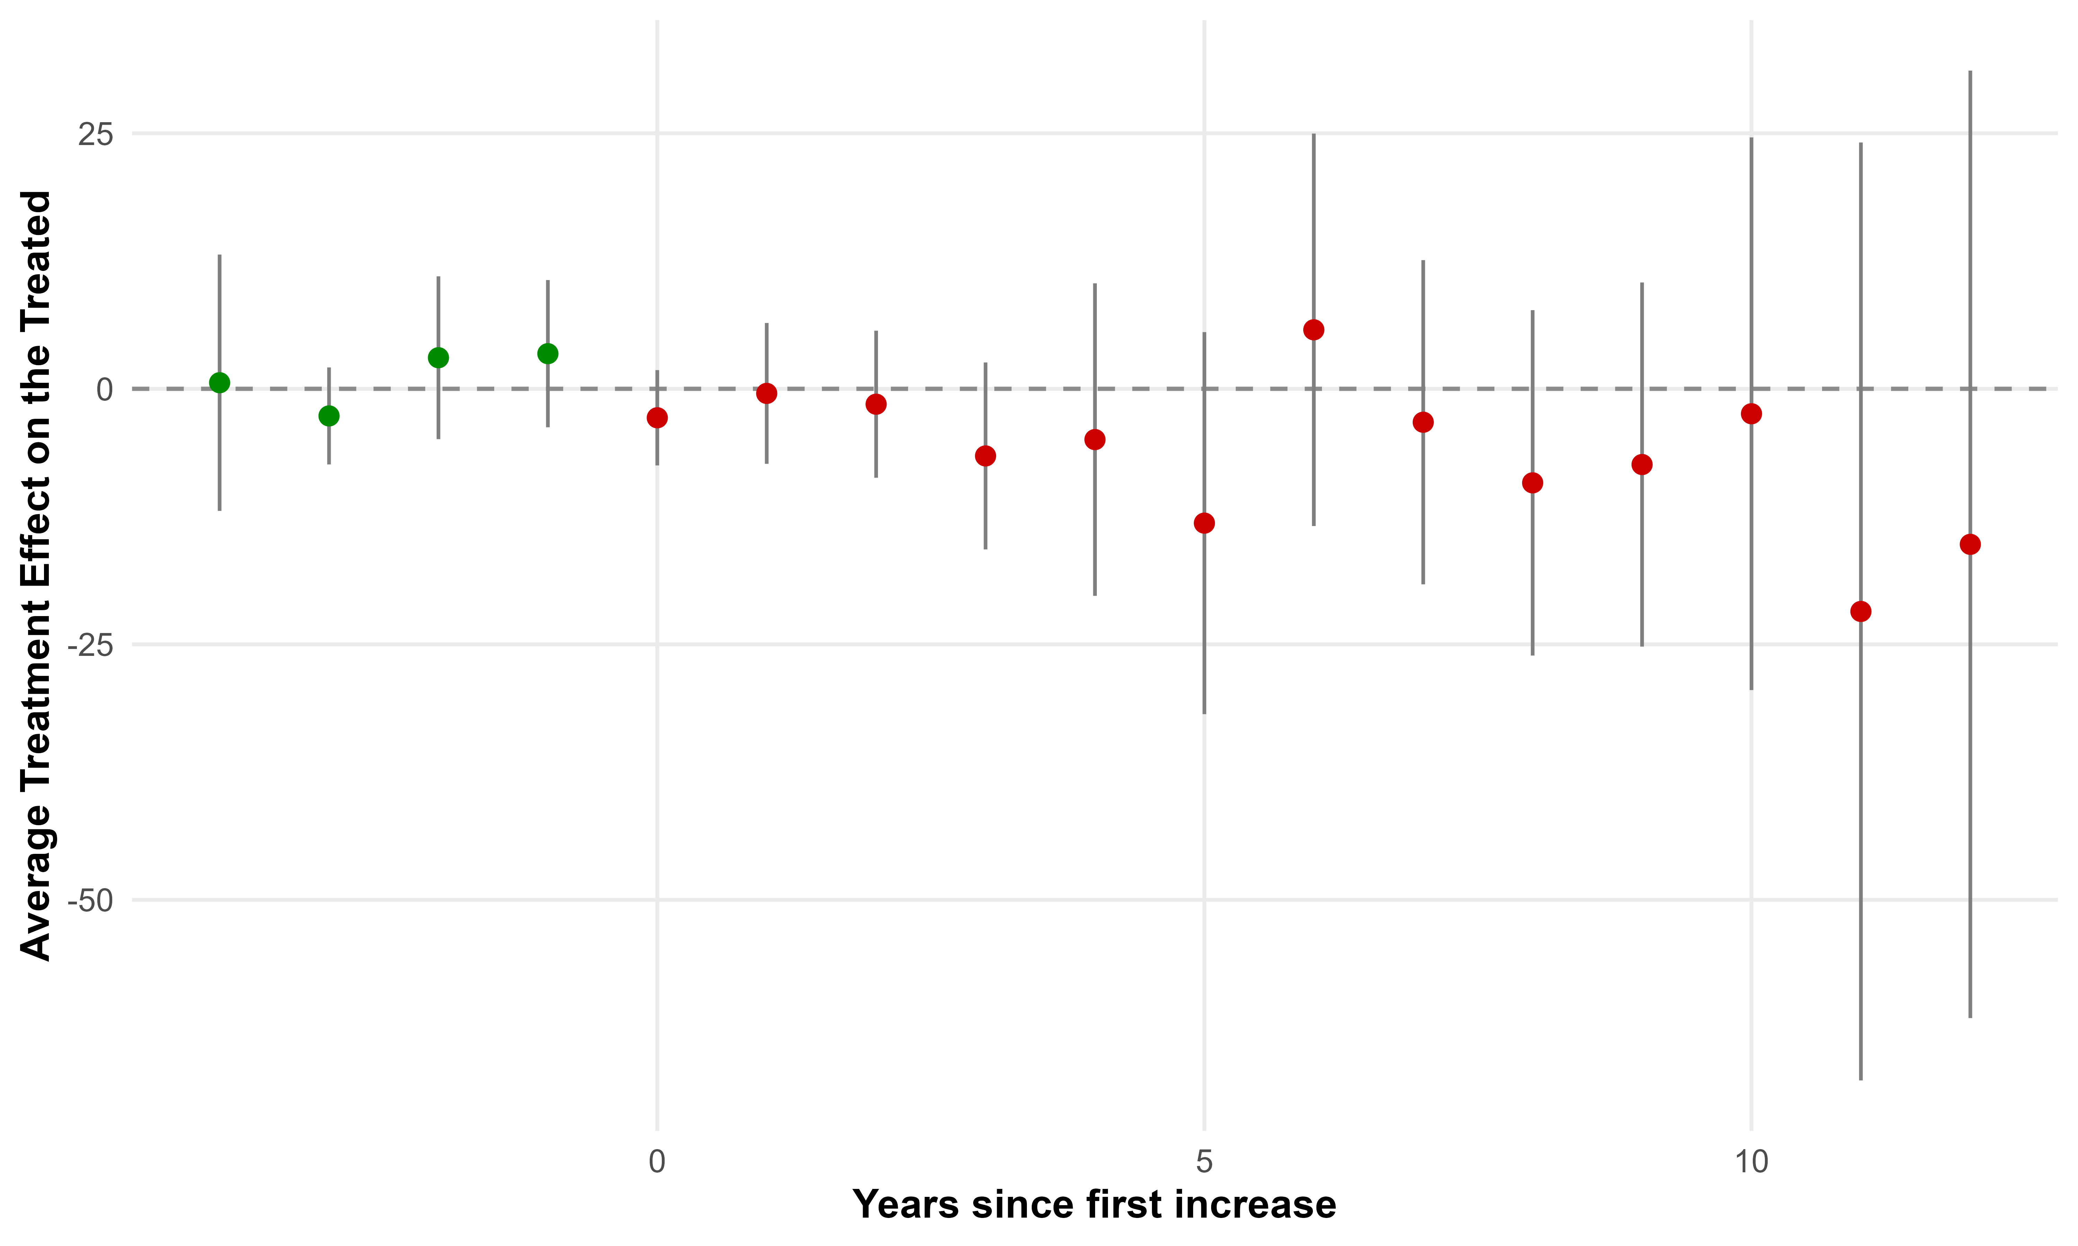
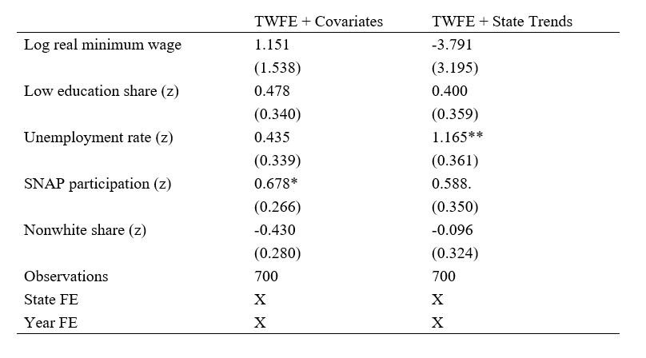
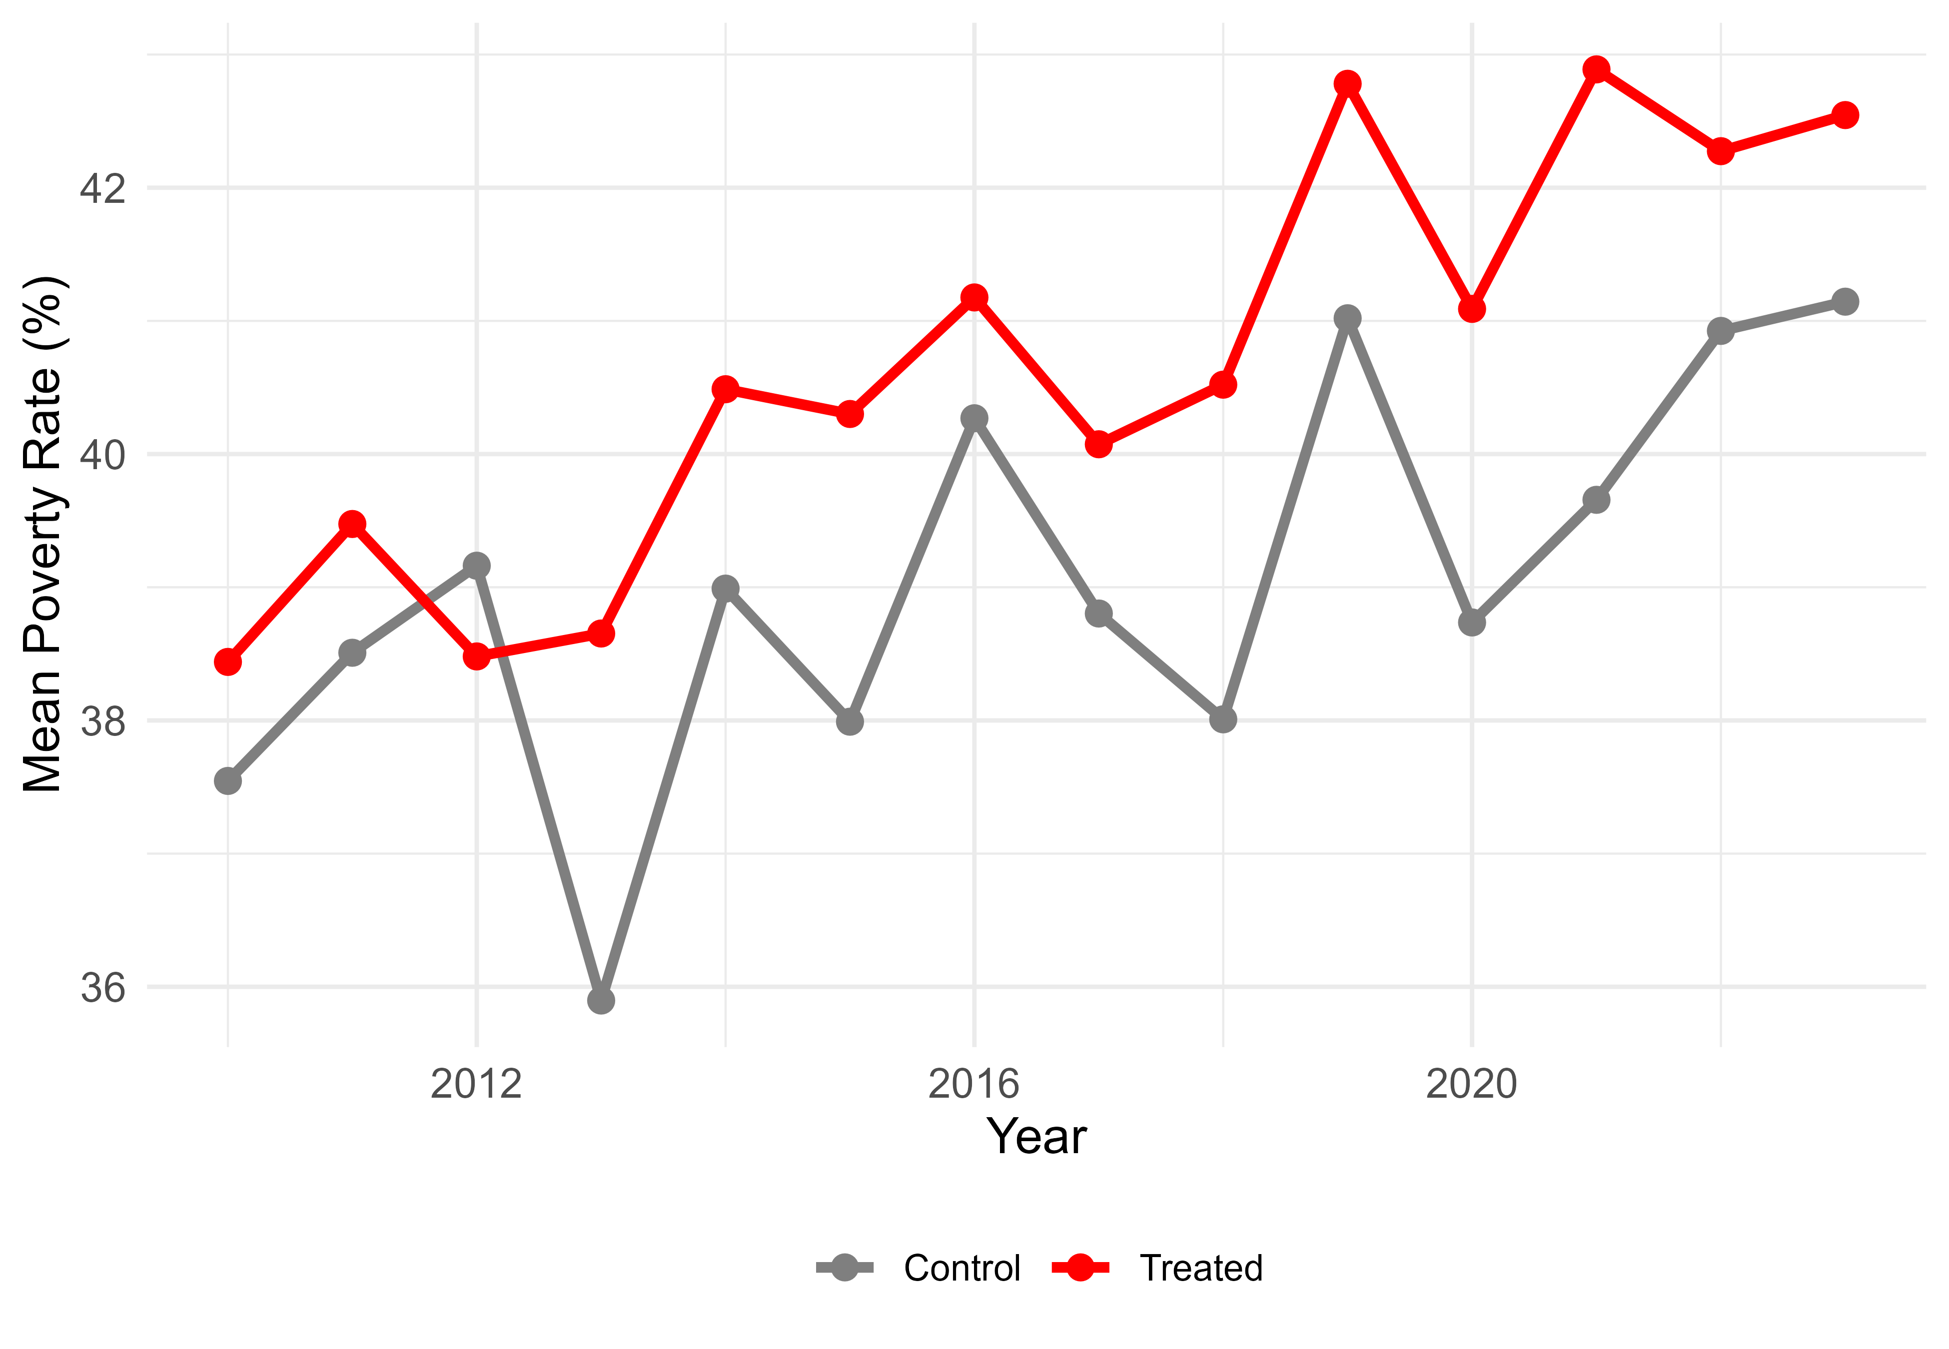
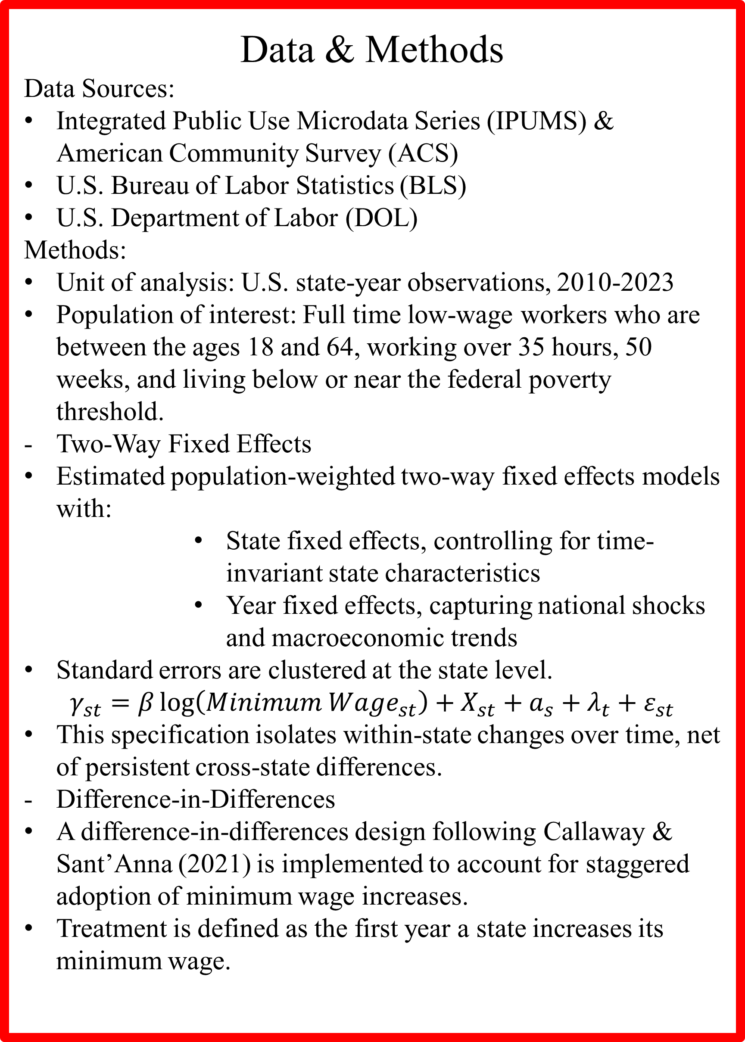
The Effects of Minimum Wage on Poverty Reduction. Evidence from U.S. State-Level Data (2010-2023)
Calvin Burzynski
Data Analytics
Research Advisor Dr. Zhe Wang
Introduction
Minimum wage policy is widely used as an anti-poverty tool, yet empirical evidence on its effectiveness remains mixed.
Discussion around minimum wage policy suggests that it should be much higher as current rates fail to cover basic costs of living.
Prior research finds that minimum wage increases often raise earnings at the bottom of the wage distribution, but effects on poverty are inconsistent and sensitive to how treatment outcomes are defined (Dube, Lester & Reich, 2010).
States adopt minimum wage increases at different times and magnitudes, creating variation that can be used to study policy impacts.
This study aimed to investigate whether state-level minimum wage increases reduce poverty rates among full-time low-wage workers, using modern panel-data methods.
Results
Treated states begin the period with slightly higher poverty rates among full-time low-wage workers than control states, reflecting underlying differences in economic conditions prior to minimum wage increases.
Two-way fixed effects estimates indicate that the relationship between the real minimum wage and poverty is statistically indistinguishable from zero across specifications.
Labor market conditions exhibit stronger associations with poverty than the minimum wage itself.
SNAP participation is positively and statistically significant in the baseline specification, consistent with program targeting toward economically disadvantaged populations.
Demographic characteristics, including educational attainment and racial composition, display smaller and less precisely estimated effects, suggesting more limited explanatory power relative to labor market conditions.
Event-study results reinforce these findings. In the years leading up to a minimum wage increase, estimated coefficients are small and statistically indistinguishable from zero, indicating no evidence of differential pre-treatment trends between treated and control states. Following treatment, point estimates suggest modest declines in poverty; however, these effects are imprecisely estimated, with confidence intervals widening at longer horizons due to reduced sample sizes. Parallel trends diagnostics further support the identifying assumptions of the difference-in-differences framework, though the post-treatment results should be interpreted cautiously.
Results
Discussion
- Do minimum wage increases reduce poverty?
Across specifications, minimum wage increases are not associated with statistically precise reductions in poverty among full-time low-wage workers, suggesting that wage floors alone may be insufficient to lift workers above the poverty threshold.
- Role of economic conditions:
Labor market factors, particularly unemployment, exhibit stronger and more consistent relationships with poverty than minimum wage levels
- Program Participation:
The positive association between SNAP participation and poverty likely reflects program targeting toward economically vulnerable populations.
Limitations
- Imprecision and limited post-treatment support
Event-study estimates become increasingly imprecise at longer horizons, reflecting fewer treated observations and reduced statistical power.
- Policy variation and scope
State-level minimum wage increases vary in magnitude and timing, and many increases are modest relative to prevailing living costs. This limits the ability to detect large poverty effects.
Next Steps
Examine alternative poverty measures, including household-level or supplemental poverty thresholds, to better reflect income sharing and cost-of-living differences.
Incorporate local price or housing cost indices to assess whether minimum wage increases fail to keep pace with rising expenses.
Evaluate minimum wage policy alongside complementary anti-poverty programs, such as tax credits or employment subsidies.
Acknowledgements
I want to give special thanks to Dr. Wang for her guidance and support throughout this process. Additionally, I would like to thank the Data Analytics department for their teachings and help.
Figure 1. Event Study of Minimum Wage Increases on Poverty Rates. Event-study estimates of the average treatment effect on the treated following minimum wage increases are pictured, using the staggered difference-in-differences estimator with covariates. Points represent estimated effects by event time. Pre-treatment estimates cluster near zero, while post-treatment estimates suggest modest declines in poverty with substantial uncertainty.
Data & Methods
Data Sources:
Integrated Public Use Microdata Series (IPUMS) & American Community Survey (ACS)
U.S. Bureau of Labor Statistics (BLS)
U.S. Department of Labor (DOL)
Methods:
Unit of analysis: U.S. state-year observations, 2010-2023
Population of interest: Full time low-wage workers who are between the ages 18 and 64, working over 35 hours, 50 weeks, and living below or near the federal poverty threshold.
Two-Way Fixed Effects
Estimated population-weighted two-way fixed effects models with:
  State fixed effects, controlling for time-invariant state characteristics
  Year fixed effects, capturing national shocks and macroeconomic trends
Standard errors are clustered at the state level.
$$γ_{st}=β\log\left({Minimum Wage}_{st}\right)+X_{st}+a_{s}+λ_{t}+ε_{st}$$
This specification isolates within-state changes over time, net of persistent cross-state differences.
Difference-in-Differences
A difference-in-differences design following Callaway & Sant’Anna (2021) is implemented to account for staggered adoption of minimum wage increases.
Treatment is defined as the first year a state increases its minimum wage.
Table 1. Two-Way Fixed Effects Estimates of Minimum Wage Effects on Poverty. The table reports population-weighted two-way fixed effects estimates of the relationship between the real minimum wage and poverty rates among full-time low-wage workers. Column (1) includes state and year fixed effects with covariates. Column (2) adds state-specific linear time trends. Standard errors clustered by state are shown in parentheses. Statistical significance is denoted by . p < 0.1, * p < 0.05, ** p < 0.01, and *** p < 0.001.
Works Cited
Bilinski, A., & Hatfield, L. A. (2020). Nothing to see here? Non-inferiority approaches to parallel trends and other model assumptions. arXiv.
Callaway, B., & Sant’Anna, P. H. C. (2021). Difference-in-differences with multiple time periods. Journal of Econometrics, 225(2), 200–230.
Dube, A., Lester, T. W., & Reich, M. (2010). MINIMUM WAGE EFFECTS ACROSS STATE BORDERS: ESTIMATES USING CONTIGUOUS COUNTIES. The Review of Economics and Statistics, 92(4), 945–964.
U.S. Department of Labor, Wage and Hour Division. (2024). Changes in Basic Minimum Wages in Non-Farm Employment Under State Law: Selected Years 1968 to 2024.
U.S. Bureau of Labor Statistics. (2024). Local Area Unemployment Statistics (LAUS).
Winkler, M. R., Clohan, R., Komro, K. A., Livingston, M. D., & Markowitz, S. (2025). State minimum wage and food insecurity among US households with children. JAMA Network Open, 8(3), e252043.
Figure 2. Parallel Trends in Poverty Rates for Treated and Control States. Mean poverty rates for treated and control states prior to minimum wage increases. Similar pre-treatment trajectories provide descriptive support for the parallel trends assumption underlying the difference-in-differences framework.

