Slide 1
Type Hint in Python
Reduce the surprises you get in runtime…

Slide 2
Python Is Beginner Friendly?
I don’t think so.

Slide 3
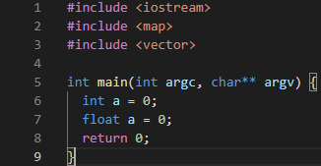
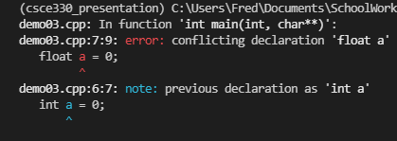

Slide 4
In C++
Every thing is mouthful but minimizes the surprise in runtime.

Slide 5
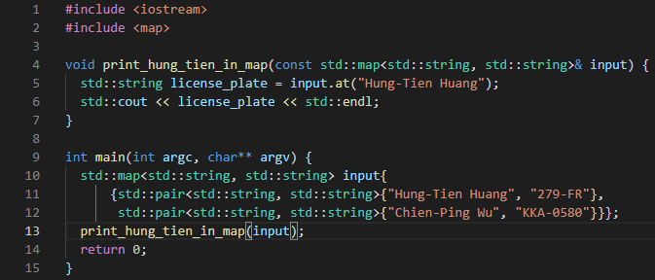
Absolutely Normal C++ Program

Slide 6
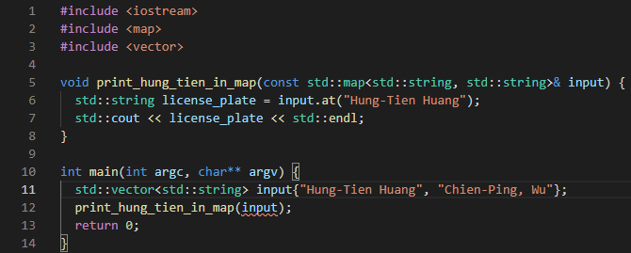
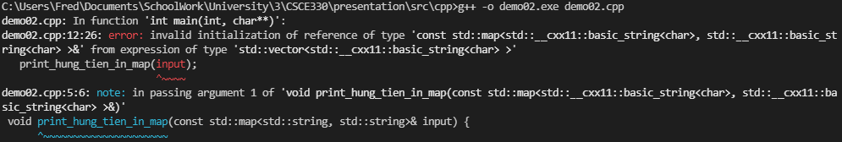
C++ Compiler Likes to Complains…

Slide 7
In Python
Every thing is concise but the surprise in runtime makes me punch my keyboard.

Slide 8
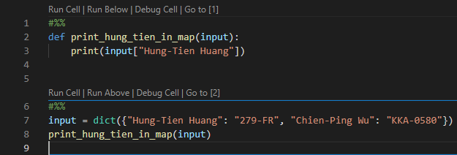
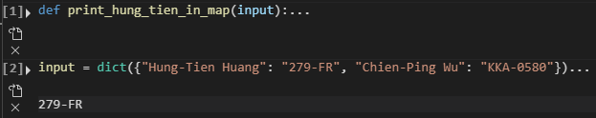
Absolutely Normal Python Program

Slide 9
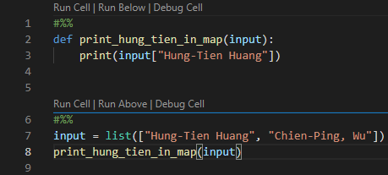
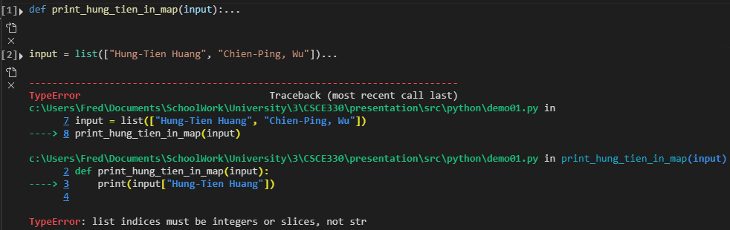
Depressing Runtime Type Error in Python…

Slide 10
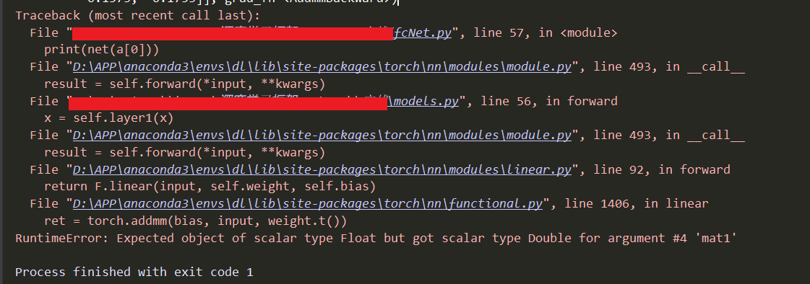
It Might Take Day(s) to Show This…

Slide 11
Python Type Hint
An attempt to reduce runtime surprises.

Slide 12
How to Declare Type Hint
Since Python 3.9
Python 3.6 – 3.8

Slide 13
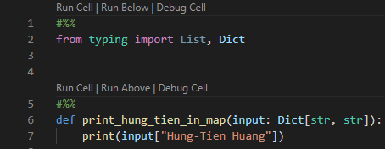
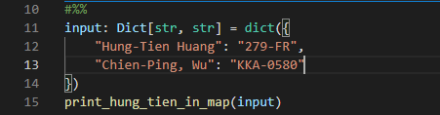
Things Are Way Clearer Now.

Slide 14

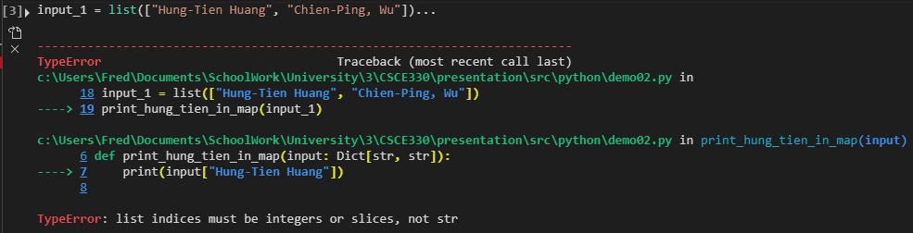
What If We Insist Being Stupid?

Slide 15
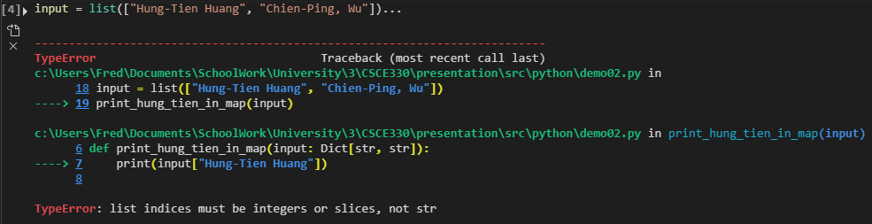
Hold A Second, Line 7?

Slide 16
Yes, because…

Slide 17
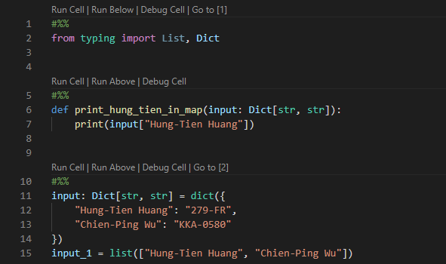
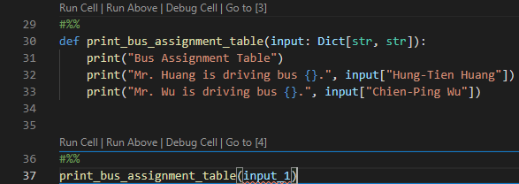
What is the Expected Output of Below Code?

Slide 18
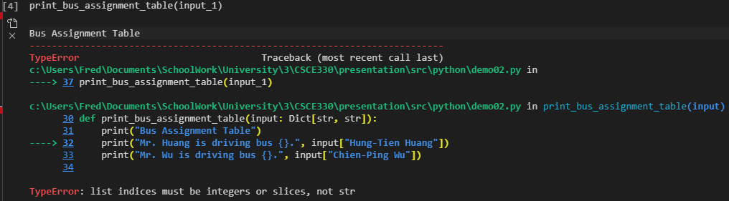
Error Are Raised Until Line 32 instead of 30…

Slide 19
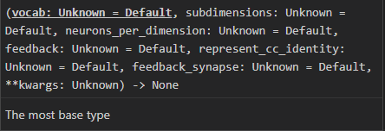

Why Is It Useful? In VS Code…

