Slide 1

CLO DOCUMENT TRACKING SYSTEM
Complete System
Workflow
From account setup and incoming documents to routing, tracking, and archive
END-TO-END PROCESS OVERVIEW
Roles - decisions - system records - operational boundaries
Notes:
Introduce the presentation as a guide to the CLO Document Tracking System. It covers the end-to-end document lifecycle, user roles, supporting account processes, and the actual system pages.
Good morning or afternoon. Today I will present the complete workflow of the City Legal Office Document Tracking System, or CLO DTS. We will follow how a document enters the office, gets assigned and processed, moves between recipients, and is tracked and archived. I will also cover the roles and supporting system features that help protect and manage that work.

Slide 2
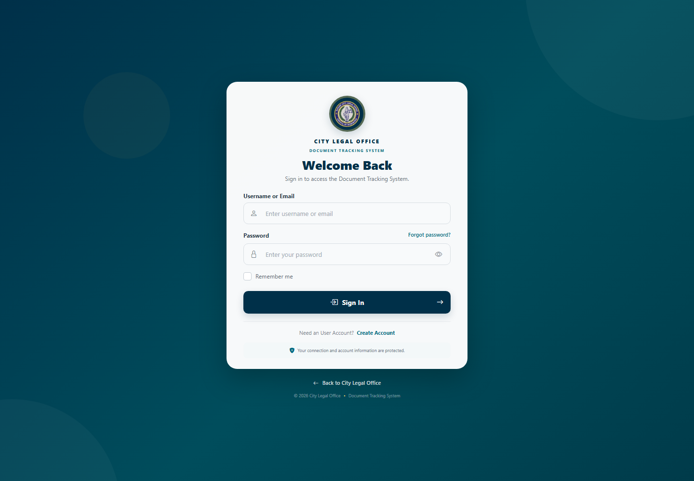
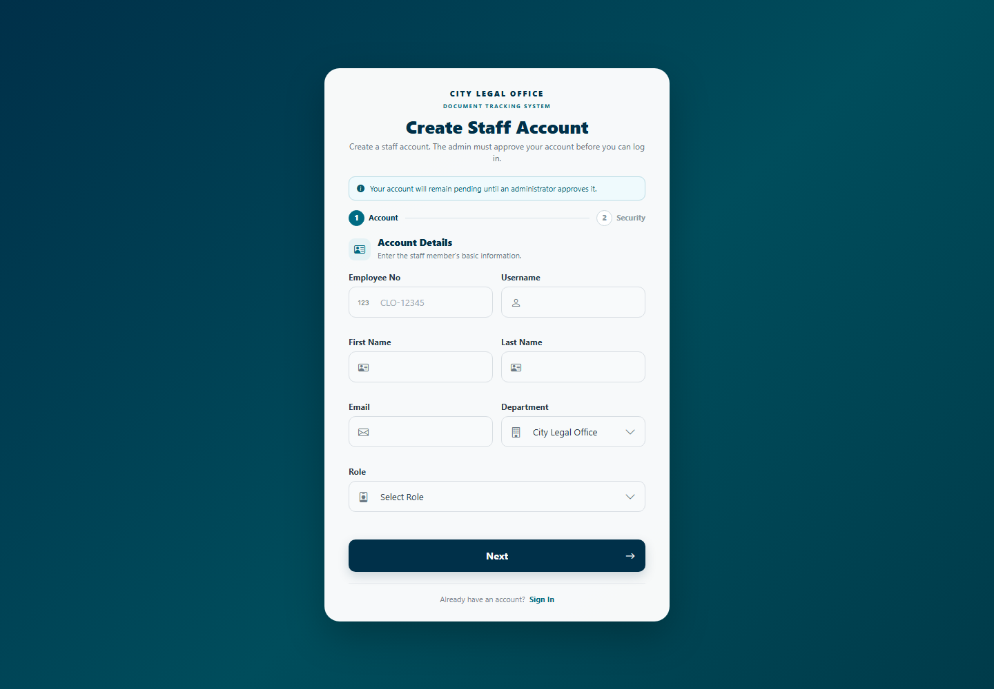
What the CLO system looks like
Actual user-interface screenshots from the local CLO Document Tracking System
SIGN-IN SCREEN
STAFF REGISTRATION SCREEN
Staff accounts sign in here before accessing the system.
New accounts remain pending until an administrator approves them.
CLO DOCUMENT TRACKING SYSTEM | SYSTEM INTERFACE
02
Notes:
Explain the main lifecycle from intake and registration through assignment, review, routing, tracking, and archive. Account access, confidentiality requests, notifications, and administration support the document flow..
These are actual screens from the CLO system. The sign-in page is where staff access their account, and the registration page allows a staff member to request an account. A new staff account remains pending until an administrator reviews and approves it. The screenshots show the interface without submitting personal information.

Slide 3
The full lifecycle at a glance
Core document path, supported by account, access, and administration workflows
01 INTAKE
02 REGISTER
03 ASSIGN
04 REVIEW
05 ROUTE
06 TRACK
07 ARCHIVE
Receive or import
Capture details
Send to staff
Process and update
Send and receive
Monitor progress
Restore if needed
SUPPORTING WORKFLOWS
OVERSIGHT AND CONTROL
User registration and approval - roles and permissions - password recovery - confidential access requests
Notifications - reports - audit trail - tracking slips - session and file-access safeguards
CLO DOCUMENT TRACKING SYSTEM | COMPLETE WORKFLOW
02
Notes:
Describe the usual responsibilities of each role. Page access can be changed by an administrator, while document assignment and confidentiality rules still apply.
The main document path begins with intake, followed by registration, assignment, review, routing, tracking, and archive. Some documents may pass through several review and routing cycles before work is complete. Account approval, access requests, notifications, reports, and audit records support this main lifecycle.

Slide 4
Who participates?
Role permissions are configurable; these describe usual system responsibilities
ADMIN
INCOMING
OUTGOING
RECORDS OFFICER
Accounts, roles, settings, broad oversight, and outbound routing.
Document intake, registration, assignment, Excel import, and tracking slips.
Outbound coordination and routing to other departments.
Records monitoring, internal routing, and archive work.
CITY ATTORNEY
LEGAL STAFF
DOCUMENT VIEWER
RECIPIENTS
Authorized legal review and document processing.
Assigned legal processing, drafting, and internal routing.
Viewing and tracking only, as granted by permissions.
Assigned CLO staff, destination users, or external recipients.
A role menu does not override document assignment, confidentiality, or recipient checks.
CLO DOCUMENT TRACKING SYSTEM | COMPLETE WORKFLOW
03
Notes:
Incoming staff register documents in Document Management or use the spreadsheet import workflow. Record complete metadata, classify the document, assign it when known, and keep the generated tracking number.
Each role has a different responsibility. Incoming staff handle intake and may import spreadsheet records; outgoing staff coordinate outbound routing; legal staff and the city attorney process assigned legal work; and records officers monitor records and archive tasks. Administrators manage users and configuration, while document viewers have viewing access as granted. The exact pages available to a role can be configured, and assignment and confidentiality rules still apply.

Slide 5
1. Receive, register, and import
INCOMING is the primary intake role; other authorized users may register documents if permitted
REGISTER A NEW DOCUMENT
IMPORT AN EXCEL WORKBOOK
1. Receive the item and open Document Management.
2. Enter title, description, type, origin/current department, priority, confidentiality, and dates.
3. Assign staff if known and upload the available document file.
4. Submit; record the generated tracking number.
INCOMING can import document rows from a validated Excel workbook.
- Review the preview and resolve data errors before import.
- Up to 500 document rows and 30 columns per workbook.
- Type, department, date, and assignee values must match valid system records.
- Verify imported records and tracking numbers.
Record only accurate information. File visibility depends on role, assignment, confidentiality, and any approved access grant.
CLO DOCUMENT TRACKING SYSTEM | COMPLETE WORKFLOW
04
Notes:
An authorized user assigns a document to staff. The recipient accepts a pending assignment, reviews the document, records work, and continues or routes it when permitted.
For a new document, an authorized user records its title, type, originating and current department, priority, confidentiality, and relevant dates. The user assigns a staff member when appropriate, uploads the file, and submits the record. The system generates a tracking number, which should be kept for follow-up. Incoming staff may also import an Excel workbook: first preview and correct its rows, then confirm the import and verify the resulting records. The import limit is 500 rows and 10 megabytes per workbook.

Slide 6
2. Assign, accept, and process
The current assignment identifies who is responsible for the next action
ASSIGN
ACCEPT
REVIEW
CONTINUE
Incoming or another authorized user assigns the document to a staff member.
The recipient accepts a pending assignment; the system records acceptance.
The assignee reviews the file, updates relevant details, and adds processing information.
The assignee completes the task, reassigns or routes onward when permitted.
FILE VERSIONING
Upload a replacement only when a new version is required. Keep the document history clear for later review.
CLO DOCUMENT TRACKING SYSTEM | COMPLETE WORKFLOW
05
Notes:
Describe the internal and outbound route paths. A route records destination, recipient, remarks, and any due date. The receiving system user confirms receipt; an external recipient without an account cannot acknowledge inside DTS.
After registration, an authorized user assigns the document to a staff member. If the assignment is awaiting acceptance, the recipient accepts it in the system. The assignee then reviews the file and document details, records the required work, and continues processing. When an updated file is needed, upload a new version rather than replacing a file unnecessarily so the document history remains useful.

Slide 7
3. Route and receive
Routing creates a traceable movement record; the destination recipient confirms receipt in DTS
INTERNAL CLO ROUTE
PENDING ROUTE
RECEIPT & NEXT ACTION
CITY_ATTORNEY, LEGAL_STAFF, RECORDS_OFFICER, and INCOMING route to a CLO staff recipient. ADMIN and OUTGOING can also route within CLO.
Choose department and recipient, add action remarks, and set a due date when needed. DTS records the route as pending and notifies the recipient.
The addressed user opens Document Routing, records receiving remarks if needed, and confirms receipt. DTS records the received time and movement history.
OUTBOUND ROUTE
EXTERNAL RECIPIENT
ADMIN and OUTGOING may route beyond CLO to another department.
Allowed for ADMIN/OUTGOING if destination has no DTS users. A recipient without an account cannot acknowledge receipt in DTS.
Routing alone does not grant access to confidential file contents.
CLO DOCUMENT TRACKING SYSTEM | COMPLETE WORKFLOW
06
Notes:
Explain that seeing a document record is different from opening its file. Users may request access to a restricted file; the current assignee reviews the request. Routing alone does not grant access. Actual file access also depends on the document classification and current system rules.
When work needs to move to another recipient, an authorized user creates a route, chooses a destination and recipient, adds remarks, and sets a due date when needed. The route initially appears as pending, and the intended system recipient is notified. That recipient opens the routing page and confirms receipt, which records the received time and movement history. Administrators and outgoing staff can route beyond CLO; other routing roles are restricted to a CLO recipient. An external recipient without a DTS account cannot acknowledge receipt in the application, so use the office's separate delivery record.

Slide 8
4. Confidential-file access
Separate document metadata visibility from access to the actual file
REQUESTER
CURRENT ASSIGNEE
FILE ACCESS
A user who can see the record but cannot open a restricted file submits Request Access from Document Management.
Reviews the request and may grant or reject access. The assignee may later revoke a grant.
An approved access grant allows the requester to open the restricted file. Routing itself is not an access grant.
REQUESTER OPTION
ADMIN VISIBILITY
The requester may cancel their own pending request.
ADMIN can review requests system-wide and cancel them; approval/rejection/revocation is currently restricted to the current assignee.
Current behavior: documents use their stored confidentiality level; the system does not automatically mark every document confidential.
CLO DOCUMENT TRACKING SYSTEM | COMPLETE WORKFLOW
07
Notes:
Use tracking and pending queues to monitor work. Reports summarize available records, and authorized staff can archive completed records. Restoring an archived document returns it to Received for further processing.
It is important to distinguish seeing a document record from opening its actual file. When a user cannot open a restricted file, they may submit an access request. The current assignee reviews the request and can grant or reject it; granted access may later be revoked. A requester may cancel their own request, and an administrator can monitor requests and cancel them. Routing alone does not grant file access, and the system uses the confidentiality classification stored on each document.

Slide 9
5. Track, report, and archive
Use tracking and work queues during processing; archive only when active work is complete
TRACKING AND PENDING QUEUE
REPORTS AND TRACKING SLIPS
ARCHIVE AND RESTORE
Search by tracking number. Review status, current department/assignee, dates, and route history. Use Pending Documents for daily action and overdue checks.
Authorized users review period-based reports and available print/export actions. INCOMING can print tracking slips for selected documents.
Archive completed records under office policy. Authorized users can restore an archived record; restore returns its status to Received.
AUDIT TRAIL
ADMIN can review recorded user, document, routing, password-reset, and account events. IP/browser information appears only when recorded.
CLO DOCUMENT TRACKING SYSTEM | COMPLETE WORKFLOW
08
Notes:
Staff registration remains pending until an administrator reviews and activates the account. Administrators also maintain roles, departments, document types, and system settings.
Users can search by tracking number to check status, current department and assignee, dates, and movement history, subject to visibility rules. Pending Documents provides a daily queue for work that needs action, including overdue items. Reports summarize the records available for a selected period, and Incoming staff can print tracking slips. When a document is complete under office policy, an authorized user can archive it. If it needs further work later, an authorized user can restore it; the restored status is Received.

Slide 10
6. Accounts and system administration
These supporting workflows govern who can use the application and what they can do
ACCOUNT LIFECYCLE
ROLES AND CONFIGURATION
PROFILE AND RECOVERY
Staff submits registration -> account waits pending/inactive -> ADMIN reviews and approves/activates -> user signs in. ADMIN can edit, deactivate/reactivate, or delete accounts when authorized.
ADMIN manages role-to-page permissions, active departments, document types and retention settings, and system settings. Assign only the access needed.
Users update profile details and recovery answers. Regular staff use recovery-question verification to reset a password; admin accounts need manual assistance.
MESSAGES
SESSIONS
Users can send and manage one-to-one conversations.
Inactive sessions expire after 30 minutes; sign in again when prompted.
CLO DOCUMENT TRACKING SYSTEM | COMPLETE WORKFLOW
09
Notes:
Notifications help users find routes, assignment work, access requests, and account approvals. Messages support one-to-one communication; session timeout helps protect unattended accounts.
The account process begins when a staff member submits registration details. The account remains pending until an administrator reviews and activates it. Administrators can also edit or deactivate accounts and manage role access, departments, document types, retention settings, and office information. Staff can update their own profile and recovery answers. Regular staff can use the password-recovery process; administrator accounts require manual assistance.

Slide 11
7. Notifications and daily monitoring
Notifications connect users to work that needs attention
NOTIFICATION BELL
DAILY CHECKS BY ROLE
May show:
- Routes addressed to the user
- Receipts related to a route they sent
- Pending assignment acceptance
- Confidential-access requests requiring attention
- Pending account approvals for ADMIN
Selecting a notice opens the related module. Reading does not delete it.
RECORDS OFFICER: new records, route receipts, overdue work, archive readiness.
LEGAL STAFF / CITY ATTORNEY: assigned documents, notifications, due dates, and next action.
ADMIN: pending accounts, role assignments, audit trail, settings, and backups.
Notification visibility follows role and relationship to the document or route.
CLO DOCUMENT TRACKING SYSTEM | COMPLETE WORKFLOW
10
Notes:
Emphasize these operational boundaries: file confidentiality follows the stored classification; external recipients have no in-app acknowledgement; route receipt is recorded, but unsupported completed/returned transitions should not be assumed; restore sets status to Received.
The notification bell helps users find work that needs attention. Depending on the user's role and relationship to a record, notifications may relate to new routes, route receipts, assignments, access requests, or account approvals. Records officers can use the pending queue to check new work and due dates. Legal staff should review assigned documents and notifications, while administrators should monitor account approvals, role assignments, audit activity, and settings. A notification is a prompt; users should open the related page to complete the action.

Slide 12
Important system behavior and boundaries
Follow actual system status and office policy; do not assume unsupported automation
ACCESS IS CONTEXTUAL
EXTERNAL HANDOFF
A role alone may not grant a restricted file. Assignment and approved grants also matter.
Recipients without DTS accounts have no in-app receipt action. Use the office delivery proof process.
ROUTE STATUS
CONFIDENTIALITY
Routes start as pending and record receipt. Do not assume routes automatically become Completed or Returned.
The current system uses each document stored classification; it does not automatically classify every document as confidential.
ROLE CONFIGURATION
RESTORE STATUS
ADMIN can configure page access. Menu visibility and document-level file access are separate checks.
Restoring an archived document returns it to Received for further processing.
End of workflow overview
CLO DOCUMENT TRACKING SYSTEM | COMPLETE WORKFLOW
11
Notes:
This is the sign-in screen. Users enter their account credentials here. Remember Me should only be used on a trusted workstation.
Before looking at the screenshots, keep several system boundaries in mind. File access depends on the document's stored confidentiality level and the user's assignment or approved grant; not every document is automatically classified as confidential. External recipients without accounts cannot acknowledge receipt in DTS. Routes begin as pending and record receipt, so do not assume the system automatically marks them completed or returned. Finally, restoring an archived document returns it to Received, and page permissions are separate from access to a particular file.

Slide 13
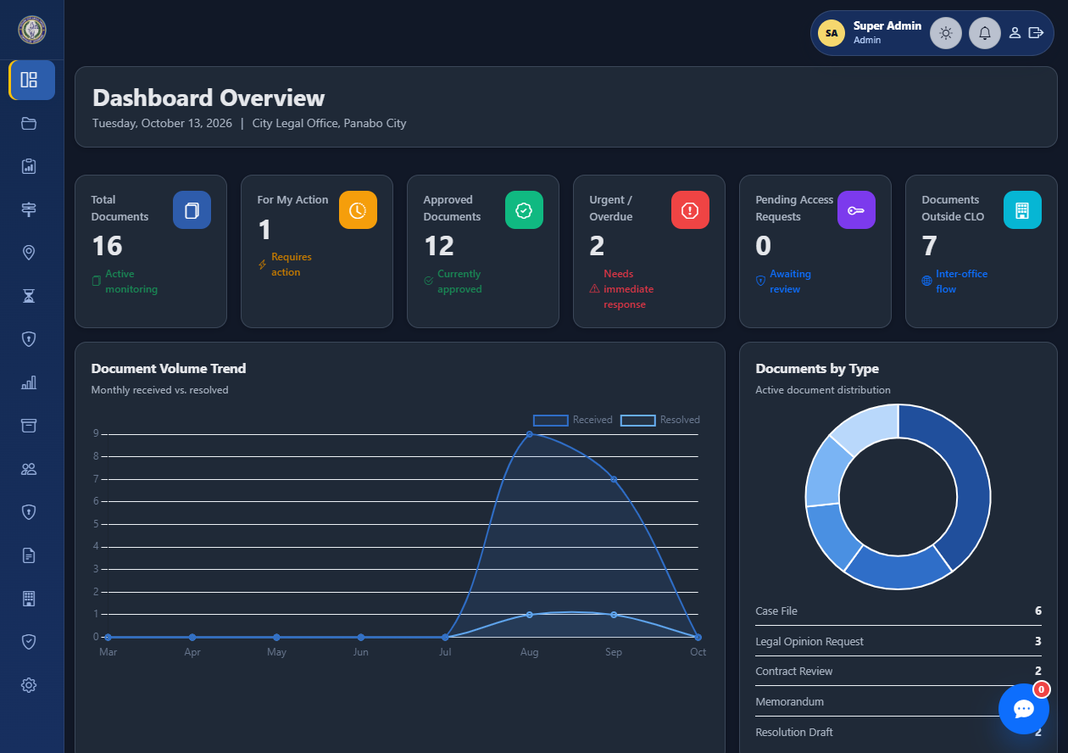
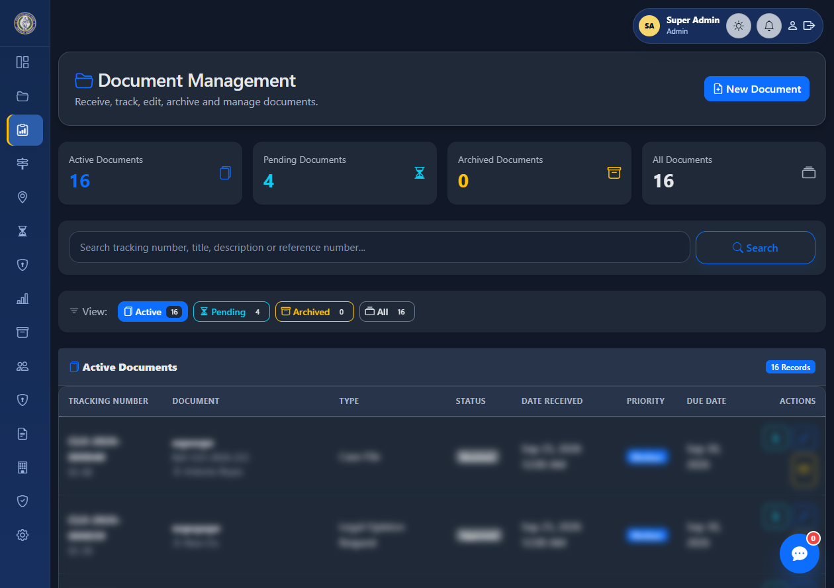
Actual System: Dashboard and Documents
Real screenshots from the local CLO DTS; personal document rows are blurred.
DASHBOARD
DOCUMENT MANAGEMENT
Overview cards, workload indicators, and document activity.
Receive, search, review, and manage registered documents.
CLO DOCUMENT TRACKING SYSTEM | ACTUAL SYSTEM SCREENSHOTS
13
Notes:
This is the dashboard and document-management interface. The dashboard summarizes workloads and shortcuts; Document Management is where authorized users receive, search, and maintain document records. Personal document rows are obscured in the screenshot.
This slide shows the dashboard and Document Management page. The dashboard gives staff an overview of workload indicators and shortcuts. Document Management is used by authorized staff to receive, search, review, and maintain document records. Some record details in the screenshot are blurred to protect privacy.

Slide 14
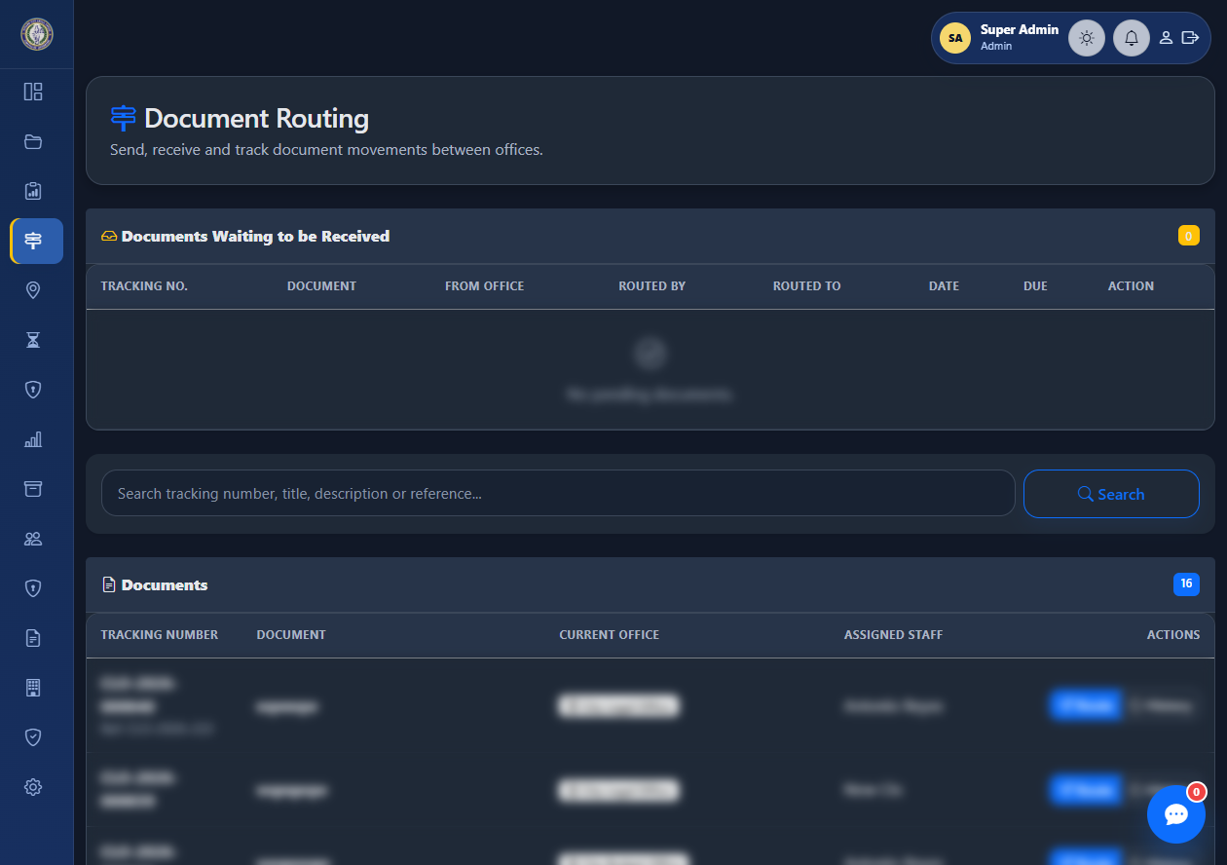
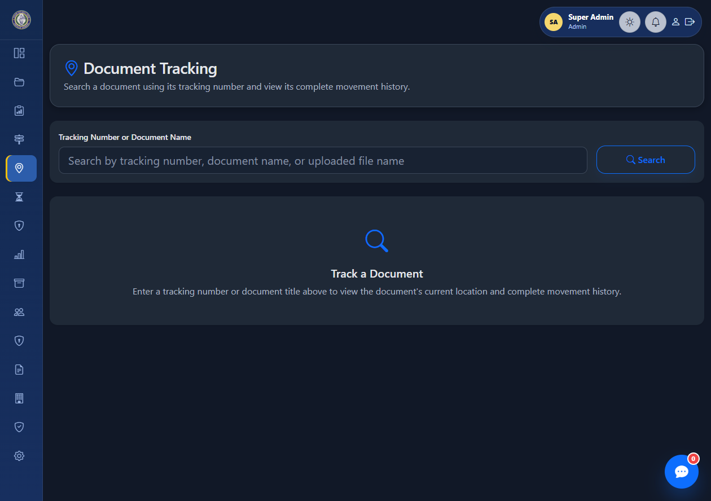
Actual System: Routing and Tracking
Screens from the document movement and lookup modules.
DOCUMENT ROUTING
DOCUMENT TRACKING
Review routes awaiting receipt and manage document movements.
Search a tracking number to review current location and movement history.
CLO DOCUMENT TRACKING SYSTEM | ACTUAL SYSTEM SCREENSHOTS
14
Notes:
These screens show document routing and tracking. Routing is used to send and receive work between offices; tracking is used to look up movement history. No tracking number is entered in the example screenshot.
Here we see the routing and tracking pages. Routing supports sending a document to its next recipient and recording receipt. Tracking is used to look up a document's current location and movement history. In normal work, the user searches using a tracking number or other allowed search details.

Slide 15
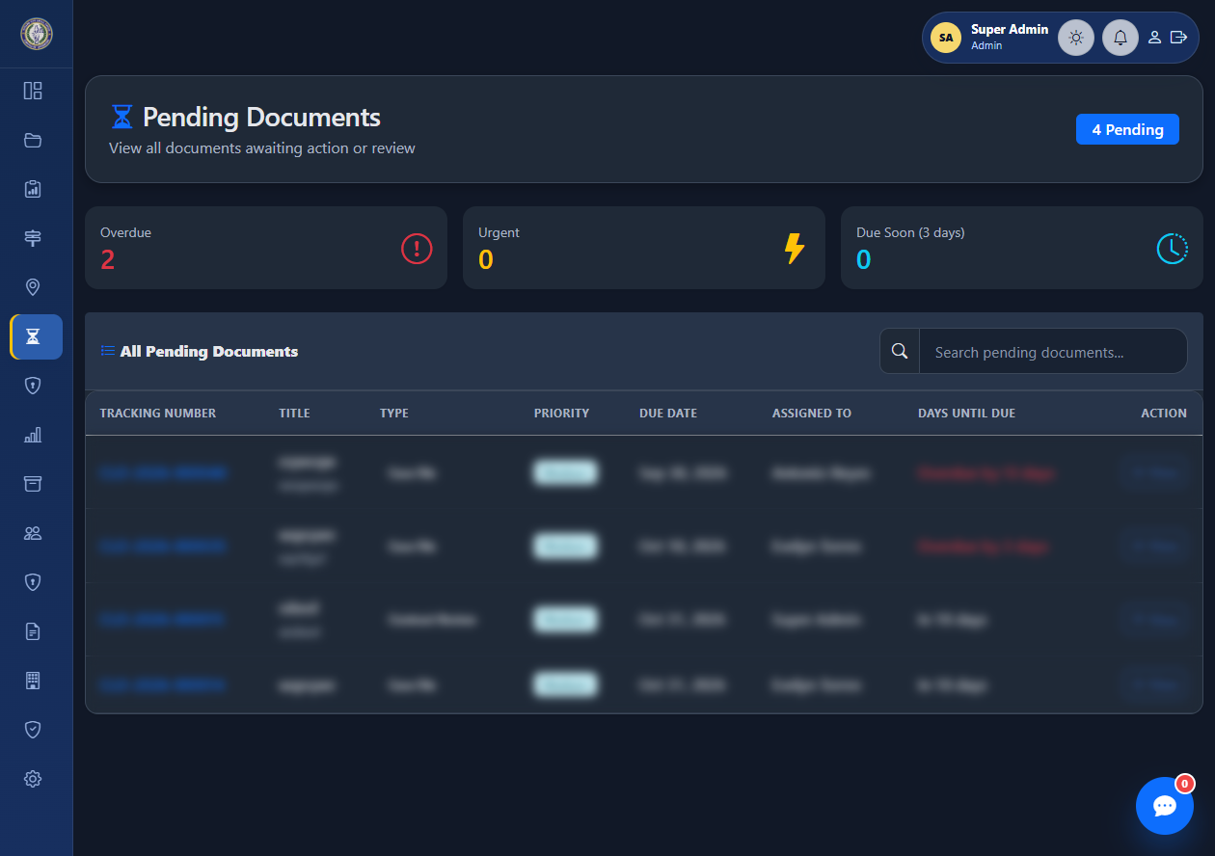
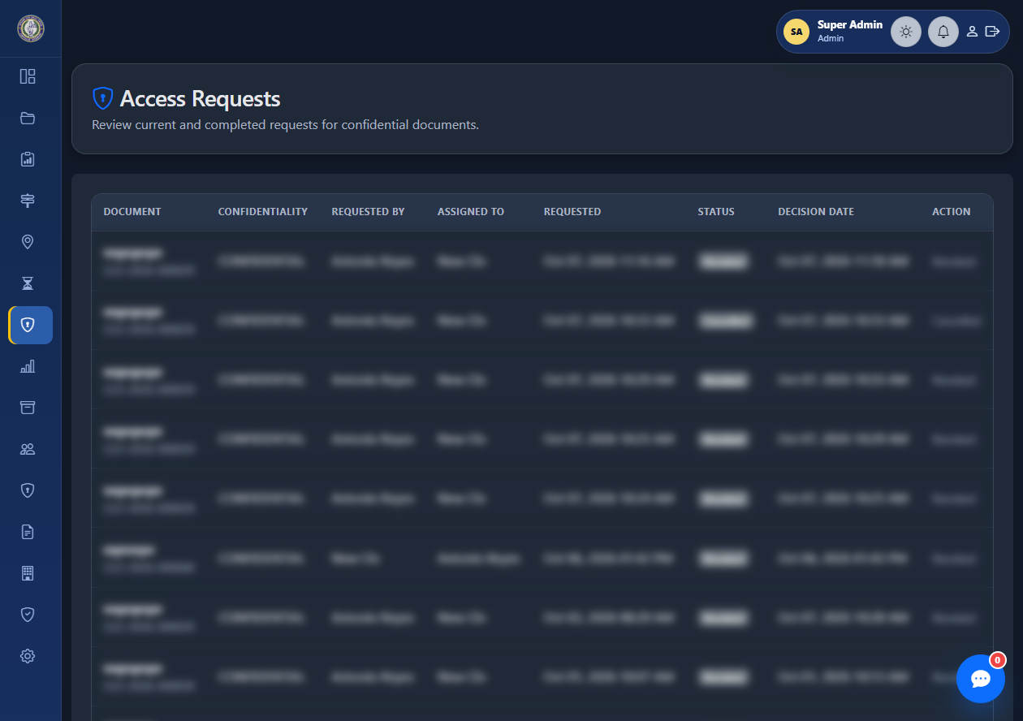
Actual System: Work Queues and Access
Daily processing and restricted-document access request screens.
PENDING DOCUMENTS
ACCESS REQUESTS
Review pending items, due dates, and work requiring action.
Review requests for access to confidential document files.
CLO DOCUMENT TRACKING SYSTEM | ACTUAL SYSTEM SCREENSHOTS
15
Notes:
Pending Documents is a work queue for items needing action. Access Requests lists requests for restricted file access; the requester and current assignee follow the applicable actions, while administrators can monitor requests.
Pending Documents helps staff find records that need action and review due dates. Access Requests is used to review requests for restricted document files. The requester, current assignee, and administrator have different responsibilities here: the current assignee handles the access decision, while an administrator can monitor requests and cancel them.

Slide 16
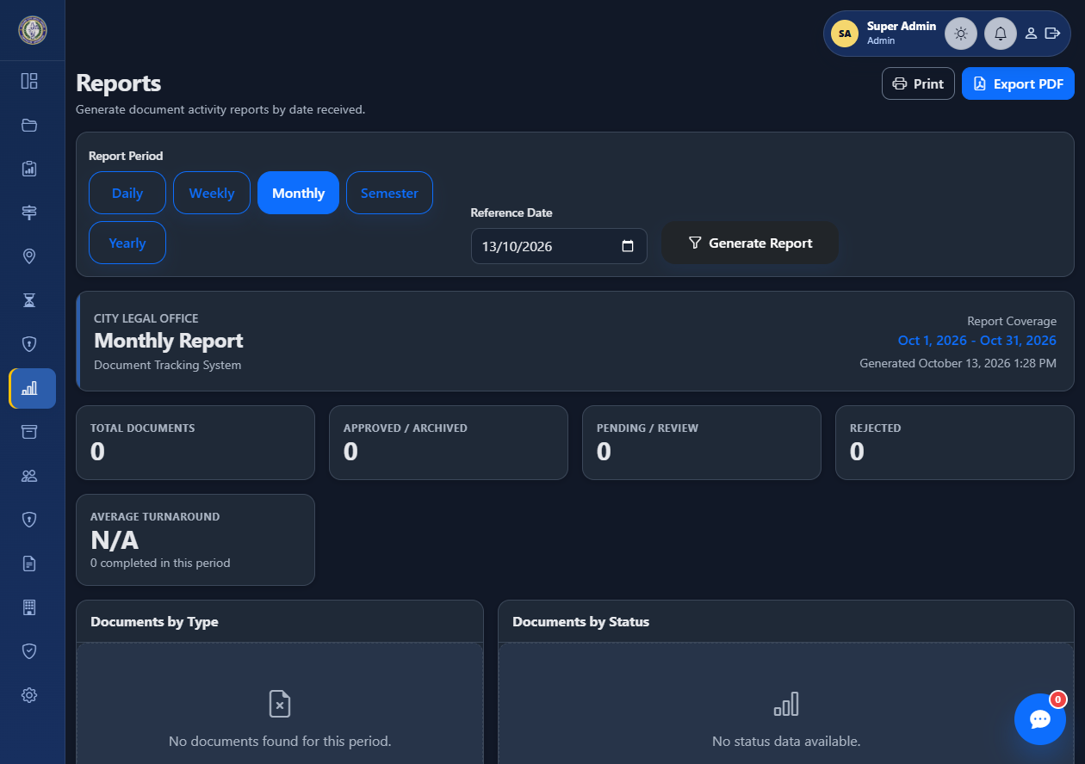
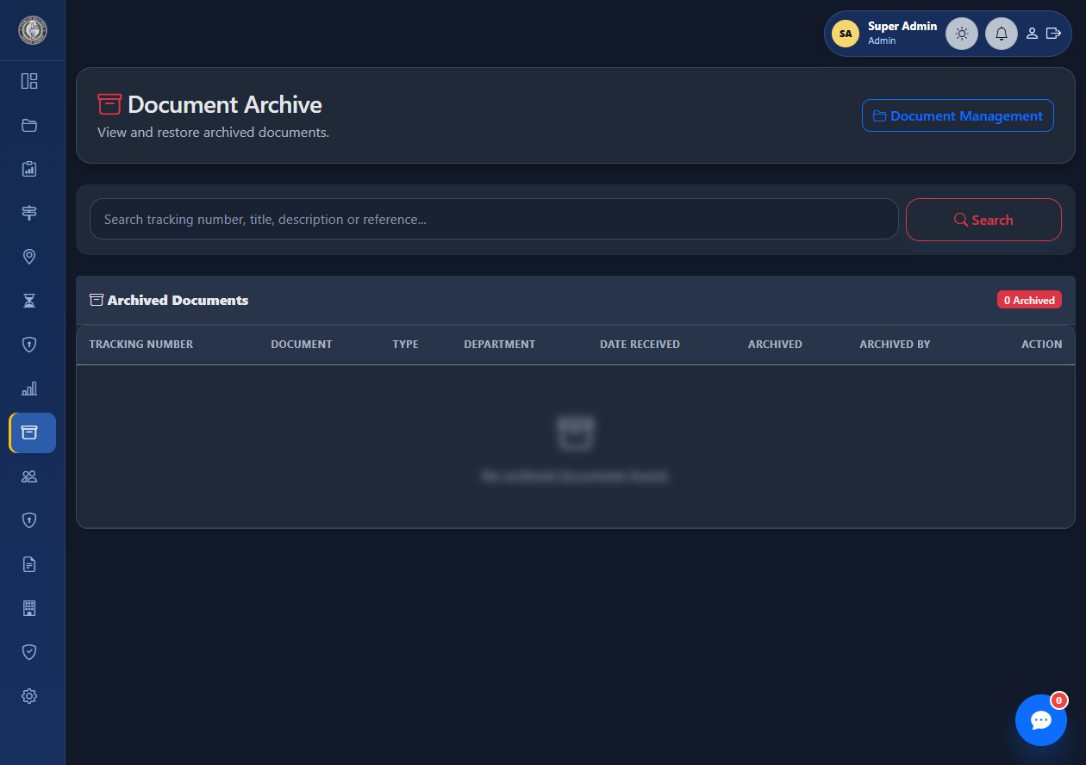
Actual System: Reports and Archive
Screens from reporting and records-retention modules.
REPORTS
DOCUMENT ARCHIVE
Choose a report period and review document activity summaries.
Search archived records and restore documents when authorized.
CLO DOCUMENT TRACKING SYSTEM | ACTUAL SYSTEM SCREENSHOTS
16
Notes:
Reports provides period-based activity summaries. The archive screen is used to find archived records and restore them when authorized.
The Reports page lets authorized users select a reporting period and review available document activity summaries. The Archive page is for locating archived records and restoring a record when further processing is needed. Archive decisions should follow the office's records-retention policy.

Slide 17
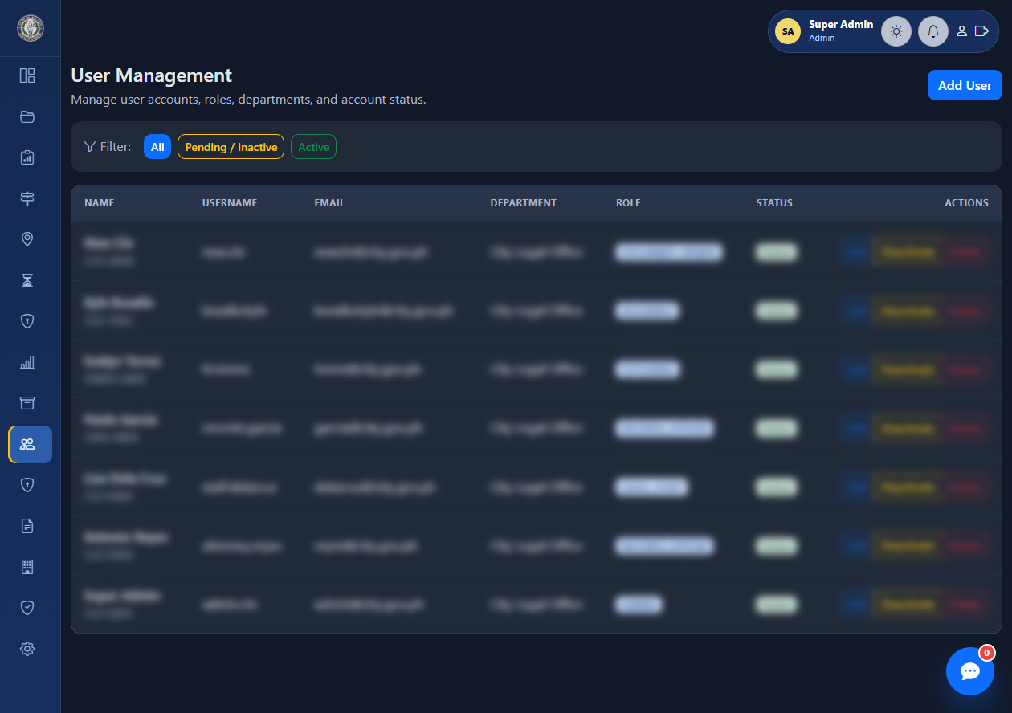
Actual System: User Administration
Administrator view for account approval and role management.
ACCOUNT LIFECYCLE
1. STAFF REGISTERS
Submits account details and selects a role.
2. ADMIN REVIEWS
The account stays pending until approved.
3. USER SIGNS IN
After activation, the user sees pages allowed by their role.
ADMIN can later edit, deactivate, reactivate, or delete accounts.
USER MANAGEMENT
Review accounts, roles, departments, and activation status.
CLO DOCUMENT TRACKING SYSTEM | ACTUAL SYSTEM SCREENSHOTS
17
Notes:
This slide shows administrator User Management and summarizes the account lifecycle. Staff registration appears only once in the presentation; after registration, an administrator reviews the account and the user signs in after activation.
This screen shows User Management. Administrators can review account details, roles, departments, and account status. The account lifecycle is: staff submits a registration request, an administrator reviews and approves it, and the user signs in after activation. The registration screen is shown only once in this presentation.

Slide 18
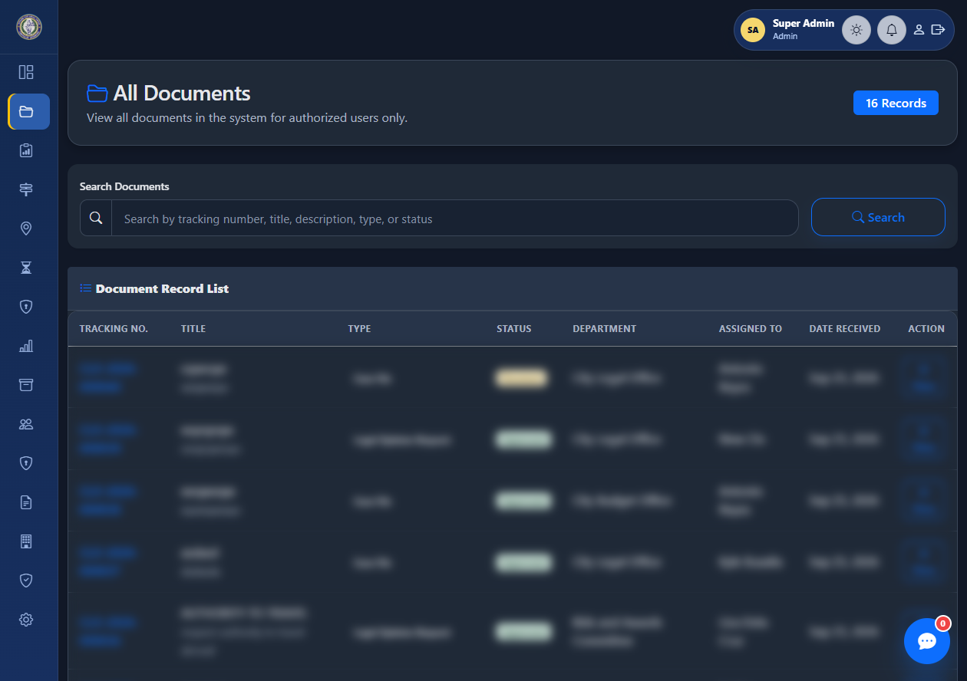
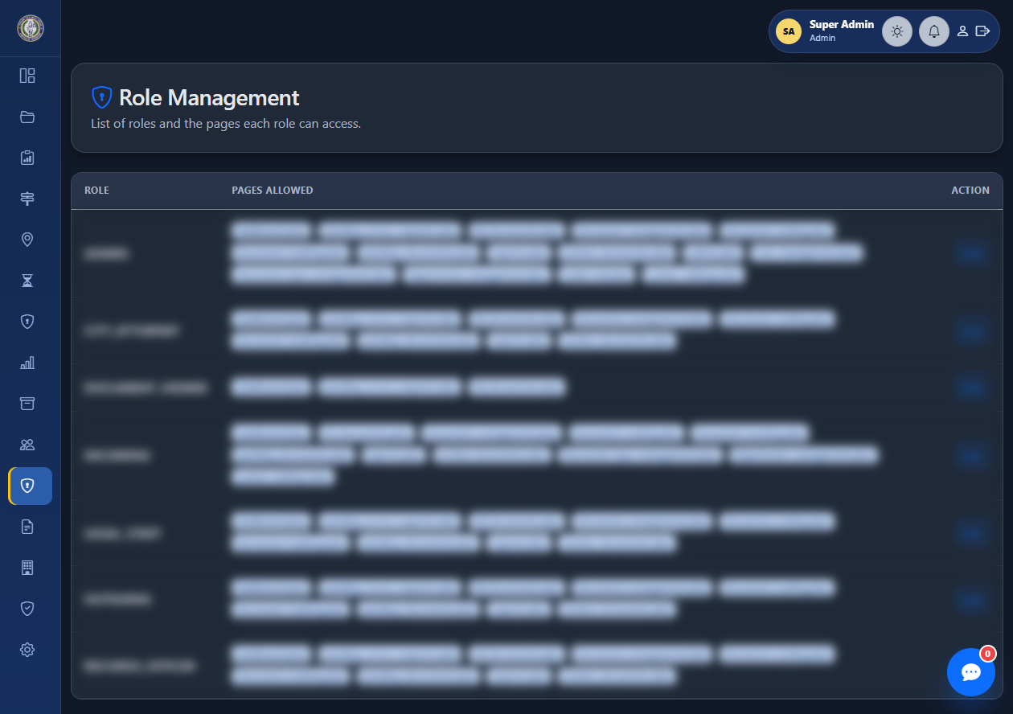
Actual System: All Documents and Roles
Document overview and administrator-configured page permissions.
ALL DOCUMENTS
ROLE MANAGEMENT
Search the authorized document list and review its current status.
Set which system pages each role can access.
CLO DOCUMENT TRACKING SYSTEM | ACTUAL SYSTEM SCREENSHOTS
18
Notes:
All Documents provides an authorized overview of document records. Role Management controls which pages a role may open; it does not by itself override document-level confidentiality.
All Documents provides an overview for authorized users to search and review document records. Role Management controls which pages each role can open. Remember that permission to open a page does not automatically grant access to every confidential file listed or referenced there.

Slide 19
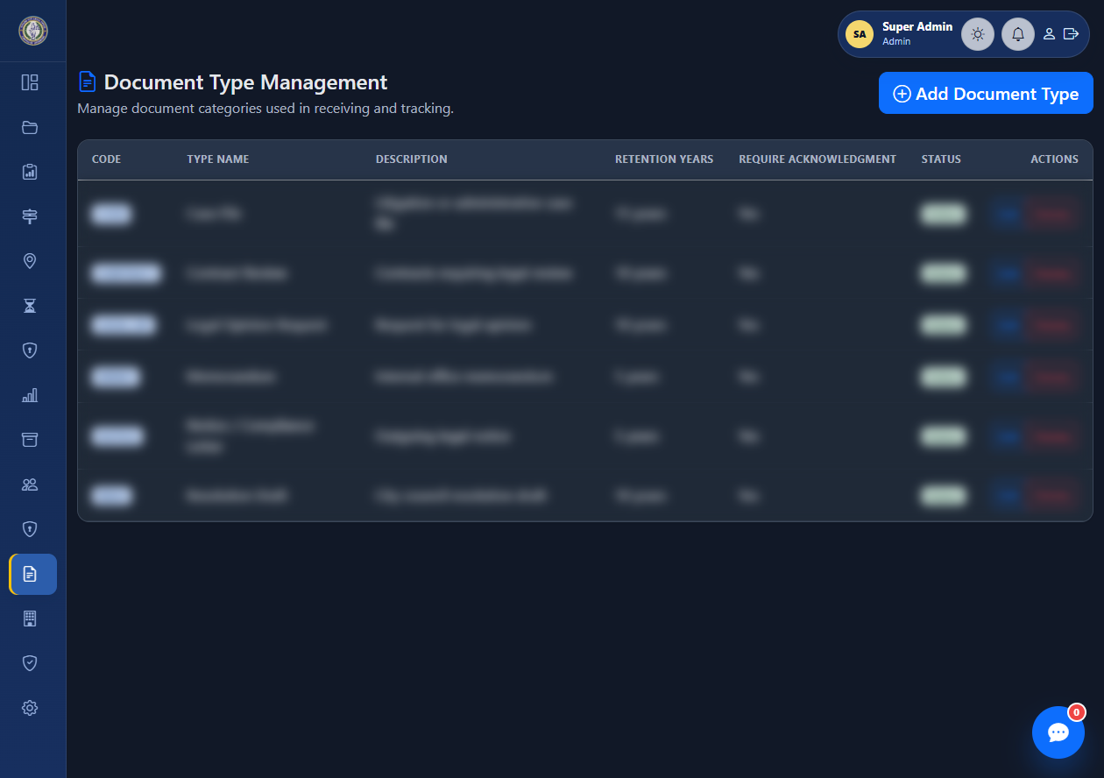
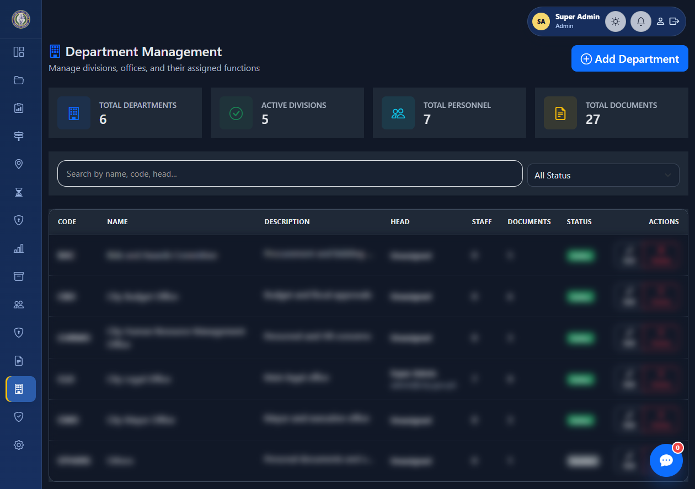
Actual System: Document Types and Departments
Configuration screens for office units and document categories.
DOCUMENT TYPES
DEPARTMENT MANAGEMENT
Maintain document categories and retention settings.
Maintain offices, divisions, staff, and department status.
CLO DOCUMENT TRACKING SYSTEM | ACTUAL SYSTEM SCREENSHOTS
19
Notes:
Document Types maintains document categories and retention settings. Department Management maintains office units and their assigned functions. Review dependencies before deactivating a type or department.
Administrators use Document Types to maintain categories and retention settings. Department Management is used to maintain office units and related information. Before changing or deactivating a type or department, administrators should check whether active records depend on it.

Slide 20
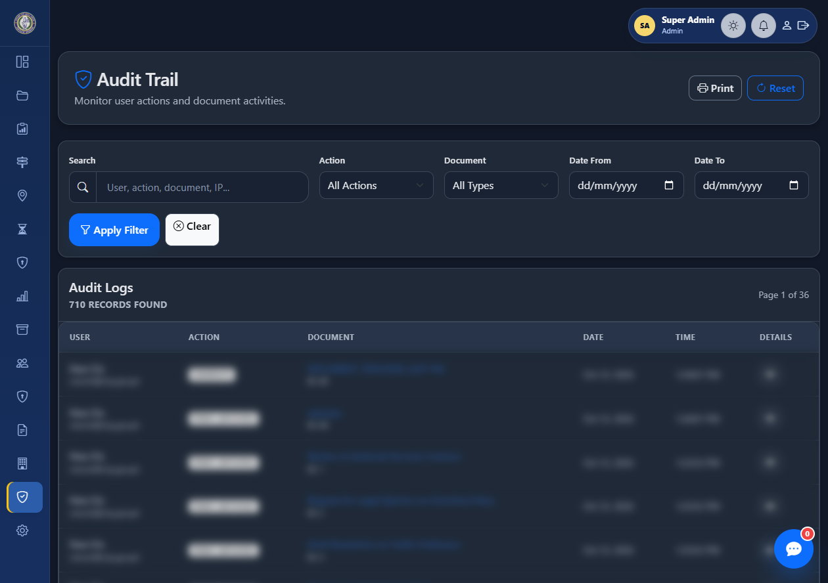
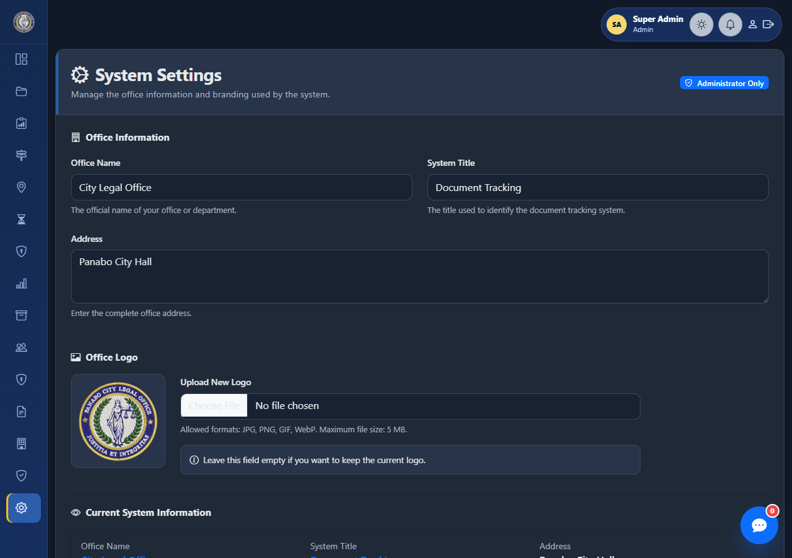
Actual System: Audit and Settings
Administration and system-wide monitoring screens.
AUDIT TRAIL
SYSTEM SETTINGS
Filter recorded user, document, and routing activities.
Manage office information, branding, and system identity.
CLO DOCUMENT TRACKING SYSTEM | ACTUAL SYSTEM SCREENSHOTS
20
Notes:
Audit Trail supports review of recorded system activity. System Settings maintains office identity and branding. Treat audit and configuration access as administrator functions.
The Audit Trail provides filters for reviewing recorded user, document, and routing activity. System Settings holds office information and branding used by the application. These are administrative functions and should be changed only by authorized users.

Slide 21
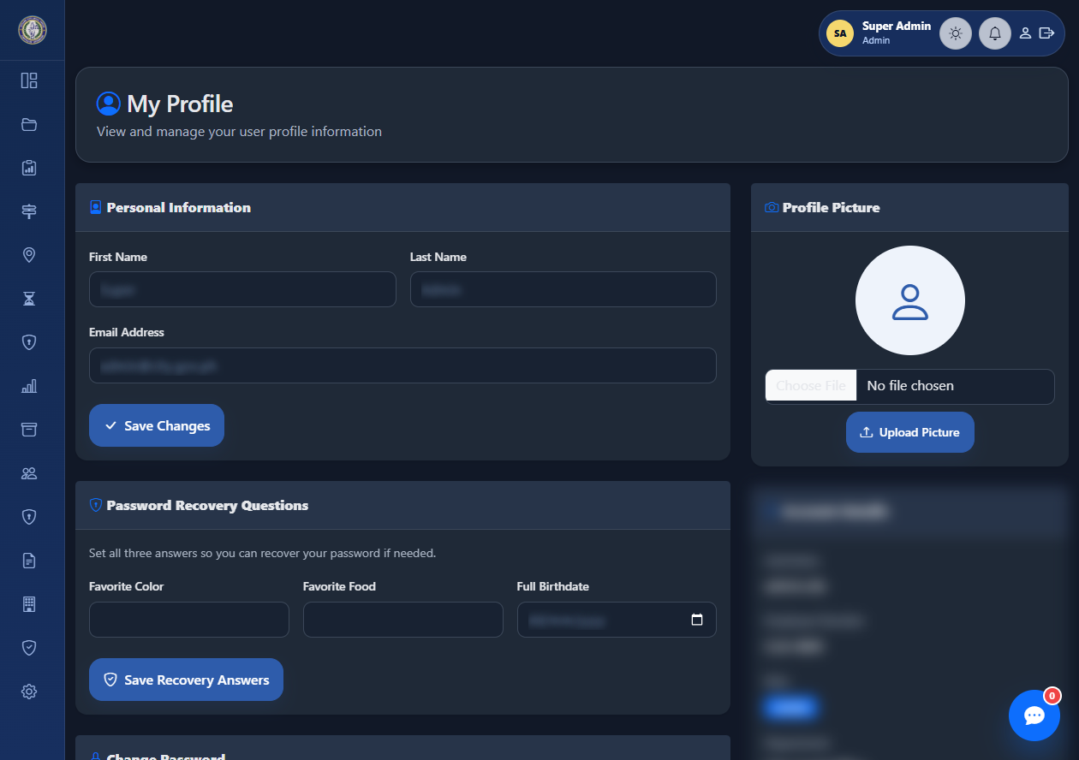
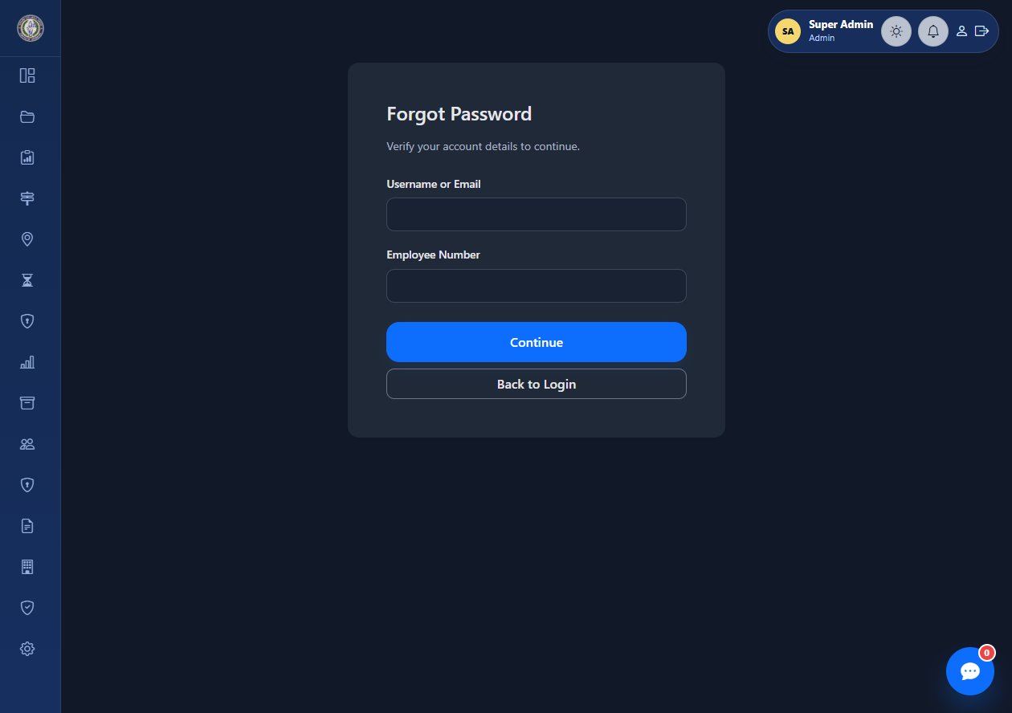
Actual System: Profile and Password Recovery
User self-service pages for profile maintenance and account recovery.
MY PROFILE
FORGOT PASSWORD
Manage profile, recovery answers, and account information. Personal values are obscured.
Verify account details and follow the password recovery process.
CLO DOCUMENT TRACKING SYSTEM | ACTUAL SYSTEM SCREENSHOTS
21
Notes:
My Profile supports personal profile and recovery-answer maintenance; the screenshot obscures personal values. Forgot Password starts account verification for regular staff; administrator resets require manual assistance.
My Profile lets users maintain personal profile details and recovery answers. Personal values in this screenshot are obscured. Forgot Password begins the account verification process for regular staff. Administrator accounts do not use self-service password reset and need manual support.

Slide 22
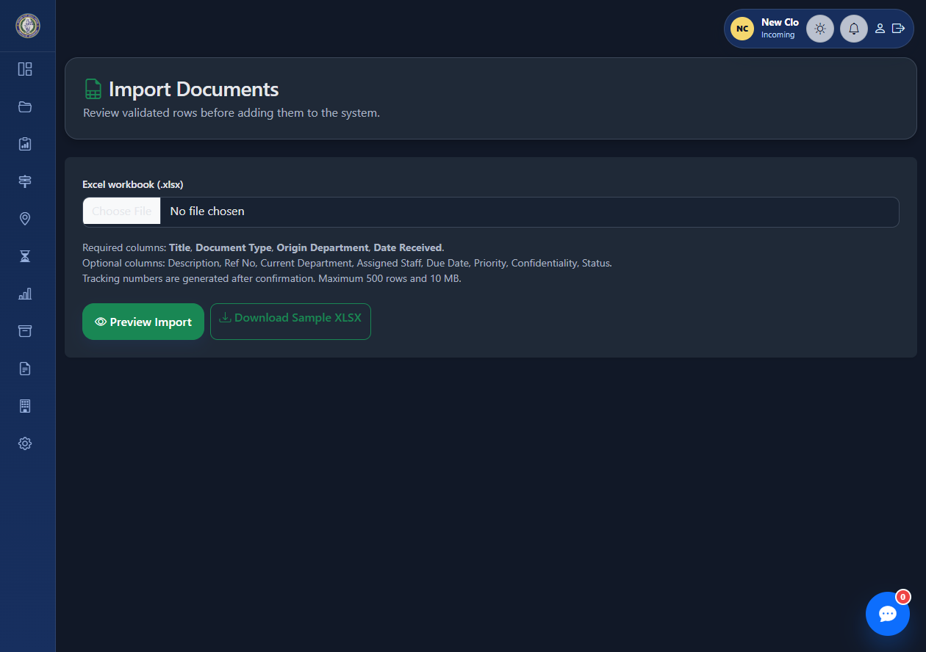
Actual System: Import Documents
INCOMING staff can upload and validate spreadsheet rows before importing documents.
IMPORT STEPS
1. Select workbook
Choose a valid .xlsx file using the sample template.
2. Preview and validate
Review rows and fix missing or invalid values.
3. Confirm import
Import only after the preview is correct.
4. Verify records
Check generated tracking numbers and assignments.
Up to 500 rows and 10 MB per workbook. Required columns: Title, Document Type, Origin Department, Date Received.
CLO DOCUMENT TRACKING SYSTEM | ACTUAL SYSTEM SCREENSHOT
22
Notes:
This is the INCOMING-only spreadsheet import page. Choose an XLSX workbook, preview and validate its rows, correct errors, then confirm the import and verify generated tracking numbers. The application limits the workbook to 500 rows and 10 MB.
This final screen is the Import Documents page for Incoming staff. The user selects an Excel workbook, previews and validates the rows, corrects any errors, and confirms the import only when the preview is accurate. Afterward, the user verifies the imported records and generated tracking numbers. The workbook must be an XLSX file and may contain up to 500 rows, with a maximum file size of 10 megabytes.
To conclude, the CLO DTS supports the document journey from intake to archive while recording assignments, routes, and follow-up actions. Correct role permissions, careful handling of confidential files, and timely receipt updates help keep that history reliable. Thank you. I am ready to answer your questions.

