Slide 1

<html>

Slide 2
What is HTML?
What is HTML?
HTML is a markup language for describing web documents (web pages).
HTML stands for Hyper Text Markup Language
A markup language is a set of markup tags
HTML documents are described by HTML tags
Each HTML tag describes different document content

Slide 3
HTML Example
<!DOCTYPE html> <html> <head> <title>Page Title</title> </head> <body> <h1>My First Heading</h1> <p>My first paragraph.</p> </body> </html>

Slide 4
Example Explained
The DOCTYPE declaration defines the document type to be HTML
The text between <html> and </html> describes an HTML document
The text between <head> and </head> provides information about the document
The text between <title> and </title> provides a title for the document
The text between <body> and </body> describes the visible page content
The text between <h1> and </h1> describes a heading
The text between <p> and </p> describes a paragraph
Using this description, a web browser can display a document with a heading and a paragraph.

Slide 5
HTML Tags
HTML tags are keywords (tag names) surrounded by angle brackets:
<tagname>content</tagname>
HTML tags normally come in pairs like <p> and </p>
The first tag in a pair is the start tag, the second tag is the end tag
The end tag is written like the start tag, but with a slash before the tag name

Slide 6
Web Browsers
The purpose of a web browser (Chrome, IE, Firefox, Safari) is to read HTML documents and display them.
The browser does not display the HTML tags, but uses them to determine how to display the document:

Slide 7
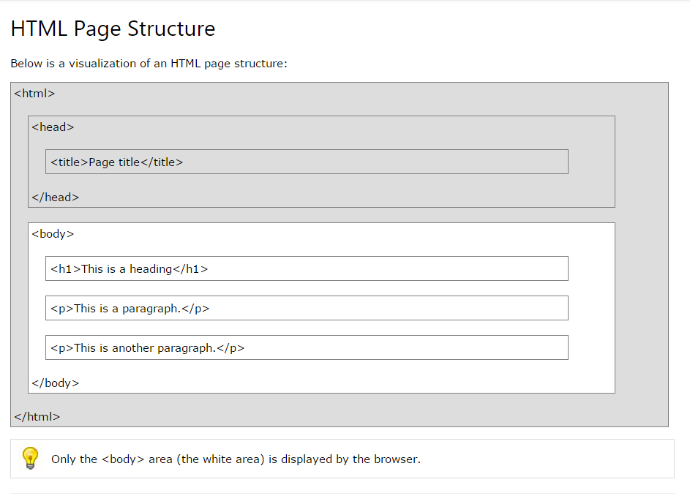

Slide 8
HTML Documents
All HTML documents must start with a type declaration: <!DOCTYPE html>.
The HTML document itself begins with <html> and ends with </html>.
The visible part of the HTML document is between <body> and </body>.

Slide 9
Example
<!DOCTYPE html> <html> <body> <h1>My First Heading</h1> <p>My first paragraph.</p> </body> </html>

Slide 10
HTML Headings
HTML headings are defined with the <h1> to <h6> tags:
<h1>This is a heading</h1> <h2>This is a heading</h2> <h3>This is a heading</h3>

Slide 11
HTML Paragraphs
HTML paragraphs are defined with the <p> tag:
<p>This is a paragraph.</p> <p>This is another paragraph.</p>

Slide 12
HTML Links
HTML links are defined with the <a> tag:
<a href="http://www.google.com">This is a link</a>

Slide 13
HTML Images
HTML images are defined with the <img> tag.
The source file (src), alternative text (alt), and size (width and height) are provided as attributes:
<img src=“myphoto.jpg" alt=“Google.com“
width="104" height="142">

Slide 14
HTML Elements

Slide 15
HTML Elements
HTML elements are written with a start tag, with an end tag, with the content in between:
<tagname>content</tagname>
The HTML element is everything from the start tag to the end tag:
<p>My first HTML paragraph.</p>

Slide 16
HTML Attributes

Slide 17
HTML Attributes
HTML elements can have attributes
Attributes provide additional information about an element
Attributes are always specified in the start tag
Attributes come in name/value pairs like: name="value"

Slide 18
The title Attribute
HTML paragraphs are defined with the <p> tag.
In this example, the <p> element has a title attribute. The value of the attribute is "About CPI":
<p title="About CPI"> Computer Professionals Inc. (CPI) is a Filipino-owned IT company with a successful history of delivering high-quality software services and solutions to a long list of satisfied customers. </p>

Slide 19
The href Attribute
HTML links are defined with the <a> tag. The link address is specified in the href attribute:
<a href="http://www.cpi.com.ph">This is a link</a>

Slide 20
Size Attributes
HTML images are defined with the <img> tag.
The filename of the source (src), and the size of the image (width and height) are all provided as attributes:
<img src=“cpi-logo.png“
width="104" height="142">

Slide 21
HTML Headings
Headings are defined with the <h1> to <h6> tags.
<h1> defines the most important heading. <h6> defines the least important heading.
<h1>This is a heading</h1> <h2>This is a heading</h2> <h3>This is a heading</h3>

Slide 22
HTML Headings
Use HTML headings for headings only. Don't use headings to make text BIG or bold.
Users skim your pages by its headings. It is important to use headings to show the document structure.
h1 headings should be main headings, followed by h2 headings, then the less important h3, and so on.

Slide 23
HTML Horizontal Rules
The <hr> tag creates a horizontal line in an HTML page.
The hr element can be used to separate content:
<p>This is a paragraph.</p> <hr> <p>This is a paragraph.</p> <hr> <p>This is a paragraph.</p>

Slide 24
HTML Paragraphs
The HTML <p> element defines a paragraph.
<p> This paragraph contains a lot of lines in the source code, but the browser ignores it. </p>

Slide 25
Preformatted Text <pre> Element
The text in a <pre> element is displayed in a fixed-width font and preserves both spaces and line breaks:
<pre> My Bonnie lies over the ocean. My Bonnie lies over the sea. My Bonnie lies over the ocean. Oh, bring back my Bonnie to me. </pre>

Slide 26
The HTML Style Attribute
Setting the style of an HTML element, can be done with the style attribute.
The HTML style attribute has the following syntax:
style="property:value;"

Slide 27
HTML Background Color
The background-color property defines the background color for an HTML element:
This example sets the background for a page to lightgrey:
<body style="background-color:lightgrey;"> </body>

Slide 28
HTML Text Color
The color property defines the text color for an HTML element:
<h1 style="color:blue;">This heading is color blue.</h1>
<p style="color:red;">This paragraph is color red.</p>

Slide 29
HTML Fonts
The font-family property defines the font to be used for an HTML element:
<h1 style="font-family:verdana;">This is a heading</h1>
<p style="font-family:courier;">This is a paragraph.</p>

Slide 30
HTML Text Size
The font-size property defines the text size for an HTML element:
<h1 style="font-size:300%;">This is a heading</h1>
<p style="font-size:160%;">This is a paragraph.</p>

Slide 31
HTML Text Alignment
The text-align property defines the horizontal text alignment for an HTML element:
<h1 style="text-align:center;">Centered Heading</h1> <p>This is a paragraph.</p>

Slide 32
HTML Text Formatting Elements
<b>This text is bold</b>.
<strong>This text is strong</strong>.
<i>This text is italic</i>.
<em>This text is emphasized</em>.
<h2>HTML <small>Small</small> Formatting</h2>
<h2>HTML <mark>Marked</mark> Formatting</h2>
<p>My favorite color is <del>blue</del> red.</p>
<p>My favorite <ins>color</ins> is red.</p>
<p>This is <sub>subscripted</sub> text.</p>
<p>This is <sup>superscripted</sup> text.</p>
Tag | Description
<b> | Defines bold text
<em> | Defines emphasized text
<i> | Defines italic text
<small> | Defines smaller text
<strong> | Defines important text
<sub> | Defines subscripted text
<sup> | Defines superscripted text
<ins> | Defines inserted text
<del> | Defines deleted text
<mark> | Defines marked/highlighted text

Slide 33
HTML Comments
Comment tags <!-- and --> are used to insert comments in HTML.
Comments are not displayed by the browser, but they can help document your HTML.
With comments you can place notifications and reminders in your HTML:
<!-- Write your comments here -->

Slide 34
Cascading Style Sheets (CSS)
Styling can be added to HTML elements in 3 ways:
Inline - using a style attribute in HTML elements
Internal - using a <style> element in the HTML <head> section
External - using one or more external CSS files

Slide 35
Inline Styling (Inline CSS)
Inline styling is used to apply a unique style to a single HTML element:
Inline styling uses the style attribute.
This example changes the text color of the <h1> element to blue:
<h1 style="color:blue;">This is a Blue Heading</h1>

Slide 36
Internal Styling (Internal CSS)
Internal styling is used to define a style for one HTML page.
Internal styling is defined in the <head> section of an HTML page, within a <style> element:

Slide 37
Internal Styling (Internal CSS)
<html> <head> <style> body {background-color:lightgrey;} h1 {color:blue;} p {color:green;} </style> </head> <body> <h1>This is a heading</h1> <p>This is a paragraph.</p> </body> </html>

Slide 38
External Styling (External CSS)
An external style sheet is used to define the style for many pages.
With an external style sheet, you can change the look of an entire web site by changing one file!
To use an external style sheet, add a link to it in the <head> section of the HTML page:

Slide 39
External Styling (External CSS)
<html> <head> <link rel="stylesheet" href="styles.css"> </head> <body> <h1>This is a heading</h1> <p>This is a paragraph.</p> </body> </html>

Slide 40
External Styling (External CSS)
body { background-color: lightgrey; } h1 { color: blue; } p { color:green; }

Slide 41
More examples
p {
color: blue; font-family: verdana; font-size: 300%; border: 1px solid black;
padding: 10px;
margin: 30px; }

Slide 42
The id Attribute
All the examples above use CSS to style HTML elements in a general way.
To define a special style for one special element, first add an id attribute to the element:
<p id=“name">Juan dela Cruz</p>

Slide 43
The id Attribute
CSS:
p #name { color: blue;
font-weight: bold; }

Slide 44
The class Attribute
To define a style for a special type (class) of elements, add a class attribute to the element:
<p class="error">I am different</p>
CSS:
p.error { color: red; }

Slide 45
Reminder!
Use id to address a single element.
Use class to address groups of elements.

Slide 46
HTML Links
HTML links are hyperlinks.
A hyperlink is a text or an image you can click on, and jump to another document.
<a href="url">link text</a>
Example:
<a href="http://www.cpi.com.ph/">CPI Web Page</a>

Slide 47
HTML Links - The target Attribute
The target attribute specifies where to open the linked document.
This example will open the linked document in a new browser window or in a new tab:
<a href=http://www.cpi.com.ph/
target="_blank">Computer Professionals, Inc.<a>

Slide 48
HTML Links - The target Attribute
_blank | Opens the linked document in a new window or tab
_self | Opens the linked document in the same frame as it was clicked (this is default)
_parent | Opens the linked document in the parent frame
_top | Opens the linked document in the full body of the window
framename | Opens the linked document in a named frame

Slide 49
Link Styling
<style> a:link {color:green; background-color:transparent; text-decoration:none;}
a:visited {color:pink; background-color:transparent; text-decoration:none;}
a:hover {color:red; background-color:transparent; text-decoration:underline;}
a:active {color:yellow; background-color:transparent; text-decoration:underline;} </style>

Slide 50
HTML Links - Image as Link
<a href=“www.cpi.com.ph">
<img src=“cpi-logo.png“
title=“CPI Site“>
</a>

Slide 51
HTML Tables
<table style="width:100%"> <tr> <td>Jill</td> <td>Smith</td> <td>50</td> </tr> <tr> <td>Eve</td> <td>Jackson</td> <td>94</td> </tr> </table>

Slide 52
HTML Tables
Example explained:
Tables are defined with the <table> tag.
Tables are divided into table rows with the <tr> tag.
Table rows are divided into table data with the <td> tag.
A table row can also be divided into table headings with the <th> tag.

Slide 53
Table with a Border Attribute
If you do not specify a border for the table, it will be displayed without borders.
A border can be added using the border attribute:
<table border="1" style="width:100%">
</table>

Slide 54
Table with a Border Attribute
table, th, td { border: 1px solid black; } th, td { padding: 15px; }

Slide 55
HTML Table Headings
Table headings are defined with the <th> tag.
By default, all major browsers display table headings as bold and centered:
<tr> <th>Firstname</th> <th>Lastname</th> <th>Points</th> </tr>

Slide 56
Cells that Span Many Columns
<table style="width:100%"> <tr> <th>Name</th> <th colspan="2">Telephone</th> </tr> <tr> <td>Bill Gates</td> <td>555 77 854</td> <td>555 77 855</td> </tr> </table>

Slide 57
Cells that Span Many Rows
<table style="width:100%"> <tr> <th>Name:</th> <td>Bill Gates</td> </tr> <tr> <th rowspan="2">Telephone:</th> <td>555 77 854</td> </tr> <tr> <td>555 77 855</td> </tr> </table>

Slide 58
Table With a Caption
<table style="width:100%"> <caption>Monthly savings</caption> <tr>
<td>….</td>
</tr>
</table>

Slide 59
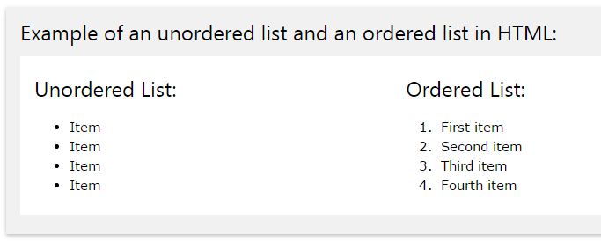
HTML Lists

Slide 60
Unordered HTML Lists
An unordered list starts with the <ul> tag. Each list item starts with the <li> tag.
The list items will be marked with bullets (small black circles):
<ul> <li>Coffee</li> <li>Tea</li> <li>Milk</li> </ul>

Slide 61
Unordered Lists - Styles
Style | Description
list-style-type:disc | The list items will be marked with bullets (default)
list-style-type:circle | The list items will be marked with circles
list-style-type:square | The list items will be marked with squares
list-style-type:none | The list items will not be marked

Slide 62
UL Example:
<ul style="list-style-type:disc"> <li>Coffee</li> <li>Tea</li> <li>Milk</li> </ul>

Slide 63
Ordered HTML Lists
An ordered list starts with the <ol> tag. Each list item starts with the <li> tag.
The list items will be marked with numbers:
<ol> <li>Coffee</li> <li>Tea</li> <li>Milk</li> </ol>

Slide 64
Ordered Lists - The Type Attribute
Type | Description
type="1" | The list items will be numbered with numbers (default)
type="A" | The list items will be numbered with uppercase letters
type="a" | The list items will be numbered with lowercase letters
type="I" | The list items will be numbered with uppercase roman numbers
type="i" | The list items will be numbered with lowercase roman numbers

Slide 65
OL Example:
<ol type="1"> <li>Coffee</li> <li>Tea</li> <li>Milk</li> </ol>

Slide 66
Nested HTML Lists
<ul> <li>Coffee</li> <li>Tea <ul> <li>Black tea</li> <li>Green tea</li> </ul> </li> <li>Milk</li> </ul>

Slide 67
Horizontal Lists
HTML lists can be styled in many different ways with CSS.
One popular way, is to style a list to be displayed horizontally:
<style> li { display:inline; } </style>

Slide 68
The <div> Element
The <div> element is a block-level element that is often used as a container for other HTML elements.
The <div> element has no required attributes, but style and class are common.
When used together with CSS, the <div> element can be used to style blocks of content:

Slide 69
Example:
<div style="background-color:black; color:white; padding:20px;"> <h2>Manila</h2> <p>Manila is the capital city of the Philippines. It is the home to extensive commerce and seats the executive and judicial branches of the Filipino government.</p> </div>

Slide 70
Sources:
-php.net
-w3schools.com

