Slide 1

G2M Case Study
Name : Buse Küçükçoban
Location: Turkey
Team: Data and Analytics
Date: 14-March-2021

Slide 2

Executive Summary
XYZ is a private firm in US. Due to remarkable growth in the Cab Industry in last few years and multiple key players in the market, it is planning for an investment in Cab industry.
Analysis contains four parts:
Data Understanding
Find and analyze relationships between features
Recommendations for cab investment

Slide 3
Data Exploration
Timeframe of the data: 2016-01-31 to 2018-12-31
Total data points :359,393
Our final data = Customer_ID.csv + City.csv + Cab_Data.csv + Transaction_ID.csv
Assumptions:
Outliers are present in Price_Charged feature but due to unavailability of trip duration details ,we we did not treat any value as outlier.
To calculate profit, we used Price Charged and Cost of Trip features and evaluate profit for per KM.

Slide 4
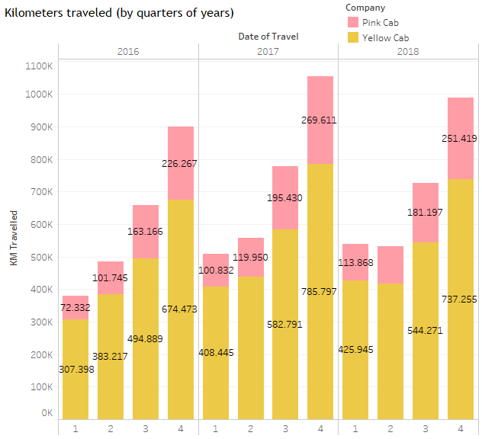
Profit Analysis
In the 4th quarter in 3 years, the maximum km in both companies, but Yellow Cab Company about 3 times more km each year than Pink Cab Company.

Slide 5
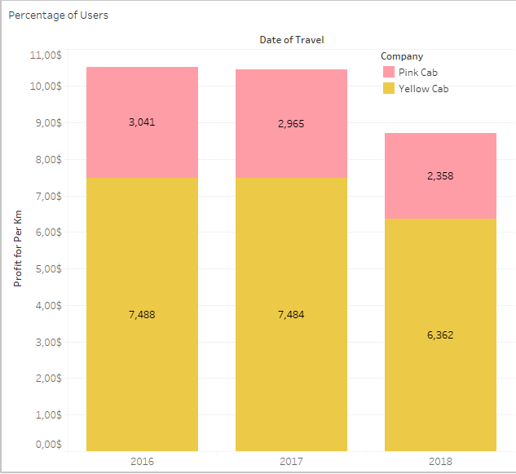
Profit Analysis for per km
When we look at the years, the profit per km is more in Yellow Cab Company.

Slide 6
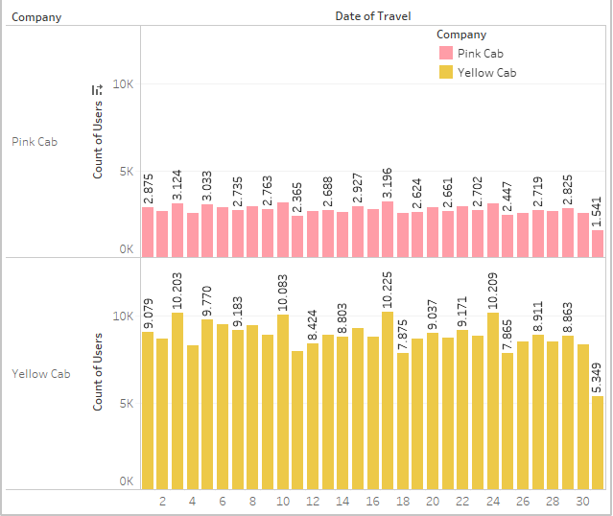
Number of users for companies

Slide 7
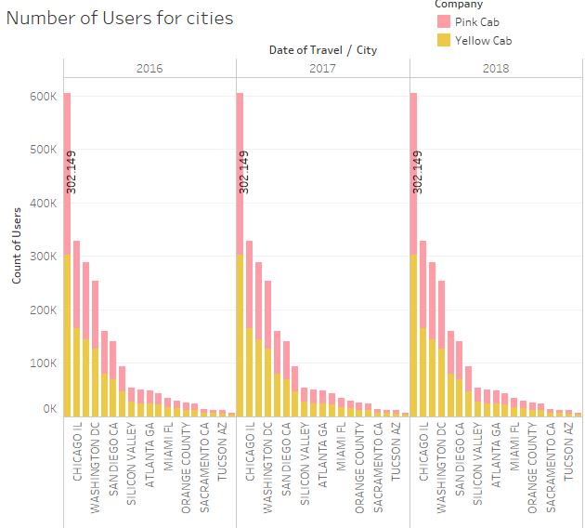
Number of users in cities

Slide 8
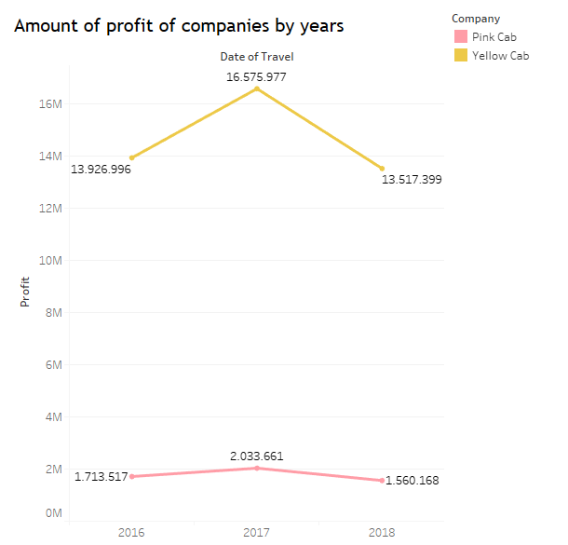
Profit Analysis

Slide 9
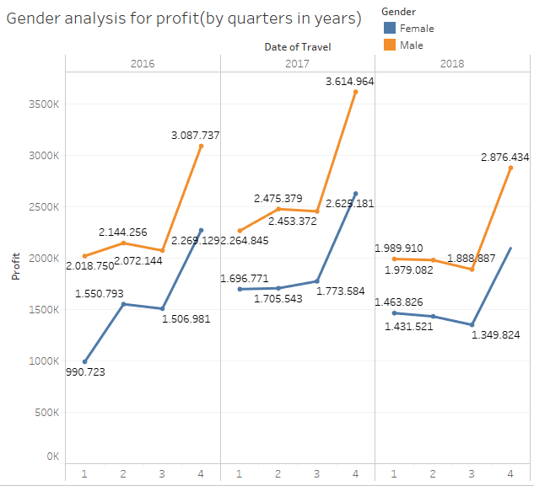
Gender Analysis

Slide 10
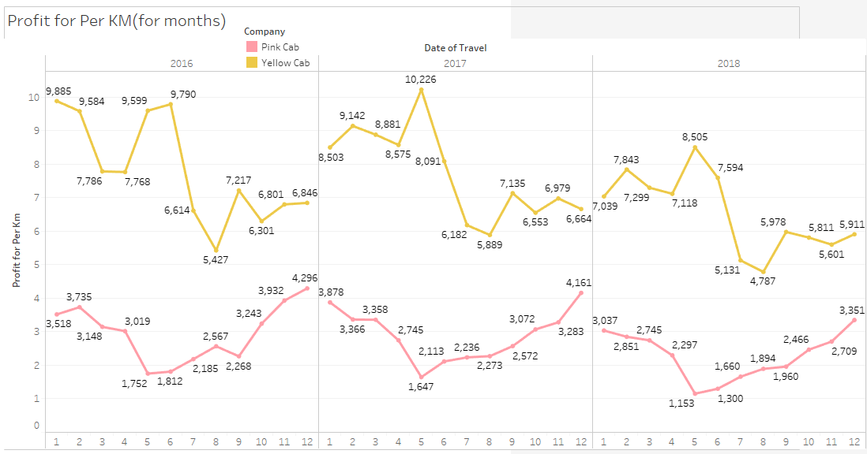
Profit Analysis
When we consider the Profit as the month, we see that Yellow Cab Company is more in the months when the profit of Pink Cab Company decreases.
We can observe an increase in the last months for both.

Slide 11
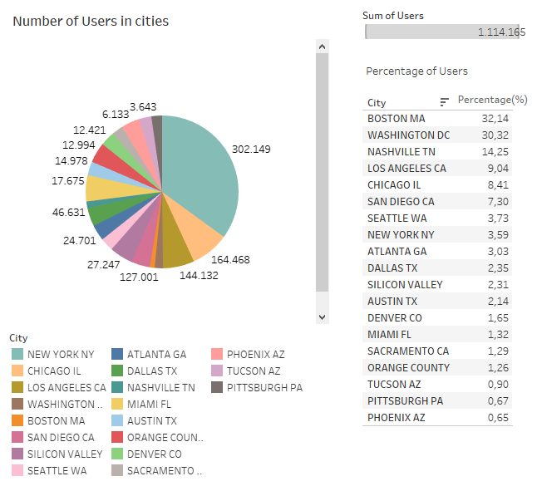
Number of Users
Cities with the most cab users
(Top 5)
New York
Chicago
Los Angeles
Washington
Boston

Slide 12
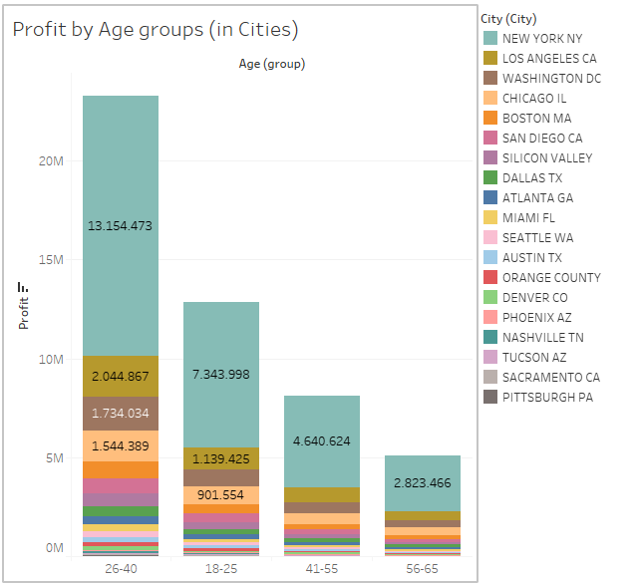
Number of Users
26-40 age group provides profit the most.
Top Profit cities:
New York
Los Angeles
Washington

Slide 13
Recommendations
From the observations, we can say that Yellow Cab is better than Pink Cab for investment.
Customer Reach :In every city, users prefer Yellow Cab more.
Average Profit per KM: Yellow cab’s average profit for per KM is almost three times the average profit per KM of the Pink cab.
Profit: In terms of profit per KM, Yellow Cab periodically provides more profit than Pink Cab.
Preferences according to months: In all periods of the year, Yellow Cab is preferred more than Pink Cab.
We will recommend Yellow cab for investment.

Slide 14

Thank You

