Slide 1
theatre

Slide 2
contents
theater activities
informations about theater
benefits of theater

Slide 3
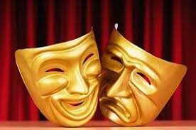
Theater activities
show
stand up
theatre
cinema
opera
ballet dance

Slide 4
Information about theat
Theater is the use of speech and movement to convey an idea through the behavior of the characters of a story, transforming them into action on the stage. Theater is the only art that uses all the arts and transforms them into a harmonious form. A theater structure is a creation with its own rules and content.

Slide 5
Benefits of Theaters
Brings beneficial and beneficial benefits to society
Theater children instill the consciousness of being a member of the society they live in. It gives the ability to look at events from different angles. It teaches cooperation and solidarity. Developing aesthetic perception and directing interest in art.

