Slide 1

Stream will start soon.

Slide 2

Missing Data Treatment in :
A Hands-on Illustration Using {mice}

Slide 3

(FHI)

Slide 4
Statistics is a missing-data problem.
— Little, R. J. (2013)

Slide 5


Missing Data Treatment
A hand-on illustration using package mice

Slide 6
Part 1: Background

Slide 7
Teacher unfairness (OECD, 2015, p. 34)
Code 1
# Install necessary package
install.packages(
c("mice", "VIM“, “MASS”, “lattice”),
dependencies = T
)
# Load the mice package
suppressWarnings(suppressMessages(
library(mice)
))

Slide 8
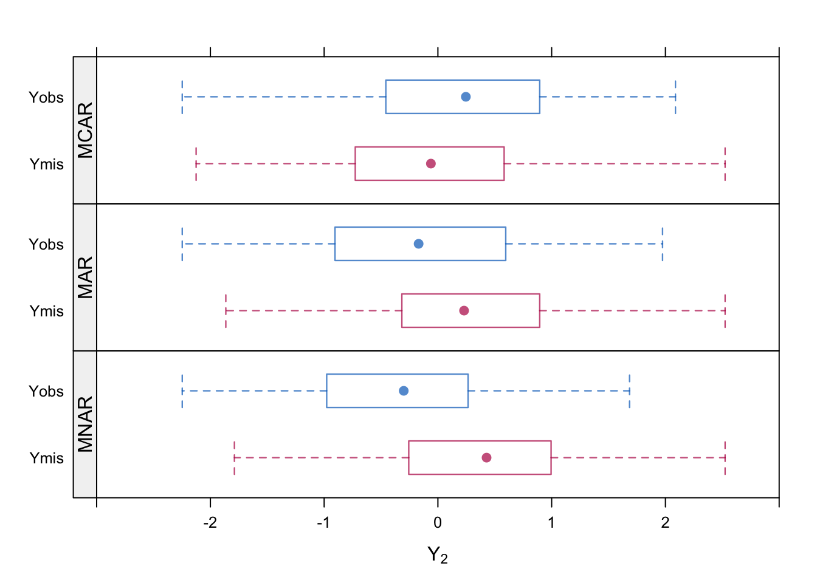
Data Missing Mechanism (Rubin, 1976)
Code 2
Missing completely at random (MCAR)
r2.mcar <- 1 - rbinom(n, 1, 0.5)
Missing at random (MAR)
r2.mar <- 1 - rbinom(n, 1, logistic(y[, 1]))
Missing not at random (MNAR)
r2.mnar <- 1 - rbinom(n, 1, logistic(y[, 2]))

Slide 9
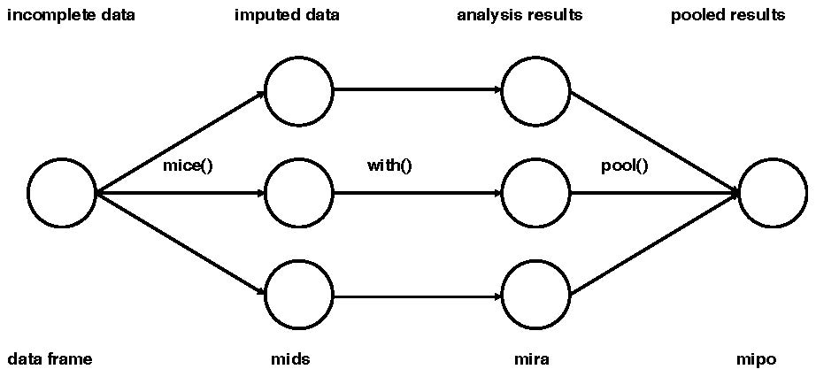
Multiple Imputation (van Buuren & Groothuis-Oudshoorn, 2011)
Observed
identical across m imputation sets
Missing
uncertainty reflected in variations across m imputation sets
Rubin’s rule
correct standard errors
Modulation
separates missing data problem from substantive scientific question
Abbreviations:
mids: multiply imputed dataset
mira: multiply imputed repeated analysis
mipo: multiple imputed pooled outcomes

Slide 10
Part 2: Missing Data Inspection

Slide 11
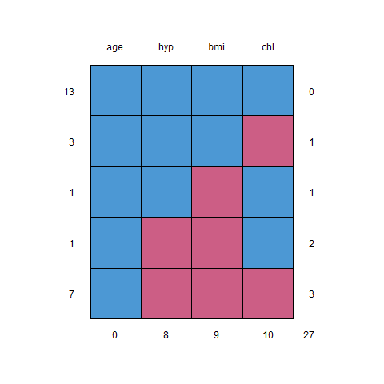
Macro-inspection (Dataset Level)
Code 3
# Use the example dataset nhanes (came with mice package)
nhanes
# observations = 25, variables = 4
# Variable names
# age age group ordered categorical
# bmi body mass index numerical
# hyp hypertension status binary
# chl cholesterol level numerical
# Inspect missing pattern (Method 1: Visual)
md.pattern(nhanes)
# Colour convention
# blue observed
# red missing
# Interpretation
# 13 rows are complete
# 3 row that chl is missing
# 1 row that bmi is missing
# 1 row that both hyp and bmi are missing
# 7 rows that only age is observed
#
# Total number of missing values = 3x1 + 1x1 + 1x2 + 7x3 = 27
# Most missing values (10) occur in chl
# Inspection by variable pairs (Method 2: Tabulation)
md.pairs(nhanes)
# Symbol convention (left, top)
# r observed (remain?)
# m missing
# Interpretation (focus on (bmi, chl) pair)
# ($rr) 13 completely observed paris
# ($rm) 3 pairs: bmi is observed but chl is missing
# ($mr) 2 pairs: bmi is missing but chl is observed
# ($mm) 7 pairs: both bmi and chl are missing

Slide 12
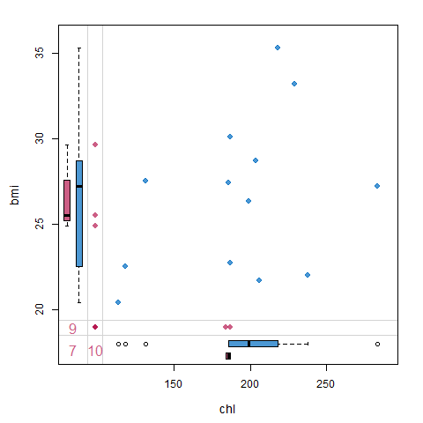
Micro-inspection (Variable-pair Level)
Code 4
# Margin plot
par(mar = c(7, 7, 3, 3)) # In order to show the axes labels
# Inspect data range
c(min(nhanes$chl, na.rm = T), max(nhanes$chl, na.rm = T)) # (113, 284)
c(min(nhanes$bmi, na.rm = T), max(nhanes$bmi, na.rm = T)) # (20.4, 35.3)
# Generate margin plot
VIM::marginplot(nhanes[, c("chl", "bmi")],
xlim = c(110, 290), ylim = c(20, 36),
col = mdc(1:2), pch = 19,
cex = 1.2, cex.lab = 1.2, cex.numbers = 1.3
)
# Interpretation
# red 9 variable bmi contains 9 missings
# red 10 variable chl contains 10 missings
# red 7 The variable pair (bmi, chl) contains 7 missings
#
# three red dots on the left: bmi values are known but chl missing
# two red dots on the bottom: chl values are known but bmi missing
# red dot cross between bmi and chl actually represents 7 dots
#
# Total # dots = 13 (blue) + 3 (red left) + 2 (red bottom) + 7 (red cross) = 25
#
# Box plots: marginal distributions (blue = obs, red = mis)
#
# If MCAR => red and blue box plots are expected to be identical

Slide 13
Part 3: Multiple Imputation

Slide 14
Multiple Imputation
Code 5
# Impute missing data
imp <- mice(nhanes, printFlag = F, seed = 23109)
# The multiply imputed dataset, imp, is of class mids print(imp)
R> print(imp)
Class: mids
Number of multiple imputations: 5
Imputation methods:
age bmi hyp chl
"" "pmm" "pmm" "pmm"
PredictorMatrix:
age bmi hyp chl
age 0 1 1 1
bmi 1 0 1 1
hyp 1 1 0 1
chl 1 1 1 0

Slide 15
Diagnostic Check
Code 6
# Diagnostic check
# Recall that bmi contains 9 missings
# The MI procedure produced five guesses for each missing:
imp$imp$bmi
# The 1st complete dataset combines the observed and imputed values:
complete(imp)
# We can print out the 2nd set of the complete dataset
complete(imp, 2)
# If complete to start with => identical in all five sets
# If missing to start with => differ in each set
#
# Degree of difference reflects degree of uncertainty
R> imp$imp$bmi
1 2 3 4 5
1 27.2 27.2 29.6 27.4 20.4
3 27.2 27.2 29.6 35.3 27.2
4 24.9 25.5 25.5 20.4 22.0
6 21.7 21.7 20.4 27.4 25.5
10 22.5 22.5 22.5 33.2 26.3
11 29.6 27.2 27.2 35.3 33.2
12 22.0 25.5 27.2 30.1 28.7
16 35.3 27.2 35.3 29.6 27.2
21 28.7 25.5 22.5 33.2 20.4

Slide 16
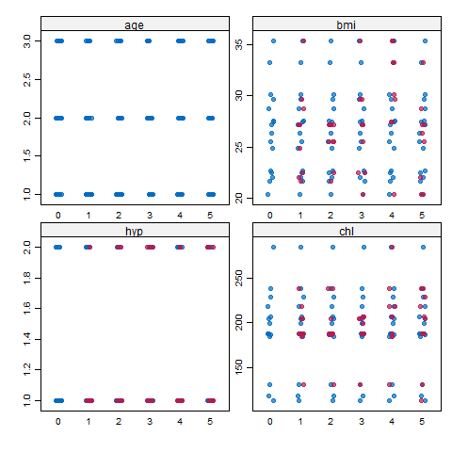
Visual Inspection (Dataset Level)
Code 7
# Visual inspection (big picture)
stripplot(imp, pch = 20, cex = 1.2)
# Colour convention
# blue observed
# red imputed
# Each x-axis marker is one version of MI:
# 0 = original set
# Red points follow the blue points reasonably well, including the gaps in the distribution.

Slide 17
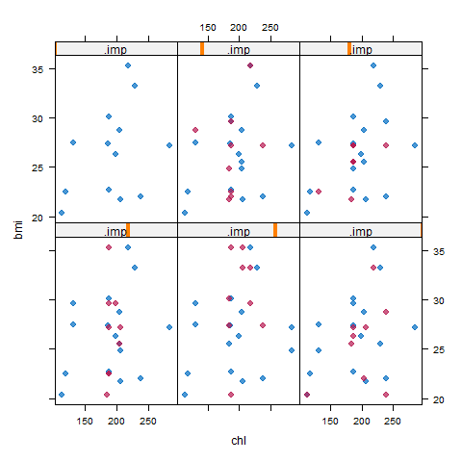
Visual Inspection (Variable-pair Level)
Code 8
# Visual inspection (fine details)
xyplot(imp, bmi ~ chl | .imp, pch = 20, cex = 1.4)
# Red points have more or less the same shape as blue data => imputed data could have been plausible measurements if they had not been missing
# Differences between the red points represents uncertainty about the true, but unknown, values

Slide 18
Analysing Imputed Datasets
Code 9
# Original regression:
# lm(chl ~ age + bmi)
# Repeat this analysis to each version of MI
fit <- with(
data = imp,
exp = lm(chl ~ age + bmi)
)
# Pool the multiple versions of the analyses together
summary(pool(fit))
# Both age and bmi are significant at .05 level
# If we increase m, the number of imputations, significant levels may change
summary(pool(with(
mice(nhanes, m = 10, printFlag = F, seed = 23109),
lm(chl ~ age + bmi)
))) # More significant
term estimate std.error statistic df p.value
1 (Intercept) 0.2189968 63.074241 0.003472047 14.80613 0.99727606
2 age 28.0471913 10.633709 2.637573645 11.58238 0.02223126
3 bmi 5.3831348 2.126757 2.531146954 11.55051 0.02702526
term estimate std.error statistic df p.value
1 (Intercept) -9.674430 73.298622 -0.1319865 9.439981 0.89776550
2 age 33.490119 11.713067 2.8592100 9.673572 0.01752687
3 bmi 5.384538 2.288883 2.3524742 9.390434 0.04201958

Slide 19
Customise MI
Code 10
# Specifying Imputation Methods
summary(pool(with(
mice(nhanes,
method = c("", "norm", "pmm", "mean"), # Specify MI method for each var
m = 10, print = F, seed = 23109 # printFlag = print = pri
),
lm(chl ~ age + bmi)
)))
summary(pool(with(
mice(nhanes,
method = "norm", # Use norm MI method for all variables
m = 10, pri = F, seed = 23109
),
lm(chl ~ age + bmi)
)))
# In order to show case different imputation methods, use nhanes2 dataset
str(nhanes2)
# Data type
# age factor, 3 levels
# bmi numeric
# hyp factor, 2 levels
# chl numeric
summary(pool(with(
mice(nhanes2,
me = c("polyreg", "pmm", "logreg", "norm"), # me = method
m = 10, pri = F, seed = 23109
),
lm(chl ~ age + bmi)
)))
term estimate std.error statistic df p.value
1 (Intercept) -3.896819 50.834969 -0.07665627 16.99445 0.939792232
2 age 31.299527 8.530883 3.66896674 15.88864 0.002095030
bmi 5.237195 1.567365 3.34140136 16.03713 0.004130752
term estimate std.error statistic df p.value
1 (Intercept) -85.791421 81.186319 -1.056723 6.582155 0.32787166
2 age 49.978785 13.871964 3.602863 6.436433 0.01004440
bmi 7.244128 2.332117 3.106246 7.787269 0.01501989
term estimate std.error statistic df p.value
1 (Intercept) -24.632281 71.334869 -0.3453049 7.235180 0.739687355
2 age40-59 55.012062 29.585793 1.8594080 4.259259 0.132128968
3 age60-99 87.113022 23.387866 3.7247102 8.217308 0.005560425
4 bmi 6.812331 2.329388 2.9245153 8.723360 0.017468510

Slide 20
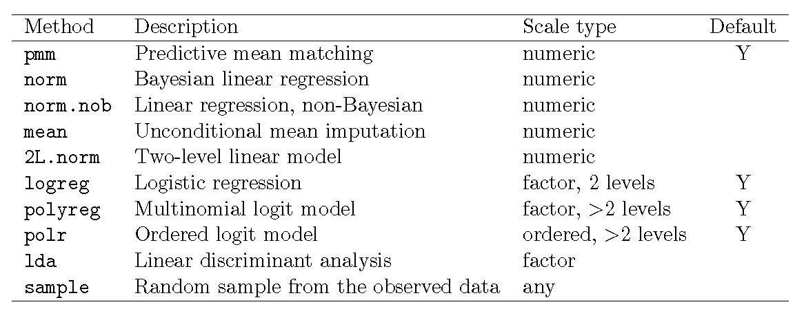
Imputation Methods

Slide 21
Multilevel MI (van Buuren & Groothuis-Oudshoorn, 2011, pp. 21—22)
Code 11
# Inspect original data
head(popmis)
# Extract predictor matrix
suppressWarnings(suppressMessages(
ini <- mice(popmis, maxit = 0)
))
pred <- ini$pred
# Turn every entry in the predictor matrix to zero
pred <- matrix(0,
nrow = nrow(pred), ncol = ncol(pred),
dimnames = list(rownames(pred), colnames(pred))
)
# Assign info to the "popular" row
pred["popular", ] <- c(0, -2, 0, 2, 1, 2, 0)
# MI
suppressWarnings(suppressMessages(
imp <- mice(popmis,
meth = c("", "", "2l.norm", "", "", "", ""),
pred = pred, pri = F, maxit = 1, seed = 71152
)
))
# Inspect imputed data
head(complete(imp))
pupil school popular sex texp const teachpop
1 1 1 NA 1 24 1 7
2 2 1 NA 0 24 1 7
3 3 1 7 1 24 1 6
4 4 1 NA 1 24 1 6
5 5 1 NA 1 24 1 7
6 1 7 0 24 1 7
pupil school popular sex texp const teachpop
1 1 1 8.483879 1 24 1 7
2 2 1 7.646901 0 24 1 7
3 3 1 7.000000 1 24 1 6
4 4 1 8.400386 1 24 1 6
5 5 1 7.892165 1 24 1 7
6 6 1 7.000000 0 24 1 7

Slide 22
Part 4: Additional Resources

Slide 23
Reporting Template (van Buuren, 2018, pp. 344—345)
The percentage of missing values across the nine variables varied between 0 and 34%. In total 1601 out of 3801 records (42%) were incomplete. Many girls had no score because the nurse felt that the measurement was “unnecessary,” or because the girl did not give permission. Older girls had many more missing data. We used multiple imputation to create and analyze 40 multiply imputed datasets. Methodologists currently regard multiple imputation as a state-of-the-art technique because it improves accuracy and statistical power relative to other missing data techniques. Incomplete variables were imputed under fully conditional specification, using the default setting of the mice 3.0.0 package (van Buuren and Groothuis-Oudshoorn, 2011). The parameters of substantive interest were estimated in each imputed dataset separately, and combined using Rubin’s rules. For comparison, we also performed the analysis on the subset of complete cases.
We obtained similar results when the analysis was restricted to the complete case only. Multiple imputation was generally more efficient as can be seen from the shorter confidence intervals and lower p-values in Table X.

Slide 24
Bibliography
Carpenter, J. R. & Kenward, M. G. (2013). Multiple imputation and its application. Wiley. https://10.1002/9781119942283
Enders, C. K. (2010). Applied missing data analysis. Guilford Press. http://hsta559s12.pbworks.com/w/file/fetch/52112520/enders.applied
Little, R. J. (2013). In praise of simplicity not mathematistry! Ten simple powerful ideas for the statistical scientist. Journal of the American Statistical Association, 108(502), 359—369. https://doi.org/10.1080/01621459.2013.787932
Little, R. J. A. & Rubin, D. B. (2020). Statistical analysis with missing data (3rd ed.). Wiley. https://doi.org/10.1002/9781119482260
OECD. (2015). Student questionnaire for PISA 2015 (computer-based version, main survey version). OECD Publisher. https://www.oecd.org/pisa/data/CY6_QST_MS_STQ_CBA_Final.pdf
Rose, N. (2013). Item nonresponses in educational and psychological measurement (URN: urn:nbn:de:gbv:27-20130627-105533-2) [Doctoral dissertation, Freidrich-Schiller-Universität Jena]. https://www.db-thueringen.de/receive/dbt_mods_00022476
Rubin, D. B. (1976). Inference and missing data. Biometrika, 63(3), 581—590. https://doi.org/10.1093/biomet/63.3.581
van Buuren, S. (2018). Flexible imputation of missing data (2nd ed.). CRC Press. https://stefvanbuuren.name/fimd/
van Buuren, S. & Groothuis-Oudshoorn, K. (2011). mice: Multivariate imputation by chained equations in R. Journal of Statistical Software, 45(3), 1—67. https://doi.org/10.18637/jss.v045.i03

