Slide 1
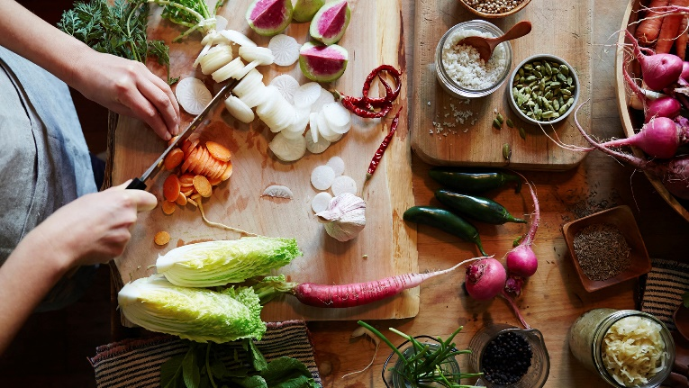
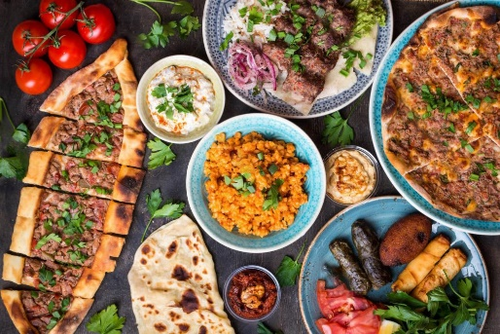

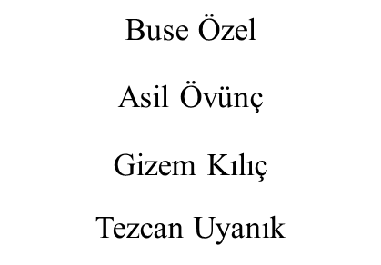


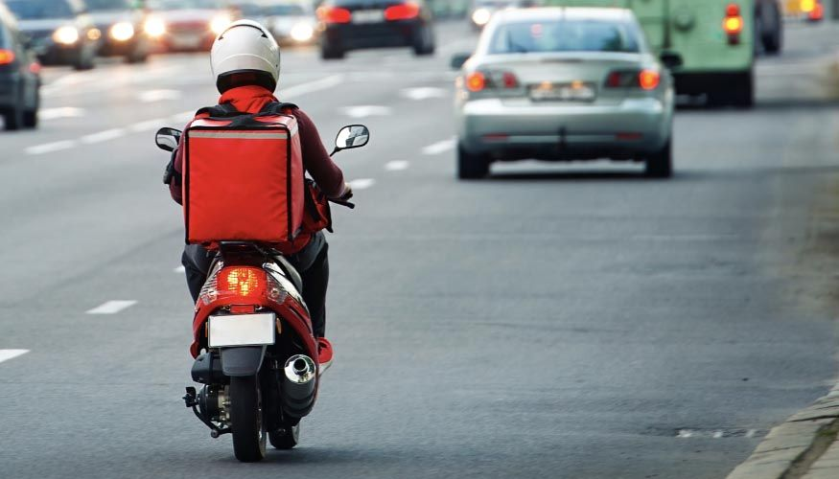
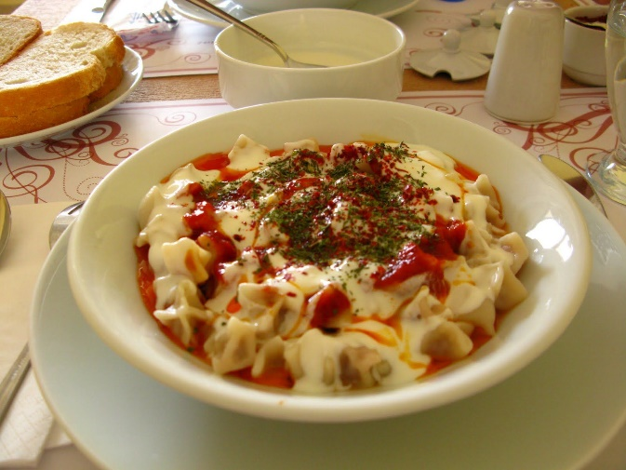
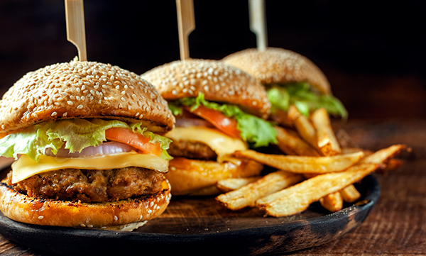

* OUR GOALS *
This system we want to develop is a website where people can order the food and drink they want whenever they want. They can find the restaurant information closest to their location and order the food they want without wasting time going to the restaurant thus avoiding getting contact with the virus.
While doing this, we want to give a privilege to small tradesmen by making commissions easier with the help of our sponsors and to introduce them to a larger crowd.
WEBSITE SIMULATION FOR ORDERING FOOD
HOW DOES IT WORK ?
ABOUT OUR PROJECT
GABT is both a mobile and web application that different users can enter.
Customers can save or change their addresses, food allergies and payment methods in their own accounts. This info will be completely confidential and by no means to be shared. If this information is in the hands of third parties who are not included in the contract, the Privacy Policy will be violated and thus will constitute a crime.
The system will locate your place on the map and show you the available options or you can select another location as your base.
1
Enable customers to make extensive searches based on the type of the food,
To keep small businesses running,
Shows that the content of the food is safe with the content information we will receive from the workplaces we have contracted with,
To be known among the local food sector and work with advertisement companies,
For our regular customers, if they are satisfied with a local restaurant, they will have the option to buy the same meal or other dishes of the restaurant at the same time each day before ordering again. (Customers can cancel this delivery at any time.) In addition, they can get discounts as a result of these subscriptions.
In addition, in order to increase the tendency to the site, campaigns such as giving gift orders once every 10-15 orders can be organized.
WHY GABT ?
During the pandemic it is a known fact that quite a lot of local food bussinesses had to close their places permanently. Let it be because of low income or astonishingly high expenses. Apart from these bussiness since lockdown, the people started to order fast foods continuously as a result their immune system gets affected from low nutrition.
With this project we plan to resolve both of these problems.
The system works with online ordering.
The user can register and by doing that they will be able to obtain the requested food daily without delay. To do that they’ll have to choose the requested food and the restaurant then enter the expected time. The customers could enter their allergies on their profile page and with that they will get a notification if the food they selected contains that ingredient.
The payment could be made by different methods. If the customer hasn’t entered the info they could select the method in this stage. After the payment they will get notifications about their delivery.
The local restaurants will have their own user entry and the food on their pages will have to list all the ingredients they’ve used.
2
3
Our
Objectives
4
5

