Slide 1
MAY 2026 · FINAL PROJECT
Cross-Market Arbitrage
Detecting Informed Trading from Polymarket → Kalshi
When an informed trader moves a price on a transparent market, the opaque one is slow to follow. That lag is measurable.
1,544
16
393
18
SIGNALS
MARKET PAIRS
WALLETS SCORED
DAYS LIVE
Methodology adapted from Mitts & Ofir (SSRN 6426778, 2026)

Slide 2


THE CORE IDEA
An asymmetry between two prediction markets
POLYMARKET
KALSHI
Transparent · on-chain
Opaque · regulated
Every wallet address and every trade is public.
An insider can't hide — their trades move the price.
Source of wallet-level order flow.
Per-user trade data is private.
Market prices are public — but update slower.
Used purely as a price series to measure against.
The asymmetry is the opportunity. If someone with non-public information trades Polymarket first, a price gap opens before Kalshi reprices. The system detects that gap, flags the likely-informed wallet, and paper-trades the Kalshi side.

Slide 3





HOW IT WORKS
The detection pipeline
1
2
3
4
5
›
›
›
›
Score wallets
Poll every 5 min
Compare venues
Paper-trade Kalshi
Close on catch-up
393 wallets rated on 5 informed-trading signals → Layer 1 watchlist
Detect large trades by watchlist wallets, plus outsized one-offs
Same event priced differently on Kalshi → a signal fires
Open a position in the direction of the Polymarket signal
Exit when Kalshi converges within 3¢ (or expire)
Two layers run in parallel. Layer 1 = known smart wallets. Layer 2 = any single trade >1% of volume in an illiquid market (<$150k). P&L is tracked separately to see which layer is the better signal.

Slide 4
BUILD PROCESS & ARCHITECTURE
Built in milestones on a lean stack
✓
✓
✓
✓
✓
✓
M0
M1
M2
M3
M4
M5
M6
Research
Lead-lag PoC
Layer 1
Layer 2
Historical
Live + paper
Dashboard
M6 dashboard scaffolded, not yet wired up
THE STACK
MARKET-PAIR DISCOVERY
Python · SQLite (single file, 5 tables) · Flask
Deployed on Railway — Flask serves a health check while a background thread runs the 5-minute polling loop.
~2,200 Kalshi markets + Polymarket → keyword pre-filter → Claude Haiku semantic scoring → 1:1 dedup → human review queue

Slide 5

ACADEMIC BASIS
Adapting an informed-trading framework cross-platform
PRIMARY METHODOLOGY
SUPPORTING
Mitts & Ofir — “From Iran to Taylor Swift: Informed Trading in Prediction Markets”
Gómez-Cram, Guo, Jensen & Kung — “Crowd Wisdom or Informed Minority?”
SSRN 6426778 · 2026
SSRN 6617059 · 2026
A 5-signal composite score per wallet:
1 Bet size vs. market
2 Bet size vs. own history
98,906
EVENTS
3 Profitability
4 Pre-event timing
$13.76B
5 Directional concentration
VOLUME
1.72M
ACCOUNTS
Their flagged wallets: 69.9% win rate, 60+ SD above chance, ~$143M anomalous profit.
~3.14%
FLAGGED “SKILLED”

Slide 6
THE HEADLINE RESULT
Clean the data, and the edge sharpens
ALL MARKETS
EXCL. NOISE MARKET
STRICT (EXCL. NOISE + IRAN)
$2,354
$2,814
$3,349
NET PAPER P&L
NET PAPER P&L
NET PAPER P&L
62% win rate
68% win rate
80% win rate
64% expired (didn't converge)
52% expired (didn't converge)
36% expired (didn't converge)
The signal is real — but data quality dominates. Removing one mismatched market lifts the win rate from 62% to 80%. The flip side: across everything, 64% of signals expired without converging.

Slide 7
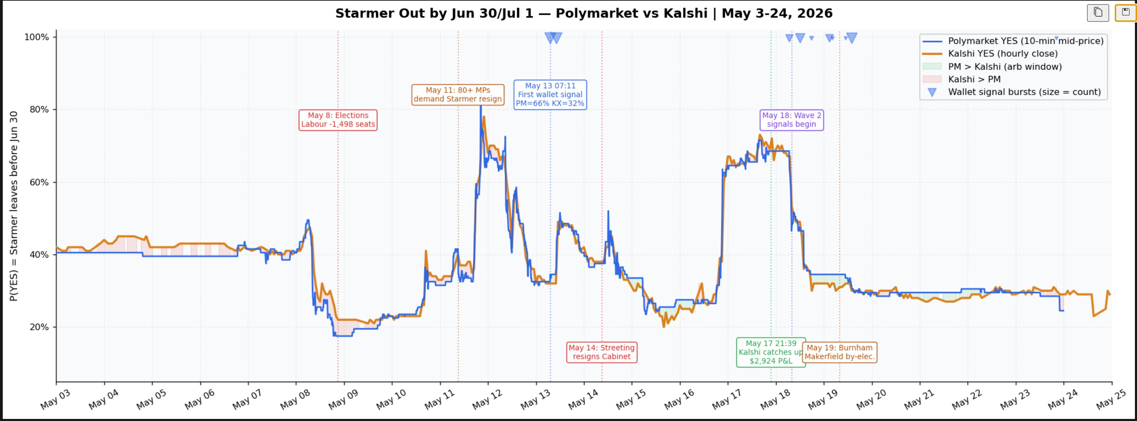
CASE STUDY #1 · THE HOME RUN
The Starmer trade
“Will Keir Starmer leave office by July 2026?” A May 13 wallet burst priced Polymarket at 66% vs Kalshi 32% — a 34¢ gap Kalshi took ~4.5 days to close.
$2,924 NET P&L
90.7% WIN RATE
118 CLOSED TRADES
1.43 SHARPE-LIKE

Slide 8
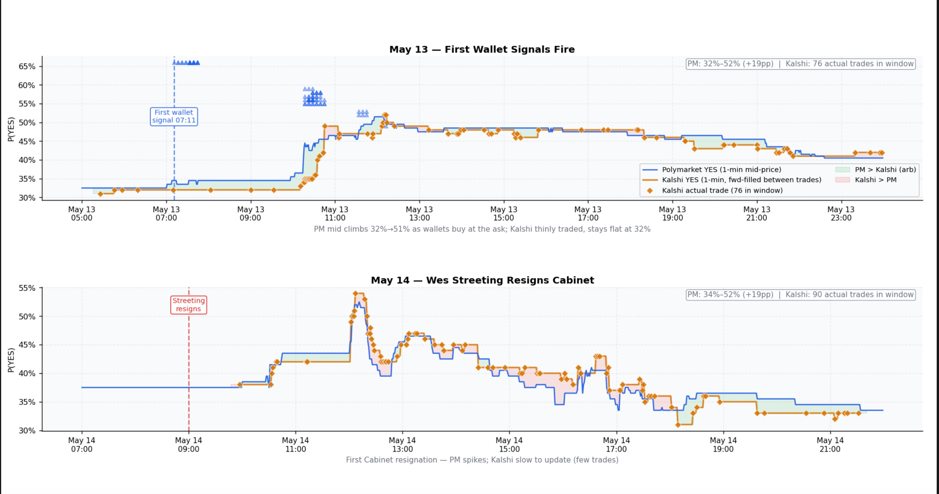
CASE STUDY #1 · INTRADAY DETAIL
Polymarket leads, Kalshi lags — trade by trade
Wallet bursts lift Polymarket first; Kalshi (orange = real fills) catches up hours later. Green band = open arbitrage window.

Slide 9
THE BRUTAL TRUTH
One trade carried almost everything
NET CLOSED P&L
$2,924
Starmer's share of the $2,354 net total. Everything else combined was −$570.
Without Starmer: 346 closed trades, 52.3% win rate, net loss.
This is how event-driven arbitrage works. Sit flat most days and capitalize on the occasional high-conviction setup. The real question: will the infrastructure catch the next one?

Slide 10
CASE STUDY #2 · THE REPEATABLE ENGINE
Hormuz — the scalable version of the strategy
147
74
WHY IT MATTERS
Origin story. This market was the project's M1 proof-of-concept — the first place the lead-lag signal was confirmed. On May 6, Kalshi sat at 0.17 while Polymarket spiked to 0.435; Kalshi only partially caught up.
SIGNALS
CLOSED
~1%
91.9%
Repeatable, not a one-off. Unlike Starmer's single spike, Hormuz produced consistent, near-zero-expiry convergence: only 2 of 147 signals expired.
EXPIRY RATE
WIN RATE
$683 total P&L 1.14 Sharpe-like
⚠ Caveat: a different Hormuz contract window lost money (18.8% win rate). Contract selection matters.

Slide 11


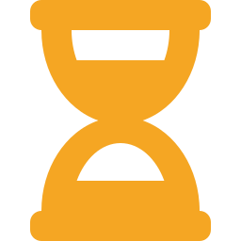

WHAT THE SIGNAL LOOKS LIKE
Four findings consistent with informed trading
Alpha is concentrated
70.6%
Score has a sweet spot
0.65+ → 0%
Top 3 wallets drive most of the gross profit — the fingerprint of a small informed group.
Scores 0.55–0.60 win 79% of the time. Above 0.65, performance collapses entirely.
Slower is more profitable
$20 vs $1.80
Time-of-day matters
88% vs ~10%
Trades closing in 3–7 days averaged $20 each; sub-30-minute closes averaged just $1.80.
Signals at the European open (07:00 UTC) converge 88% of the time; US-afternoon fires, 3–13%.

Slide 12
WHERE THE NOISE CAME FROM
73% of expired trades came from two bad matches
RATE CUT — STRUCTURAL MISMATCH
US–IRAN AGREEMENT — STRUCTURAL GAP
420 signals — all noise
~25¢ gap that never converged
Polymarket priced P(zero cuts) ≈ 0.32; Kalshi priced P(≥1 cut) ≈ 0.65. These are complements — the 33¢ “gap” is permanent and fake. The system was trading against itself.
Polymarket priced the Iran deal ~25¢ above Kalshi across six separate weeks. Likely different resolution definitions (“any deal announced” vs “formally signed”) — venue-level divergence, not a timing lag.
−$460 booked · 88% expired
−$535 booked across both Iran contracts
The fix is cheap. Discovery matched on keyword similarity without checking contract direction. A single direction-check would have prevented ~$460 in losses and 600+ junk signals polluting the metrics.

Slide 13


CONCLUDING THOUGHTS
The edge is real
The lead-lag effect is real. 80–91% win rates on the cleanest markets aren't chance. Kalshi demonstrably lags Polymarket when informed wallets move prices.
But the edge is fragile. It lives in a handful of wallets and a handful of events, and it evaporates with bad contract matching or tight time windows.
BEST ENTRY FILTER FOUND
Gap 7–30¢ · wallet score 0.55–0.65 · trade size $50–$5k
→ 80.8% win rate · $20 avg/trade · Sharpe-like 1.15

Slide 14

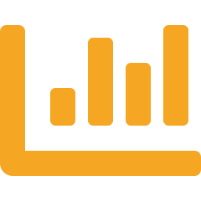



CAVEATS & RISKS
What this analysis does not prove
Hypothetical paper trading only
Tiny sample, short window
No execution costs, slippage, or Kalshi liquidity modeled. Real fills would erode the edge in thin markets.
18 days; nearly all P&L from a single event. Not yet statistically robust.
Correlation ≠ insider causation
64% expiry rate
Lead-lag could reflect liquidity or attention differences, not non-public information.
Most signals never converge; selection and survivorship effects flatter the headline numbers.
Legal & ethical exposure. Trading on others' suspected inside information raises CFTC, market-manipulation, and Kalshi terms-of-service questions, plus KYC and geographic restrictions. Real execution is a different risk regime than analysis.

Slide 15
NEXT STEPS · MAKING IT ACTIONABLE
From prototype to a validated strategy
1
Fix discovery first Add a contract-direction check. Would have prevented ~$460 in losses + 600 junk signals.
2
Validate against ground truth Back-test every paper trade against actual resolutions for realized, not paper, P&L.
3
Wallet-graph analysis Detect co-trading clusters where insiders use multiple wallets; treat the cluster as the unit.
4
Wire up the M6 dashboard Live monitoring of events, watchlist, and cumulative P&L by layer.
5
Only then, real execution With position sizing for liquidity and signal confidence. Put money behind our analysis.

