Slide 1
Compilation Time Configurable Pipelined AES Encoder and Decoder
Alex Pearson
Daniel Collins
Scott Lawson

Slide 2
Outline
AES Overview
Round Overview
Key Schedule
SystemVerilog Implementation
Block Diagram
Design/Verification Methodology
Pertinent Features Used
Simulation and Emulation Results

Slide 3
AES Overview

Slide 4
AES Overview
The AES standard is based on the Rijndael Cipher but only supports a block size of 128bits and 3 key sizes of 128, 192, and 256 bits termed AES-128, AES-192, and AES-256 respectively.
Algorithm consists of multiple rounds of input manipulation to produce output

Slide 5
AES Overview – Round Overview
The encryption is performed by applying a round consisting of 4 stages (the final stage omits MixColumns) repeatedly on the state (initial state is the plain text input) and using the derived round keys.
The number of rounds differs across the 3 AES standards with AES-128 requiring 10 rounds, AES-192 requiring 12 rounds, and AES-256 requiring 14 rounds.
The 4 stages are: SubBytes, ShiftRows, MixColumns, AddRoundKey
Notes:
Sub Bytes – a non-linear substitution where each byte is replaced by another using a LUT based on finite field polynomials
Shift Rows – a transposition step where the last three rows of the state are shifted cyclically
Mix Columns – a mixing operation where the 4 bytes of each column are combined
Add Round Key – a step when the round key is XOR’d with the state

Slide 6
AES Overview – Key Schedule
The AES cipher requires the use a Key Expansion module based on the Rijndael’s key schedule to generate a 128-bit round key for each round (plus an additional round key added as a first step)
Input Key
Computed Blocks →
…
{
{
{
{
…
Round 0
Key
Round 1
Key
Round 2
Key
Round 3
Key

Slide 7
SystemVerilog Implementation

Slide 8
SystemVerilog Implementation
Our project was based on the Federal Information Processing Standard Publication 197 that describes the Advanced Encryption Standard (AES)
We didn’t start with any existing hardware level description of an AES encoder or decoder
We also utilized a paper (An AES crypto chip using a high-speed parallel pipelined architecture by Yoo, et. al) that shows one method for pipelining the AES cipher that we based our pipelined methodology on

Slide 9
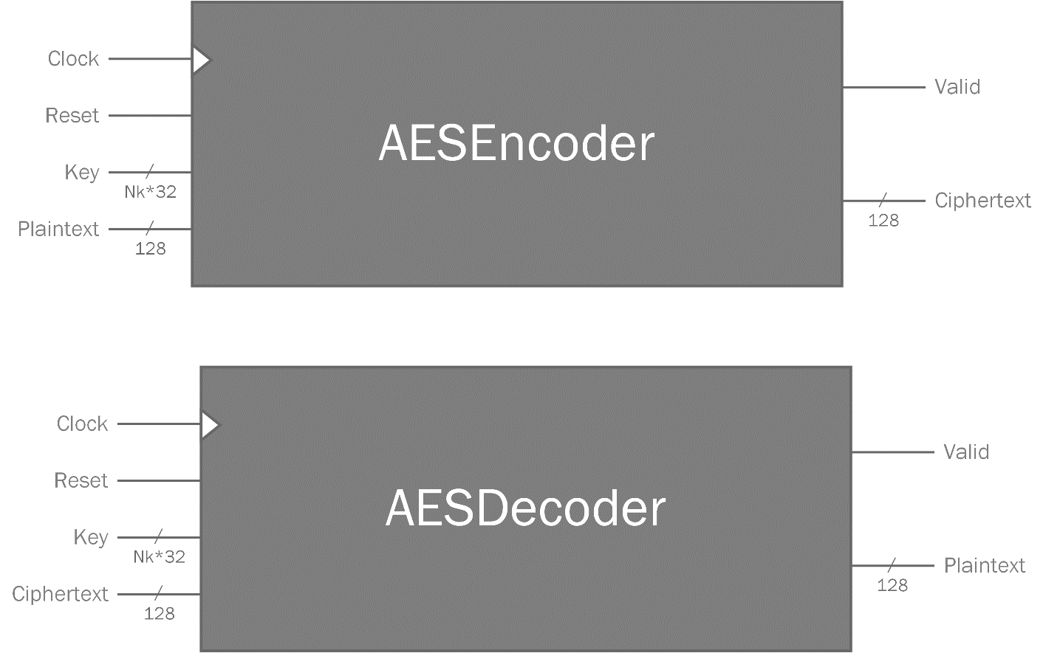
SystemVerilog Implementation Block Diagram
Notes:
Nk = 4, 6, or 8

Slide 10
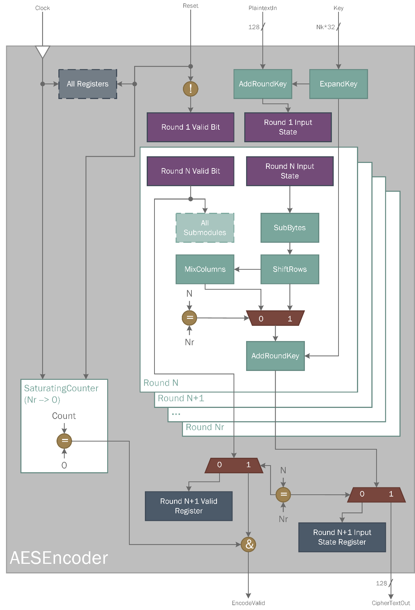
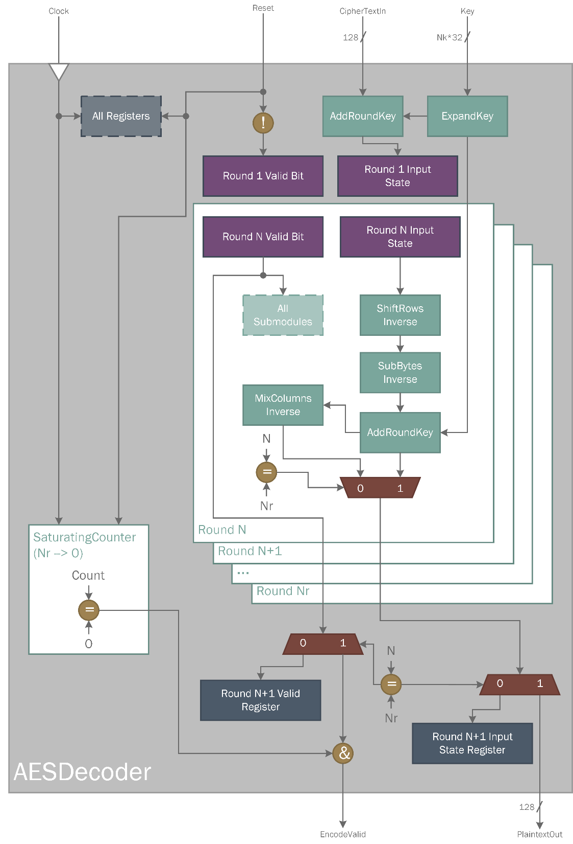

Slide 11
SystemVerilog Implementation Design and Verification Methodology
Top Level Black Box
Top Level Testbench using SECMI Pipes
ExpandKey and Round Definition
Design
Verification
ExpandKey and Round Testbenches
MixColumns, AddRoundKey, SubBytes, ShiftRows Definition
Individual Sub-module TestBenchs

Slide 12
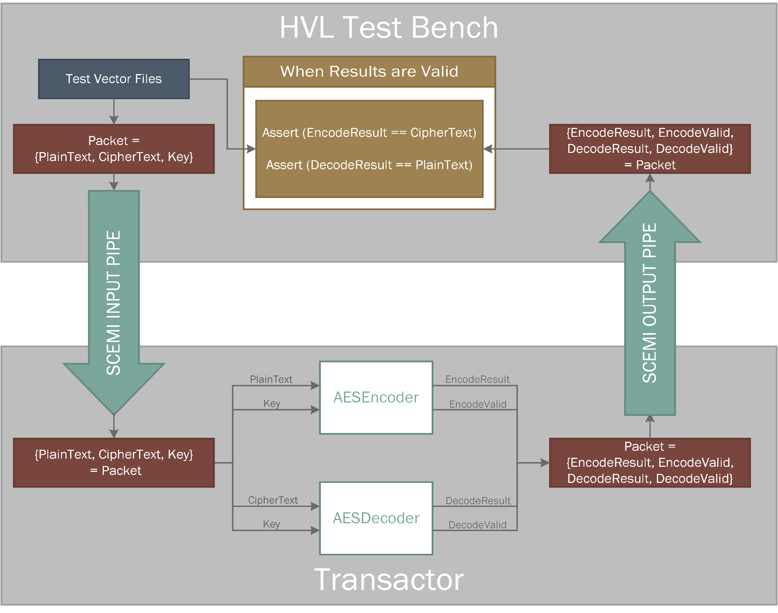

Slide 13
SystemVerilog Implementation Pertinent Features Used
Used classes to implement our test methodology and allow code reuse between testbenches with the same or similar requirements
Used queues to create variable length storage that we could use as FIFO input from our testbenches
Used always_comb and always_ff blocks for our logic
Used typedefs for all of our signals, which greatly aided in implementing compile-time configurability of our project
Used packed structs to organize groups of signals
Used packages to organize our code and share definition and functionality among modules
Used parameterized types to create generic modules that could be instantiated to operate on different types of data
Used byte streaming operators to send and receive data through the SCEMI pipes, transforming it from an unpacked to packed array

Slide 14
Simulation and Emulation Results

Slide 15
Simulation and Emulation Results
For top level testing we had a single testbench split across a HVL file written in SystemVerilog (but containing non-synthesizable constructs) and a SystemVerilog “Transactor” only containing synthesizable constructs that can run on the emulator in TBX mode using SCEMI pipes
Our testbench is able to run in “puresim” mode solely on the simulator or in “veloce” mode, splitting the tesbench with the HVL code running in Questa and the Transactor code running on Veloce

Slide 16
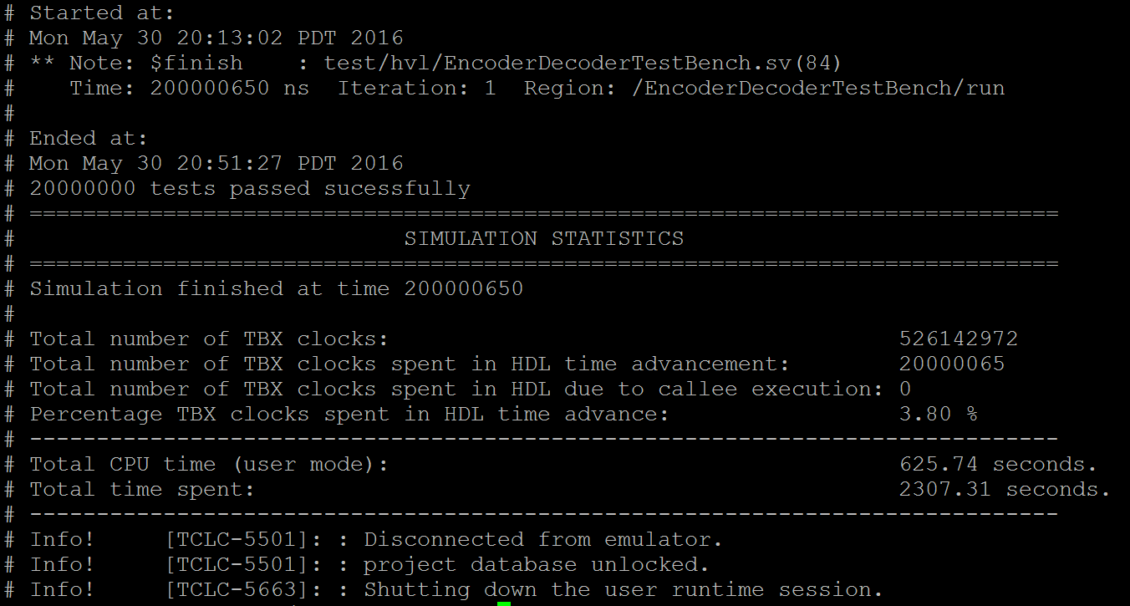
Simulation and Emulation Results
10,000,000 randomly generated vectors for each key size
All key sizes performed similarly
Simulation
Compile / load time: < 1 minute
Execution time: ~42 minutes
Emulation
Compile / load time: ~4 minutes
Execution time: ~38.45 minutes

Slide 17
Future Work
Optimize AES design
Investigate methods for combining multiple stages in a round
Add intermediate pipelining for key expansion module
Reduce the amount of expanded key data being buffered between each round
Encrypted/Decrypted output check on emulator via assertions
Notes:
AES design: Can combine subbytes and mixcolumns steps, look for other tricks
Output check: eliminate the time it takes to transfer the data back
Anything else here guys?

Slide 18
Questions?

