Slide 1
Efficient Verification of an Elaboration-Time, Key Size Configurable, Pipelined AES Encoder and Decoder using a Mentor Veloce Emulator
Alex Pearson
Daniel Collins

Slide 2
Outline
Advanced Encryption Standard Overview
Round Computation
Key Schedule
Implementation
Block Diagram
Design/Verification Methodology
Simulation and Emulation Results

Slide 3
Advanced Encryption Standard Overview

Slide 4
AES Overview
AES is a symmetric-key block cipher used to encrypt electronic data
Specified in the FIPS 197 document published by NIST in 2001
Operates on 128-bit blocks of data
Supports three key sizes: 128, 192, and 256 bits
Widely adopted, designed with hardware implementations in mind
Performs multiple rounds of state transformation on the input block to produce the output
Notes:
Subset of the Rijndael cipher

Slide 5
AES Overview Round Computation
Each AES variant performs a fixed number of rounds
AES-128: 10 rounds
AES-192 12 rounds
AES-256: 14 rounds
Each round applies four transformations to the state
SubBytes
ShiftRows
MixColumns (omitted on the final round)
AddRoundKey
Notes:
Sub Bytes – a non-linear substitution where each byte is replaced by another using a LUT based on finite field polynomials
Shift Rows – a transposition step where the last three rows of the state are shifted cyclically
Mix Columns – a mixing operation where the 4 bytes of each column are combined
Add Round Key – a step when the round key is XOR’d with the state

Slide 6
AES Overview Key Schedule
The initial input key is expanded into separate 128-bit round keys
Copy last 4B of previous key block, perform schedule core on it
Rotate word, Sbox substitution, Rcon operation on leftmost byte, XOR with corresponding column of previous block
Input Key
Computed Blocks →
…
{
{
{
{
…
Round 0
Key
Round 1
Key
Round 2
Key
Round 3
Key
Notes:
Round Keys
Round keys are always 128 bits, regardless of the key size
Some shifting involved at key sizes other than 128-bit

Slide 7
Implementation

Slide 8
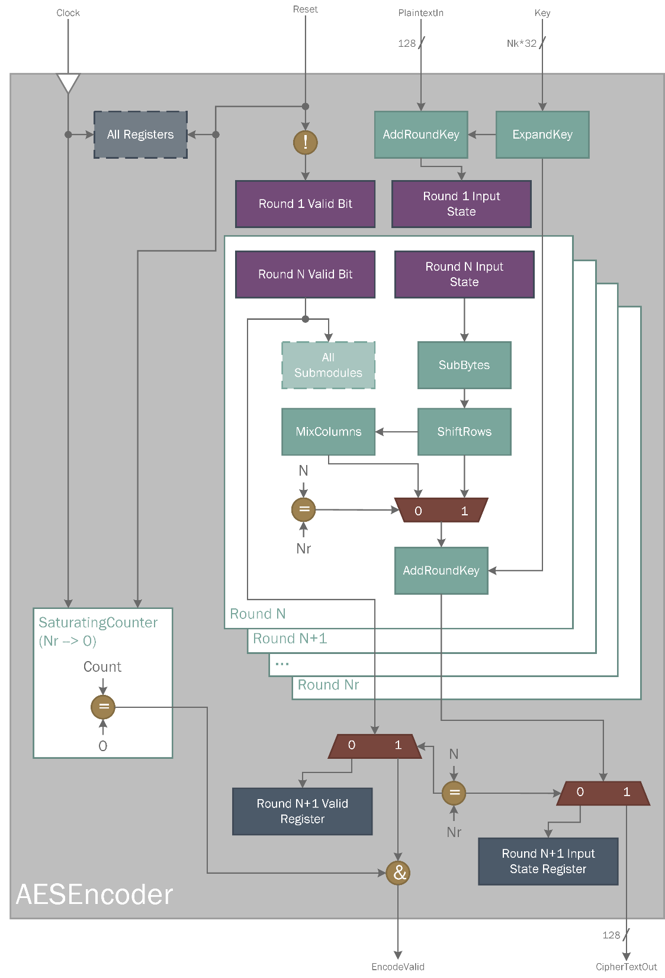
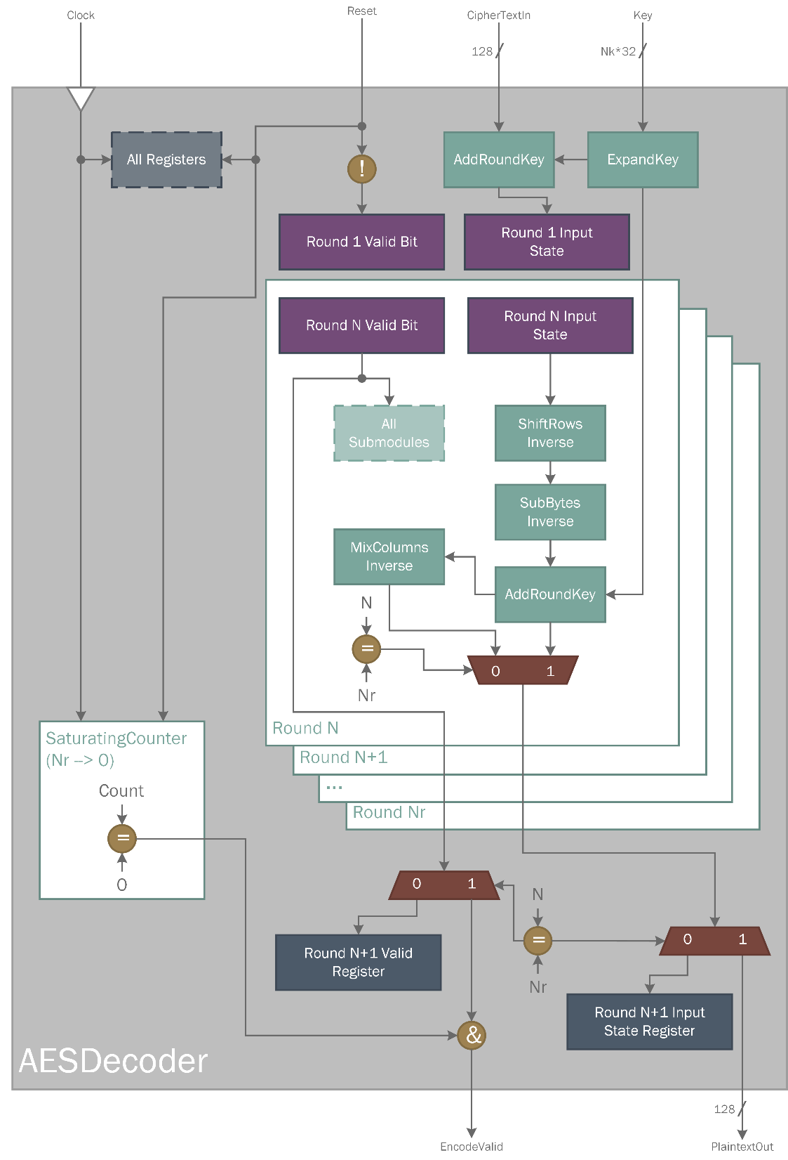
Notes:
We attempted to pipeline the key expansion module
Works for encoder, impossible for decoder
Decoder requires keys in reverse order – the last computed key is needed first (data dependency)

Slide 9
Implementation Design and Verification Methodology
Top Level Black Box
Top Level Testbench using SCEMI Pipes
ExpandKey and Round Definition
Design
Verification
ExpandKey and Round Testbenches
MixColumns, AddRoundKey, SubBytes, ShiftRows Definition
Individual Sub-module Testbenches

Slide 10
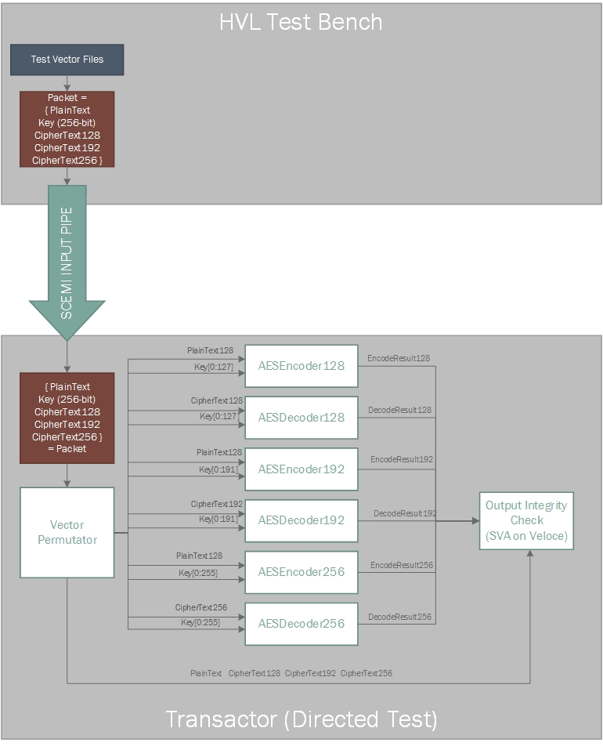
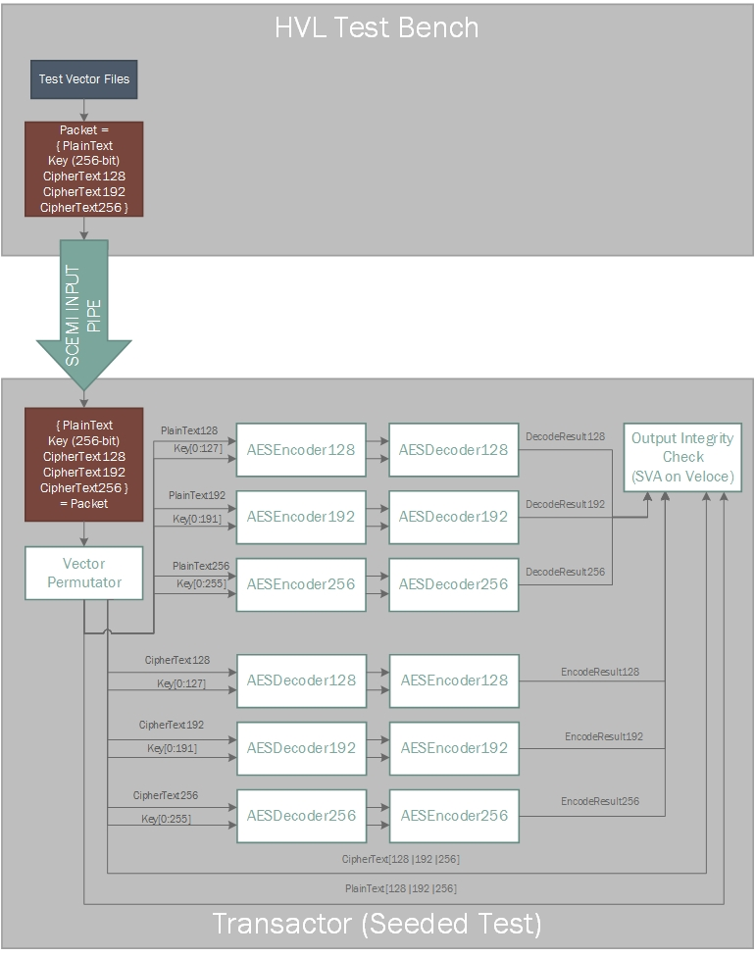

Slide 11
Simulation and Emulation Results

Slide 12
Simulation and Emulation Execution Times with and without inferred RAMs
Simulation and Emulation Execution Time with and without inferred RAMs
 | 128-bit Key w/ Inferred RAMs | 128-bit Key w/out Inferred RAMs
Simulation Runtime | 3,174 s | 3,192 s
Emulation Runtime | 64 s | 27 s
Emulation Speedup over Simulation | 50x | 118x
Emulator HDL Time Advance (Throughput) | 87.59% | 75.70%
Emulator Clock Speed | 207 kHz | 740 kHz
Veloce Compilation Time | 5 minutes | 10 minutes
Notes:
Emulator clock speed is limited by our critical path – tried to improve but not possible for decoder due to data dependency.
Presumably the RAM access limited the clock speed the emulator could run at – multiple accesses in different parts of the code for each emulated clock cycle.
Compile time is better for RAMs because not as much logic is routed, memory files are created and uploaded at runtime to the emulator.

Slide 14
Future Work
More carefully tune the performance tradeoff of logic vs RAM for look up tables.
Investigate advanced concurrent strategies for inbound and outbound streaming of data.
Increase compiled frequency of the emulator by reducing the design critical path or finding additional compilation options.

Slide 15
References
[1] Advanced Encryption Standard. (2016, October 12). In Wikipedia, The Free Encyclopedia. Retrieved 13:29, October 12, 2016. (http://en.wikipedia.org/w/index.php?title=Advanced_Encryption_Standard&oldid=743995771)
[2] Pub, NIST FIPS. "197: Advanced encryption standard (AES)." Federal Information Processing Standards Publication 197 (2001): 441-0311. (http://csrc.nist.gov/publications/fips/fips197/fips-197.pdf)
[3] S.-M. Yoo, D. Kotturi, D.W. Pan, J. Blizzard, An AES crypto chip using a high-speed parallel pipelined architecture, Microprocessors and Microsystems, Volume 29, Issue 7, 1 September 2005, Pages 317-326, ISSN 0141-9331, http://dx.doi.org/10.1016/j.micpro.2004.12.001. (http://www.sciencedirect.com/science/article/pii/S0141933104001632)
[4] A. Pearson, D. Collins, S. Lawson, Compilation Time Configurable Pipelined AES Encoder and Decoder
PSU ECE571, Spring 2016

Slide 16
Questions?
https://github.com/kinap/AES-Processor/

