Slide 1
BASIC OF THREADS

Slide 2
Start of threads
public class MyThread extends Thread {
public void run() {
long sum=0;
for (int i = 0; i < 1000; ++i) {
sum += i;
}
System.out.println(sum);
}
}
MyThread t = new MyThread();
t.start();
public class SomeJob implements Runnable {
@Override
public void run() {
//this code will be executed in new thread
}
}
SomeJob job = new SomeJob();
Thread t = new Thread(job);
t.start();

Slide 3
Threads priority
Threads names
Threads daemon

Slide 4
Blocking and non blocking methods
InterruptedException
Handling InterruptedException
There is blocking methods which can block current thread execution and non blocking methods.
Blocking methods are wait() join() sleep() and others
Non blocking methods are all your methods that do not contain blocking methods.
interrupt() isInterrupted() interrupted() methods and handling InterruptedException.
Never ignore InterruptedException in real world applications.

Slide 5
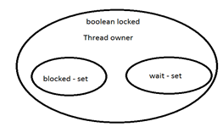
Synchronization
Monitor concept
Thread states

Slide 6
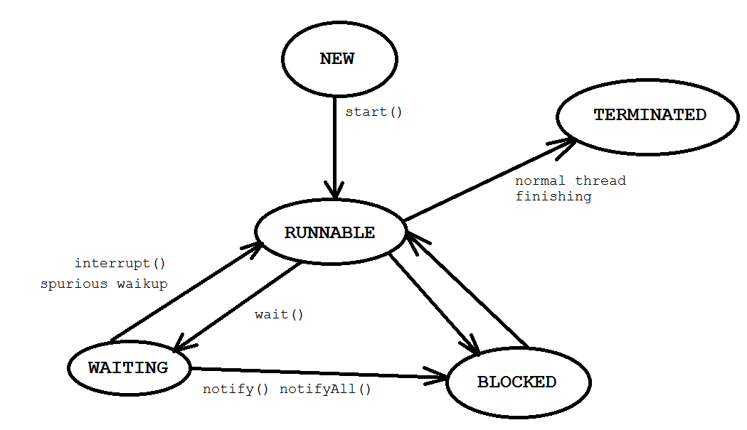
Threads states conversion diagram

Slide 7
Gaps while using monitor concept and synchronized and private mutex
class X {
public synchronized void method1() {
}
}
public class TestX {
public void someMethod(X x) {
synchronized(x) {
while(true);
}
}
}
After this code no one thread can call method1() on the x object

Slide 8
Gap two: another terrible piece of code:
public class TestX {
public void someMethod(X x) {
synchronized(x) {
while(true) {
x.wait();
}
}
}
}
After execution this code when other threads on object x call method notify() notify method invocation will be absorbed!!! Avoid this.

Slide 9
Correct way…
use internal final object as a lock object
use synchronization on this object
public class AnotherTestClass {
private final Object LOCK = new Object();
public void m83() {
synchronized(LOCK) {
//do some usefull actions
}
}
}

Slide 10
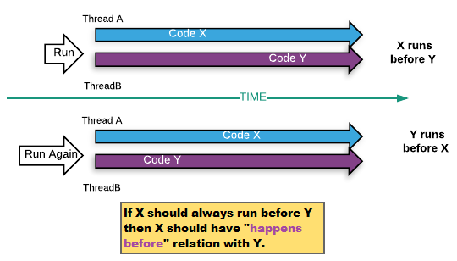
Race condition and happen-before...
The situation where two threads compete for the same resource, where the sequence in which the resource is accessed is significant, is called race conditions. A code section that leads to race conditions is called a critical section. In the absence of a happens-before ordering between two operations, the JVM is free to reorder them as it wants. Happens-before is not just reordering of actions in 'time' but also a guarantee of ordering of read and write to memory .

Slide 11
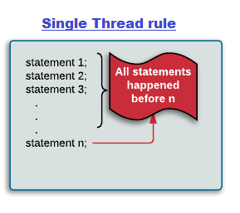
Single thread rule: Each action in a single thread happens-before every action in that thread that comes later in the program order.

Slide 12
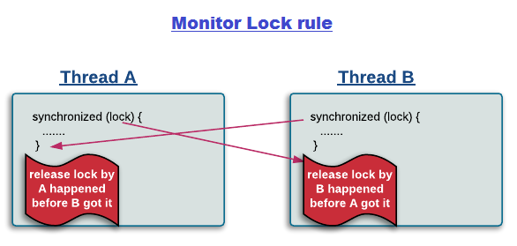
Monitor lock rule: An unlock on a monitor lock (exiting synchronized method/block) happens-before every subsequent acquiring on the same monitor lock.

Slide 13
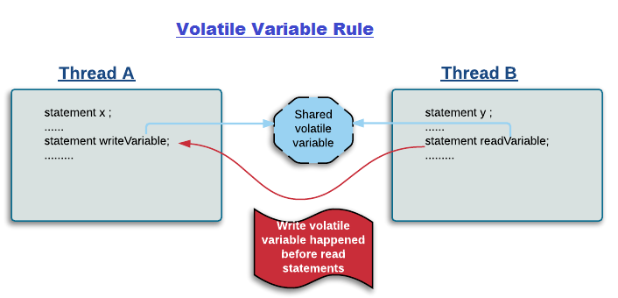
Volatile variable rule: A write to a volatile field happens-before every subsequent read of that same field. Writes and reads of volatile fields have similar memory consistency effects as entering and exiting monitors (synchronized block around reads and writes), but without actually aquiring monitors/locks.

Slide 14
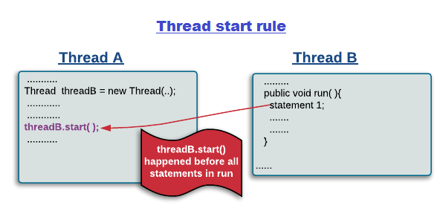
Thread start rule: A call to Thread.start() on a thread happens-before every action in the started thread. Say thread A spawns a new thread B by calling threadA.start(). All actions performed in thread B's run method will see thread A's calling threadA.start() method and before that (only in thread A) happened before them.

Slide 15
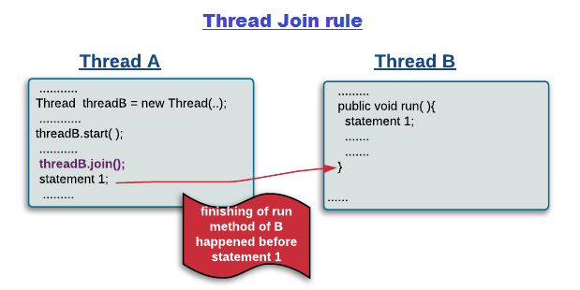
Thread join rule: All actions in a thread happen-before any other thread successfully returns from a join on that thread. Say thread A spawns a new thread B by calling threadA.start() then calls threadA.join(). Thread A will wait at join() call until thread B's run method finishes. After join method returns, all subsequent actions in thread A will see all actions performed in thread B's run method happened before them.

Slide 16
Thread priority - number which can be set to thread. According to this number thread will have more time for execution.
Monitor - one of synchronization primitives allows to set safe threads communication.
Daemon threads - this thread will stop it`s execution when all non daemon threads were finished.
Threads state - certain states in which threads can be.

Slide 17
Race condition - when several threads try to modify shared resource.
Critical section - parts of the program where the shared resource is accessed are protected.

Slide 18
End of second lection

